Slide 1

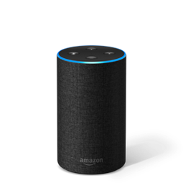

Alexa, I need to go to Albertson’s tomorrow...
Siri, I would like to eat breakfast for one hour at Stacks Pancake House this Saturday.
Ok, are you referring to the closest Albertson’s to your home location, near the intersection of Irvine Blvd and Jeffrey Blvd?
Ok, are you referring to Stacks Pancake House on Culver Blvd?
Yes.
Yes.
Ok, how long do you estimate you’ll be there?
Ok, accuweather.com predicts rain this Saturday with 80% probability, do you still want to go on Saturday?
Let’s plan on 30 minutes.
Yes.
Ok, based on your existing calendar events, estimated travel time, the venue’s hours, and the venue’s peak crowd levels, I recommend you leave for Albertson’s at 2pm.
Should I add this event to your Google calendar?
Ok, based on your existing calendar events,…, and the weather forecast, I recommend you leave for Stacks Pancake House at 930am.
Please know I’ve adjusted for 10 additional minutes of driving time, due to the weather. Don’t forget your umbrella!
Should I add this event to your Apple calendar?

