Slide 1
Command Pattern

Slide 2
Command - Intent
Encapsulate a request as an object, thereby letting you parameterize clients with different requests, queue or log requests, and support undoable operations.
Also Known As
Action, Transaction
Notes:
A command is a reified method call. Another way to say this is that command is an object-oriented version of a callback function.
- http://gameprogrammingpatterns.com/command.html
A method, its target and its parameters are packaged into an object so you can pass them around together and use them more easily.
Deterministic + randomness = different results

Slide 3
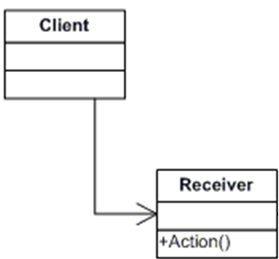
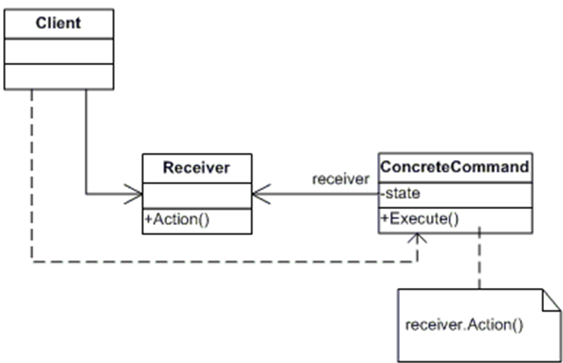
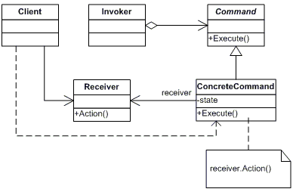
Command - Structure
Notes:
Command – defines the interface for executing an operation
Concrete command – implements the execute operation by invoking the operation(s) on the receiver
Receiver – intended target of the operation
Invoker – object that issues the request for action
Client – application that creates the concrete command and sets its receiver

Slide 4

Command - CtrlGroup Example
Notes:
https://youtu.be/4suhhh6DbEo?t=28

Slide 5
Command - Implementation
How intelligent should a command be?
(Commands only require Execute)
Supporting undo and redo
Notes:
How intelligent should a command be? A command can have a wide range of abilities. At one extreme it merely defines a binding between a receiver and the actions that carry out the request. At the other extreme it implements everything itself without delegating to a receiver at all. The latter extreme is useful when you want to define commands that are independent of existing classes, when no suitable receiver exists, or when a command knows its receiver implicitly.
Supporting undo and redo. Commands can support undo and redo capabilities if they provide a way to reverse their execution (e.g., an Unexecute or Undo operation).
Avoiding error accumulation in the undo process. Hysteresis can be a problem in ensuring a reliable, semantics-preserving undo/redo mechanism. Errors can accumulate as commands are executed, unexecuted, and reexecuted repeatedly so that an application's state eventually diverges from original values.

Slide 6
Command - Advantages
Decoupling
Extension
Object based callback
Notes:
Command decouples the object that invokes the operation from the one that knows how to perform it.
It’s easy to add new Commands, because you don’t have to change existing classes, you simply extend the existing interface.
Commands are first-class objects. They can be manipulated and extended like any other object.

