Slide 1
Composite Pattern
Encapsulating hierarchies
Notes:
Problem
Application needs to manipulate a hierarchical collection of "primitive" and "composite" objects.
Processing of a primitive object is handled one way, and processing of a composite object is handled differently. Having to query the "type" of each object before attempting to process it is not desirable.

Slide 2
Composite
Intent
Let clients treat collections of objects as if they were a single object.
This idea aids in the distribution and execution of requests.
Notes:
The whole point of the Composite pattern is that the Composite can be treated atomically, just like a leaf. If you want to provide an Iterator protocol, fine, but I think that is outside the pattern itself. At the heart of this pattern is the ability for a client to perform operations on an object without needing to know that there are many objects inside.
Composite and Decorator have similar structure diagrams, reflecting the fact that both rely on recursive composition to organize an open-ended number of objects.

Slide 3
Composite
Component
*
contains
Client
Operation()
Add(Component)
Remove(Component)
Operation()
Leaf
Composite
Operation()
Operation()
Add(Component)
Remove(Component)
Notes:
Participants
Component
Declares the interface for objects in the composition.
Implements default behavior for the interface common to all classes, as appropriate.
Declares an interface for accessing and managing its child components.
Optionally defines an interface for accessing a component’s parent in the recursive structure, and implements it if that’s appropriate.
Leaf
Represents leaf objects in the composition. A leaf has no children.
Define behavior for primitive objects in the composition.
Composite
Defines behavior for components having children.
Stores child components.
Implements child-related operations in the Component interface.
Client
Manipulates objects in the composition through the Component interface.
Collaborations
Clients use the Component class interface to interact with objects in the composite structure. If the recipient is a Leaf, then the request in handled directly. If the recipient is a Composite, then it usually forwards the requests to its child components, possibly performing additional operations before and/or after forwarding.

Slide 4
Composite - Sample Code
// CCompositeItem.h
class CCompositeItem : public CLevelItem
{
something< CLevelItem *> m_Items;
public:
void Add(CLevelItem *leaf);
void Remove(CLevelItem *leaf);
void Update();
};
// CCompositeItem.cpp
void CCompositeItem ::Update()
{
…
for (size_t i = 0; i < m_Items.size(); ++i)
m_Items[i]->Update();
}

Slide 5
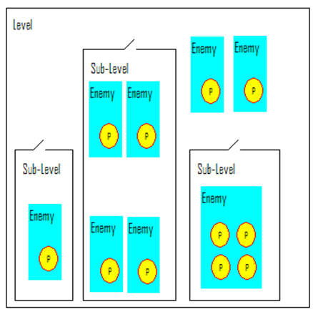
Composite - Example
A game level can have sublevels, potions, enemies, objects and so on …
Notes:
The Composite patterns lets you represent whole-part hierarchies in a tree-like structure. For example, graphics applications like drawing editors build complex diagrams out of simple components like circles and lines. These complex structures can be treated the same way as the simple components they were constructed from.
I could draw a stick figure using lines and circles and then push the Draw-button in the graphical editor. The editor would then call “Draw” recursively on all elements that make up this figure, i.e. on all the lines and circles.
Can also be used for GUI elements in a game, or inventory storage.

Slide 6
Composite - Example
Notes:
Here we take advantage of inheritance so as to not redefine the composite behavior in all the classes which need it.

Slide 7
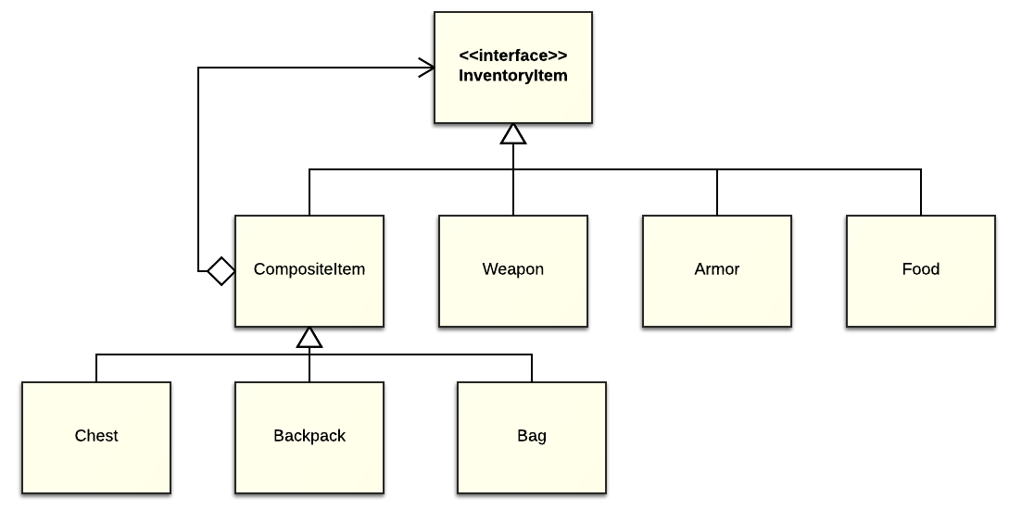
Composite - Example
Notes:
In this example, everything is an inventory item.
A chest holds a mace, a turkey leg, and a backpack.
The backpack holds a dagger, a helmet, and a muffin.

Slide 8
Composite - Implementation
Sharing components
SetDimensions (Composite Bullets)
GetCompleted (Composite Quests)
What's the best data structure for storing components?
Notes:
Sharing components. It's often useful to share components, for example, to reduce storage requirements. But when a component can have no more than one parent, sharing components becomes difficult.
Maximizing the Component interface. One of the goals of the Composite pattern is to make clients unaware of the specific Leaf or Composite classes they're using. To attain this goal, the Component class should define as many common operations for Composite and Leaf classes as possible. The Component class usually provides default implementations for these operations, and Leaf and Composite subclasses will override them.
Who should delete components? In languages without garbage collection, it's usually best to make a Composite responsible for deleting its children when it's destroyed. An exception to this rule is when Leaf objects are immutable and thus can be shared.
What's the best data structure for storing components? Composites may use a variety of data structures to store their children, including linked lists, trees, arrays, and hash tables. The choice of data structure depends (as always) on efficiency.

Slide 9
Composite - Disadvantages
No direct access to parts.
You only have base class reference!
Base class can become bloated with methods.
Notes:
One of the biggest advantages of the Composite patterns is the fact that you can treat simple and nested objects uniformly; they’re all Components.
New components can be made very easily, by combining existing simple and nested objects.
The down-side to this uniform interface is that you cannot access the parts of a composite structure, because you only have a reference to a Component.
Another price to pay in order to keep the interface transparent is that all the methods that are declared in either Leaf or Composite class must also be declared in the Component class.

Slide 10
Evolution
Component based Architectures
Notes:
https://www.youtube.com/watch?v=J5ZNuM6K27E#t=501
http://www.raywenderlich.com/24878/introduction-to-component-based-architecture-in-games
http://www.gameprogrammingpatterns.com/component.html

Slide 11
Composite
Summary
Treat a group like a single object (power strip).
Do it transparently (encapsulation).

Slide 12
Study Questions
How does polymorphism apply to the Composite pattern?
How does abstraction apply to the Command pattern?
What is a callback function?

