Slide 1
Revision Control with GIT
Notes:
Git command line info can be found on:
Git-scm.com – official git website
Gitref.org – pro git
Progit.org – git book – online – free – pdf format

Slide 2
Ignores
Set them up before committing files!
Once you commit something, it’s there forever, even if you delete it.
Notes:
To easily setup your git ignore file for things that don’t exist yet, or to setup wildcards or folders, first pick a file and ignore it. Next, open the .gitignore file and add any other files or folders you want to ignore.
Common ignores for visual studio projects include build folders such as Debug and Release as well as intellisense files like .sdf and .opensdf files.
Learn more here:
https://git-scm.com/book/en/v2/Git-Basics-Recording-Changes-to-the-Repository#Ignoring-Files

Slide 3
Revert
A revert in git will undo any changes you have made since the last commit.
You can also revert older commit nodes from the log.
Notes:
This is useful when you just want to try something out but not actually commit it to the project.
The git bash equivalent for the first kind of revert is ‘git reset –hard HEAD’
The actual revert command in the git bash does something a little more flexible than the Tortoise log revert and requires your working tree to be clean.
See
http://git-scm.com/book/en/Git-Basics-Undoing-Things
http://git-scm.com/docs/git-revert.html

Slide 4
Creating a new Branch
To create a branch you can either use checkout or create branch.*
Make sure to commit any changes first.
Notes:
*Beware the default with create branch is to NOT switch to the new branch, you must check the box.
If your working copy contains un-committed modifications, they will float into the new WC context when you switch branches. What this means is that changes are not tied to a branch until you commit them.
Sometimes you will not be able to float changes into a branch because there are already changes there that conflict. In this case, you can stash the changes before switching.

Slide 5
Master
When you create a repository with GIT ‘master’ is the default branch you are working inside of.
When you see commit -> “FactoryMethod-Work” this means you are not saving changes into the master branch!

Slide 6
Checkout
The checkout command allows you to switch your working copy to another branch.
It can also be used to switch to a previous version of a branch. *
Notes:
*Be careful doing this because you no longer have a HEAD pointer. In tortoise it will default to creating a new branch at the location to prevent being in a headless state.
The HEAD points the WC to a branch. When you are in a headless state, your commits will not be connected to any branch. Branchless commits will not show up in the tortoise log.

Slide 7
Git Flow - Branching
Notes:
Branch – create a spin-off of a repository node for concurrent development
Tag – bookmark a revision set with a title for easy checkouts
Merge – copy changes from one branch into another branch
Image sourced from the following article:
http://nvie.com/posts/a-successful-git-branching-model/
Related articles:
http://jeffkreeftmeijer.com/2010/why-arent-you-using-git-flow/
https://danielkummer.github.io/git-flow-cheatsheet/

Slide 8
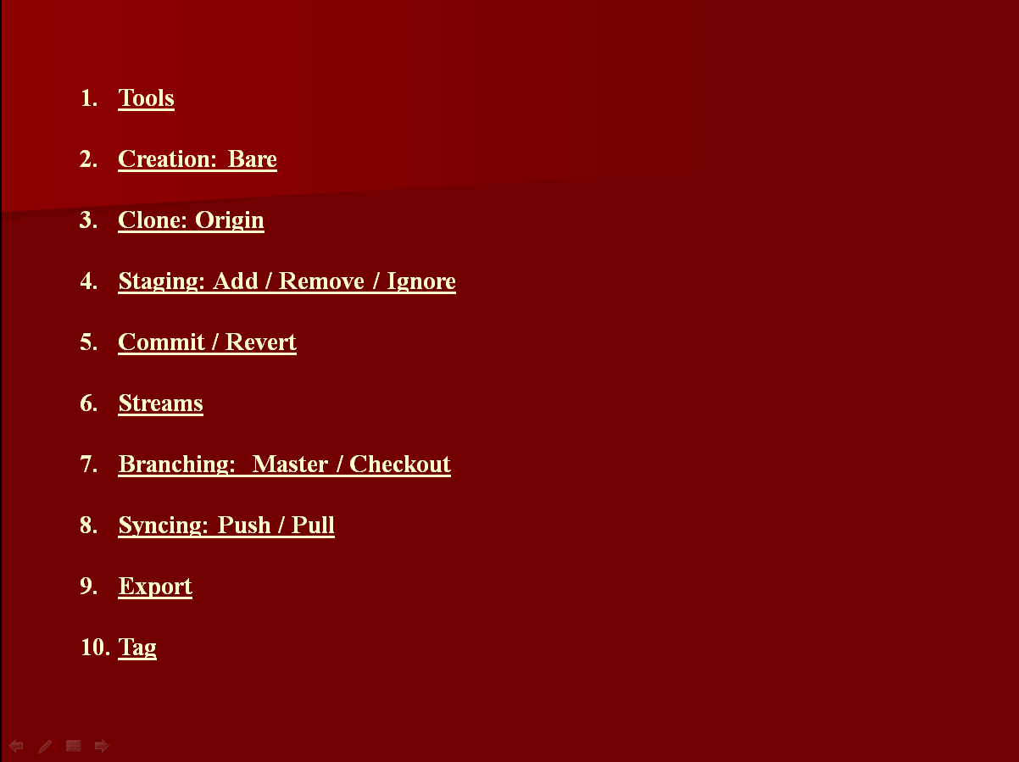
Export
Creates a clean copy of your folder without the embedded source control metadata.
You will use this for making backups of your work in my class.
Notes:
Export – create a clean copy of a single check-out without any revision files
(See Tortoise Help 3.27. Exporting a Git Working Copy)

