Slide 1
Dependencies
Physical and Logical
Notes:
Material for this lecture was absorbed from many sources including (but not limited to) web-based articles such as [http://gamesfromwithin.com/physical-structure-and-c-part-2-build-times] and books like Effective C++ [by Scott Meyers] and Large-Scale C++ Software Design [by John Lakos].

Slide 2
Physical – Always use Relative Paths
When the class wizard uses fully realized path names, they won’t compile on someone else’s computer.
Since it does not always generate relative paths, you sometimes need to change the generated statements.

Slide 3
Physical – Prefer Forward Class Declaration
#include “GameObject.h”
#include “Weapon.h”
class Armor;
class Profile;
class Soldier : public GameObject
{
Weapon m_Weapon;
Armor *m_pArmor;
public:
void Update(Profile &p);
};
Notes:
We are abstracting the preprocessor statement.
Forward class declarations only work for classes which are not actually used in the code contained solely within the header file.
In the case of inheritance, templates, typedefs and containment by value we can not use them.
For pointers and reference variables however, they are useful.

Slide 4
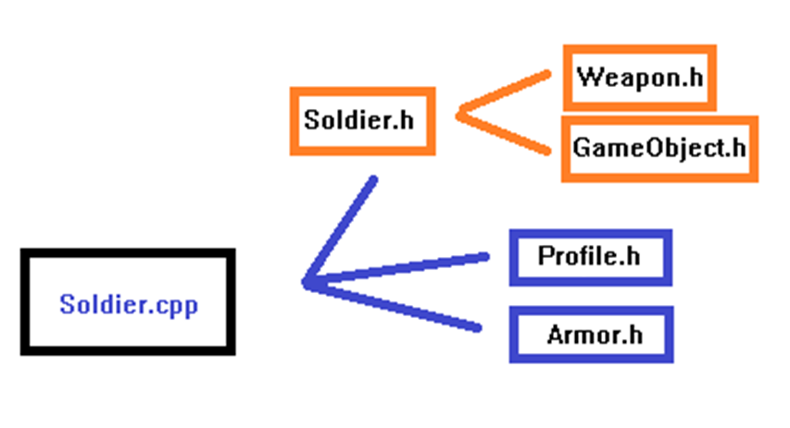
Forward Declarations – Not Why
Notes:
In the case of something like forward class declarations, the act of moving the include directive into the .cpp does not change the translation unit of the source file, only that of other source files.

Slide 5

Forward Declarations - Why
Notes:
The benefits for forward declarations in “Soldier.h” do not apply to the associated “Soldier.cpp” file, because that file will #include “Armor.h” and “Profile.h” anyway.
The benefit is for the third party “Game.cpp” file that pulls in the “Soldier.h” file (directly or indirectly via “Game.h”).
Since “Soldier.h” no longer includes “Armor.h” and “Profile.h”, the translation unit for “Game.cpp” will not indirectly include them through “Soldier.h”.

Slide 6
Physical - Forward Declarations
It is a good practice to use forward declarations in a header when definition is not needed.
This helps in that you eliminate unnecessary “include chaining” thereby:
Increasing compile speed
Reducing object compilation size
Notes:
A third idea to reduce compilation times used on popular games like Madden and Marvel Ultimate Alliance is unity builds.
Common downsides to unity builds include no incremental builds and conflicting file globals.
This concept is similar to using redundant include guards for header files but works on cpp files instead.
This concept is also similar to “demoting” a common code module to enable independent reuse. (e.g. Removing struct C from A.h to its own header file, so that B.h can break the chain to all the things A.h includes while still accessing struct C.)

Slide 7
Logical – Const Correctness
class GameObject
{
int m_iXPosition;
public:
GameObject(GameObject const &poi);
const int GetXPosition() const;
void Render() const;
};
Notes:
Methods which are not intended to change the state of an object (such as copy constructors and accessors) should be declared const.
Methods which take in parameters simply for viewing purposes should declare those parameters to be const.
Methods which return objects as reference only variables should have const return value.
int getXvalue () const;
void setX (const int newX);
void DrawStuffs ( const Ship &c, const Flag &f ) const;
const Drawable * GetDrawable() const;

Slide 8
Logical - Const Correctness
It is important to stay const correct during your coding practice.
This helps you:
define your interfaces more clearly
catch bugs at compile time
avoid improper use or modifications
help the compiler optimize code

Slide 9
For Next Time
Review Virtual Function Tables + Next 2 chapters of Debugging.
Notes:
http://www.artima.com/cppsource/pure_virtual.html
Skim chapters 7-10 in OOTP.
Skim the class diagram article.

