Slide 1
Software Engineering

Slide 2
What is Software Engineering?
The main goal of software engineering is the creation of software.
This includes design, programming, testing, and maintenance of software.
Notes:
Russ Cox, a former employee of Bell Labs who now works for Google, has defined software engineering as, "what happens to programming when you add time and other programmers."

Slide 3
Classic Waterfall Lifecycle
Requirements
Analysis
Design
Coding
Testing
Maintenance
Notes:
The classic Waterfall process is a collection of stages through which traditional development progresses.
Each stage of the process contains a standard collection of activities.
When the activities from one stage are complete, the process cascades into the next stage.

Slide 4
Intro to source control
Notes:
One of the most important things you must learn as a software engineer is how to use tools that enable collaboration with other programmers.
There are a lot of GUIs (https://git-scm.com/downloads/guis ) available for git. We use TortoiseGIT (https://tortoisegit.org/) in this course.

Slide 5
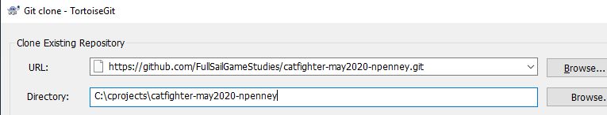
Clone
URL = source
Directory = destination (folder need not exist)
Notes:
Clone – make a copy of an existing repository
When you do this you automatically download all data and history and establish a track for the master branch of the clone to the original.

Slide 6
Origin
Origin is the default nickname for the remote repository.
We typically push/pull changes to/from branches in the origin repository.
Notes:
How do I setup a connection to a server? From the git bash
git remote add upstream URL
(where URL is something like http://server/repo.git or file:///C:/location/repo.git)
The result will look something like this in the .git/config file:
[remote “upstream"]
fetch = +refs/heads/*:refs/remotes/upstream/*
url = C:\\Users\\Nick\\Desktop\\bare

Slide 7
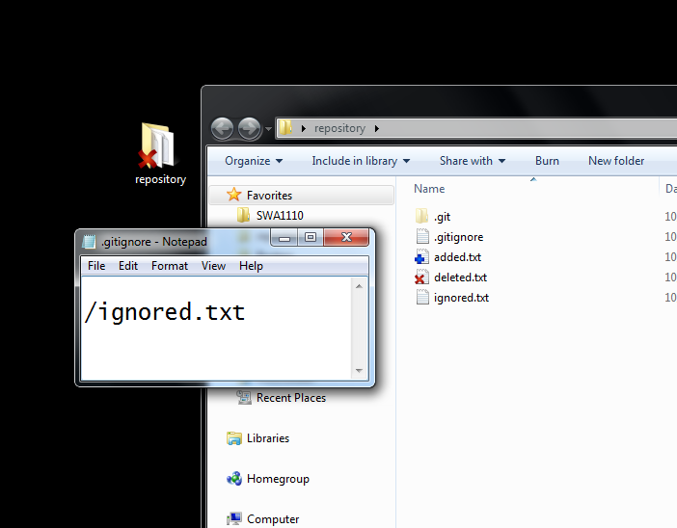
Staging Changes to the WC
Repo
WC
Notes:
Add – put individual files into a repository (creating files in a local copy does not push the file into the repo)
Remove – remove a file from the repository (just deleting the will not remove it from the repository)
Ignore – select files or folders not to upload or consider it for changes when committing
Note: to un-ignore you have to manually edit the .gitignore file to remove the entry, then add the file to the repo
The Visual Studio plugin “Git Source Control Provider” will generate a fairly comprehensive .gitignore for your projects.

Slide 8
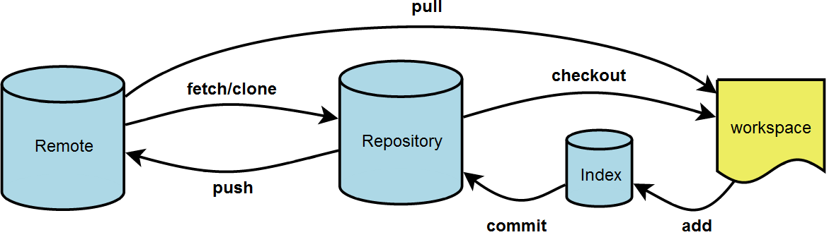
Committing changes
Index – the set of staged changes
Commit – store the index into the repo
Show Log – view all previous change sets
Notes:
Graphic image taken from
http://illustrated-git.readthedocs.org/en/latest/index.html
Index – this will contain things like edits, adds, removes, ignores, etc
Commit – store changes staged in the index into the repository database (the local .git folder)
Show Log – displays a history of all commits to the repo along with what was changed and the comment
Push – upload commits from the repository database (the .git folder, not the working folder) to a remote (usually origin)

