Slide 1
Basic Debugging
10 tips to help find and fix a bug
Notes:
The process of debugging refers to finding, analyzing and removing errors in a system.

Slide 2
Tip 1. Dissect the Error
What does it really say?
Identifier not found
Unresolved external symbol
Access violation
Heap Corruption
Notes:
Debug works, Release doesn’t
Uninitialized variables - These will get set to NULL in debug mode but not release.
Buffer overruns - Check your loops/etc to make sure you are not writing beyond your memory boundaries or trying to use unallocated blocks.
Access violation – trying to access a location in memory that your program doesn’t have access to. Ex: null/dangling/uninitialized pointer
Heap corruption – trying to perform a heap operation on a heap with invalid state
http://www.qnx.com/developers/docs/qnxcar2/topic/com.qnx.doc.neutrino.prog/topic/hat_ProblemsWithHeapCorruption.html
https://stackoverflow.com/a/1504307

Slide 3
Tip 2. Debug Windows
Locals = data local to the current scope
Autos = data local to the current/prev line
The watch window is for equations:
loop%5 array,3
Sum(3,5) x==15
Immediate window can be used similarly.
Notes:
http://msdn.microsoft.com/en-us/library/4dt5w8ta.aspx
http://www.highprogrammer.com/alan/windev/visualstudio.html
to get the message from a failing win32 function
@err = last error
@err,hr = message associated with last error
Locals – Ctrl-Alt-V;L
Autos – Ctrl-Alt-V;A
Watch – Ctrl-Alt-W;1

Slide 4
Tip 3. Memory window
Ctrl – Alt – M
Name of the pointer or address
Right click to change to 4 byte blocks

Slide 5
Microsoft CRT memory patterns
000000000 - NULL memory
CCCCCCCC - uninitialized stack memory
CDCDCDCD - uninitialized heap memory
FDFDFDFD - "no man's land" guard bytes before and after allocated heap memory
DDDDDDDD - freed heap memory*
Notes:
These are taken from the following article : http://en.wikipedia.org/wiki/Magic_number_(programming)
Other good references :
http://www.softwareverify.com/articles/memory-bit-patterns.html
http://www.nobugs.org/developer/win32/debug_crt_heap.html
http://www.codeproject.com/KB/debug/cdbntsd3.aspx
*In visual studio 2015 they have changed deletes to mark memory as dirty without calling heap free
https://ofekshilon.com/2014/09/20/accelerating-debug-runs-part-1-_no_debug_heap-2/

Slide 6
4. Memory Leaks
SaiphApp.h
#if _DEBUG
#define _CRTDBG_MAP_ALLOC
#include <crtdbg.h>
#define new new( _CLIENT_BLOCK, __FILE__, __LINE__)
#endif
Main.cpp
_CrtSetDbgFlag( _CRTDBG_ALLOC_MEM_DF
| _CRTDBG_LEAK_CHECK_DF);
Notes:
https://docs.microsoft.com/en-us/visualstudio/debugger/finding-memory-leaks-using-the-crt-library
https://docs.microsoft.com/en-us/visualstudio/debugger/crt-debug-heap-details
https://msdn.microsoft.com/en-us/library/2xse74he.aspx - _heapchk
https://stackoverflow.com/a/1504307 - Heap corruption: What could the cause be?
https://docs.microsoft.com/en-us/visualstudio/profiling/memory-usage – Using the Visual Studio profiler to evaluate memory usage

Slide 7
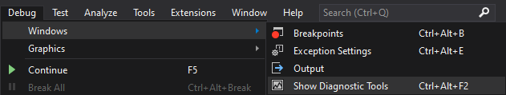
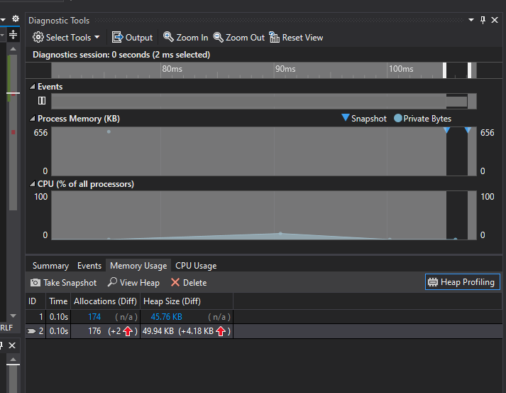
4.1 Using Instrumentation
Use heap snapshots to see changes in memory usage over time

Slide 8
Tip 5. Breakpoint
Function breakpoints
Call stack breakpoints
Data breakpoint
When did that memory change
Breakpoint Conditions
Nested loops, use i-1
Perf-tip run timing (*in 2015 and beyond)
Notes:
If you are using visual leak detector it can interfere with your ability to use data breakpoints.
Data breakpoints can also crash other programs or processes so be careful.
To create a data breakpoint you have to be running the program already.
Go to Debug ; New Breakpoint ; Data Breakpoint ; type in a memory address or &variable .
Make sure the memory address that you are using is valid.
Ex. For pointers you want ‘&pointer’ to test when the pointer changes or ‘pointer’ to see when the object changes. Note that you can only track 32bits or 64bits depending on your system & software.
See also: https://msdn.microsoft.com/en-gb/library/x98tx3cf(v=vs.120).aspx
And: https://msdn.microsoft.com/query/dev12.query?appId=Dev12IDEF1&l=EN-US&k=k(vs.debug.breakpt.action)

Slide 9
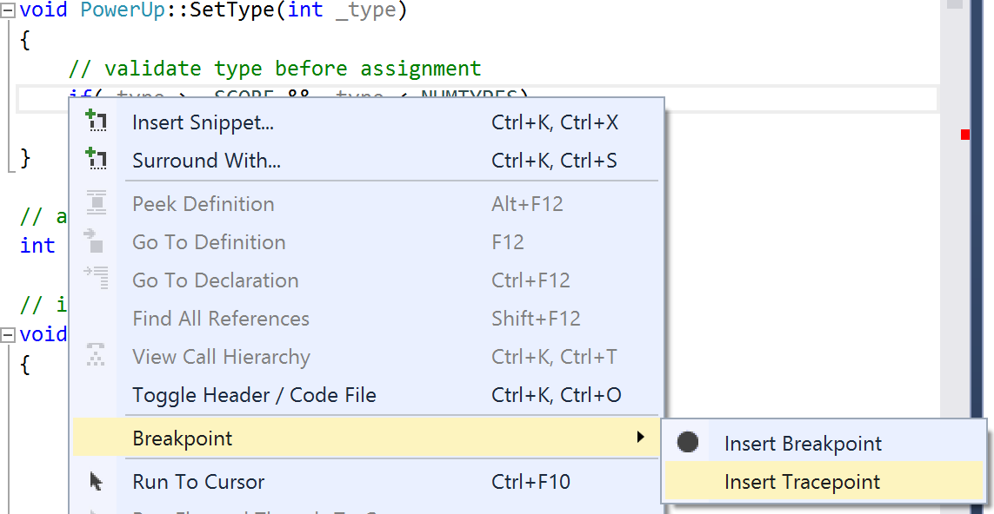
Tracepoint
Display information to the output window without hacking and without pausing execution.

Slide 10
Tip 6. Drag the execution pointer
See that little yellow arrow where your code broke?
Drag it up a little bit and see what happens when you step through.
Notes:
If the problem only happens when X=3, drag the pointer and make X=3 by editing the value (click it in the hover window).
The execution pointer is also known as the instruction pointer.

Slide 11
Tip 7. Make the problem smaller
By disabling sections of code
By using a spike solution
By limiting data or replacing data
Notes:
Isolate the data set:
Categorize the values you know are used by your context code.
Compare the results of each set of inputs.
How to Debug by Splitting the Problem Space - https://github.com/braydie/HowToBeAProgrammer/blob/master/en/1-Beginner/Personal-Skills/02-How-to-Debug-by-Splitting-the-Problem-Space.md

Slide 12
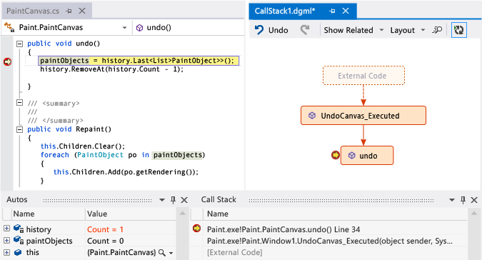
Tip 8. Visual debug - code maps
Notes:
One of the ways to help take notes about what you are doing is using Visual Studio’s code map.
See: https://msdn.microsoft.com/en-us/library/dn194476.aspx and
http://s.ch9.ms/Series/Visual-Studio-2012-Premium-and-Ultimate-Overview/Visual-Studio-Ultimate-2012Debug-visually-with-Code-Map-debugger-integration

Slide 13
Tip 9. Simple Tests
Insert temporary code to test values or produce conditions.
Output simple strings to the output window, console, or to a file.
Ctrl-f to search it
Ctrl-s to save it
Notes:
http://blogs.msdn.com/b/habibh/archive/2009/07/22/the-visual-studio-output-window-it-has-more-to-offer-than-meets-the-eye.aspx
Console.WriteLine(data) Trace.WriteLine(data) Debug.WriteLine(data)
OutputDebugString(data)

Slide 14
Tip 10. Ask for help
You should be able to show them what you have done for 1-10 already.
“The secret to learning is Work your ass off until you figure it out.” - Dr Tae
Notes:
Asking a lab instructor to give you every answer does not help develop your problem solving skills.

