Slide 1
Refactoring
Changing structure without
changing behavior

Slide 2
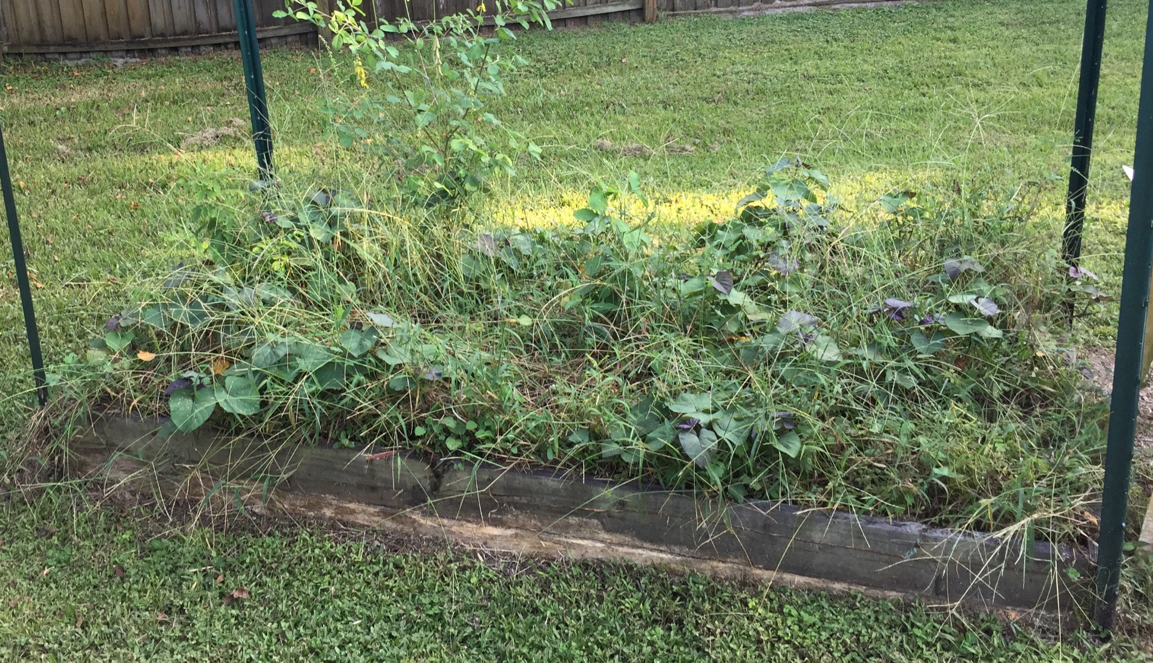
Before
Notes:
Coding is like gardening. What’s wrong with this picture?

Slide 3
Why?
Goals include:
Reduced complexity
Cleaner design
Improved extensibility
Easier to understand
More maintainable
Notes:
http://www.extremeprogramming.org/rules/refactor.html

Slide 4
Refactor to function
Abstract code from large and unwieldy methods to create smaller and more logical functions.
Can also be replacing 2 similar blocks of code to eliminate redundancy.
Notes:
An example of this might be to remove creation code from an update function and put it into a separate function just for creation.

Slide 5
Move functions
Abstract functions to improve cohesion
Consolidate related routines into a single module
Notes:
See http://www.drdobbs.com/how-non-member-functions-improve-encapsu/184401197
An example of this could be removing math functions from a physics class into a new module, or consolidating creation code into a single class.

Slide 6
Rearranging dependencies
Introduce interfaces by abstracting common functionality
Patterns such as Mediator and Strategy design patterns can allow for easier extension and more flexibility.
Notes:
If you have a few classes that do similar things in different ways, you can often unify them by creating a parent class to declare the expected functionality.
Another example of rearranging dependencies is by using dependency injection, which is the idea of passing objects into a function where they are needed rather than the function itself creating them or seeking them. By doing this, you limit the scope of the functions dependency structure and increase its modularity.

Slide 7
Encapsulating Data
Introduce getter and setter routines to improve cost of change.

Slide 8
Rename entities
Make your identifier names more meaningful
or
Introduce a metaphor
Notes:
A metaphor is an XP concept of applying a naming convention to files, classes, variables or functions.

Slide 9
Remove stale code
Remove functions that are not currently used
Over time comments often become “stale” because the algorithm was changed, but the comment never got updated.
Notes:
This is made easier by source control because the functions and comments will still exist in older commits if you ever need them.

Slide 10
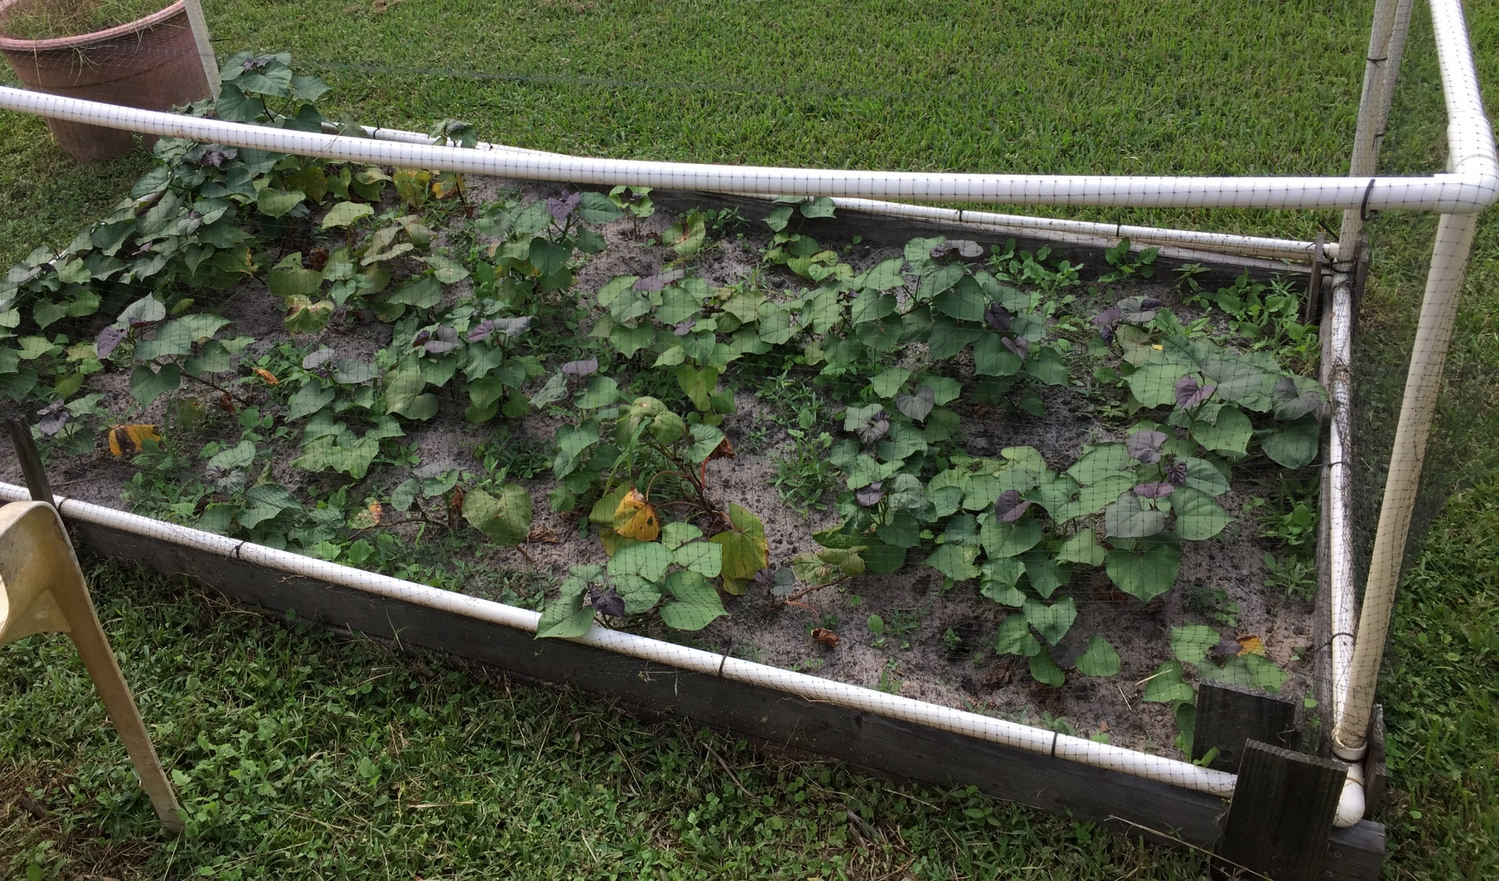
After

Slide 11
Summary
Weed your code gardens!
Notes:
Our goal with refactoring is to improve the ability to do future work by cleaning up the existing workspace.

