Slide 1




Handled
AI OFFICE MANAGER · PRODUCT CAPSTONE
The AI office manager for home & local service businesses
Answers every call
24/7, natural conversation
Books into your FSM (Soon)
Jobber · Housecall Pro · ServiceTitan
Handled answers every call, books the job into your field-service schedule, and follows up — so owner-operators stop losing revenue to the competitor who picked up first.
Office-manager scope
Text-back, follow-up, triage
John Francis Designed, built & deployed — website · customer app · test harness

Slide 2




THE PROBLEM · THE MARKET
Every missed call is a lost job — in a $600B market
Owner-operators are in the field, not by the phone — and these buyers already pay for software.
62%
85%
~$1,200
of missed callers call a competitor
of those never call back
average value of one missed call
The opportunity
Why now
Market size
~2.5M US home-service businesses. The owner can't answer — and can't justify a $42–62K/yr office manager. Handled is the affordable middle.
FSM software is ~$3.1B and growing ~12%/yr; the AI-voice slice is growing 25–40%/yr. Incumbents own voice quality — not workflow depth.
TAM ~$600B industry (~$5–10B software). SAM ~$3B (~1M shops with call volume). SOM $15–60M ARR over three years.
Miss ten calls a week at ~$1,200 each = six figures a year walking to the competitor who picked up first.
handled.ai
02 / 10

Slide 3








THE SOLUTION · THE MOAT
How it works — and why it wins
Open-ended request in, a real booked job out — plus four things competitors don't do.
1
2
3
4
5
6
Answer
→
Understand
→
Check slot
→
Book job
→
Confirm
→
Notify
24/7, no tree
intent + urgency
live FSM
into your FSM
verbatim SMS
owner summary
Dispatch-grade FSM
Office-manager scope
Emergency triage
Trust & pricing
Books the real job into Jobber / HCP / ServiceTitan — not a calendar event.
Text-back, quote follow-up, reminders, reviews — tied to the job.
Knows a burst pipe from a drip and escalates the real ones.
Flat price, hard cap, no charge for spam or hangups.
Grounded in your data · every turn logged & explainable · verbatim confirmation before any booking.
handled.ai
03 / 10

Slide 4
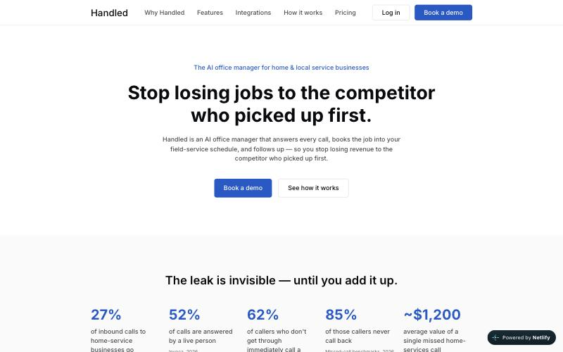


WHAT I BUILT
Three apps, one agent
Built through a stage-gated workflow — each app independent, all pointed at a single n8n webhook.
LIVE
LIVE
BUILT
Customer experience
Test harness
Next.js · n8n · Supabase
SMS-style chat
Marketing website
Owner dashboard over a 17-table Supabase schema, plus the multi-agent n8n backend. Inbox, bookings, conversion & revenue.
Impersonate ~30 seeded Acme customers, text as them, and watch the AI reply — the way the flow gets exercised.
Next.js 14 · Netlify
Static-first public site telling the Handled story, with one lead-capture endpoint.
One front door: the website, the dashboard, and the test harness all POST to the same /webhook/handled/message.
handled.ai
04 / 10

Slide 5



ARCHITECTURE · N8N IMPLEMENTATION
The agentic flow
One webhook, cheap classifiers first, then the right specialist.
Webhook
Context Loader
Guard
Router
inbound text
→
Supabase · no AI
→
Haiku · spam / injection
→
Haiku · 1 of 7 intents
↓
Router sends the turn to exactly one specialist — all six share one Claude Sonnet node (temp 0.3)
New-Booking
Claude Sonnet
Reschedule-Cancel
Claude Sonnet
Emergency-Triage
Claude Sonnet
intent: book
intent: reschedule / cancel
intent: emergency
Schedules a new visit
Moves or cancels a job
Advises, logs, escalates
Pricing-Quote
Claude Sonnet
Out-of-Area
Claude Sonnet
General-FAQ
Claude Sonnet
intent: pricing
intent: out_of_area
intent: faq / else
Quotes configured ranges
Captures out-of-area leads
Status, FAQs, handoff
handled.ai
05 / 10

Slide 6
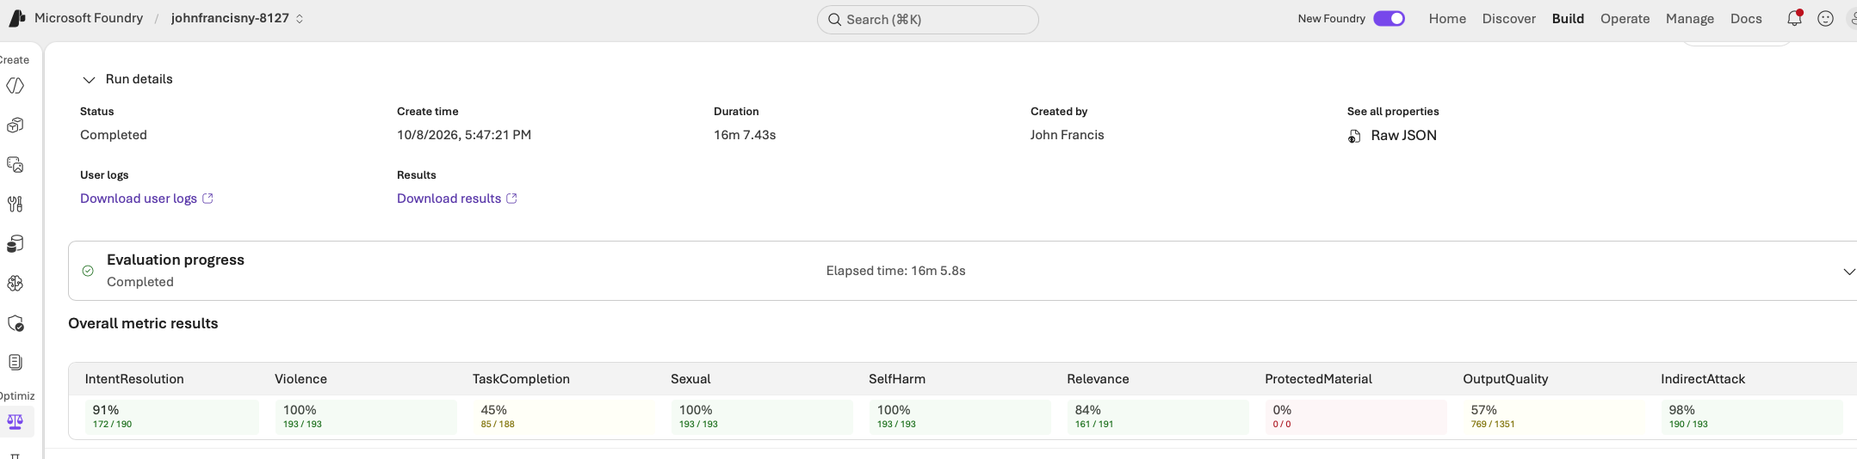
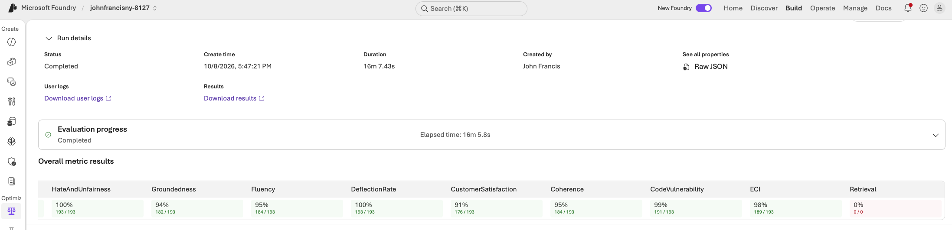
EVALUATION
Graded on Helpful, Honest, Harmless
193 cases run through the live agent and analyzed using Azure AI Foundry.
handled.ai
06 / 10

Slide 7


BUSINESS MODEL
Flat, transparent pricing that makes ROI obvious
Flat monthly tiers with included usage and a hard cap — answering the category's #1 complaint: surprise billing.
Starter
Pro
MOST POPULAR
Scale
$149 /mo
$299 /mo
$599 /mo
For the solo operator
For small teams (2–10)
Multi-location / high volume
1 business number
24/7 answering + booking into 1 FSM
Missed-call text-back
Transcripts & summaries
Spam filtering · hard spend cap
Everything in Starter
Emergency triage & warm transfer
Multi-tech dispatch logic
Outbound follow-up · Spanish
Owner dashboard
Everything in Pro
Multiple numbers & locations
Priority support
Call intelligence (sentiment, trends)
North Star: Captured Opportunity Value
Flat price, no per-minute surprises
One recovered ~$1,200 job pays for months of Handled — above a budget receptionist, far below a $42–62K/yr office manager.
A hard spend cap you control
Never charged for spam or hangups
handled.ai
07 / 10

Slide 8





My Takeaways
What I Learned
Every choice in the flow answers a question a reviewer would ask.
Multi-Agents Solutions
Cheap work first
Memory improves CX
Multiple agents enabled workflow depth and the ability to support multiple types of queries
Two small Haiku classifiers filter spam and route intent before any Sonnet specialist runs.
Keeping memory of previous chats and mixing that with customer context enables richer experience
Evals are key
Dev-OS rocks
Pricing for AI is challenging
Evals are the best way to determine the effectiveness of an AI Agent system
Helped me build the marketing, customer site, backend (supabase, n8n) and test harness easily
Market already has 10 named players with price cutting already happening. VC capital is extending the fight.
handled.ai
08 / 10

Slide 9
ROADMAP
From MVP to launch
Highest value + highest frequency first; the riskiest surfaces get the most guardrail investment.
MVP
MVP 1
Launch
Iteration
~8–10 wks
+6–8 wks
+8–10 wks
ongoing
24/7 answer + book into Jobber
Service-area check · SMS confirm
Missed-call text-back
Transcript + summary + notify
Spam filtering · flat pricing
Emergency triage + warm transfer
Housecall Pro + ServiceTitan
Configurable business rules
Dashboard v1
English / Spanish
Multi-tech dispatch logic
Outbound follow-up
Multi-location support
A2P 10DLC at scale
Billing + spend caps
Call intelligence & tagging
More FSM / CRM integrations
Additional trades
Quality-score metric
Self-serve onboarding polish
handled.ai
09 / 10

Slide 10



Handled
Let's get you Handled.
The AI office manager that answers, books, and follows up — so you never lose the next job to a missed call.
Customer Login
Marketing Website
handled-customer-app.netlify.app
handled-website-ajik.netlify.app
LinkedIn
Email
https://www.linkedin.com/in/johnfrancisny
johnfrancis04@gmail.com
John Francis · AI Product Capstone · 2026

