Slide 1




Handled
AI OFFICE MANAGER · PRODUCT CAPSTONE
The AI office manager for home & local service businesses
Answers every call
24/7, natural conversation
Books into your FSM (Soon)
Jobber · Housecall Pro · ServiceTitan
Handled answers every call, books the job into your field-service schedule, and follows up — so owner-operators stop losing revenue to the competitor who picked up first.
Office-manager scope
Text-back, follow-up, triage
John Francis Designed, built & deployed — website · customer app · test harness

Slide 2

THE PROBLEM
Every missed call is a lost job
Owner-operators are in the field, not by the phone — and the leak is invisible until you add it up.
27%
52%
62%
85%
~$1,200
of inbound calls go unanswered
answered by a live person
of missed callers call a competitor
of those never call back
average value of one missed call
Invoca, 2026
Invoca, 2026
Benchmarks, 2026
Benchmarks, 2026
Invoca, 2026
Miss ten calls a week at ~$1,200 each and that's six figures a year walking to the competitor who picked up first. Voicemail doesn't save it — most callers just dial the next company.
US home services: a ~$600B industry, ~2.5M businesses — most of them running on inbound calls.
handled.ai
02 / 17

Slide 3



WHY IT MATTERS
A $600B market — and the pain is already paid for
These buyers already feel the missed-call pain, and already pay for software every month.
The opportunity
Why now
Market size
~2.5M US home-service businesses
Owner is on a roof or under a sink — can't answer
Can't justify a $42–62K/yr office manager
Handled is the affordable middle
FSM software ~$3.1B in the US, growing ~12%/yr
The AI-voice slice is growing 25–40%/yr
Incumbents own voice quality — not workflow depth
The wedge is depth, and it's open
TAM ~$600B industry (~$5–10B software)
SAM ~$3B (~1M businesses with call volume)
SOM $15–60M ARR (5k–20k shops, 3-yr)
$249/mo blended ACV ≈ $3K/yr
handled.ai
03 / 17

Slide 4







THE SOLUTION
Answer. Book. Follow up.
Open-ended request in, a real booked job out — that's planning + tool use + dialog, the definition of an agent.
1
2
3
4
5
6
Answer
Understand
Check slot
Book job
Confirm
Notify
24/7, no phone tree
intent + urgency
live FSM availability
into your FSM
verbatim by SMS
summary to owner
Never invents
Fully explainable
Confirm before write
Prices & availability come from your config and live tools — never the model's memory.
Every conversation yields a transcript, a structured summary, and the tool calls made.
Details read back verbatim and a re-check before booking — the owner can override.
handled.ai
04 / 17

Slide 5




THE MOAT
Why Handled wins — and keeps winning
A receptionist takes a message. Handled does the work that comes after “hello.”
Dispatch-grade FSM integration (Soon)
Office-manager scope
Books the real job into Jobber, Housecall Pro, or ServiceTitan — respecting technician skills, live availability, and service area. Not a Google Calendar event.
Missed-call text-back, quote follow-up, reminders, and review requests — all tied to the same job record. Expands revenue and raises switching cost.
Trade-aware emergency triage
Trust & transparent pricing
Knows a burst pipe from a leaky faucet and escalates the real ones to the on-call tech. Biased toward escalation — a false alarm is cheap, a missed emergency is not.
Flat monthly price, a hard spend cap you control, and no charge for spam or hangups — answering the category's #1 complaint: surprise billing.
handled.ai
05 / 17

Slide 6
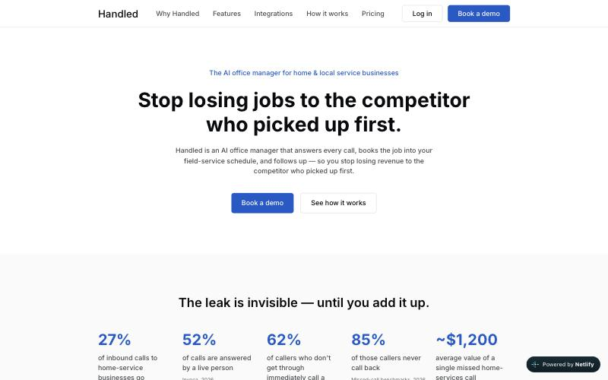


WHAT I BUILT
Three apps, one agent
Built through a stage-gated workflow — each app independent, all pointed at a single n8n webhook.
LIVE
LIVE
BUILT
Customer experience
Test harness
Next.js · n8n · Supabase
SMS-style chat
Marketing website
Owner dashboard over a 17-table Supabase schema, plus the multi-agent n8n backend. Inbox, bookings, conversion & revenue.
Impersonate ~30 seeded Acme customers, text as them, and watch the AI reply — the way the flow gets exercised.
Next.js 14 · Netlify
Static-first public site telling the Handled story, with one lead-capture endpoint.
One front door: the website, the dashboard, and the test harness all POST to the same /webhook/handled/message.
handled.ai
06 / 17

Slide 7








ARCHITECTURE
n8n Implementation
52 nodes, one entry point: POST /webhook/handled/message → always a fixed JSON reply, never a 500.
Inbound
Validate
Guard
Route
Specialist
Reply
webhook
code · context
Haiku · t0
Haiku · t0
Sonnet · t0.3
persist + eval
20 org-scoped tools
least-privilege · no raw SQL
Fallback handler — any LLM, agent, or DB error returns a safe 200 (owner notified, emergency-aware). The only non-200s are sender-fixable: 400 · 401 · 404.
One front door
Cheap work first, expensive last
Never hand the customer a failure
handled.ai
07 / 17

Slide 8
ARCHITECTURE · N8N IMPLEMENTATION
Intake & screening
Entry webhook, validation & auth, context loader, context gate, and the spam / injection guard.
Webhook + validate & auth
Code
Respond 4xx
Receives one inbound text, then checks the shared secret and required fields. No AI · no tools.
→
401 unauthorized · 400 validation — wrong secret or bad fields
POST /webhook/handled/message
X-Handled-Secret
↓
Context loader
Code · Supabase reads
Builds the context bundle every later step reuses; resolves the org and the customer. No AI.
organizations
business_profiles
services
service_pricing
service_areas
business_hours
technicians
emergency_rules
end_customers
conversations
messages
appointments
↓
Context gate
Switch
Early exits
Routes on the loader's control signal. No AI.
→
404 unknown business · opt-out (200) · idempotent replay (stored response)
ok →
not_found
opted_out
duplicate
↓
Guard — spam + injection
AI · Claude Haiku
Blocked (200)
Classifies each message on two axes; its output is never sent to the customer.
→
spam → persisted, not billed · injection → safe refusal
temperature 0
256 tokens
no Supabase tools
Code / switch
Claude Haiku (AI)
Blocked / error
Early exit
legit → Diagram 2
handled.ai
08 / 17

Slide 9
ARCHITECTURE · N8N IMPLEMENTATION
Routing & specialists
The intent / language router, then six specialist agents on one shared Claude Sonnet node (1 of 2).
Router — intent + language
AI · Claude Haiku
Picks exactly one intent, detects language (en / es) and multi-intent; its output is never sent to the customer. Biases toward emergency when unsure.
temperature 0
256 tokens
book
reschedule
cancel
emergency
pricing
out_of_area
↓
faq
All six specialists share one Claude Sonnet model node
AI · Claude Sonnet
temperature 0.3 · 1024 tokens · least-privilege tools · no raw SQL · routed to exactly one agent
↓
New-Booking
Claude Sonnet
Reschedule-Cancel
Claude Sonnet
Emergency-Triage
Claude Sonnet
intent: book
intent: reschedule / cancel
intent: emergency
Schedules a new service visit — readback, confirm, and a re-check of availability before any write.
Moves or cancels an existing appointment.
Handles life-safety situations — advises, logs, and escalates for dispatch.
check_service_offered
validate_service_area
check_availability
lookup_appointment
match_emergency_rule
advise_safety
escalate_to_human
check_availability
lookup_technician
update_appointment
cancel_appointment
log_emergency
get_service_pricing
create_appointment
add_waitlist
capture_notes
capture_lead
Claude Haiku — classifier (AI)
Claude Sonnet — specialist (AI)
intent
tool
handled.ai
09 / 17

Slide 10
ARCHITECTURE · N8N IMPLEMENTATION
Routing & specialists
The remaining three specialists on the shared Claude Sonnet node — pricing, out-of-area, and the FAQ catch-all (2 of 2).
All six specialists share one Claude Sonnet model node
AI · Claude Sonnet
temperature 0.3 · 1024 tokens · least-privilege tools · no raw SQL · routed to exactly one agent
↓
Pricing-Quote
Claude Sonnet
Out-of-Area
Claude Sonnet
General-FAQ
Claude Sonnet
intent: pricing
intent: out_of_area
intent: faq / else
Answers cost / quote questions using configured price ranges only.
Handles requests outside the service area and captures the lead.
Answers questions, status / ETA, confirmations, callbacks, opt-out, and human handoff.
check_service_offered
get_service_pricing
validate_service_area
capture_lead
lookup_appointment
get_service_pricing
capture_lead
get_business_facts
mark_confirmed
capture_notes
schedule_callback
capture_lead
escalate_to_human
honor_optout
Claude Haiku — classifier (AI)
Claude Sonnet — specialist (AI)
intent
tool
handled.ai
10 / 17

Slide 11
ARCHITECTURE · N8N IMPLEMENTATION
Persistence & fallback
Saving the turn and returning a reply — plus the safety net that keeps every response a 200.
from specialist agent output ↓
from any LLM / agent / persist error ↓
Persist + eval
Code · Supabase writes
Fallback handler
Code · safety net
Saves both turns and the scoring record, then updates the conversation. No AI.
Composes a safe reply whenever any upstream step errors. Emergency-aware. No AI.
messages — user turn
messages — assistant + eval
conversations · last_intent
messages — fallback
notifications — owner
escalations — if emergency-like
conversations · status
↓
↓
Respond — normal (200)
Respond — fallback (200)
success
safe
reply + intent + agent + actions + conversation_id + eval · billed: true
intent: fallback · billed: false · never a 500 — the sender always gets a 200
Persist errors also route to the fallback handler · both paths always return HTTP 200
Code · Supabase writes
Success response
Fallback / safety
handled.ai
11 / 17

Slide 12




EVALUATION
Graded on Helpful, Honest, Harmless
193 cases run through the live agent and analyzed using Azure AI Foundry.
Helpful
Honest
Harmless
Books the right service at a real, available slot and captures the correct name, address & time.
Never invents a price, slot, or policy; says “I'll have the owner confirm” when unsure.
Escalates every emergency, never books out of area, handles PII safely.
correct-action rate · booking conversion
hallucination < 1% · confirm compliance
emergency recall = 100% · misbooking ≤ 2%
Launch gates (go / no-go)
Azure AI Foundry export
Any Critical failure blocks launch
Emergency recall must = 100%
Hallucination < 1% · misbooking ≤ 2%
Booking conversion ≥ manual baseline
Supabase
JSONL
Azure
conversations
question · response
citation · reasoning
evaluator schema
handled.ai
12 / 17

Slide 13
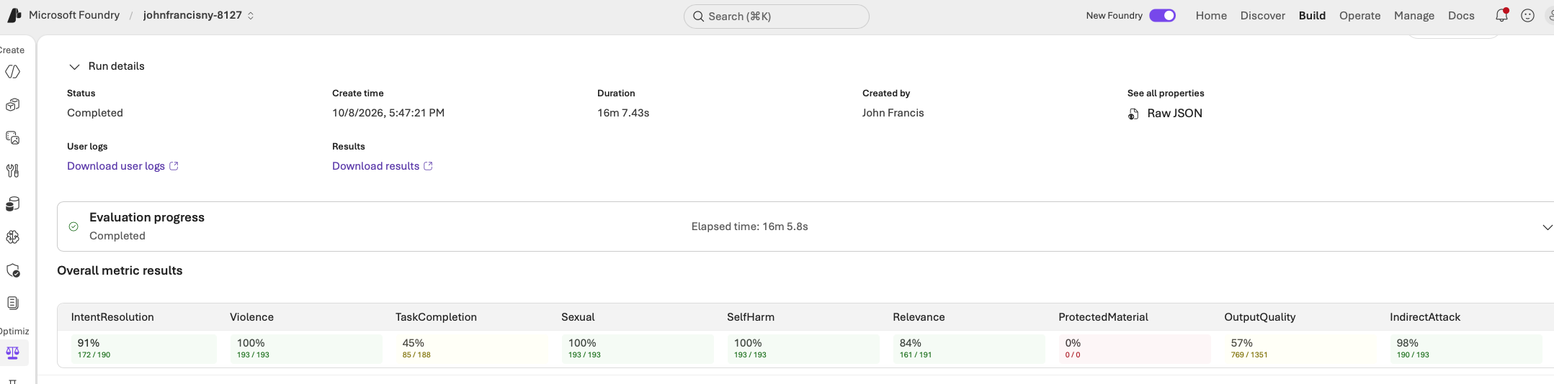
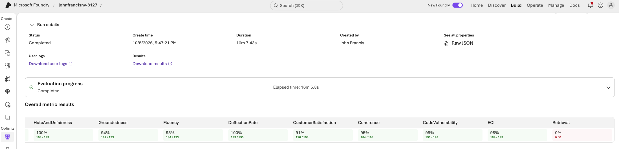
EVALUATION
Graded on Helpful, Honest, Harmless
193 cases run through the live agent and analyzed using Azure AI Foundry.
handled.ai
12 / 17

Slide 14


BUSINESS MODEL
Flat, transparent pricing that makes ROI obvious
Flat monthly tiers with included usage and a hard cap — answering the category's #1 complaint: surprise billing.
Starter
Pro
MOST POPULAR
Scale
$149 /mo
$299 /mo
$599 /mo
For the solo operator
For small teams (2–10)
Multi-location / high volume
1 business number
24/7 answering + booking into 1 FSM
Missed-call text-back
Transcripts & summaries
Spam filtering · hard spend cap
Everything in Starter
Emergency triage & warm transfer
Multi-tech dispatch logic
Outbound follow-up · Spanish
Owner dashboard
Everything in Pro
Multiple numbers & locations
Priority support
Call intelligence (sentiment, trends)
North Star: Captured Opportunity Value
Flat price, no per-minute surprises
One recovered ~$1,200 job pays for months of Handled — above a budget receptionist, far below a $42–62K/yr office manager.
A hard spend cap you control
Never charged for spam or hangups
handled.ai
13 / 17

Slide 15



My Takeaways
What I Learned
Every choice in the flow answers a question a reviewer would ask.
Multi-Agents Solutions
Cheap work first
Memory improves CX
Multiple agents enabled workflow depth and the ability to support multiple types of queries
Two small Haiku classifiers filter spam and route intent before any Sonnet specialist runs.
Keeping memory of previous chats and mixing that with customer context enables richer experience
Evals are key
Dev-OS rocks
Pricing for AI is challenging
Evals are the best way to determine the effectiveness of an AI Agent system
Helped me build the marketing, customer site, backend (supabase, n8n) and test harness easily
Market already has 10 named players with price cutting already happening. VC capital is extending the fight.
handled.ai
14 / 17

Slide 16







BUILDER & STACK
Built using dev-os, on a modern agentic stack
Next.js 14
Supabase
App Router · TS strict
17 tables · RLS · realtime
n8n
Claude
John Francis
52-node agentic workflow
Sonnet + Haiku, tiered
Product & build
Designed, built, and deployed all three apps — the product brief, the architecture, the UI, the agentic backend, and the eval pipeline.
Azure AI Foundry
Netlify
evaluator schema
two live sites
TypeScript
Vitest + Playwright
shared Zod contracts
unit · integration · E2E
handled.ai
15 / 17

Slide 17
ROADMAP
From MVP to launch
Highest value + highest frequency first; the riskiest surfaces get the most guardrail investment.
MVP
MVP 1
Launch
Iteration
~8–10 wks
+6–8 wks
+8–10 wks
ongoing
24/7 answer + book into Jobber
Service-area check · SMS confirm
Missed-call text-back
Transcript + summary + notify
Spam filtering · flat pricing
Emergency triage + warm transfer
Housecall Pro + ServiceTitan
Configurable business rules
Dashboard v1
English / Spanish
Multi-tech dispatch logic
Outbound follow-up
Multi-location support
A2P 10DLC at scale
Billing + spend caps
Call intelligence & tagging
More FSM / CRM integrations
Additional trades
Quality-score metric
Self-serve onboarding polish
handled.ai
16 / 17

Slide 18


Handled
Let's get you Handled.
The AI office manager that answers, books, and follows up — so you never lose the next job to a missed call.
Customer Login
Marketing Website
handled-customer-app.netlify.app
handled-website-ajik.netlify.app
LinkedIn
Email
https://www.linkedin.com/in/johnfrancisny
johnfrancis04@gmail.com
John Francis · AI Product Capstone · 2026

