Slide 1
Information extraction with rules

Slide 2
Information extraction
Problem: you want to get usable data from natural language.
Person | Role | Billing | Character | Work
Idris Elba | Actor | 1 | John Luther | Luther
Warren Brown | Actor | 2 | Justin Ripley | Luther
Sam Miller | Director | 1 | — | Luther
Notes:
You want to get a lot of usable information out of an existing dataset, but it's in text format. For example, let’s say you want to recreate IMDB from Wikipedia pages.

Slide 3
Information extraction
Problem: you want to get usable data from natural language.
Rules define an extraction context for an entity or relation/event.
Idris Elba is known for playing the title role in Luther.
Idris Elba is a well-known British actor. He starred in Luther…
Luther, a crime drama, stars Elba alongside Brown.
Idris, who played John Luther, is a fan favorite to play Bond.
Notes:
The difference between entities and events here is that events have arguments.
We'll focus on the case when it's in natural language, though many of the same ideas apply to more artificial text.
Unfortunately, natural language is very flexible, and any given information can be expressed in many ways.

Slide 4
Regular expressions (a.k.a. RE, regex)
RE matches
/play/ play, playing, played, display, unplayable, …
/^play/ play, playing, played, playable, …
/play$/ play, display, replay, bbbbplay …
/^play$/ play
/play(ed|s)$/ played, plays, replays, …
/^ab*$/ a, ab, abbbbbb, …
/^ab+$/ ab, abbbbb, …

Slide 5
Regular expressions (a.k.a. RE, regex)
RE matches
/^pl.y$/ play, ploy, pl&y, …
/^pl?a?y$/ play, ply, pay
/^[cfps]lay$/ clay, flay, play, slay
/^[a-z]lay$/ alay, blay, clay, …
/^[a-zA-Z0-9]lay$/ alay, blay, Alay, Blay, 0lay, 1lay …
/^(re){0,2}play$/ play, replay, rereplay

Slide 6
Part-of-speech tagging
Nouns are people, places, things, or ideas.
Let me google that for you.
Verbs are actions.
The run was refreshing.
Adjectives are qualities.
Green is my favorite color.
Notes:
The temptation is to define parts of speech by their meaning, but parts of speech are about the way words relate to each other in sentences.
Could you replace ‘google’ with ‘it’? ‘run’ with ‘ran’? ‘green’ with ‘greenest’?

Slide 7
Part-of-speech tagging
Nouns are people, places, things, or ideas.
Verbs are actions.
Adjectives are qualities.
Nouns can have determiners, can be modified by adjectives, etc.
Verbs have a subject argument, and sometimes object arguments.
Adjectives modify nouns; adverbs modify verbs.
Notes:
The temptation is to define parts of speech by their meaning, but parts of speech are about the way words relate to each other in sentences.

Slide 8
Important POS tags
DT (the, an, some)
JJ (green, bad)
JJR (greener, worse)
JJS (greenest, worst)
NN (child)
NNS (children)
NNP (RAS)
NNPS (Smiths)
PRP (it, they, I, you)
PRP$ (its, their, my, your)
CC (and, but, then)
CD (two, 1104.4)
VB (go, play)
VBG (going, playing)
VBP (go, play)
VBZ (goes, plays)
VBD (went, played)
VBN (gone, played)
MD (can, should, had)
IN (from, with, to), TO(to)

Slide 9
Named Entities
can be gathered using machine learning or through rules
may begin with B- (beginning), I- (inside), or be O (outside)
Sometimes B is excluded, i.e. IO instead of BIO notation
open-domain: PERSON, ORGANIZATION, LOCATION, ….
Reach: B-Species, I-CellLine, B-Organ, I-TissueType, B-Gene_or_gene_product, I-Family

Slide 10
Grammatical regularity
Elba, who played John Luther __ , who played __
Elba, who plays John Luther __ , who /play(s|ed)/ __
Elba, who also played John Luther __ , who /.+/? /play(s|ed)/ __
Elba, who also famously played Luther __ , who /.+/{,2} /play(s|ed)/ __
Elba, who also famously, and to the delight of fans of The Wire, played Luther __ , who /.+/* /play(s|ed)/ __
Jeffrey, who was there when Elba played ???? Luther

Slide 11
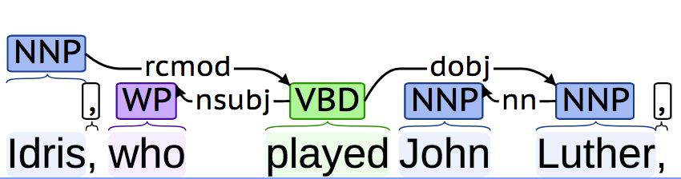
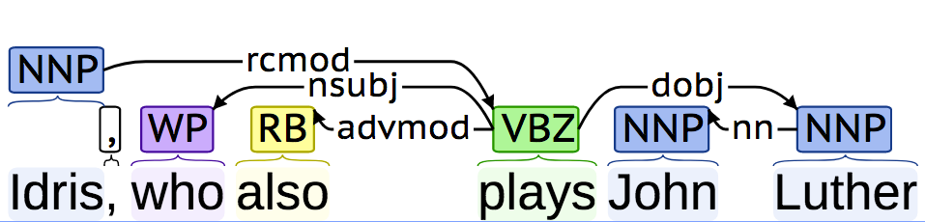
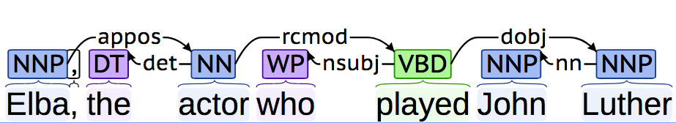
Generalization with dependencies
NNP rcmod /^play/ dobj NNP
Notes:
With a (correct) dependency graph, we can ignore irrelevant information while maintaining the important stuff.
Notice that the graph is *directed*. More than one relation can be incoming and/or outgoing from a single word
But we still have to be careful to consider how to generalize to different *syntactic* structures.

Slide 12
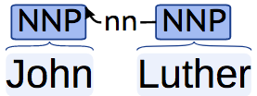
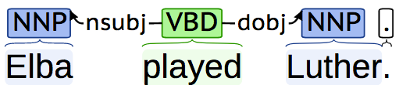
Important dependencies
nn
nsubj, dobj
nsubjpass, agent
prep_(in|to|of|with|by|…)

Slide 13
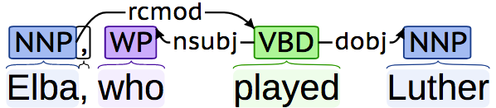
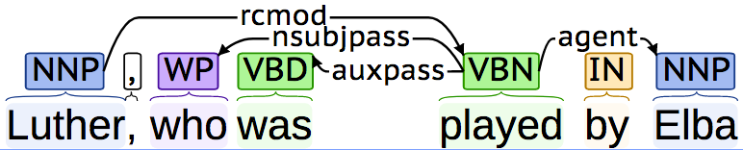
Generalizing dependencies
<nsubj dobj
<(agent|nsubj) (dobj|nsubjpass)
(<agent|<nsubj|rcmod)
(dobj|nsubjpass)
<(agent|nsubj) (dobj|nsubjpass) |
rcmod dobj | <agent <rcmod

Slide 14
Accounting for natural language
1a. Joel and Ethan Coen directed Barton Fink.
1b. Joel and Ethan Coen directed John Turturro [in Barton Fink].
2a. Joel and Ethan Coen directed Barton Fink and The Big Lebowski.
2b. Alex Winter and Keanu Reeves played Bill and Ted [respectively].

