Slide 1
Traffic Flow Optimization with Reinforcement Learning
Using AI to solve the traffic problem
Dragos Giumanca
Lect. dr. Ciprian Paduraru

Slide 2
Motivation

Slide 3
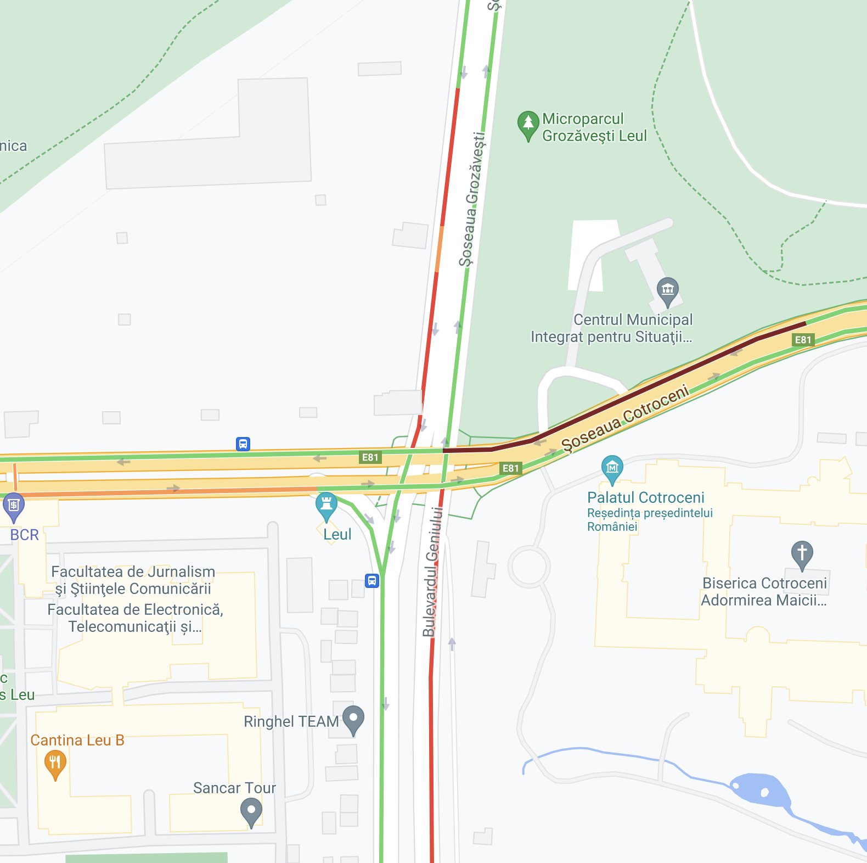
Motivation

Slide 4
Motivation
According to the Global Congestion Impact score, Bucharest has the worst traffic in the world in 2020.
One of the key factors of congestion is bad traffic lights systems.

Slide 5
Motivation
Traffic flow is dynamic changing from hour to hour
There are too many variable and cases to hardcode a good programme for red-green phases, ex. :ambulance in mission
Multiple traffic lights need to respond to incoming cars to improve overall waiting time

Slide 6
Related Work
SUMO, OSRM, Carla
State-of-the-art Reinforcement Learning approaches

Slide 7
Our Work
How does the RL methods compare and what is the simplest configuration from which we get good results?
How can we configure our data input to mimic real world situations, ex.: using sensors to get incoming traffic data?
How the results compare, what exactly is enough for the RL agent to learn something?

Slide 8
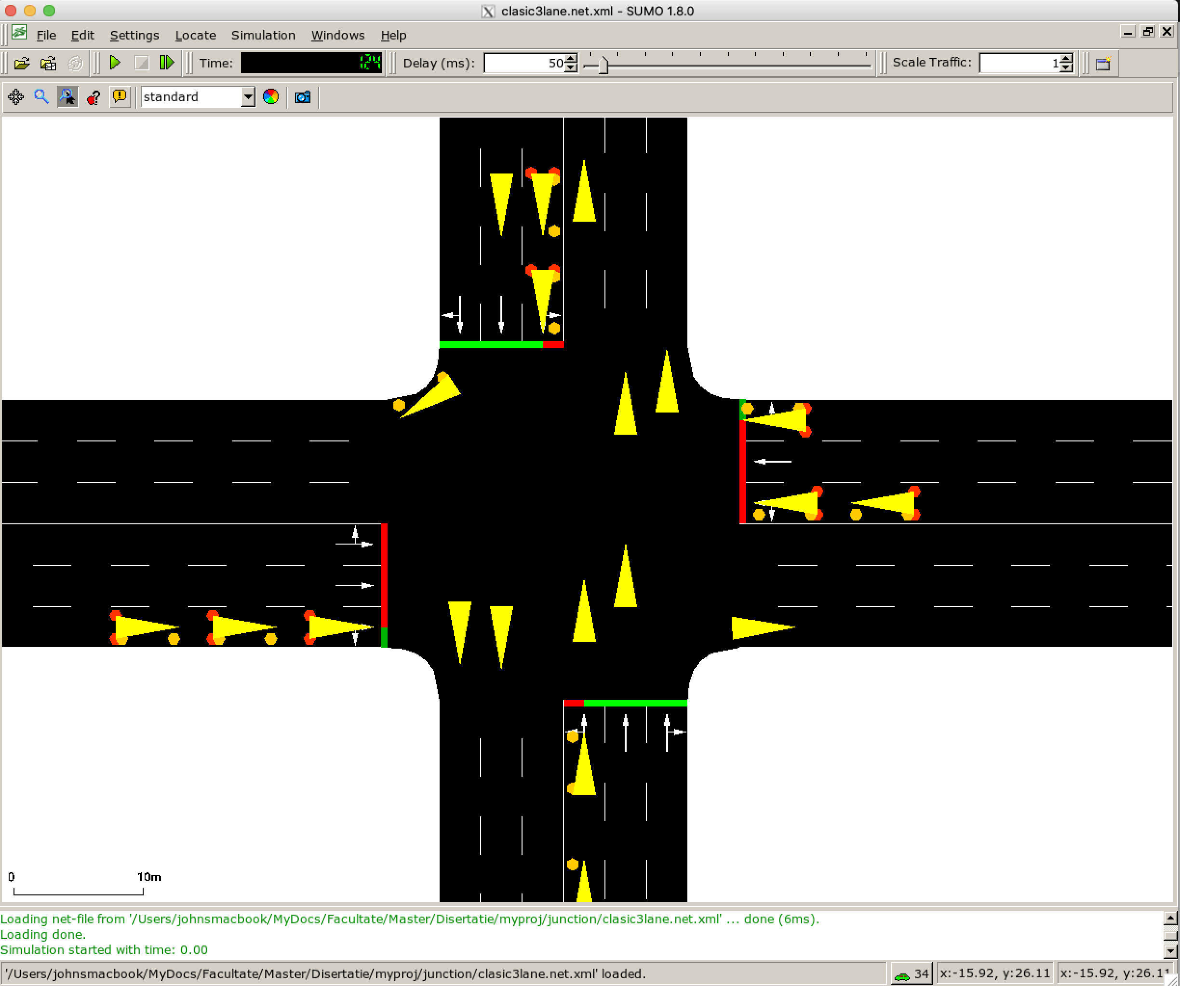
SUMO

Slide 9
SUMO
TraCI Python
Nets
Routes for cars
Special vehicles
Many stats
Good Docs

Slide 10
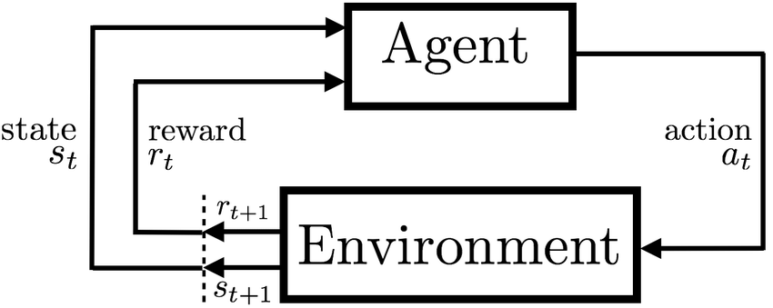
Deep Reinforcement Learning

Slide 11
SUMO
TraCI Python
RL Agent

Slide 12
Our Work
SUMO
TraCI Python
Custom Environment
RL Agent
Reward
Observation
Action

Slide 13
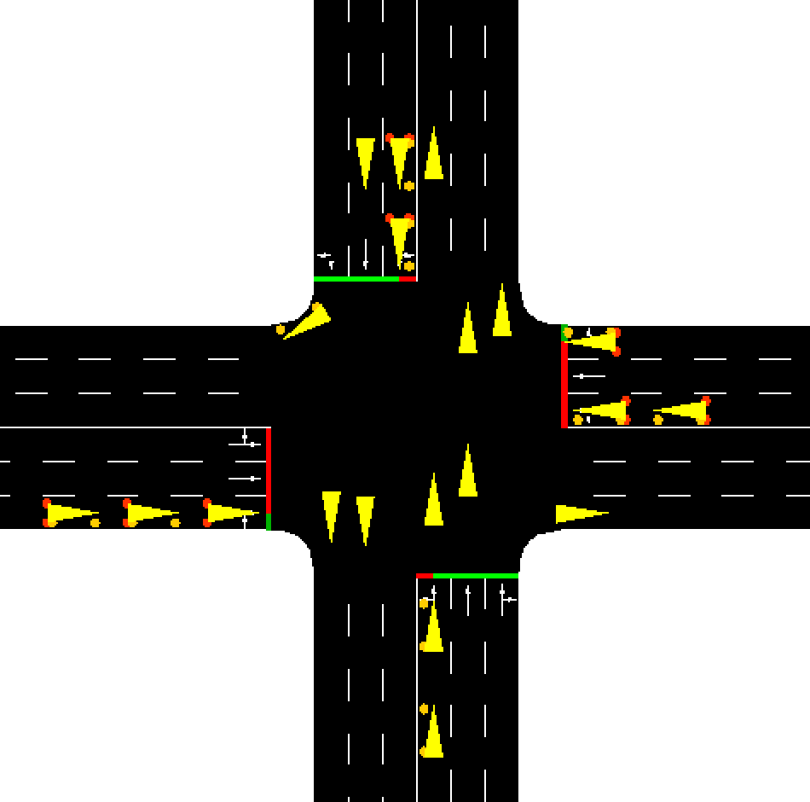
Experiments
Setup:
Classic 2 roads junction with 3 lanes
Traffic generated by custom distribution of probabilities
Default TL Programme: 42s Green 3s Yellow 10s Left-Green Cycle
Action:
[0,3] - 4 actions for each Green and Left-Green Phase
Observation:
Array of size 13, first digit [0,3] for TL phase and 12 digits for each lane stopped nr of cars (1+12)
One-hot encoding and normalized values (4+12)
Previous normalized values + values for occupancy for each lane (4+12+12)
Reward:
-1 for each stopped car for each lane and -1000 if the queue is bigger than the th.
Negative values added up for normalized observation
Negative values for accumulated waiting time added up

Slide 14
Results
Not much…

Slide 15
Experiments
Setup:
Classic 2 roads junction with 3 lanes
Traffic generated by custom distribution of probabilities
Default TL Programme: 42s Green 3s Yellow 10s Left-Green Cycle
Action:
[0,3] - 4 actions for each Green and Left-Green Phase
Observation:
Array of size 13, first digit [0,3] for TL phase and 12 digits for each lane stopped nr of cars (1+12)
One-hot encoding and normalized values (4+12)
Previous normalized values + values for occupancy for each lane (4+12+12)
Reward:
-1 for each stopped car for each lane and -1000 if the queue is bigger than the th.
Negative values added up for normalized observation
Negative values for accumulated waiting time added up

Slide 16
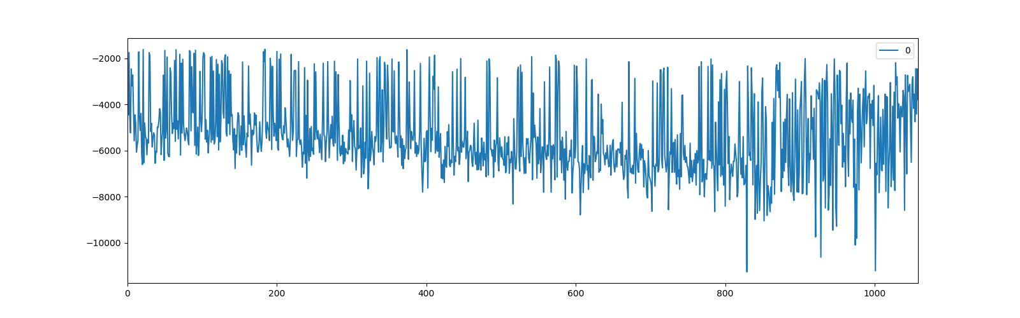
Results
Training over 1000 episodes

Slide 17
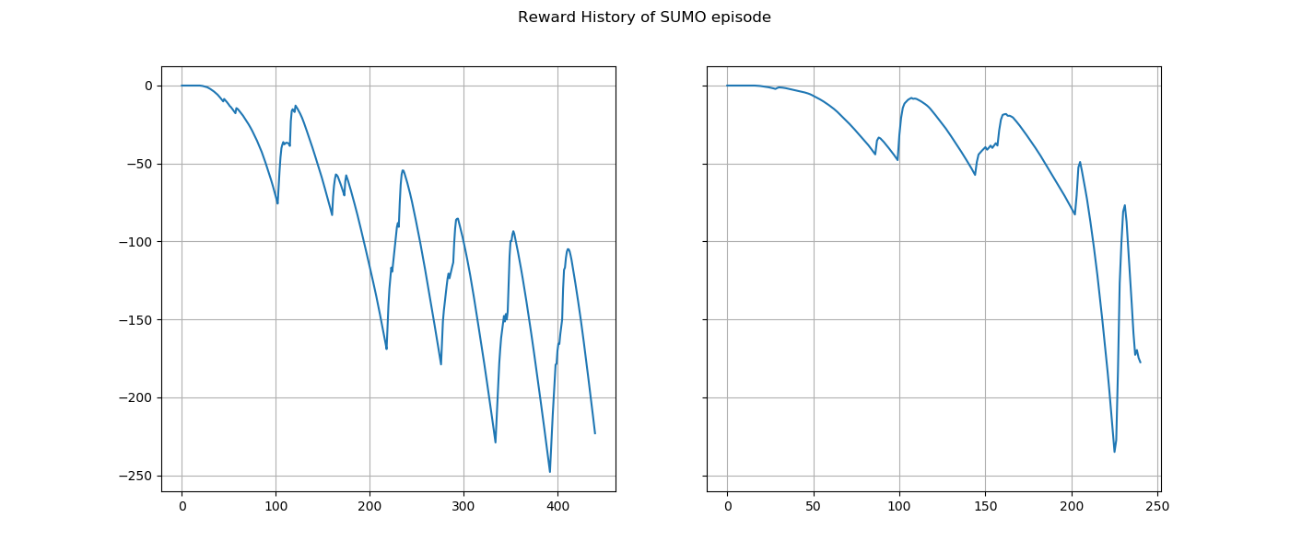
Results

Slide 18
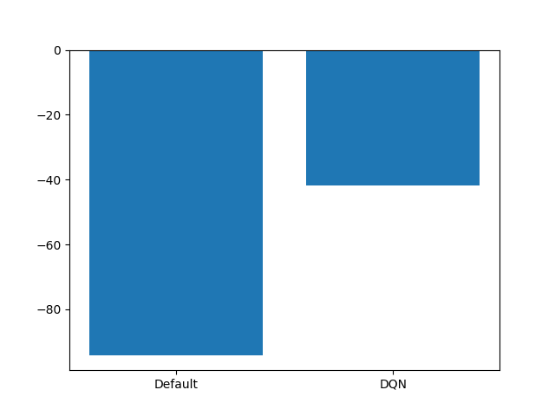
Results

Slide 19

What is Next?
More experiments with light and heavy traffic
More Observation methods with sensors to mimic real life situations

Slide 20
Thank you!

