Slide 1
Project-3
GLOBAL PROSPECTIVE ON COVID 19

Slide 2
WHAT DID WE LOOK AT
Analysis on COVID 19 and it’s impacts to:
The U.S
Countries Around the World

Slide 3
Data sources
WORLD HEALTH ORGANIZATION (WHO)

Slide 4
DATABASES
LIBRARIES
BOOSTRAP
PLOTLY
MATPLOTLIB
LEAFLET
ML
SCLEARN
NUMPY
LANGUAGES
PANDAS
TABLEAU
JAVASCRIPT
JAVASCRIPT
HTML
CSS
PYTHON

Slide 5
Jordan

Slide 6
Mohammed

Slide 7
Explanation
1
2
2
2
2

Slide 8
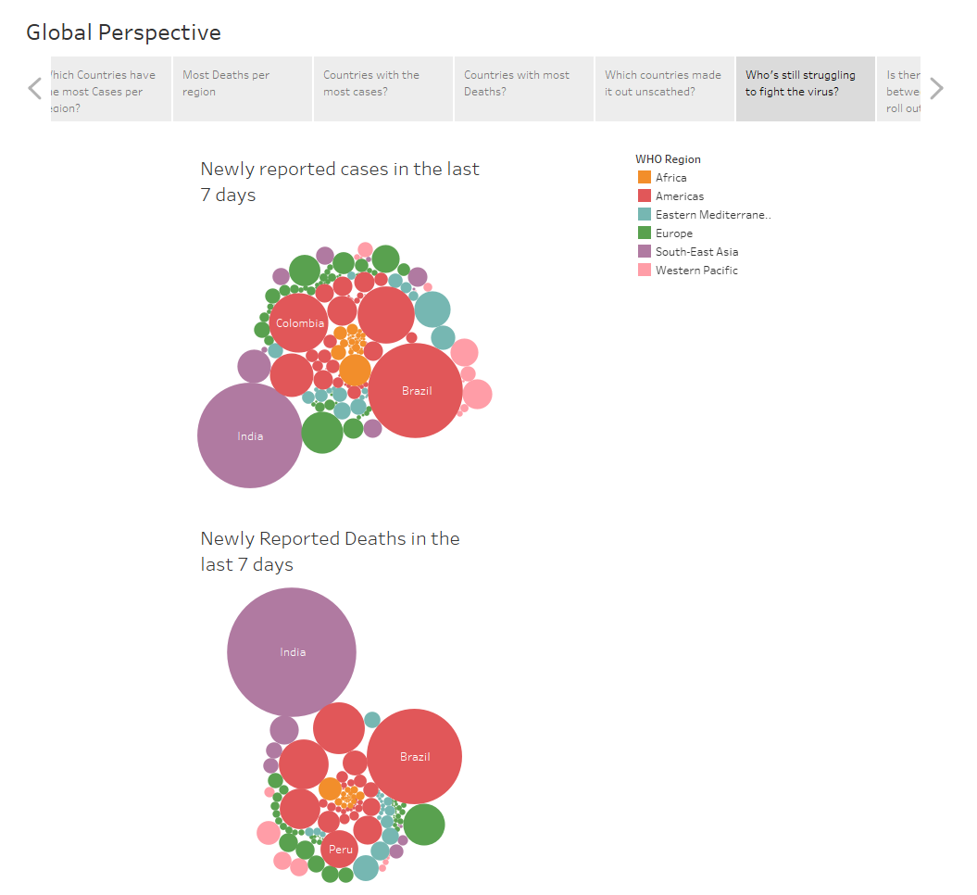
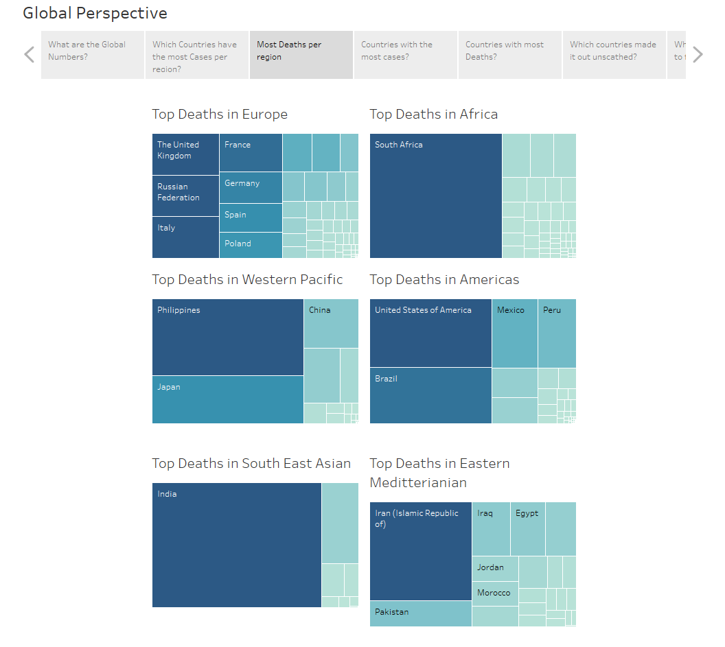
Global prospective
TABLEAU (dashboards)
FILTERS
COLOR
SIZE
TEXT
DETAILS

Slide 9
John
CSS CODE

Slide 10
What worked
Data Synchronization
Teamwork
Data Collection

Slide 11
Roadblocks
Time

Slide 12
Final analysis
The data showed inconclusive evidence that vaccinations attribute to a decline in covid cases
WHATS NEEDED
Time
More Variables
Accurate Reporting
Covid Guidance

Slide 13
END

