Slide 1

Computer Architecture
Investigation of Memory Dependence Prediction Strategies with SimpleScalar
Lorenzo Allas
John Grun
Sanandeesh Kamat

Slide 2
1.0 Introduction
The Question: To Issue Load or not to Issue Load?
  Out-of-Order scheduling enhances ILP by overlapping more instructions
  Out-of-Order scheduling of Loads risks Memory Order Violations against unresolved Stores.
  Early implementations of Dynamic Scheduling (e.g. Tomasulo) issued Loads and Stores in program order to prevent Memory Order Violations.
The Answer: Memory Dependence Prediction (MDP)
    Guess whether or not issuing a Ready Load Out-of-Order will trigger a Memory Order Violation
    Detect when Memory Order Violation does occur
    Recover processor state
    Update MDP state to learn from experience
The Purpose of this Project
  Investigate the effectiveness of Store Sets and CDP as MDP schemes.
  Utilize SimpleScalar’s Out-of-Order Simulator (simoutorder.c) as the simulation framework.

Slide 3
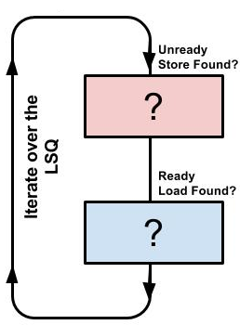
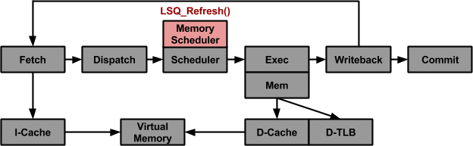
2.0 Methods & Materials
Overview of Memory Dependence Management with Load-Store-Queue (LSQ)
  Memory dependence between Loads and Stores is determined in lsq_refresh()
  Involves iterating over the elements of the LSQ as shown.
  This function served as the backbone for implementing all of the MDP schemes as well as the metric trackers.
LSQ_Refresh() Framework

Slide 4
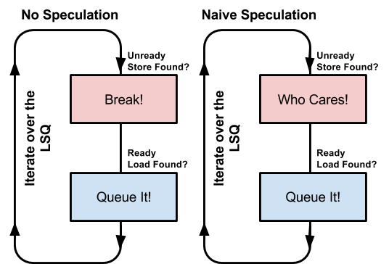
2.0 Methods & Materials
Overview of the Baseline MDP Schemes
No Speculation (Conservative)
  Queues ready Loads only if all prior Stores are ready
  Worst-case reference for False Dependencies
Naive Speculation (Aggressive)
  Queues all ready Loads regardless of prior Stores’ readiness
  Worst-Case reference for Memory Order Violations

Slide 5
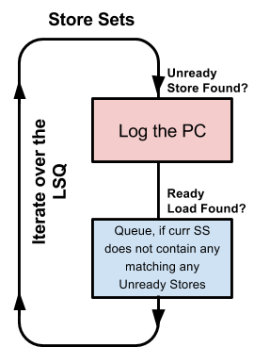
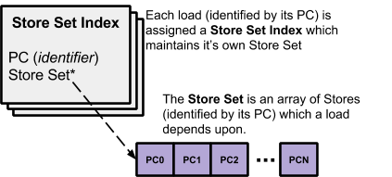
2.0 Methods & Materials
Overview of the Store Sets MDP Scheme
The processor incrementally logs the PCs of Stores upon which Loads have historically depended to determine the soonest point in time at which a given load may issue.
As conflicting stores which were initially unaccounted for are encountered (detected by Memory Order Violations), their PCs are added to the Store Set to improve future performance.

Slide 6
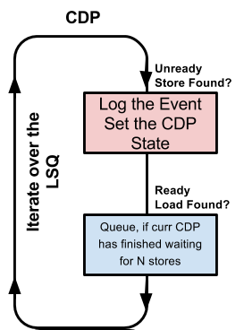
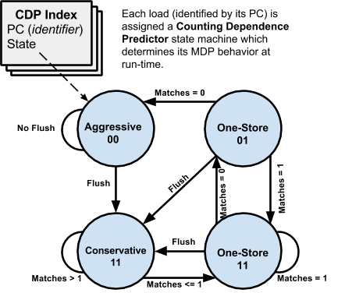
2.0 Methods & Materials
Overview of the Counting Dependence Predictor
MDP Scheme
Behavior of Load is dictated by CDP state machine.
Predicts the number of stores (not specific PCs) which a load must wait for.
Defaults to Aggressive if no dependencies are encountered.
Defaults to Conservative if >N dependencies are encountered

Slide 7
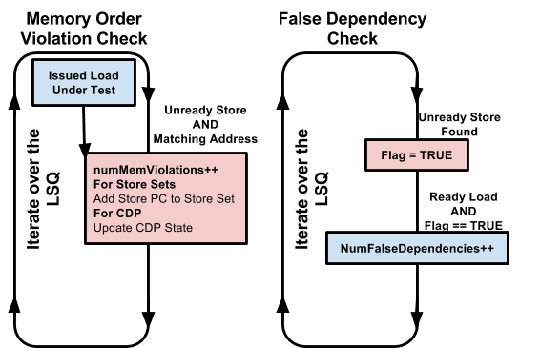
2.0 Methods & Materials
Overview of the Performance Metrics
Memory Order Violation
A program error in which an out-of-order load executes before prior store with a matching effective address.
False Dependency
  Wasted clock cycles during which a ready load is stalled due to the detection of a prior unready store which does not have a matching effective address.
Instructions Per Cycle (IPC)
  The average number of instructions which are retired per cycle.

Slide 8
3.0 Implementation of the Experiments
CLI arguments were added to toggle between MDP Schemes
  ./sim-outorder -ALGORITHM_TYPE * ./tests/bin/*
Each test program was run against each MDP scheme to generate 40 simulation runs.
The SimpleScalar parameters were fixed as shown across all simulations.
The performance metrics were logged and analyzed to evaluate the MDP schemes
Test Programs
anagram
test-args
test-dirent
test-fmath
test-llong
test-lswlr
test-math
test-printf
MDP Scheme | Memory Order Violations | False Dependencies | Project Function Name | CLI
Default | None | Many | lsq_refresh() | 0
No Speculation | None | Many | lsq_refresh_NoSpeculation() | 1
Naive Speculation | Many | None | lsq_refresh_NaiveSpeculation() | 2
Store Sets | Few | Few | lsq_refresh_InfStoreSets() | 3
CDP | Few | Few | lsq_refresh_CountingDependencePredictor() | 4
SimpleScalar Parameter | Val
Instruction Fetch Queue Size (in insts) | 4
Instruction Decode Width (insts/cycle) | 4
Instruction Issue B/W (insts/cycle) | 4
Instruction Commit B/W (insts/cycle) | 4
Memory Access Bus Width (in bytes) | 8
Register Update Unit Size | 8
Load/Store Queue Size | 4

Slide 9
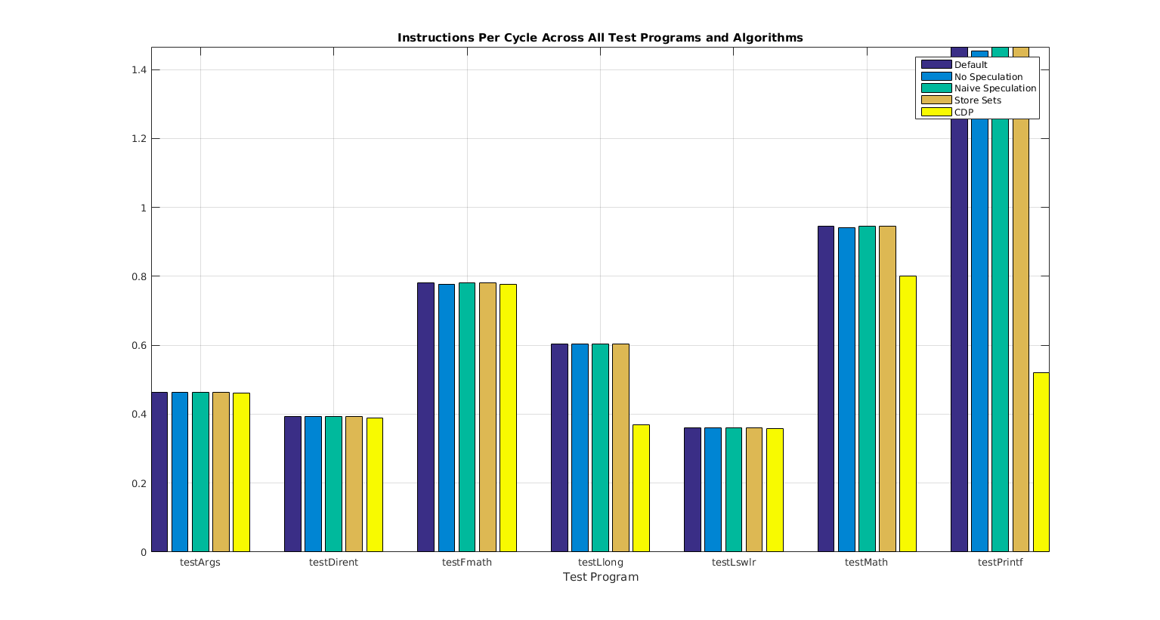
3.0 Results
Instructions Per Cycle (IPC)
The various MDP schemes applied to the test data did not result in significant variation in IPC.
Consistent decrease in IPC for No Speculation which is by definition the most sluggish of all MDP schemes.
Possible that these results would have greater variance if B/Ws were increased.

Slide 10
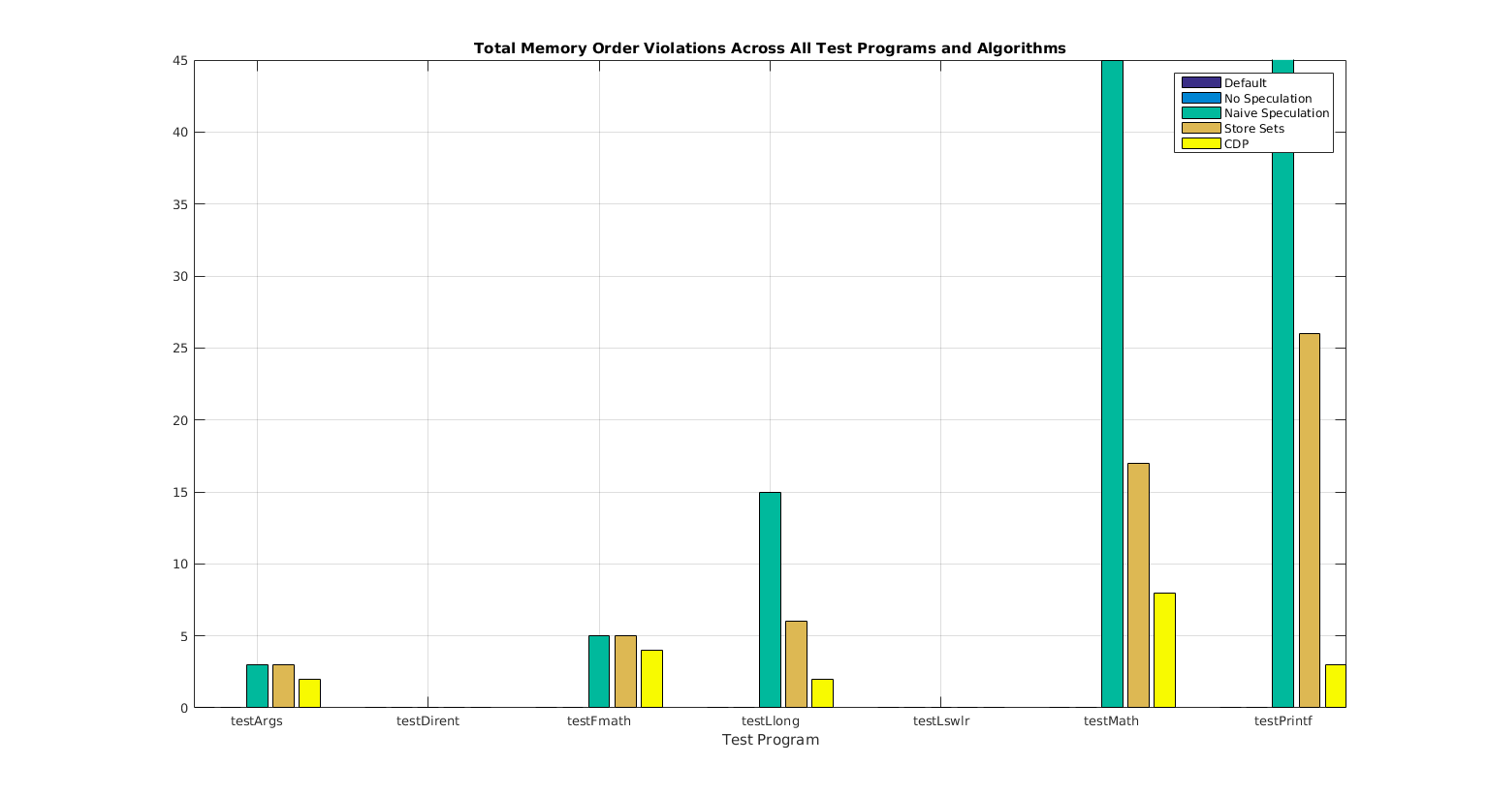
3.0 Results
Memory Order Violations
Default, No Speculation consistently generated zero
Naive Speculation consistently generated many.
As expected, Store Sets and CDP consistently generated > 0 but fewer than Naïve Speculation (the worst case baseline)

Slide 11
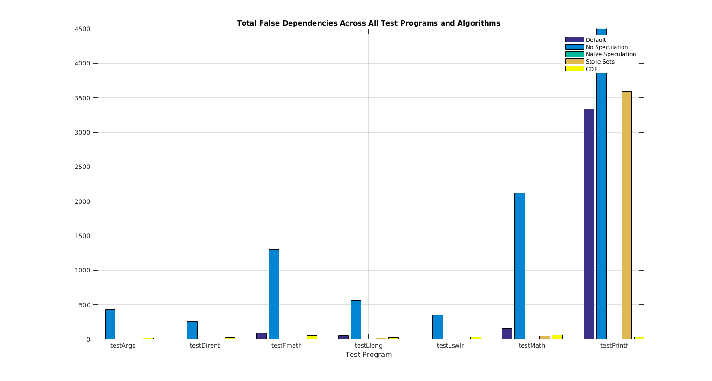
3.0 Results
False Dependencies
Naïve Speculation consistently generated zero.
No Speculation consistently generated the most.
It is optimistic that the Store Sets and CDP schemes resulted in fewer False Dependencies than the Default and No Speculation.
However, as there was no significant improvement in IPC, the overall value of these experimental MDP schemes is still undemonstrated.

Slide 12
4.0 Discussion
IPCs did not indicate enhanced performance of MDP schemes
As expected, the Baseline MDPs …
  For Memory Order Violations: the Default and No Speculation generated none and the Naive Speculation generated many.
  For False Dependencies: the Default and No Speculation generated many and the Naive Speculation generated none.
As expected, the Store Sets and CDPs …
  For Memory Order Violations: generated >0 Memory Order Violations, which is the trigger event by which the Store Sets and CDPs are to be initialized in the first place. But fewer than Naïve Spec.
  For False Dependencies: generated fewer than Default, No Speculation, and Naive Speculation.

Slide 13
4.0 Conclusion
Memory Dependence Predictor (MDP) schemes are developed to permit Loads to execute out-of-order without incurring Memory Order Violations.
This project sought to demonstrate the performance enhancement capabilities of Store Sets and Counting Dependence Predictor (CDP), within the SimpleScalar simulation framework.
The project’s developed source code toggles between four different MDP schemes:
  No Speculation and Naive Speculation (Baseline) successfully demonstrated the predicted behavior of maximizing False Dependencies and Memory Order Violations, respectively.
  The Store Sets and CDP (Experimental) successfully demonstrated an expected moderate incurrence of Memory Order Violations and False Dependencies which were not as high as worst-case Baseline MDPs
  However, Store Sets and CDP did not achieve higher IPC which does not support the utility of the implementations.

