Slide 1
Introduction to UML
By: Dr. Chris Simmons

Slide 2
What is UML?

Slide 3
Unified Modeling Language
A family of graphical notations, containing a meta-model to assist with describing and designing software.
Grew from OO analysis and design methods.

Slide 4
UNIFIED MODELING LANGUAGE
UML is a big, complicated diagramming language
UML comprises roughly 10 different kinds of diagrams:
Activity
Class
Communication
Component
Deployment
Object
Package
Sequence
State Machine
Use Case
This talk will cover a few types of diagrams, but mainly Class and Use Case Diagram

Slide 5
Classification of UML Types
Diagram
Structure Diagram
Class
Composite Structure
Behavior
Activity
Object
Component
Deployment
Package
Use Case
State Machine
Interaction
Sequence
Communication
Interaction Overview
Timing

Slide 6
UML Usage
Three ways to use UML:
Sketch
Blueprint
Programming language

Slide 7
UML as a Sketch
Developers use the UML to help communicate some aspects of the system.
Can involve forward/reverse engineering
FE: Drawing a UML diagram before you write code.
RE: Builds a diagram from existing code to assist with understanding.

Slide 8
UML as a Blueprint
Associated to the completeness of a designed system.
Blueprints are developed by the designer for a programmer to code.
All design decision are succinctly laid out
Straightforward activity that requires little thought for the programmer.
Usually the designer is a more senior programmer
Comes from the construction thought process

Slide 9
UML as a Programming Language
Developers draw UML diagrams directly from executable code.
UML becomes the source code.
Requires sophisticated tooling

Slide 10
Notations and Meta-Models
UML defines a notation and a meta-model.
Notation is the graphical aspect you see in models.
Meta-model is a diagram that defines the concepts of the language.
meta-modeling is the analysis, construction and development of the frames, rules, constraints, models and theories applicable and useful for modeling a predefined class of problems.

Slide 11
Fitting UML into a Process
Requirements Analysis
What the customers and users of a software effort want the system to do.
Associated techniques:
Use Case Diagram – Interaction with the system
Class Diagram – Building a rigorous vocabulary of the domain
Activity Diagram – Describes the workflow of the organization
State Diagram – Useful if a concept has an interesting lifecycle, with various states and events that change the state.

Slide 12
Fitting UML into a Process
Design
Often requires more technical detail, where more precise notation are needed.
Associated techniques:
Class diagrams – from a software perspective, which shows classes in the software and how they relate.
Sequence diagrams – utilize the most common scenarios from use cases to figure out what happens in the software.
Package diagrams – depicts large-scale organization of the software.
State diagrams – use for complex life histories.
Deployment diagrams – depict physical layout of the software.

Slide 13
Class Diagrams

Slide 14
Class Diagrams
Class Diagram – describes the types of objects in the system and the various kinds of static relationships that exist among them.
Consists of:
Classes, which are divided into three compartments:
Name of class (in bold)
Attributes
Operations

Slide 15
Class Diagrams Con’t
Properties – represent structural features of a class. (E.g. fields in a class)
Attribute notation – describes a property as line of text within the class.
Association – a solid line between two classes (E.g. source -> target)

Slide 16
Class Representation
Each class is represented by a rectangle subdivided into three compartments
Name
Attributes
Operations
Modifiers are used to indicate visibility of attributes and operations.
‘+’ is used to denote Public visibility (everyone)
‘#’ is used to denote Protected visibility (friends and derived)
‘-’ is used to denote Private visibility (no one)
By default, attributes are hidden and operations are visible.

Slide 17
Example of a Class
Name
Account_Name
- Customer_Name
- Balance
Attributes
+addFunds( )
+withDraw( )
+transfer( )
Operations

Slide 18
Relationships
connections between classes
dependency
generalization
association

Slide 19
Dependency
A dependency is a “using” relationship within which the change in the specification of one class may affect another class that uses it.
Example: one class uses another in operation
Window
Event
handleEvent()

Slide 20
Generalization
A generalization is a “kind of” or “is a” relationship between a general thing (superclass or parent) and a more specific thing (subclass or child).
Shape
Circle
Rectangle

Slide 21
Association
An association is a structural relationship within which classes or objects are connected to each other. (An association between objects is called a link.)
Person
Company

Slide 22
Association Name
describes nature of relationship:
can also show direction to read name:
works for
Person
Company
works for
Person
Company

Slide 23
Association Roles
describe “faces” that classes present to each other within association
class can play same or different roles within different associations
employee
Person
Company
employer

Slide 24
Association Multiplicity
possible values same as for classes: explicit value, range, or * for “many”
Example: a Person is employed by one Company; a Company employs one or more Persons
1..*
Person
Company
1

Slide 25
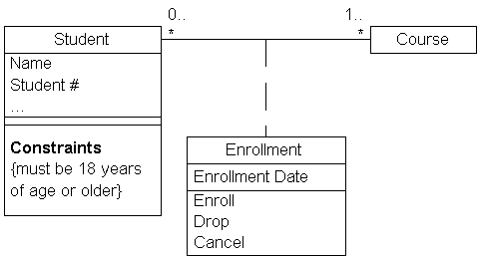
Class Diagram Example

Slide 26
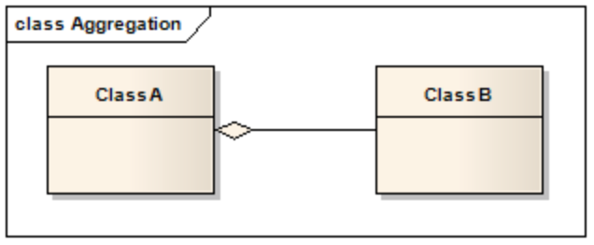
Aggregation Link
Part-of relationship between ClassA (whole) and ClassB (part),
Use aggregation link instead of the association link, highlighting that ClassB can also be aggregated by other classes in the application

Slide 27
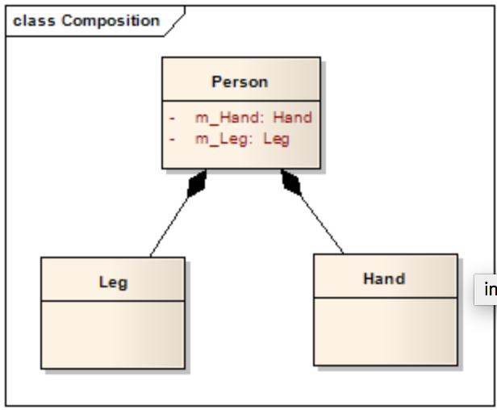
Composition Link
Cases where in addition to the part-of relationship between ClassA and ClassB, a strong lifecycle dependency between the two.
When ClassA is deleted then ClassB is also deleted as a result.

Slide 28
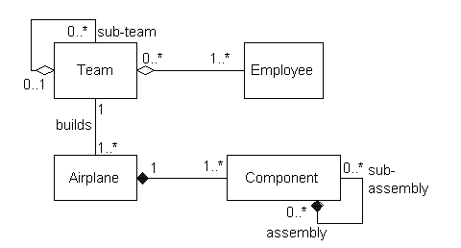
Class Diagram Example

Slide 29
Sequence Diagrams

Slide 30
Sequence Diagram
Models the collaboration of objects based on a time sequence.
It shows how the objects interact with others in a particular scenario of a use case.
A lifeline is a vertical dashed line that represents the lifetime of an object.
A focus of control is a tall, thin rectangle that shows the period of time during which an object is performing an action.

Slide 31
Sequence Diagram(make a phone call)
Caller
Phone
Recipient
Picks up
Dial tone
Dial
Ring notification
Ring
Picks up
Hola

Slide 32
Use Case Diagram

Slide 33
Use Case Diagram
For capturing the functional requirements of a system.
Typical interaction between user and system
captures some user-visible function
achieves a discrete goal for the user
note the distinction between the user goal and system interaction in which system interaction is the low-level work that ultimately achieves the user goal

Slide 34
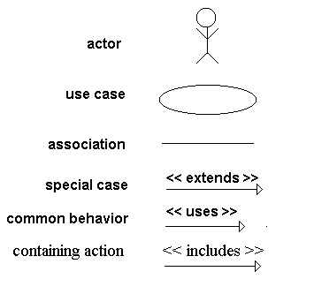
Notation

Slide 35
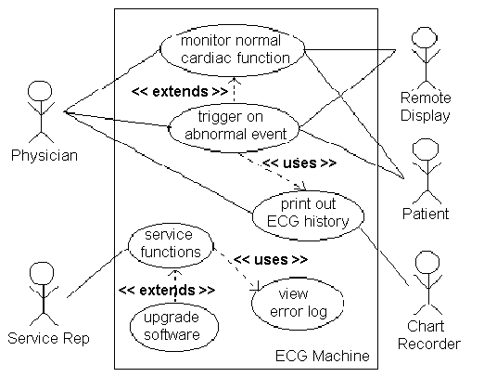
An Example Use Case Diagram

Slide 36
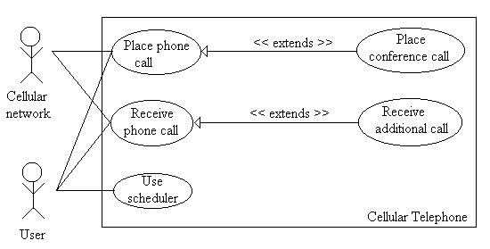
Another Example Use Case Example

Slide 37
Common Uses
to model the context of a system
system, actors, and their interactions with it
to model the requirements of a system
what system should do
independent of how it is done
point of view outside of system

Slide 38
Caution
it is easy to get too low-level
A use case is a relatively large end-to-end process description that typically includes many steps or transactions; it is not normally an individual step or activity in a process.
Larman [1998] Applying UML and Patterns

Slide 39
Steps
capture normal case first
for every step, ask:
“What can go wrong”
“How might this work differently”
each variation is plotted as an extension
common behavior can be encapsulated in another use case to be used by other cases

Slide 40
Steps (cont.)
after creating the diagram, write a generic scenario (called a use case description) which is a series of sentences describing each step in the interaction
Each step in a use case is an element of the interaction between an actor and the system.
use case description can be used to generate specific scenarios and interaction diagrams

Slide 41
Scenario
A thread through a use case
A sequence of steps describing an interaction between a user and a system.
A use case is a set of scenarios tied together by a common user goal.

Slide 42
State Machine Diagrams
Describe the behavior of a system
An OO technique for a single class to show lifetime behavior of a single object.
Consist of:
Internal Activities (Self-transition) – Reaction to events without transition.
Entry Activity – Executed whenever you enter a state.
Exit Activity – Whenever you leave a state.

Slide 43
State Diagrams Con’t
Activity State – a state in which an object is doing some ongoing work.
Marked with the term do/

Slide 44
Secret Panel Controller
Secret Panel State
changeStateTo (SecretPanelState)
handleCandleRemoved
handleKeyTurned
handleSafeClosed
handleCandleRemoved
handleKeyTurned
handleSafeClosed
state1
Wait State
Lock State
handleCandleRemoved
handleKeyTurned
handleSafeClosed
handleCandleRemoved
handleKeyTurned
handleSafeClosed

Slide 45
Activity Diagram
Technique to describe procedural logic, business process, and work flow.
Similar to flow charts
Contains:
Initial node – initial action
Fork – an incoming action with several outgoing actions
Decision node – Option to make a decision within the activity.
Final node – the exit node

Slide 46
Activity Diagram Example
Receive Order
Fill
Order
Send Invoice
Overnight Delivery
Regular Delivery
Receive Payment
Close
Order

Slide 47
Exercise
Produce 2 use case diagrams for your project.
Produce 1 sequence diagram for your project.
Produce 1 activity diagram for your project.
Produce 2 class diagrams for your project.
Submit this exercise via Black Board under ‘Group Project’

