Slide 1
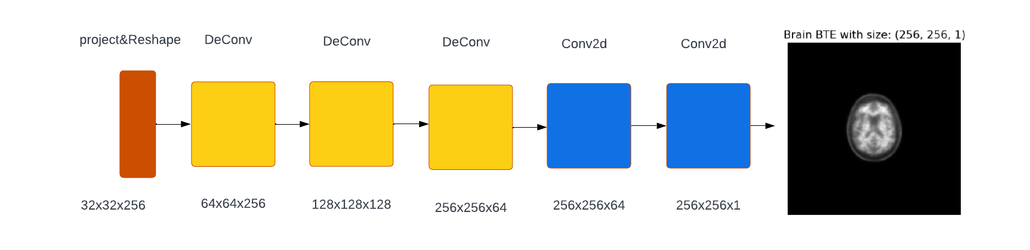
Architecture used in the Model
First , Generator

Slide 2
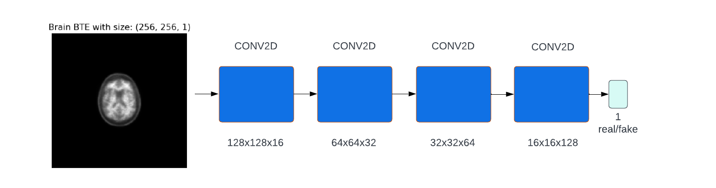
Architecture used in the Model
Second , Discriminator

Slide 3
Dataset details
Brain PET scan
The data set contains 160 patients, from AIBL
Each patient’s brain scanned into 148 frames, with dicom extension
We selected the needed frames from each patient, and converted their extension into png
The total number of data we worked with : 606 image

Slide 4
Implementation details
Use google drive and Colab to handle the run process.
Make function take path of train images and return numpy array contain of all images in this file with labels.
Rescaling images into (-1, 1), and labeling all real images with 1.
Build the Generator with 3 deconv layers contains BatchNomalization&LeakyRelu, and 2 conv2d layers with batch&leakyRelu .
Create the discriminator model has 4layers contain of same padding, convolutional, batch normalization, leakyRelu then dropout and Dense with 1 (binary classifier).
Evaluate model with plot loss and SSIM.

Slide 5
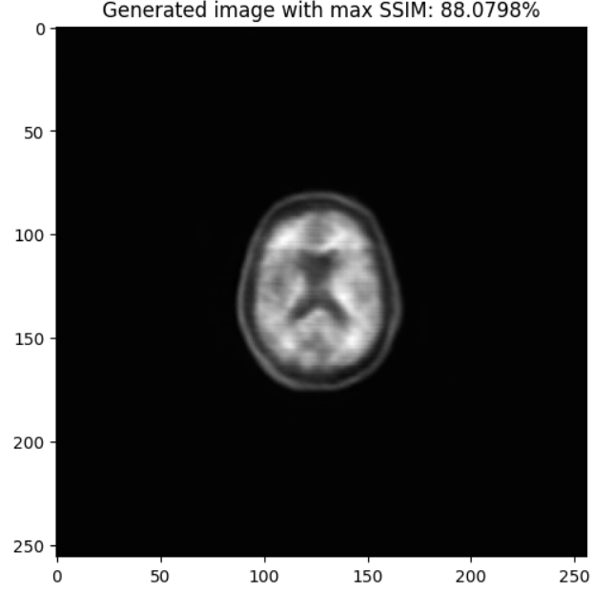
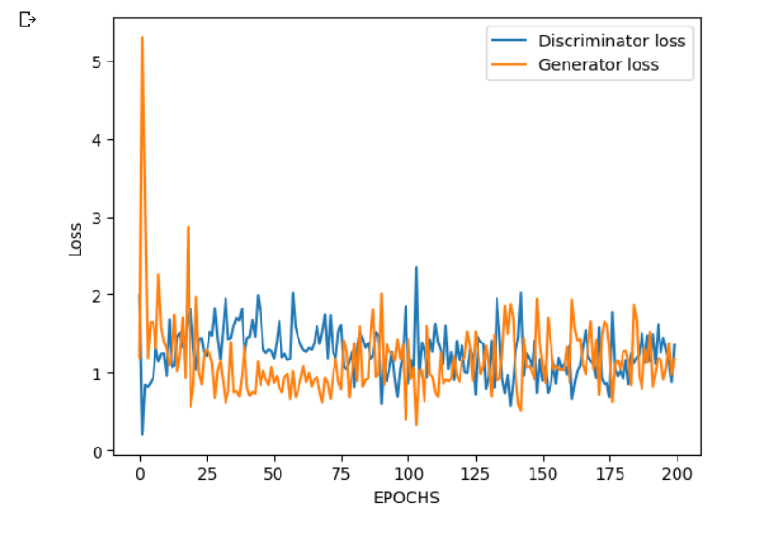
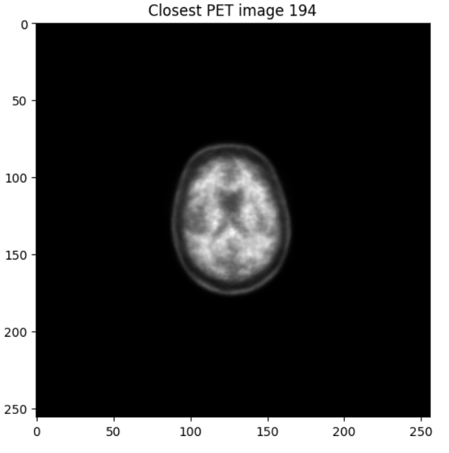
Results and visualizations
SSIM evaluation
Loss evaluation

