Slide 1



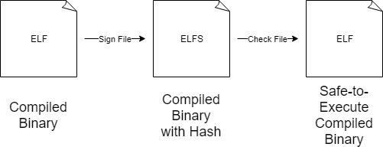


SAFEXEC
John Hardy

