Slide 1


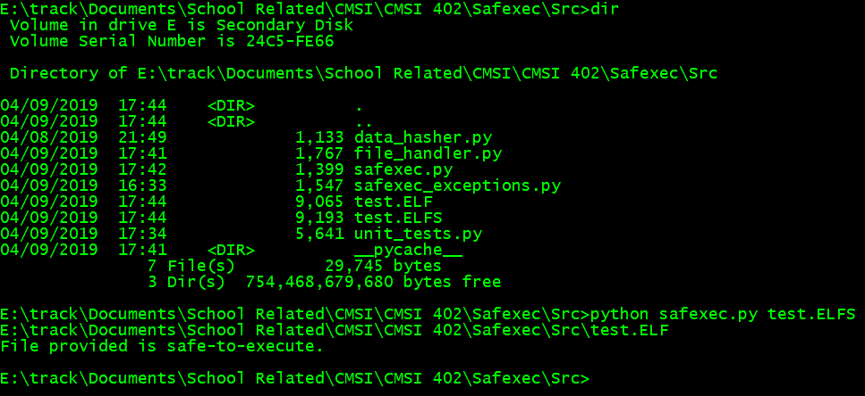
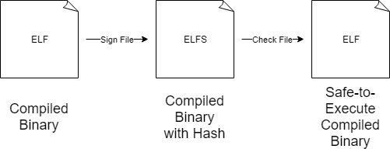





SAFEXEC
John Hardy
CMSI 402
How Does Safexec Work?
The programmer uses Safexec to sign an ELF file into an ELFS file. The ELFS is sent to the user. Safexec is run on the ELFS. Safexec informs the user if the ELFS is safe to execute. An ELF is then produced for the user.
What is Code Signing?
Code signing is the process of digitally signing a binary executable in order to confirm that the code has not been tampered with since it was signed. Safexec is a code signing application for executable files on Linux.
Resources Utilized
All of the source code for Safexec was written in Python. The Hashlib library was used for the SHA 512 hashing. HxD was used to manipulate executables in hexadecimal format. GitHub was used for version control. Ubuntu was used for generating ELF files for modification.

