Slide 1

Deloitte: Investment Project
John hios
08/06/2022

Slide 2
Contents
Introduction
What is Productivity?
Challenges
UK Productivity (OECD data)
Prediction of Productivity Based on Investment
Conclusions
Future Work

Slide 3
Introduction
The Business Problem
Productivity is key to the development of local businesses and the wider economy. Over the past decade, productivity has slowed down globally with the UK lagging behind some other developed economies.
The Business Questions
How can we improve productivity within Scotland and the UK overall?
Does government spending on factors such as mental health, education, and research and development affect productivity in the UK?
Is there a relationship between government investment and productivity?
Can you predict productivity based on investment?

Slide 4

What is Productivity?
It is the ratio between the output volume and the volume of inputs.
Productivity measures how efficiently production inputs, such as labour and capital, are being used in an economy to produce a given level of output.
Gross Domestic Product (GDP) per hour worked is one of the most widely used measures of productivity
How is Productivity linked to Investment?
When productivity fails to grow significantly, it limits potential gains in wages, corporate profits, and living standards.
Investment in an economy is equal to the level of savings because investment has to be financed from savings.
Low savings rates can lead to lower investment rates and lower growth rates for labour productivity and real wages.
https://www.bls.gov/k12/productivity-101/home.htm#what-is-productivity/home

Slide 5
Challenges
Wealth of data coming from different sources (eg OECD, ONS) and having different formats (.csv, .xls, .xlsx)
Data required cleaning and narrowing down
Scarcity of mental health information for the UK and other countries
Lack of business intelligence (no background in finance/investment sector)

Slide 6
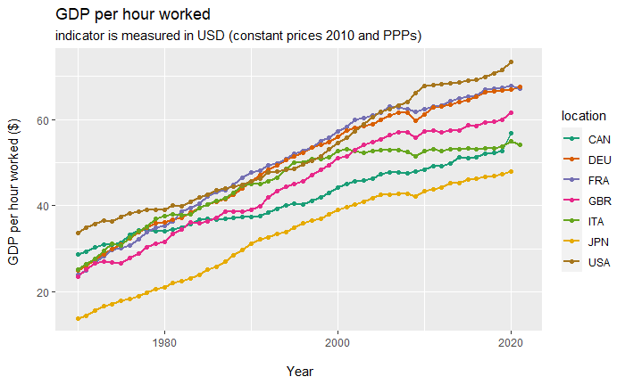
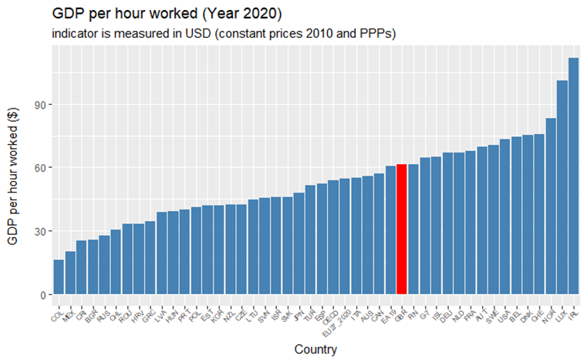
UK Productivity (OECD data)
UK productivity growth dropped after 2008
Overall, the UK is not ranking high
UK productivity among G-7 countries is somewhere in the middle

Slide 7
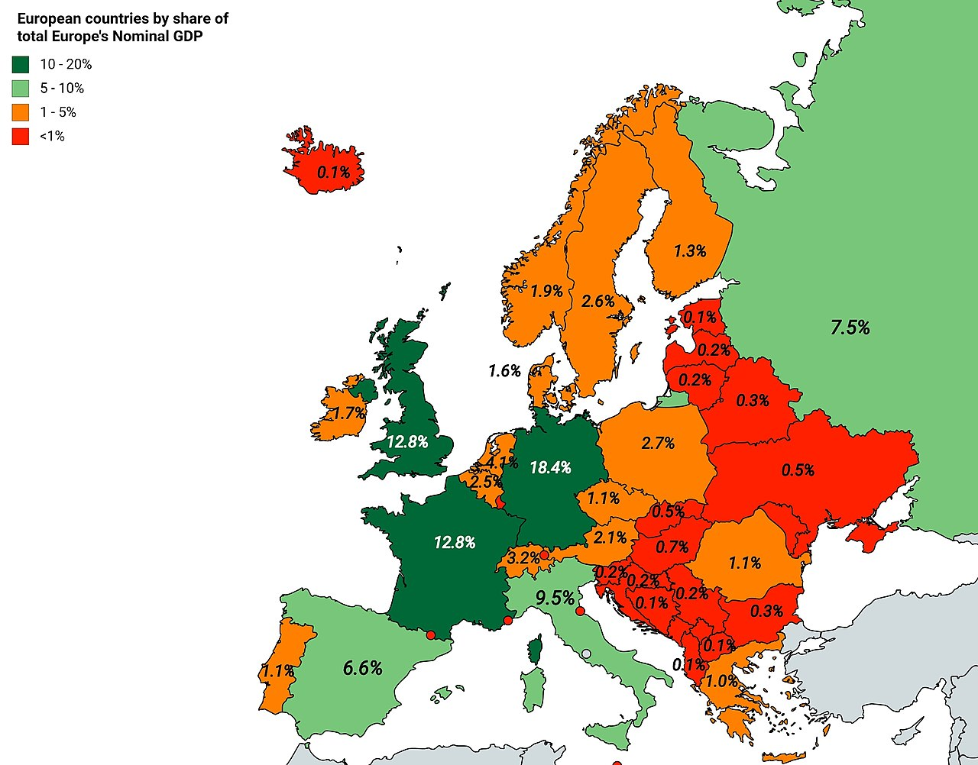
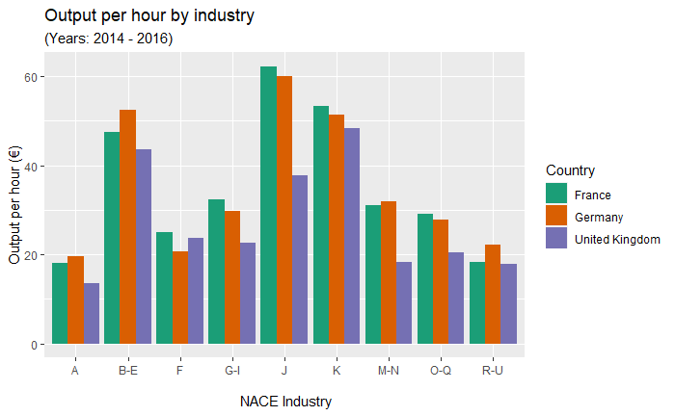
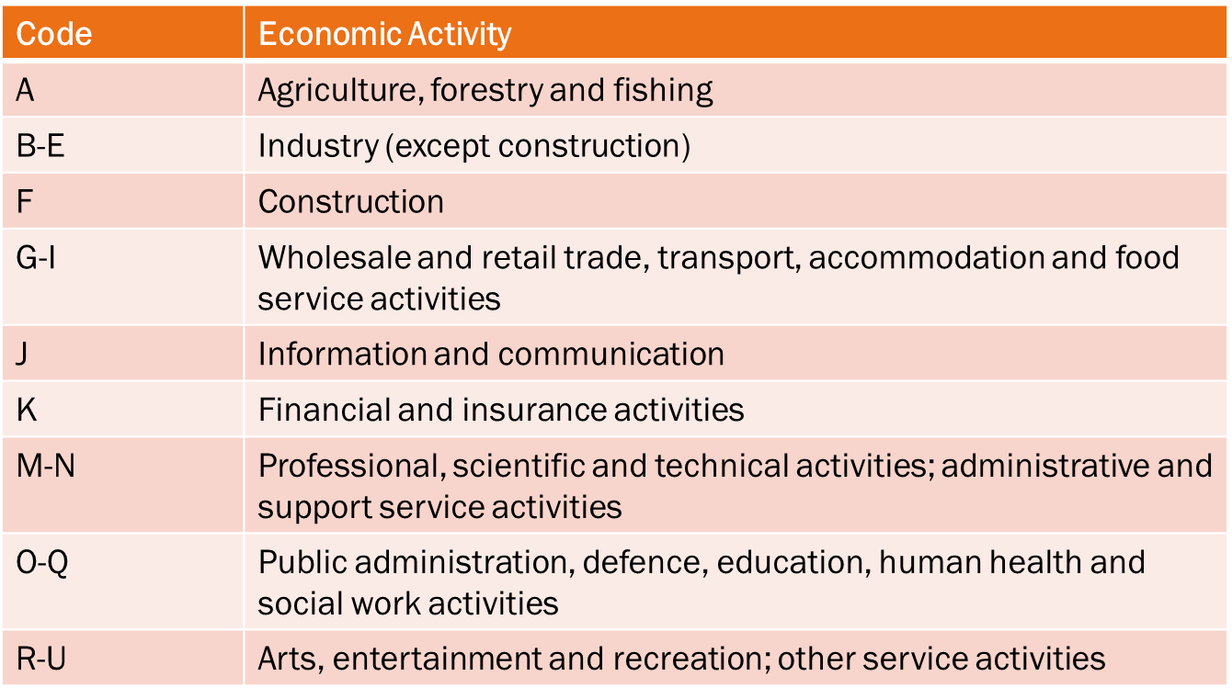
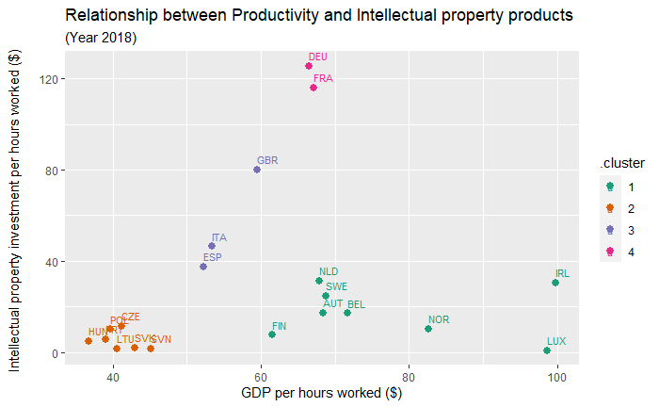
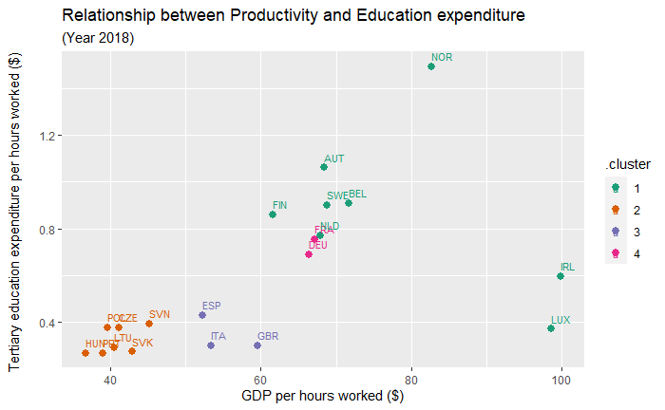
https://www.wikiwand.com/en/Financial_and_social_rankings_of_sovereign_states_in_Europe

Slide 8
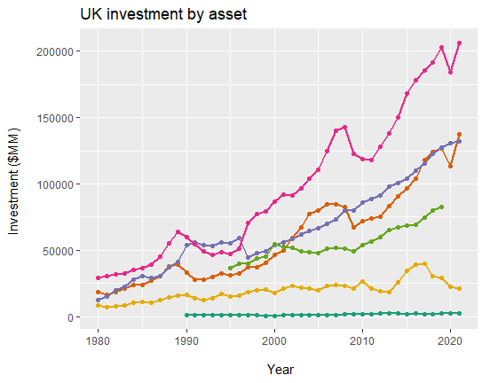
Prediction of Productivity Based on Investment
Data from years 1995-2020 were used
Factors used to predict productivity
Intellectual Property ($billion)
Dwellings ($billion)
Cultivated biological resources ($billion)
Infrastructures ($billion)
Transportation equipment ($billion)
Information and Communication Tech ($billion)
Education data were too scarce to use for modelling

Slide 9
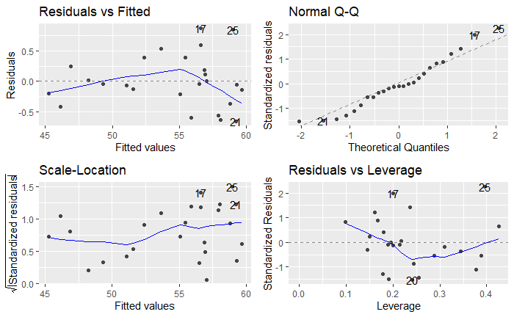
Prediction of Productivity Based on Investment
Linear Regression model:
(GDP per hour worked $) = 26.96
+ 0.1682 × (Infrastructures $billion)
+ 0.1717 × (Intellectual Property $billion)
+ 0.2123 × (Dwellings $billion)
- 0.01543 × (Infrastructures $billion × Cultivated bio resources $billion)
- 0.001436 × (Infrastructures $billion × Dwellings $billion)
variance explained (%)
32.85
17.27
34.42
0.45
15.01
RMSE | R²
0.559 | 0.994

Slide 10
Conclusions
UK productivity growth dropped after 2008 (onset of great recession) and since then it is not ranking high compared to other countries
Compared to France and Germany (countries similar in size of population and economy) productivity is notably lower in key industrial sectors
Infrastructure and Dwelling investments seem to have the largest impact in the UK GDP per hour worked
Investments in Intellectual property products in the UK is lagging compared to Germany & France and accounts to a small portion of the UK productivity
The UK Education investments are notably low compared to most higher productivity economies in Europe – scarcity of data didn’t allow for including this factor in the productivity prediction model
Lack of adequate mental health data did not allow for any assessments of its impact in productivity
A detailed study of the French and German economy should be undertaken to identify areas of improvement in the UK

Slide 11
Future Work
Acquisition of mental health info to answer the business question
Explore alternative clustering methods for grouping data ( for instance, ANN, distribution-based / density-based methods)
Detailed literature survey on predicting productivity using investment data with a view to
Identify commonly used modelling approaches (Linear regression, time-series models, ANN etc)
Best modelling practices

