Slide 1
Baton Rouge Traffic Incidents
Should More In-Depth research be done to find ways to reduce incidents?

Slide 2
14,109 total incidents in 2021
Average of 1,175 incidents per month
September with 1,698 for the most incidents
December with 142 for the least

Slide 3
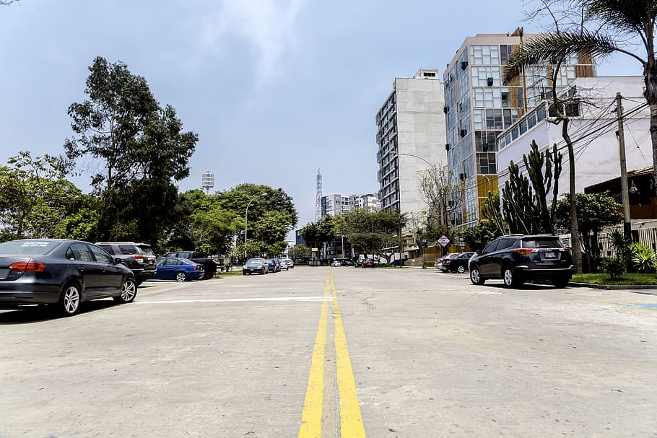
Where are the Incidents?
51% of all incidents occur on City Streets, compared to 16% on the interstate
74% of incidents occur in the Daylight
76% occur under Clear weather conditions
97% report No Abnormalities in Road Condition

Slide 4
Main Factor for Incidents
78% of incidents are due to traffic violations.

Slide 5
Conclusion
Further Research is requested
Goals
Determine Reasons for Violations
Find Methods to Reduce Violations
Reduction in violations could have an affect on traffic incidents.

