Slide 1
Iteration 3
Team 2
Cameron Adams
John Green
Emmanuel Lennix
Benson Mathew
Sarah Varghese

Slide 2
Requirements
R1. The Graphical Editor (GED) shall allow the user to create a new project.
R2. The Graphical Editor (GED) shall allow the user to delete a project.
R3. The Graphical Editor (GED) shall allow the user to save a project to the current location.
R3.1. The Graphical Editor (GED) shall allow the user to save a new project to a user specified location.
R4. The Graphical Editor (GED) shall allow the user to open existing projects.
R5. The Graphical Editor (GED) shall allow the user to create a new diagram.

Slide 3
Requirements
R6. The Graphical Editor (GED) shall allow the user to edit a new diagram
R6.1. Adding a new class: GED shall display a dialog to allow the user to enter class information like class name, attributes and type, operations and parameter, types and return types.
R6.2. Updating a class: GED shall allow the user to change the class information
R6.3. Deleting a class: GED shall allow the user to delete a class by prompting the user with a confirmation dialog.
R6.4. Adding a relationship: GED shall provide a user-friendly way to allow the user to add relationships between two or more classes.
R6.5. Selecting one or more graphical elements: GED shall provide a user-friendly way to allow the user to select one or more graphical elements (classes, relationships, or their combination of a UML diagram.)
R6.6. Moving selected graphical elements: GED shall allow the user to move selected elements by dragging them to the desired place.
R6.7. Copying, and cutting: GED shall provide the commonly used “copy” & “cut” capabilities.
R6.8. Pasting: GED shall provide the commonly used “paste” capability
R6.9. Deleting selected elements: GED shall allow the user to delete selected elements.
R6.10. Undo and redo: GED shall allow the user to undo or redo up to 10 editing operations

Slide 4
Requirements
R7. The Graphical Editor (GED) shall allow the user to delete a diagram.
R8. The Graphical Editor (GED) shall allow the user to save a diagram to the current location
R8.1. The Graphical Editor (GED) shall allow the user to save a diagram to a user specified location.
R9. The Graphical Editor (GED) shall generate Java or C++ skeleton code according to the user’s selection.
R.10. The Graphical Editor (GED) shall allow the user to export a diagram to PDF or JPEG.

Slide 5
Use Case Modeling

Slide 6
Abstract Use Cases
UC1. Create project (Actor: User, System: GED)
UC2. Delete project (Actor: User, System: GED)
UC3. Open project (Actor: User, System: GED)
UC4. Create diagram (Actor: User, System: GED)
UC5. Edit diagram (Actor: User, System: GED)
UC6. Delete diagram (Actor: User, System: GED)
UC7. Generate code (Actor: User, System: GED)
UC8. Export diagram (Actor: User, System: GED)

Slide 7
High Level Use Cases
UC5. Edit diagram
TUCBW: User selects an existing diagram on the canvas.
TUCEW: User sees the change on the diagram.
UC6. Delete diagram
TUCBW: User selects delete diagram button
TUCEW: User sees the diagram removed
UC7. Generate code
TUCBW: User presses generate code button.
TUCEW: User sees skeleton code generated from GED.
UC8. Export diagram
TUCBW: User presses export diagram button.
TUCEW: User sees exported version of diagram.
UC1. Create project
TUCBW: User selects create new project button
TUCEW: User sees the project window
UC2. Delete project
TUCBW: User selects the delete project button
TUCEW: User sees the project removed
UC3. Open project
TUCBW: User selects the open project button
TUCEW: User sees the project window
UC4. Create diagram
TUCBW: User presses the create diagram button, then select a location on the canvas.
TUCEW: User sees new diagram element on the canvas

Slide 8
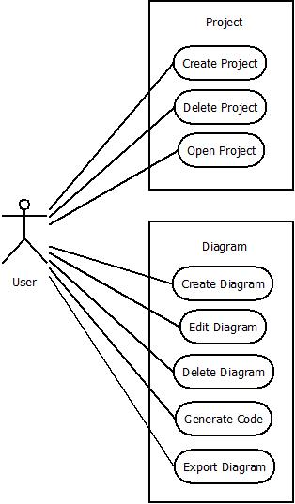
Use Case Diagram

Slide 9
Expanded Use Case: Create Diagram
Actor:User | System: GED
 | 0) The GED displays the project
1) TUCBW: User presses the create diagram button, then select a location on the canvas. | 2) System prompts the user for the diagram name in a dialog box.
3) User enters the diagram name and presses the save button. | *4) System creates a new diagram, saves the diagram, and presents the new diagram to the user on the canvas.
5) TUCEW: User sees the new diagram on the canvas.

Slide 10
Expanded Use Case: Edit Diagram
Actor:User | System: GED
 | 0) The GED displays the diagram
1) TUCBW: User selects the existing diagram on the canvas. | 2) System highlights the selected element(s) on the diagram.
3) User makes changes to the selected element(s). | *4) System performs the operation on the element(s), and displays the updated diagram to the user.
5) TUCEW: User sees the change on the diagram.

Slide 11
Domain Modeling

Slide 12
Brainstorming & Classification
Description:
A UML Class Diagram contains classes and relationships. A class contains the class name and either zero or more attributes and methods. An attribute contains the attribute name and datatype. Methods are a part of a class which contains the method name, parameters, and datatypes. A relationship connects two or more classes together. The types of relationship are association, inheritance, aggregation, multiplicity values, and labels. An association class is a class and is part of an association relationship.
Classification Key:
Noun/Noun Phrase “X of Y” expression Transitive Verbs Adjective/Adverb/Enumeration Numeric Possession expression Consists of/part of/composed of Containment/containing expression “X is Y” or generalization

Slide 13
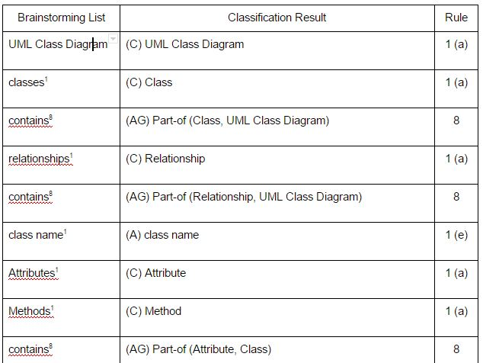
Brainstorming & Classification

Slide 14
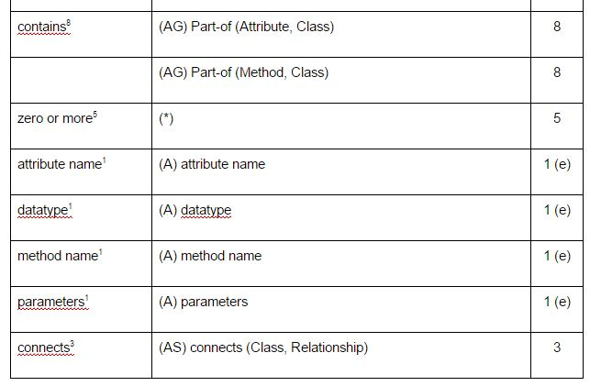
Brainstorming & Classification

Slide 15
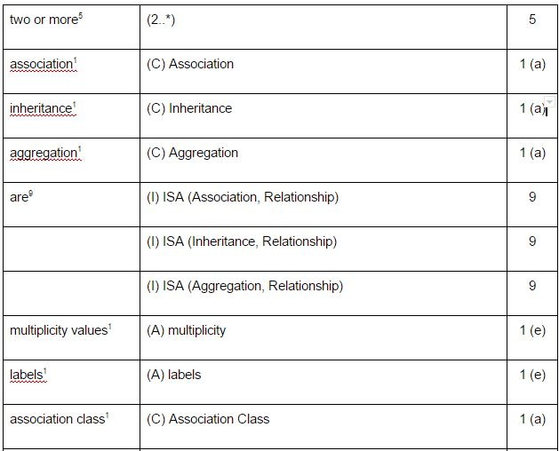
Brainstorming & Classification

Slide 16
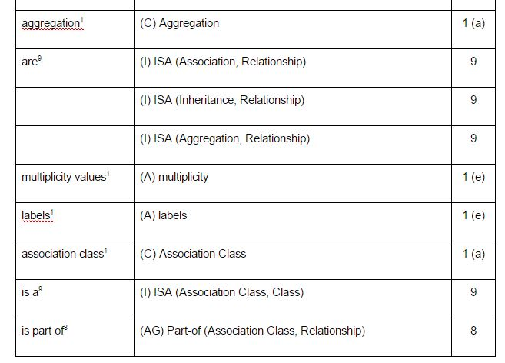
Brainstorming & Classification

Slide 17
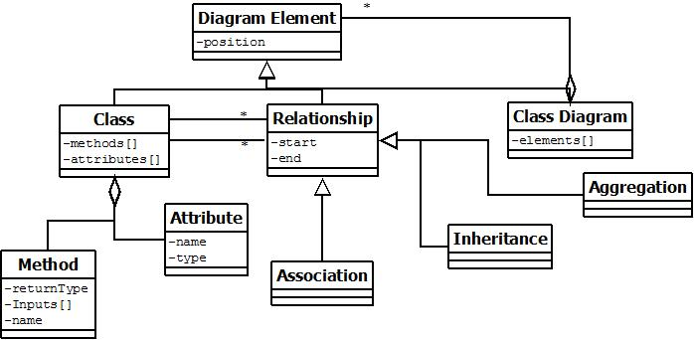
Domain Model Class Diagram
Notes:
Attributes have been added. Let me know if I need to make any adjustments

Slide 18
Object Interaction Modeling

Slide 19
Create Diagram Scenario
3 User enters the diagram name in the CreateDiagramGUI then selects the submit button
4.1 CreateDiagramGUI sends the diagram name to CreateDiagramController
4.2 CreateDiagramController creates diagram from the CreateDiagramFactory
4.3 CreateDiagramFactory creates the Diagram
4.4 CreateDiagramController sets diagram name of the Diagram
4.5 CreateDiagramController saves Diagram in the FileManager
4.6 FileManager saves Diagram in the FileManagerInterface
4.7 CreateDiagramController draws the Diagram
subject
subject action
object acted on
data/objects required for subject action

Slide 20
Create Diagram Scenario Table
# | Subject | Subject Action | Object Acted On | Other Data/Objects
3 | User | enters | CreateDiagramGUI | diagram name
4.1 | CreateDiagramGUI | sends | CreateDiagramController | diagram name
4.2 | CreateDiagramController | creates | CreateDiagramFactory
4.3 | CreateDiagramFactory | creates | Diagram
4.4 | CreateDiagramController | set | Diagram | cname
4.5 | CreateDiagramController | saves | FileManager | Diagram
4.6 | FileManager | saves | FileManagerInterface | Diagram
4.7 | CreateDiagramController | draw | Diagram

Slide 21
Edit Diagram Scenario
3 User selects the desired operation the EditDiagramGUI then selects the confirm button.
4.1 EditDiagramGUI edits operation to EditDiagramController
4.2 EditDiagramController sets the edit command in Diagram using the operation
4.3 Diagram creates the EditCommandInterface using the operation
4.4 EditDiagramController edits in the Diagram
4.5 Diagram executes the EditCommandInterface
4.6 Diagram gets the results of EditCommandInterface
4.7 EditDiagramController draws the Diagram
subject
subject action
object acted on
data/objects required for subject action

Slide 22
Edit Diagram Scenario Table
# | Subject | Subject Action | Object Acted On | Other Data/Objects
3 | User | selects | EditDiagramGUI | operation
4.1 | EditDiagramGUI | edits | EditDiagramController | operation
4.2 | EditDiagramController | set | Diagram | operation
4.3 | Diagram | create | EditCommandInterface | operation
4.4 | EditDiagramController | edits | Diagram
4.5 | Diagram | execute | EditCommandInterface
4.6 | Diagram | get | EditCommandInterface | Result
4.7 | EditDiagramController | draw | Diagram

Slide 23
Sequence Diagrams

Slide 24
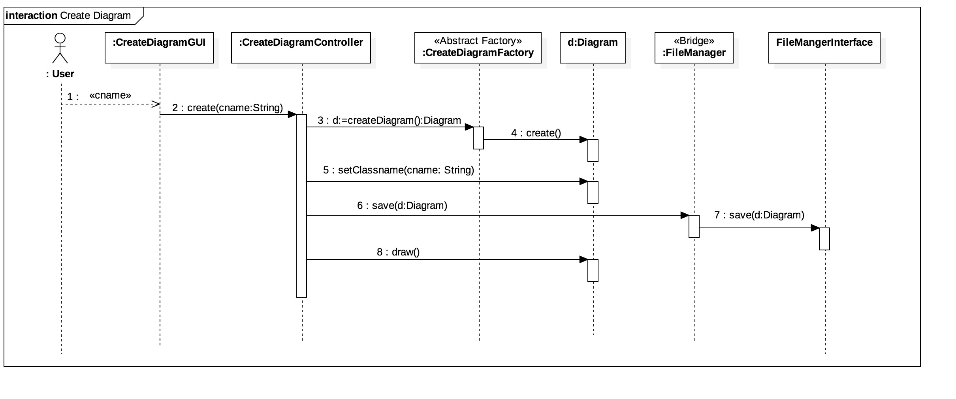
Create Diagram Sequence Diagram

Slide 25
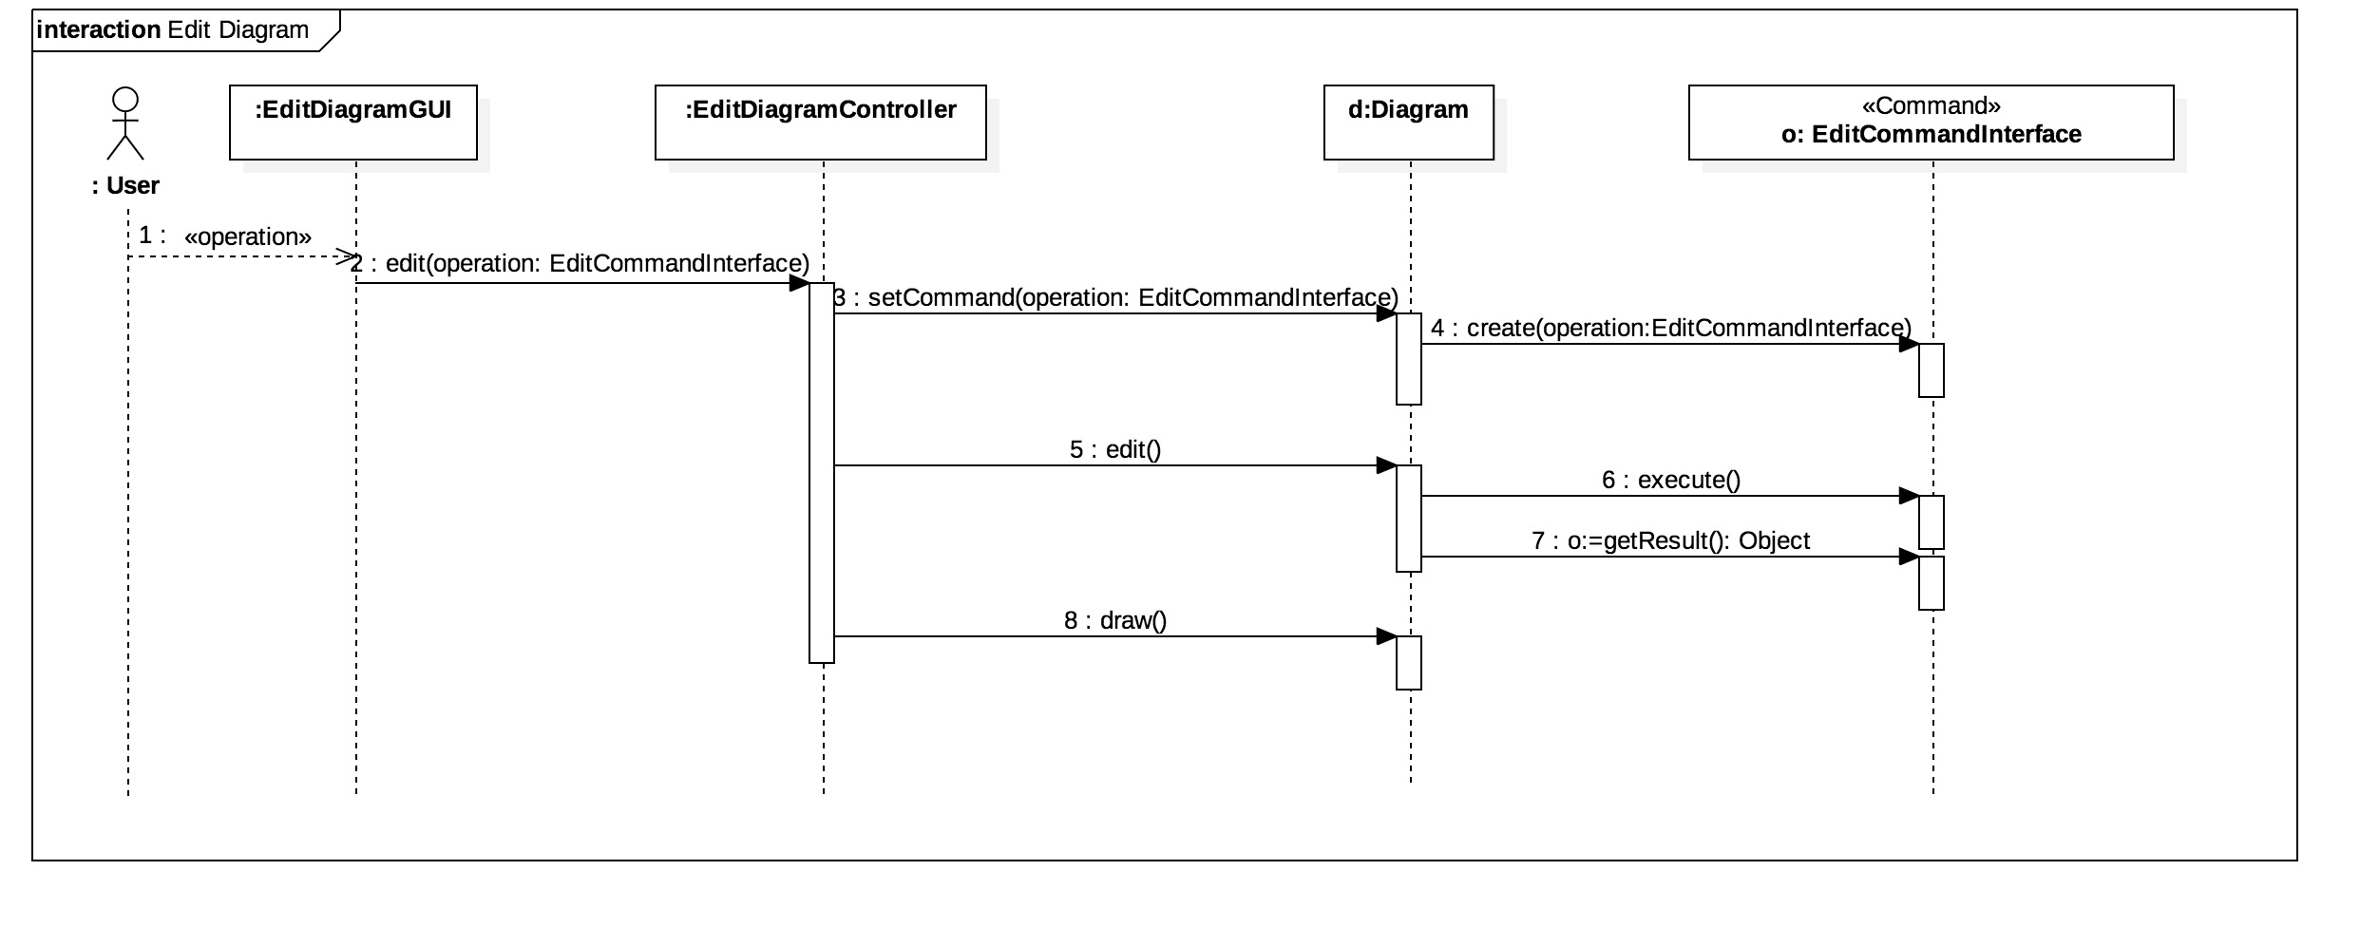
Edit Diagram Sequence Diagram
Notes:
Change Strategy to Command

Slide 26
Design Class Diagram

Slide 27
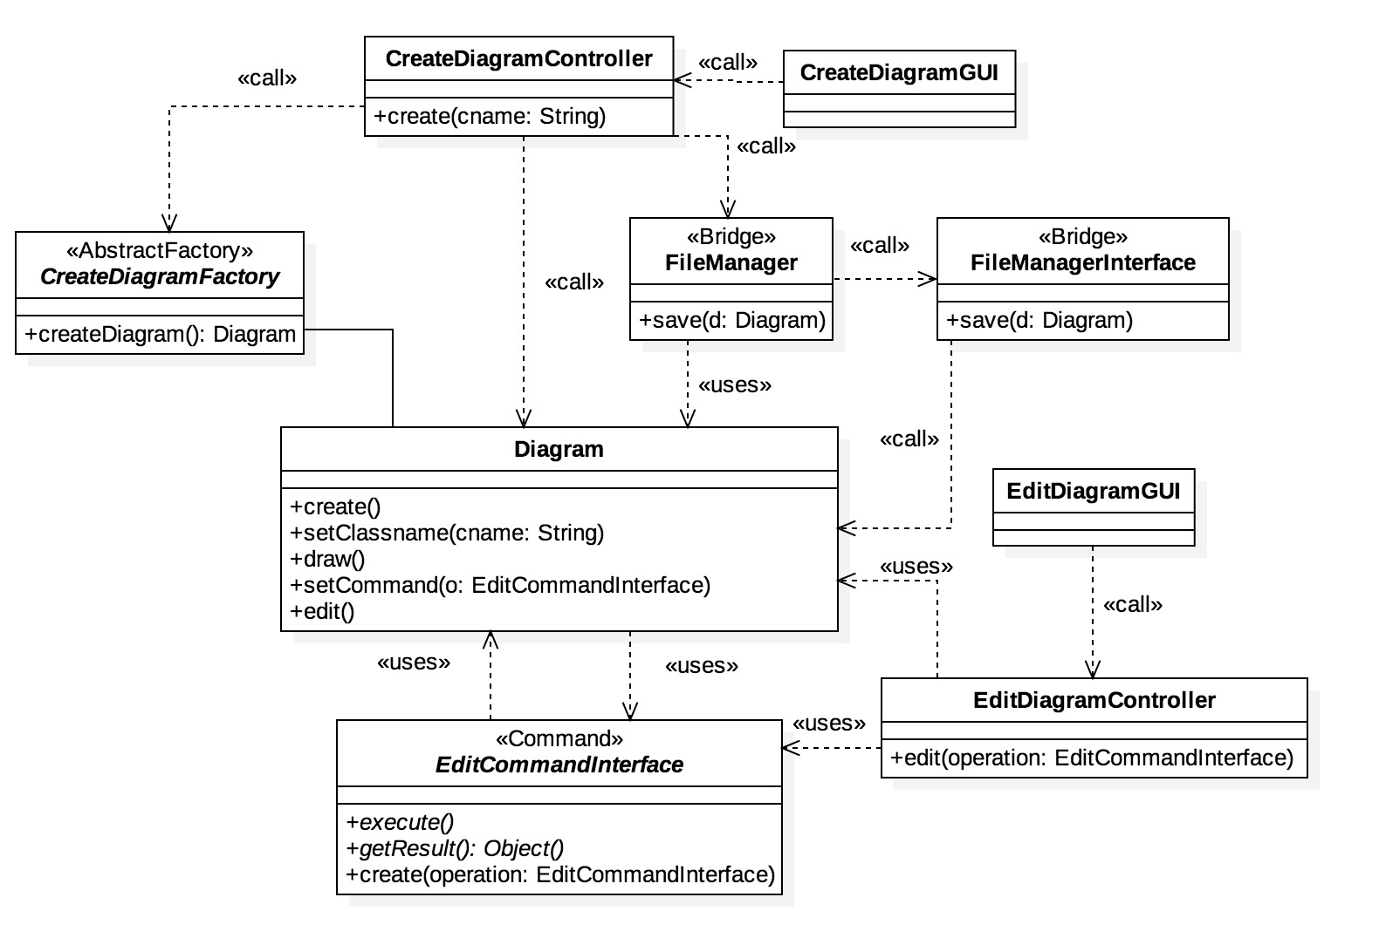
Design Class Diagram Updated
Notes:
Change Strategy to Command

Slide 28
Applying Patterns

Slide 29
Patterns
PATTERN | PROBLEM | USAGE
Expert | Stores information | Edit use case
Controller | Handles a use case request | Edit & Create use case
Command | Queue, redo, and undo edits | Edit use case
Abstract Factory | Create diagrams in different versions of UML | Create use case
Bridge | Saving files on different operating systems | Create use case
Iterator | Traversing the Diagram Element object | Used along with Command pattern
Composite | Store and manipulate multiple objects of a single type | Simplify actions between objects
Strategy | Different layouts of diagram elements on the canvas | Function of the diagram editor
Notes:
Add more detail on what problem the patterns fix

Slide 30
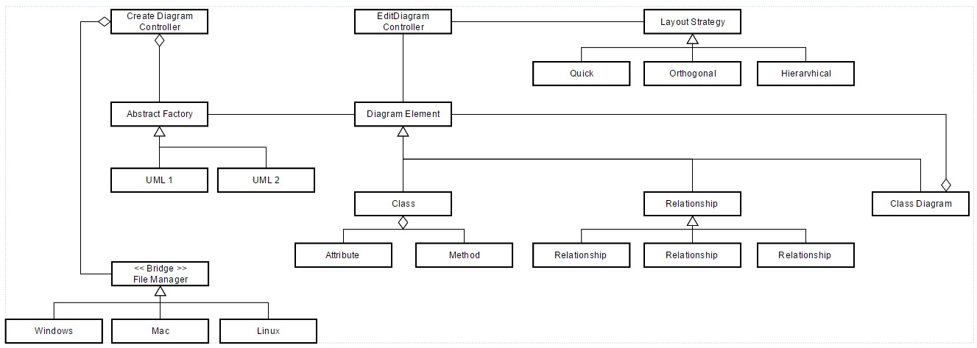
System Interaction

