Slide 1
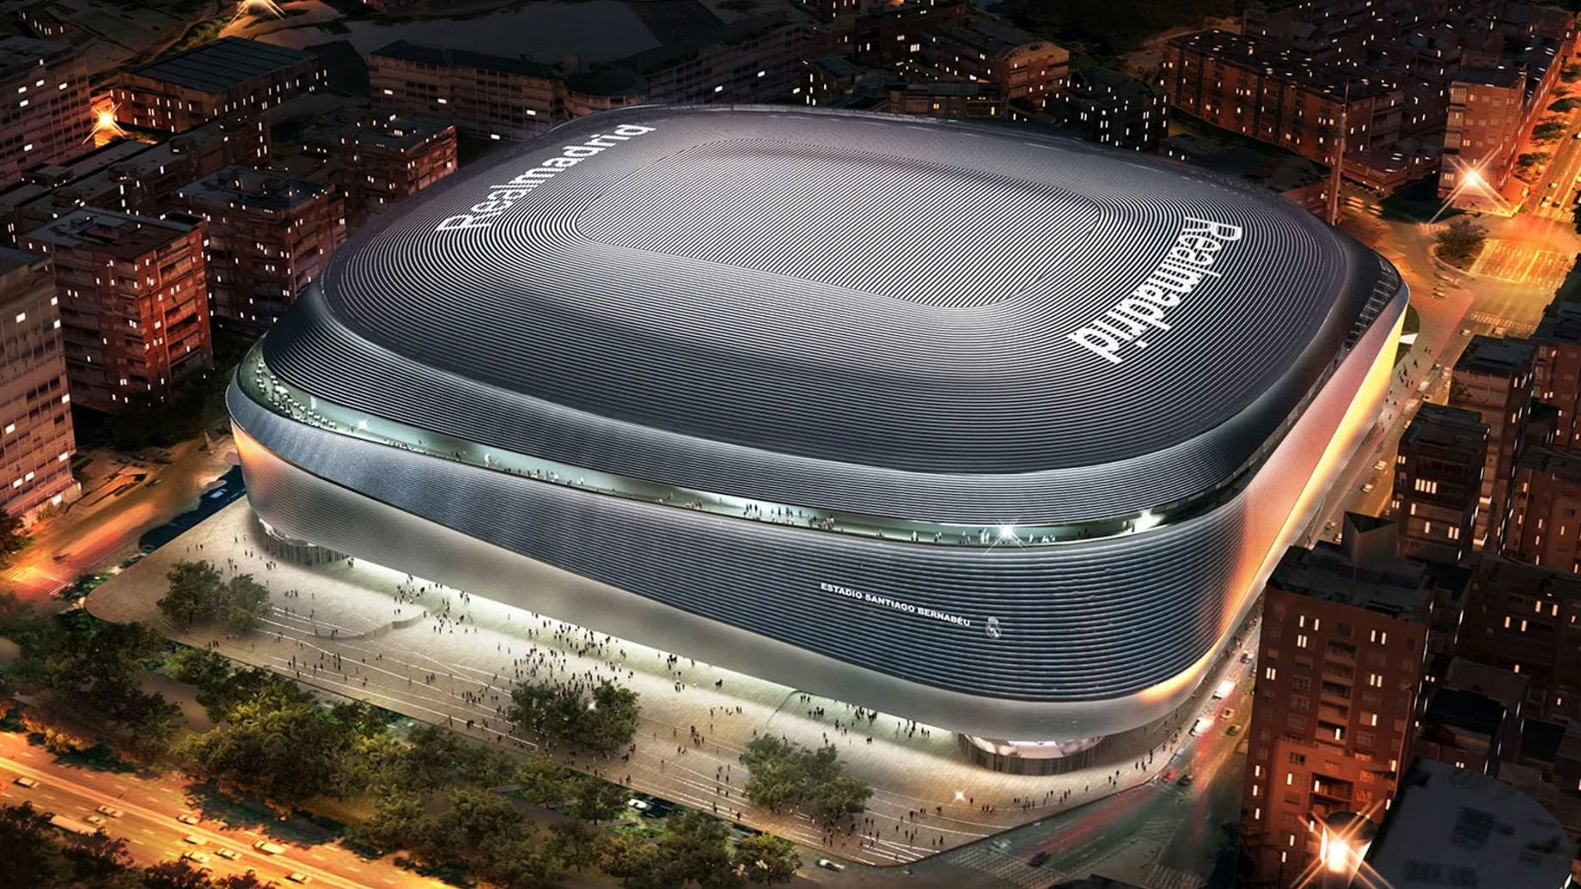
Smart Stadium Experience Enhancement System
MSc Cloud Computing
Fog and Edge Computing
John Joy Kandamkulathy
x24202321

Slide 2

Objective
Modern stadiums host tens of thousands of occupants simultaneously
Real-time crowd management, environmental monitoring and service delivery require instant data processing
High-frequency sensor data from hundreds of devices generates significant bandwidth overhead

Slide 3
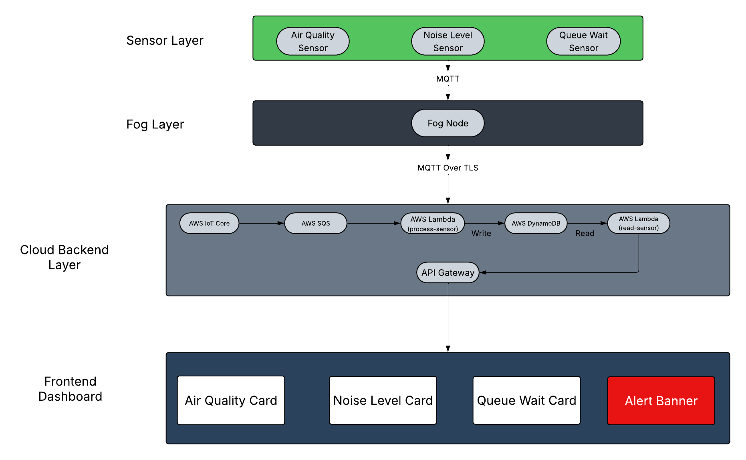
System architecture

Slide 4
System architecture
Sensor Layer
3 mock IoT sensors generating live data
Air quality, noise level, concession queue wait time
Publish via MQTT to local broker every 2–5 seconds
Fog Layer
Virtual fog node subscribes to all sensor topics
Aggregates and processes data locally every 10 seconds
Dispatches enriched payload to AWS IoT Core over MQTT/TLS
Cloud Backend Layer
AWS IoT Core → SQS → Lambda → DynamoDB → API Gateway
Fully serverless, event-driven, auto-scaling pipeline
React dashboard polls API every 5 seconds

Slide 5
Sensor Layer
Air Quality Sensor Simulates data that may come from sensors like Sensirion SCD40 CO2 and particulate sensor Metrics: CO2 ppm, PM2.5, humidity, air quality index Publishes every 4 seconds to stadium/sensors/air_quality Co2 < 800 and PM25 <35 - Good Co2 < 1200 and PM25 <75 - moderate Co2 < 1600 and PM25 <115 - poor | Noise Level Sensor Simulates a digital sound level meter like Cirrus CR:162B Metrics: average dB, peak dB, category (quiet/normal/loud/very loud) Publishes every 3 seconds to stadium/sensors/noise_level Decibel < 60 - Quiet Decibel < 85 - Normal Decibel < 100 – Loud Anything above that is very loud | Queue Wait Sensor Simulates infrared beam counters at concession stand entrances Metrics: queue length, wait time in minutes, best stand recommendation Publishes every 5 seconds to stadium/sensors/queue_wait

Slide 6
Fog Layer
Subscribes to all 3 sensor topics via local MQTT broker
Buffers incoming readings in a thread-safe in-memory list
Every 10 seconds: processes buffer, computes aggregates, clears buffer
Publishes a single enriched payload to AWS IoT Core over MQTT/TLS
Average and peak decibel calculation for noise
Average CO2 and PM2.5 for air quality
Best stand identification and wait time averaging for queues
Alert flag derivation based on threshold logic

Slide 7
Cloud Backend
AWS IoT Core
Amazon SQS
AWS Lambda
Amazon DynamoDB
Amazon API Gateway

Slide 8
Thank you!

