Slide 1
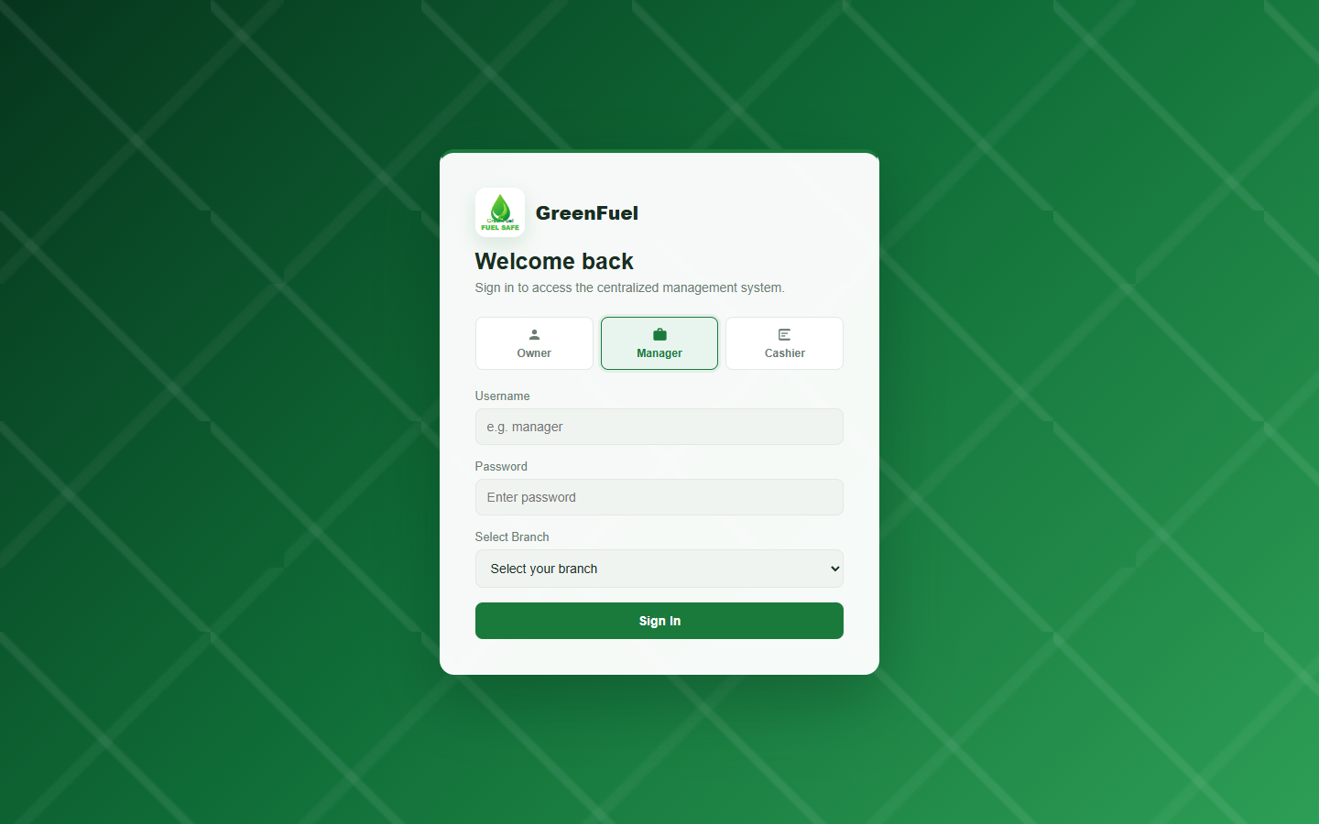
Notes:
Screenshot: Login Page
This screenshot shows the FuelSight login page where users choose their portal role. The owner can sign in without selecting a branch, while manager and cashier accounts are branch-based.
Objective/s:
Objective 2: Provide a centralized web based invoicing and sales report for Greenfuel Gas Station.
Objective 3: Develop the application software through web-based technologies such as MySQL, HTML, CSS and JavaScript.
Objective 4: Test and evaluate the developed system using ISO 25010 Software Quality Standards in terms of functionality, usability, reliability, performance efficiency, and security.

Slide 2
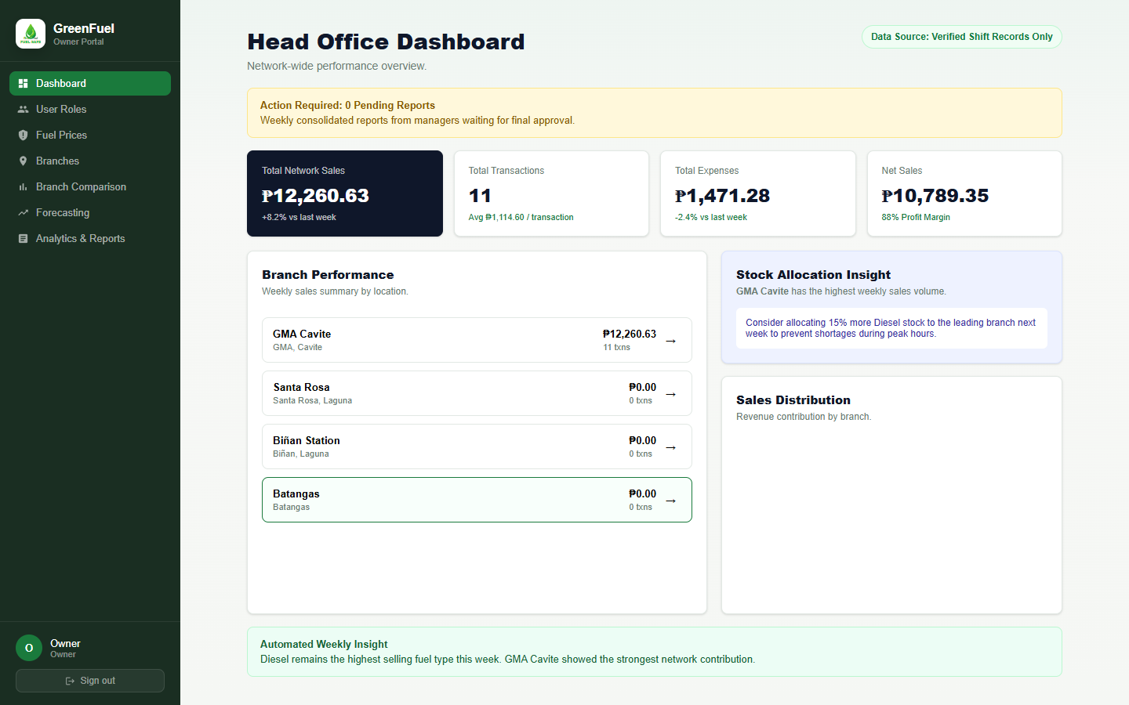
Notes:
Screenshot: Owner Dashboard
This screenshot shows the Owner Dashboard for centralized monitoring of branch sales, transactions, expenses, and branch performance.
Objective/s:
Objective 2.1: Synchronization of real-time sale information from all branches.
Objective 2.3: Sales records are monitored and analysis done graphically for sales.
Objective 2.6: Forecast and reports on branch performance.

Slide 3
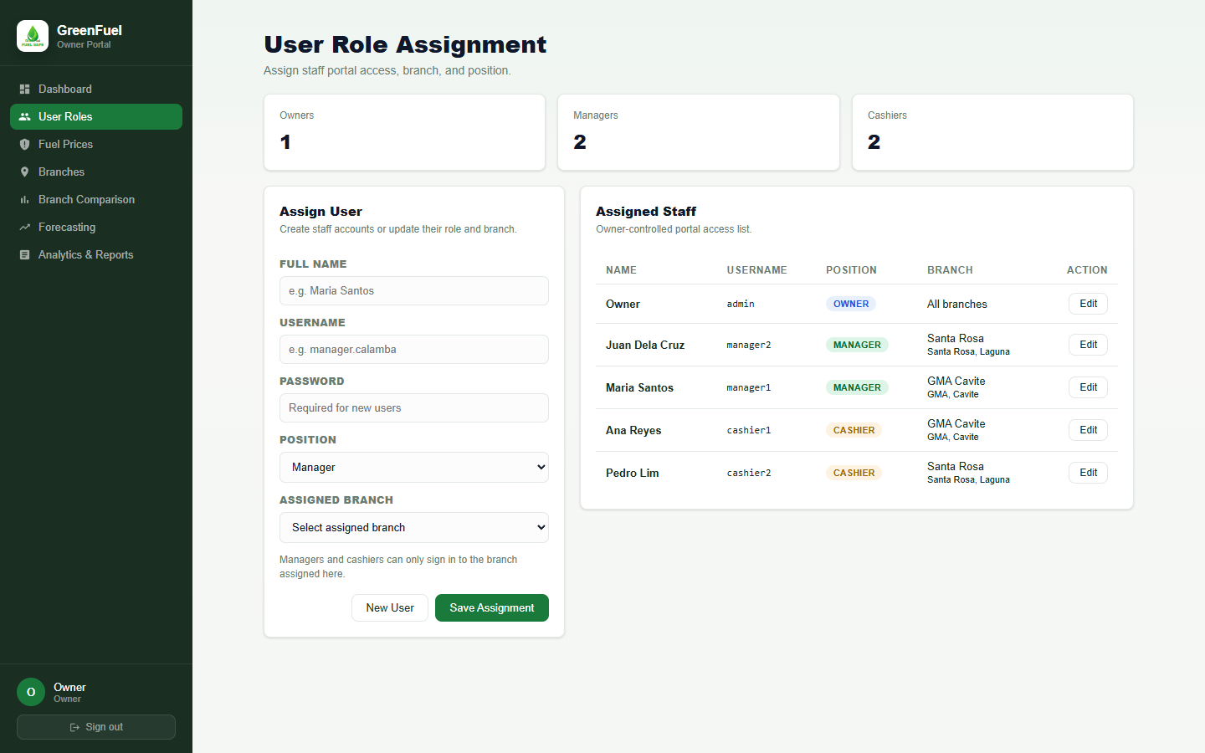
Notes:
Screenshot: Owner User Role Assignment
This screenshot shows the User Role Assignment module where the owner manages user access, roles, and branch assignments for managers and cashiers.
Objective/s:
Objective 2.4: Records audit trail log to monitor cashier transactions.
Objective 4: Test and evaluate the developed system using ISO 25010 Software Quality Standards in terms of functionality, usability, reliability, performance efficiency, and security.

Slide 4
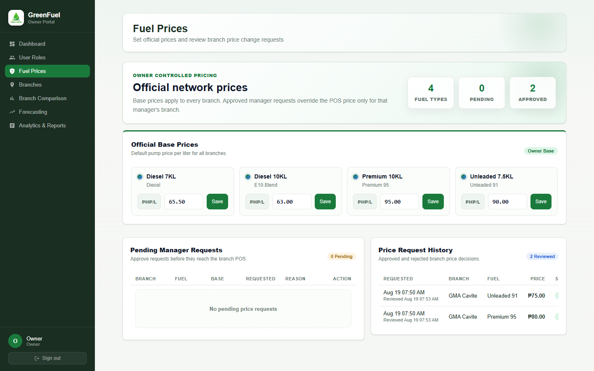
Notes:
Screenshot: Owner Fuel Prices
This screenshot shows the owner-controlled fuel pricing module where official base prices are set and manager price change requests are reviewed.
Objective/s:
Objective 2.1: Synchronization of real-time sale information from all branches.
Objective 2.4: Records audit trail log to monitor cashier transactions.
Objective 4: Test and evaluate the developed system using ISO 25010 Software Quality Standards in terms of functionality, usability, reliability, performance efficiency, and security.

Slide 5
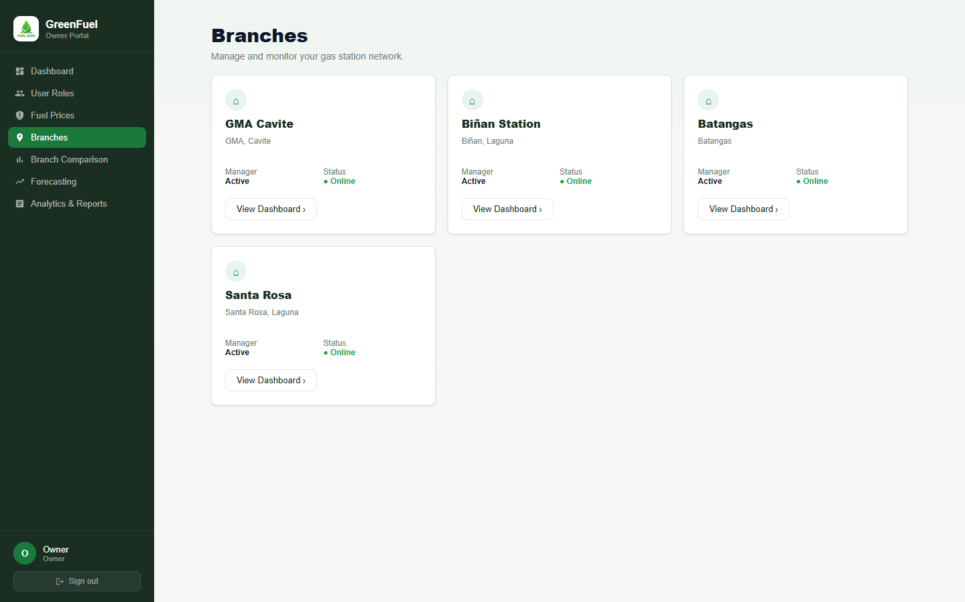
Notes:
Screenshot: Owner Branches List
This screenshot shows the Branches module where the owner can view GreenFuel branch records and open a branch dashboard for more detail.
Objective/s:
Objective 2.1: Synchronization of real-time sale information from all branches.
Objective 2.6: Forecast and reports on branch performance.

Slide 6
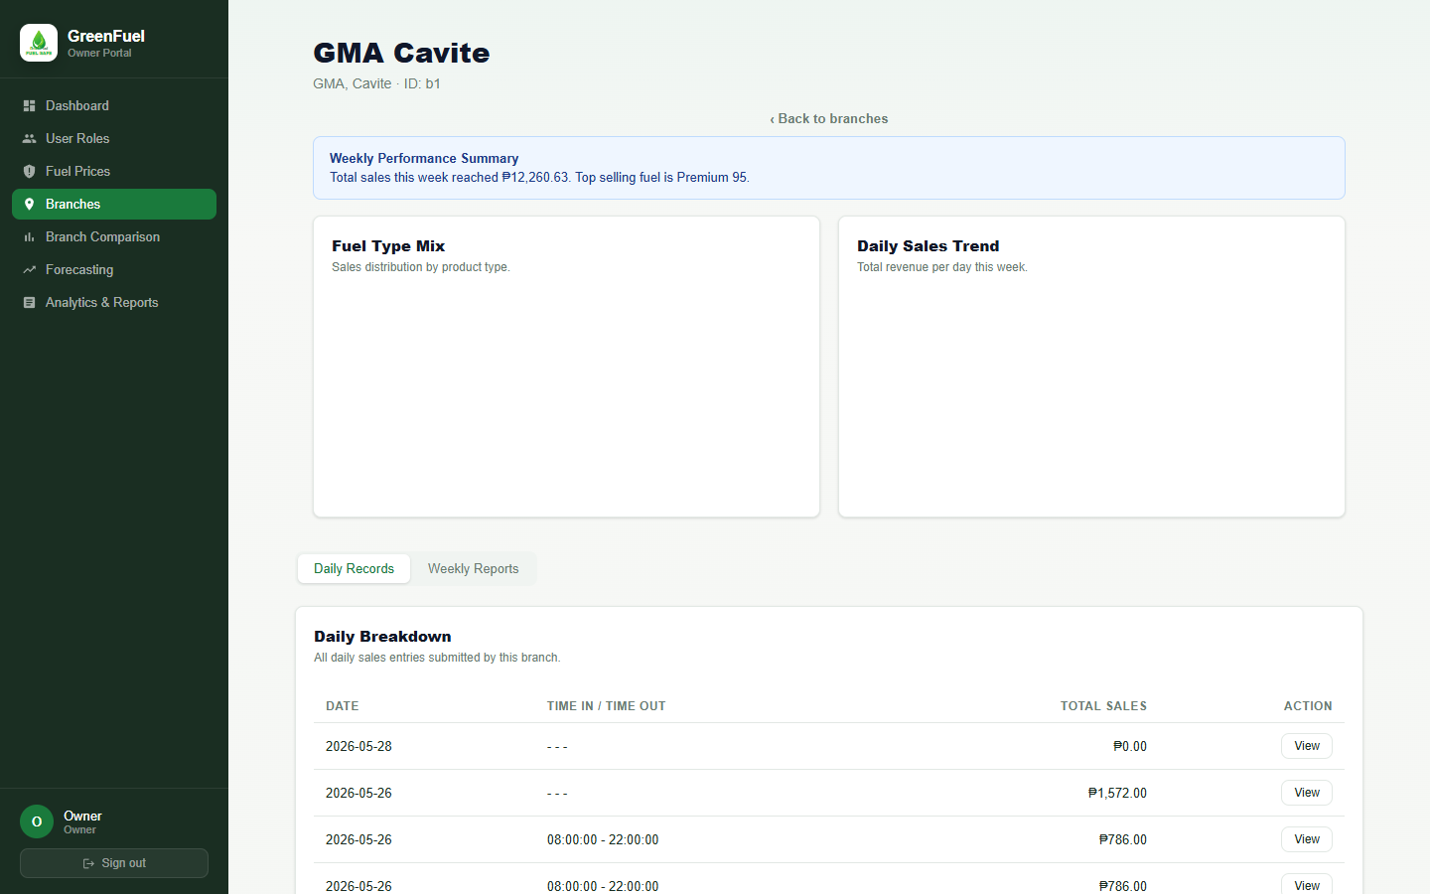
Notes:
Screenshot: Owner Branch Dashboard Daily Records
This screenshot shows the branch dashboard with branch performance information and daily records submitted by the branch manager.
Objective/s:
Objective 2.1: Synchronization of real-time sale information from all branches.
Objective 2.5: Reports can be generated on a daily or weekly basis.
Objective 2.6: Forecast and reports on branch performance.

Slide 7
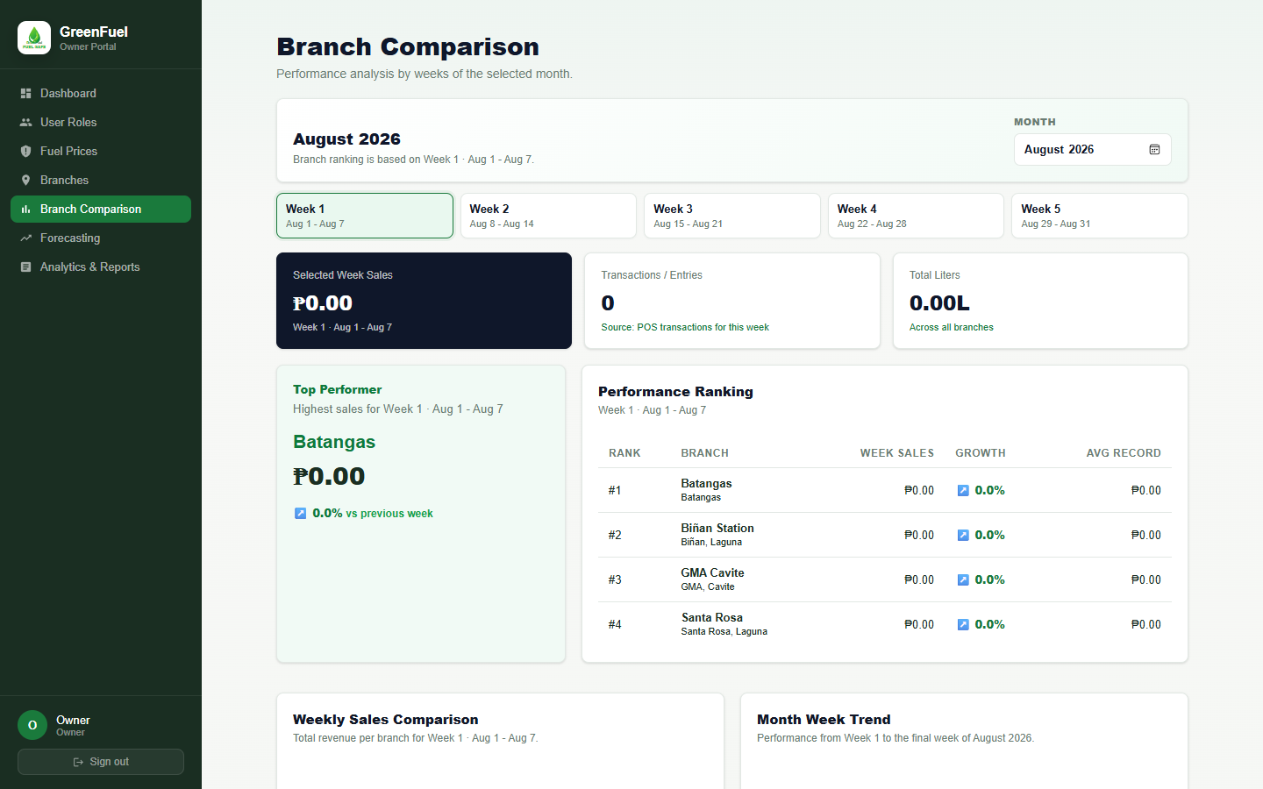
Notes:
Screenshot: Owner Branch Comparison
This screenshot shows the Branch Comparison module where branch performance is compared by weeks of the selected month.
Objective/s:
Objective 2.3: Sales records are monitored and analysis done graphically for sales.
Objective 2.6: Forecast and reports on branch performance.

Slide 8
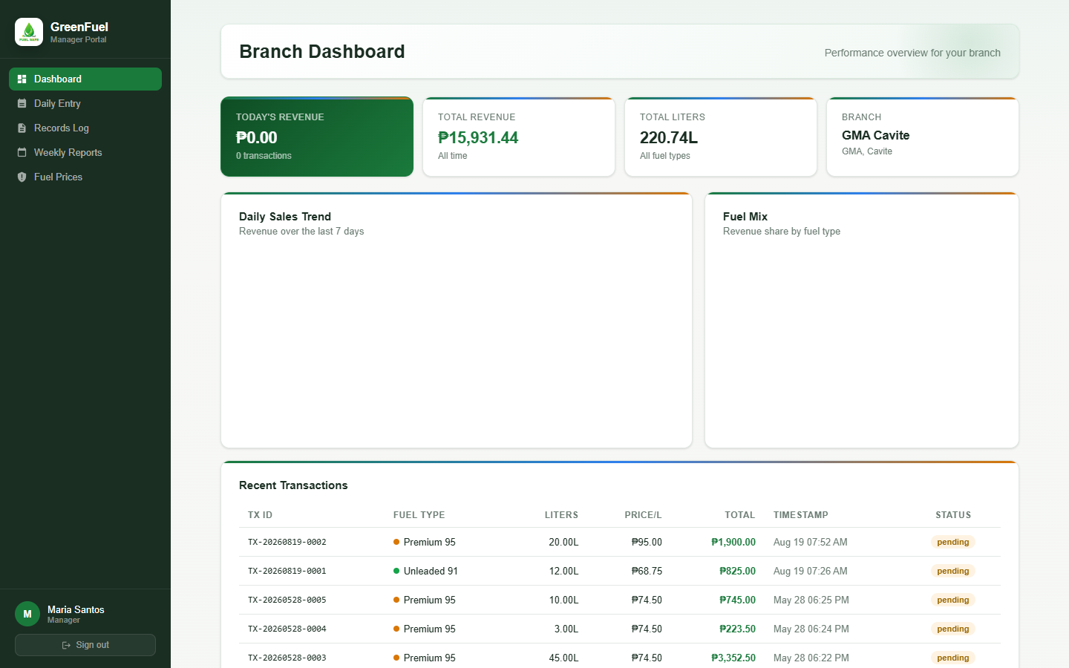
Notes:
Screenshot: Manager Dashboard
This screenshot shows the Manager Dashboard for the assigned branch, giving the branch manager access to daily records, reports, and branch-specific operations.
Objective/s:
Objective 2.1: Synchronization of real-time sale information from all branches.
Objective 2.3: Sales records are monitored and analysis done graphically for sales.
Objective 2.5: Reports can be generated on a daily or weekly basis.

Slide 9
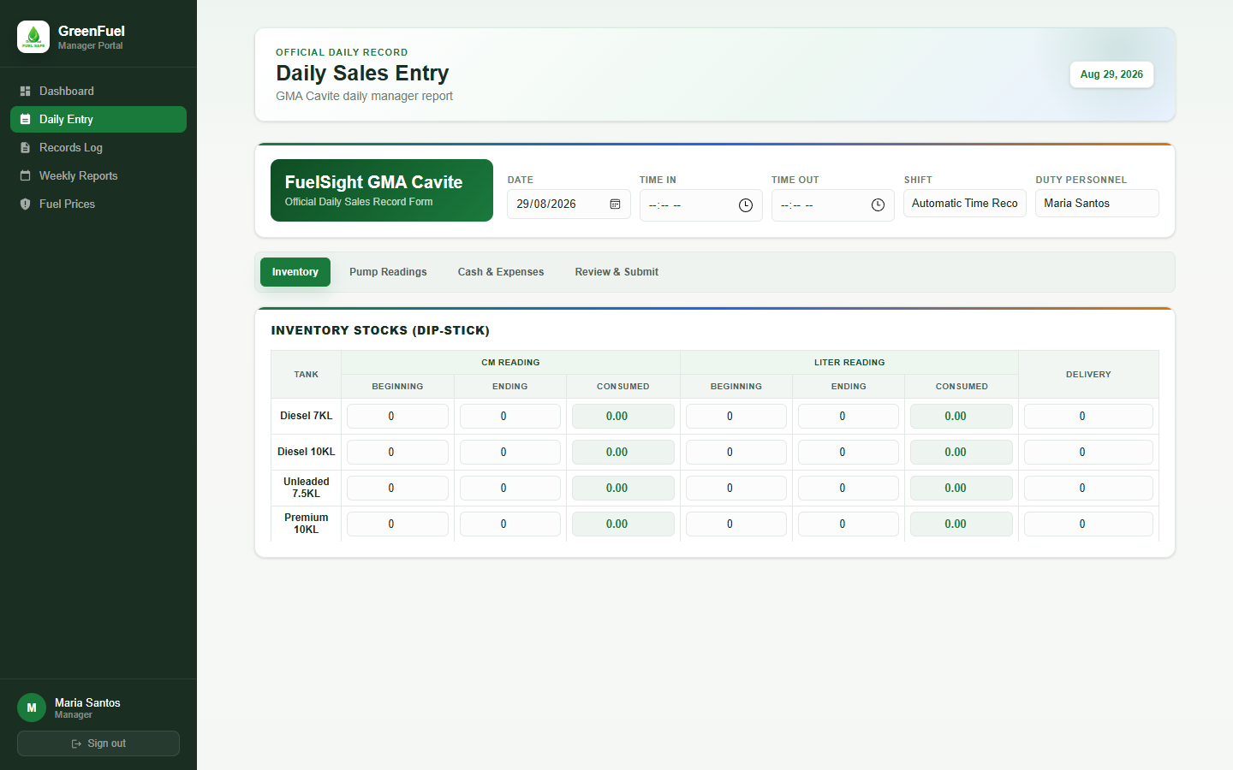
Notes:
Screenshot: Manager Daily Entry
This screenshot shows the tabbed Daily Sales Entry page used by managers for inventory, pump readings, cash and expenses, and final daily report submission.
Objective/s:
Objective 1: Identify and analyze the current process of sales reporting, invoicing and inventory monitoring carried out by Greenfuel Gas Station.
Objective 2.5: Reports can be generated on a daily or weekly basis.

Slide 10
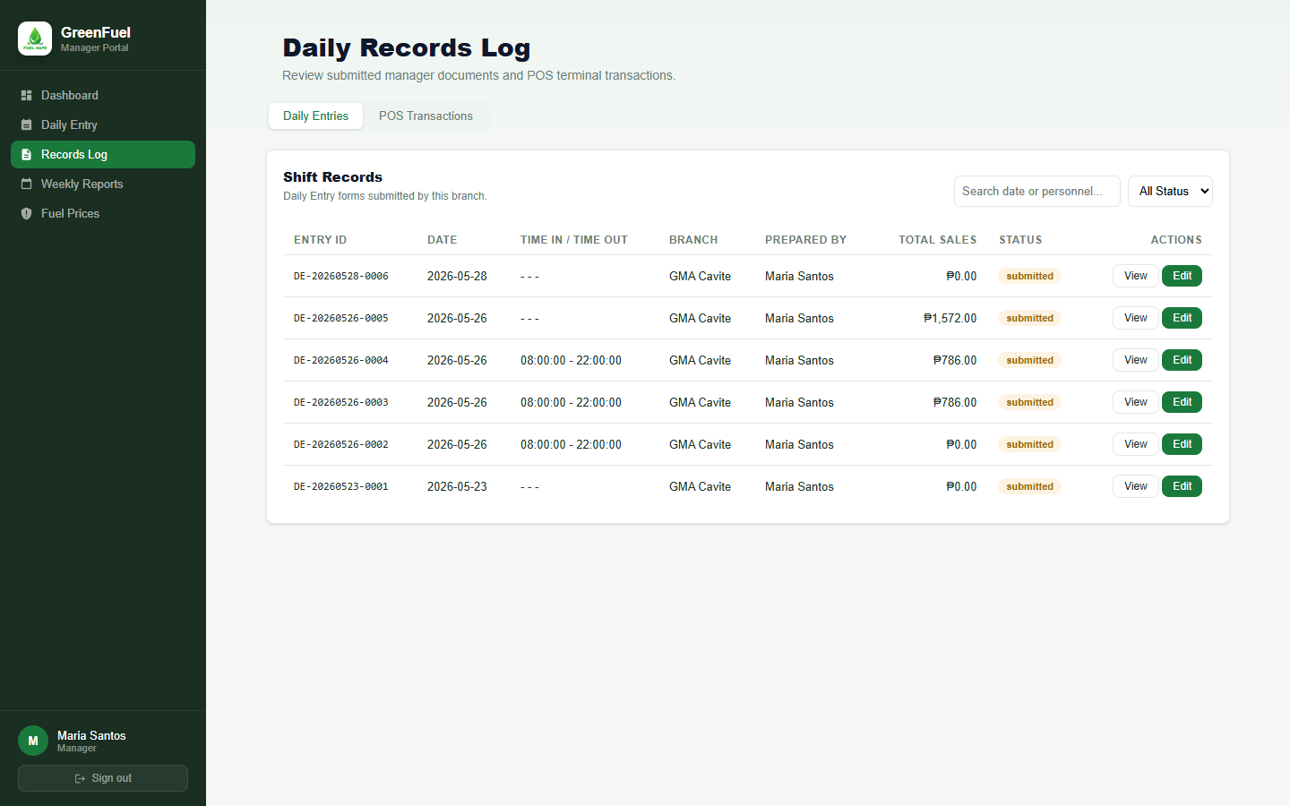
Notes:
Screenshot: Manager Daily Records Log
This screenshot shows the Records Log for submitted daily entries, including organized daily entry IDs, dates, branch information, totals, and actions.
Objective/s:
Objective 2.4: Records audit trail log to monitor cashier transactions.
Objective 2.5: Reports can be generated on a daily or weekly basis.

Slide 11
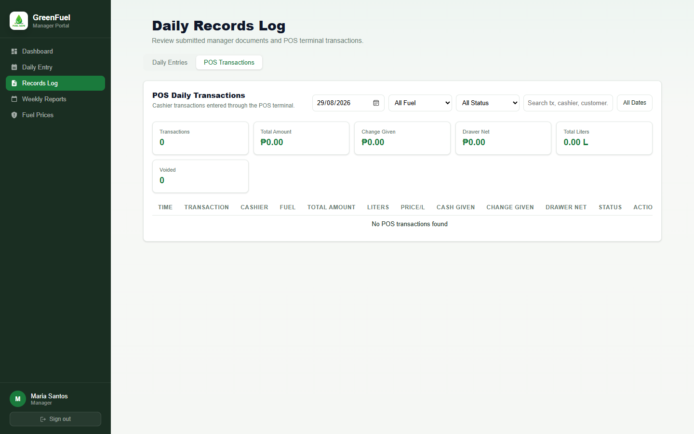
Notes:
Screenshot: Manager POS Transactions Log
This screenshot shows the POS Transactions tab where the manager can inspect cashier transactions, transaction IDs, cash data, and transaction status.
Objective/s:
Objective 2.4: Records audit trail log to monitor cashier transactions.

Slide 12
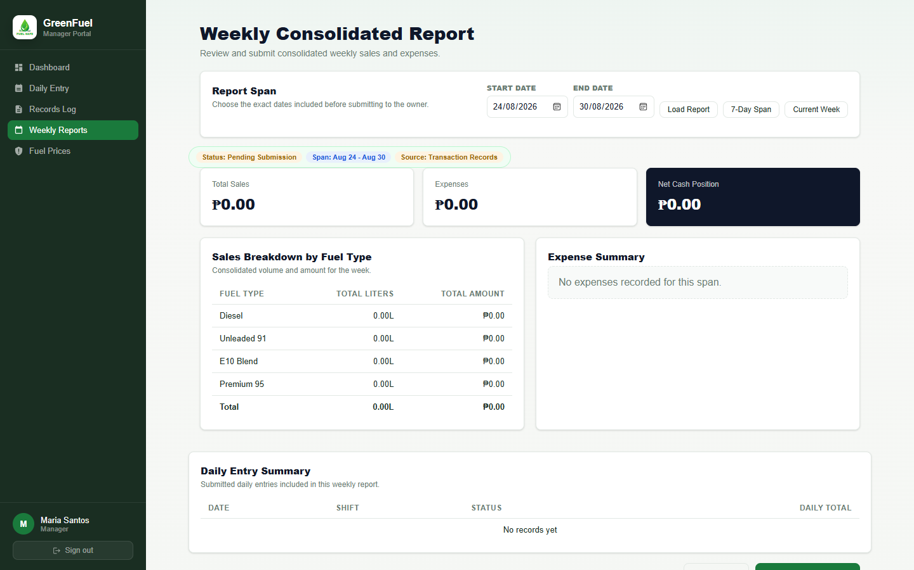
Notes:
Screenshot: Manager Weekly Reports
This screenshot shows the Weekly Consolidated Report module where managers choose a report span, review daily entry summaries, and submit weekly reports to the owner.
Objective/s:
Objective 2.5: Reports can be generated on a daily or weekly basis.
Objective 2.6: Forecast and reports on branch performance.

Slide 13
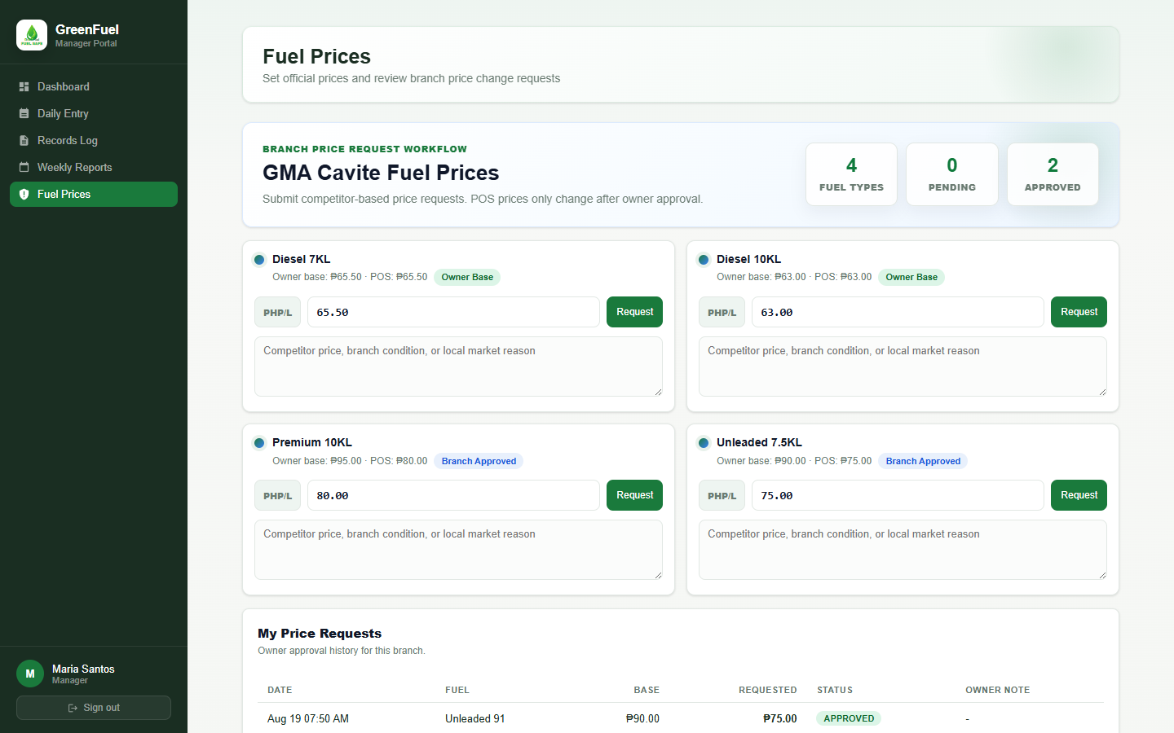
Notes:
Screenshot: Manager Fuel Price Request
This screenshot shows the manager fuel price request screen where branch managers can request branch-specific fuel price changes for owner approval.
Objective/s:
Objective 2.1: Synchronization of real-time sale information from all branches.
Objective 2.4: Records audit trail log to monitor cashier transactions.
Objective 4: Test and evaluate the developed system using ISO 25010 Software Quality Standards in terms of functionality, usability, reliability, performance efficiency, and security.

Slide 14
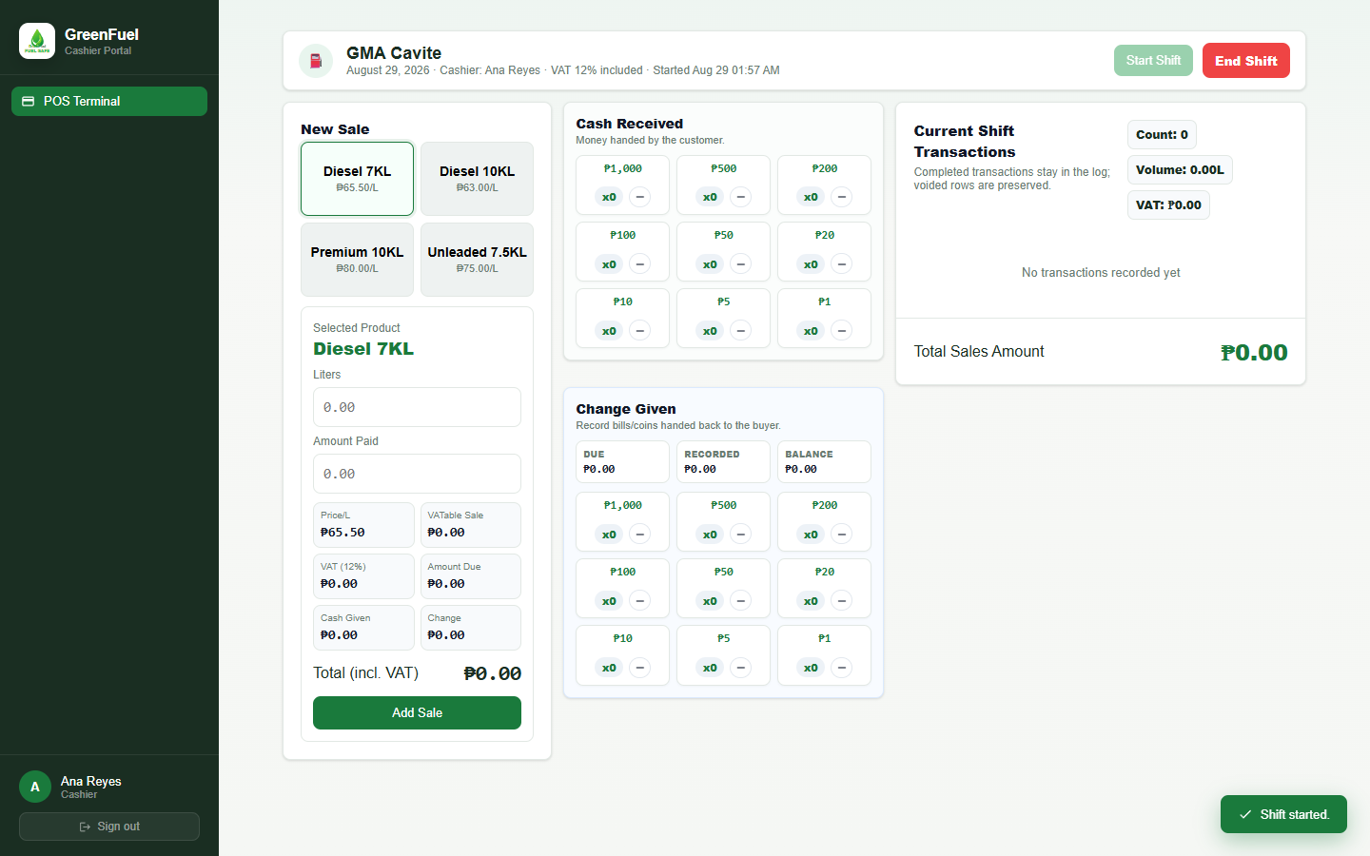
Notes:
Screenshot: Cashier POS Terminal
This screenshot shows the Cashier POS Terminal for processing fuel sales, VAT calculations, cash denominations, change given, receipt printing, transaction logging, and shift controls.
Objective/s:
Objective 2.2: Automated invoicing and receipt issuance once fuel is purchased.
Objective 2.4: Records audit trail log to monitor cashier transactions.
Objective 2.5: Reports can be generated on a daily or weekly basis.

