Slide 1
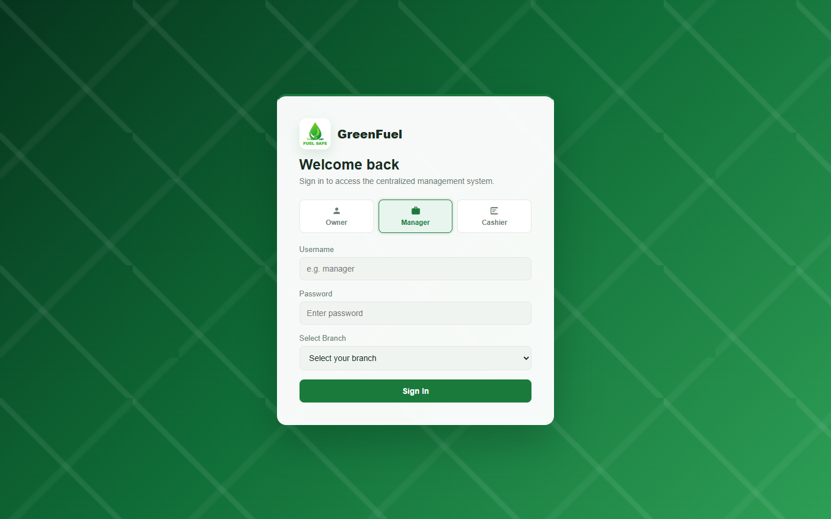
Notes:
This screenshot shows the FuelSight login page where users choose their portal role. The owner can sign in without selecting a branch, while manager and cashier accounts are branch-based. Specific objectives supported: Objective 2, Objective 3, and Objective 4.
[Sources]
Local screenshot: 01-login.png, captured from http://localhost/greenfuel-project/frontend/index.html on 2026-08-29.
Study objectives: supplied by the user in this Codex task.

Slide 2
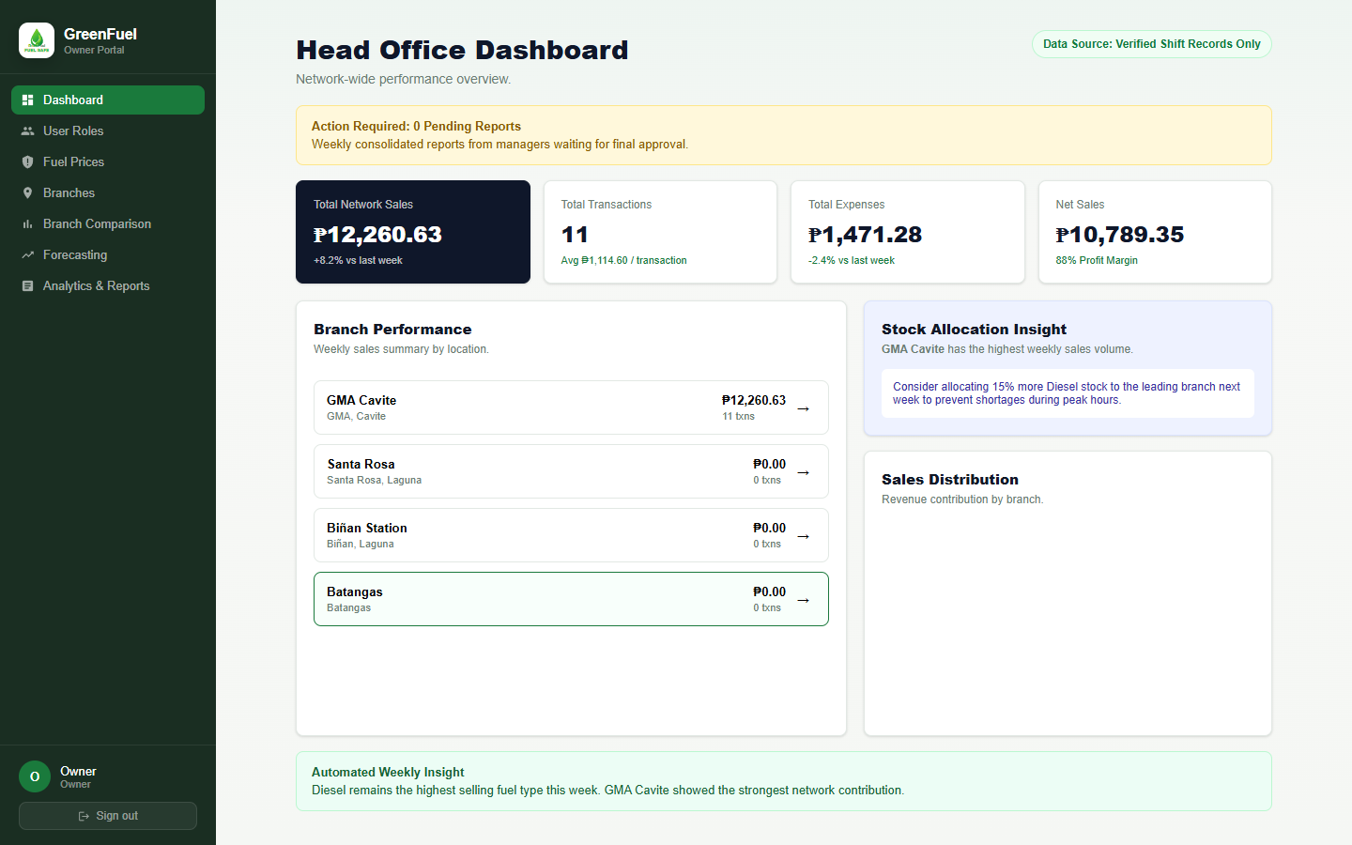
Notes:
This screenshot shows the Owner Dashboard for centralized monitoring of branch sales, transactions, expenses, and branch performance. Specific objectives supported: Objective 2.1, Objective 2.3, and Objective 2.6.
[Sources]
Local screenshot: 02-owner-dashboard.png, captured from http://localhost/greenfuel-project/frontend/index.html on 2026-08-29.
Study objectives: supplied by the user in this Codex task.

Slide 3
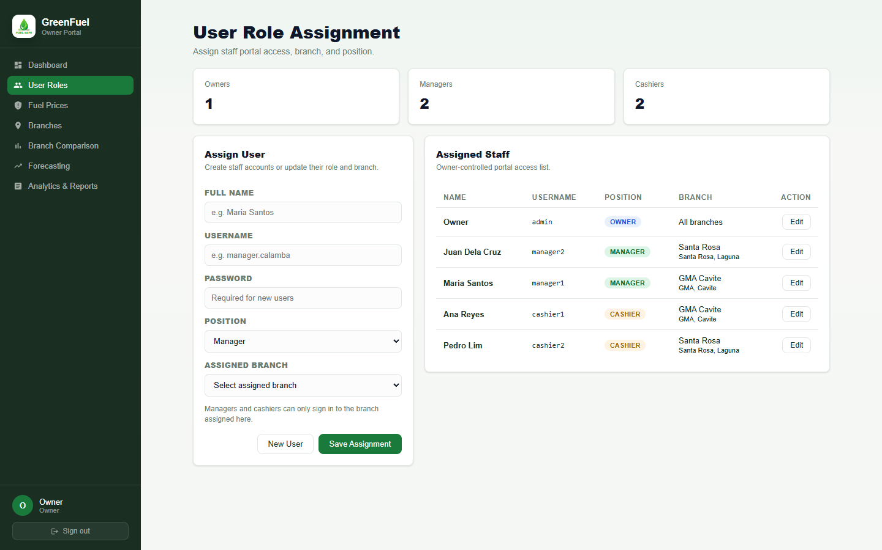
Notes:
This screenshot shows the User Role Assignment module where the owner manages user access, roles, and branch assignments for managers and cashiers. Specific objectives supported: Objective 2.4 and Objective 4.
[Sources]
Local screenshot: 03-owner-user-roles.png, captured from http://localhost/greenfuel-project/frontend/index.html on 2026-08-29.
Study objectives: supplied by the user in this Codex task.

Slide 4
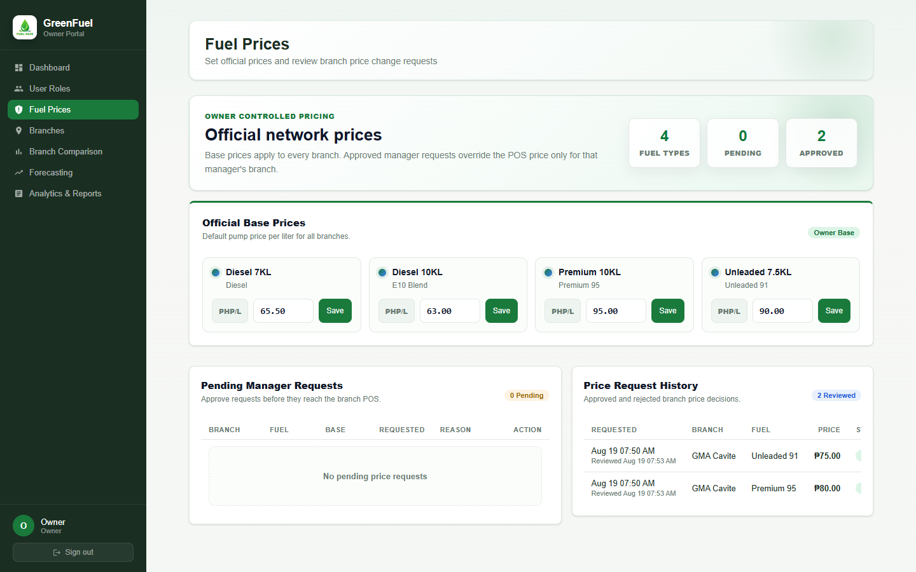
Notes:
This screenshot shows the owner-controlled fuel pricing module where official base prices are set and manager price change requests are reviewed. Specific objectives supported: Objective 2.1, Objective 2.4, and Objective 4.
[Sources]
Local screenshot: 04-owner-fuel-prices.png, captured from http://localhost/greenfuel-project/frontend/index.html on 2026-08-29.
Study objectives: supplied by the user in this Codex task.

Slide 5
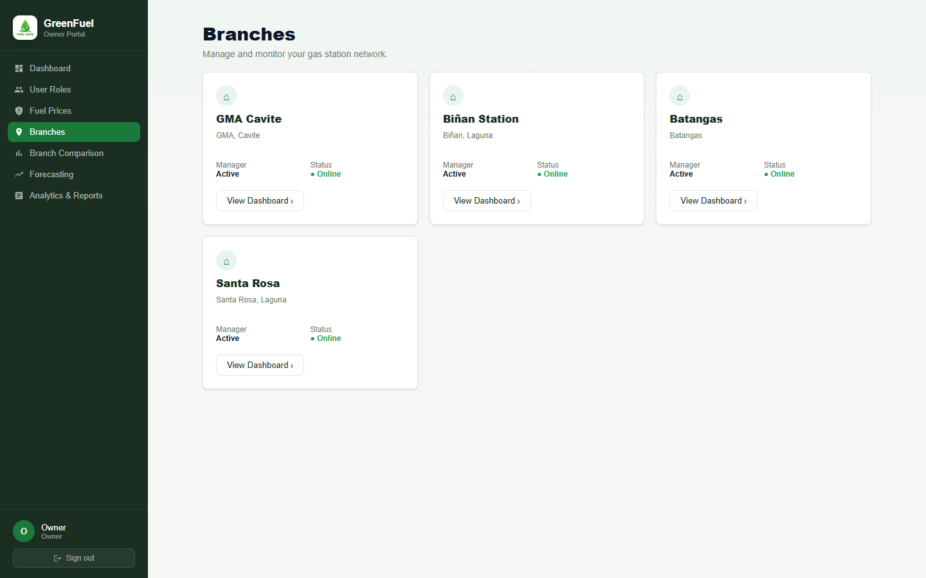
Notes:
This screenshot shows the Branches module where the owner can view GreenFuel branch records and open a branch dashboard for more detail. Specific objectives supported: Objective 2.1 and Objective 2.6.
[Sources]
Local screenshot: 05-owner-branches.png, captured from http://localhost/greenfuel-project/frontend/index.html on 2026-08-29.
Study objectives: supplied by the user in this Codex task.

Slide 6
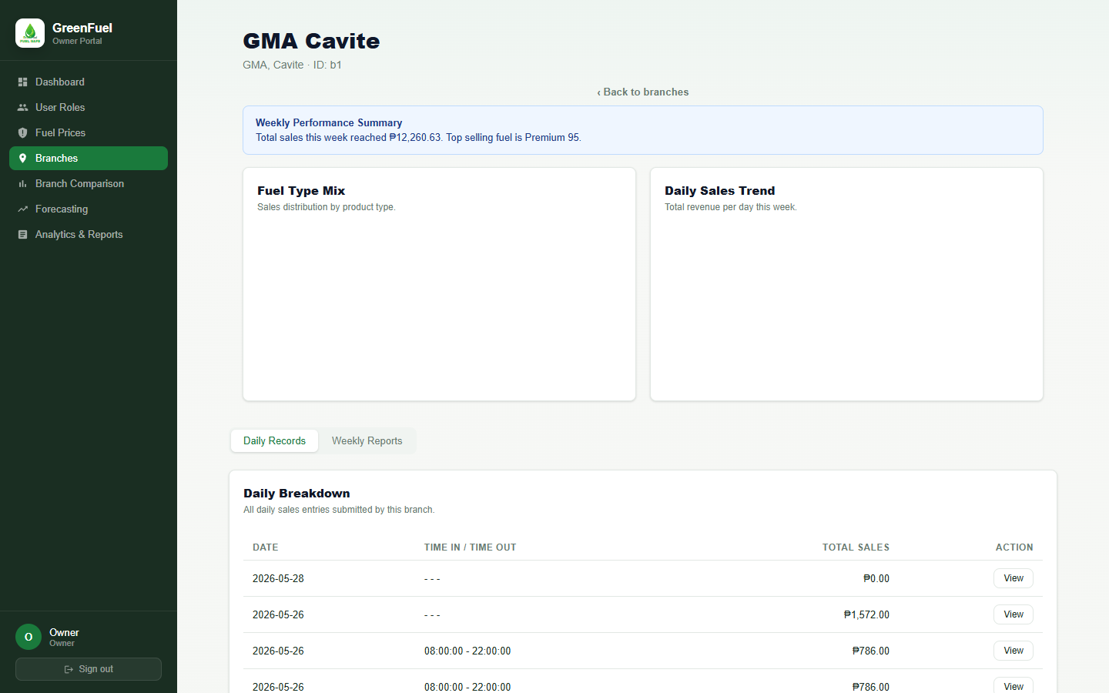
Notes:
This screenshot shows the branch dashboard with branch performance information and daily records submitted by the branch manager. Specific objectives supported: Objective 2.1, Objective 2.5, and Objective 2.6.
[Sources]
Local screenshot: 06-owner-branch-detail.png, captured from http://localhost/greenfuel-project/frontend/index.html on 2026-08-29.
Study objectives: supplied by the user in this Codex task.

Slide 7
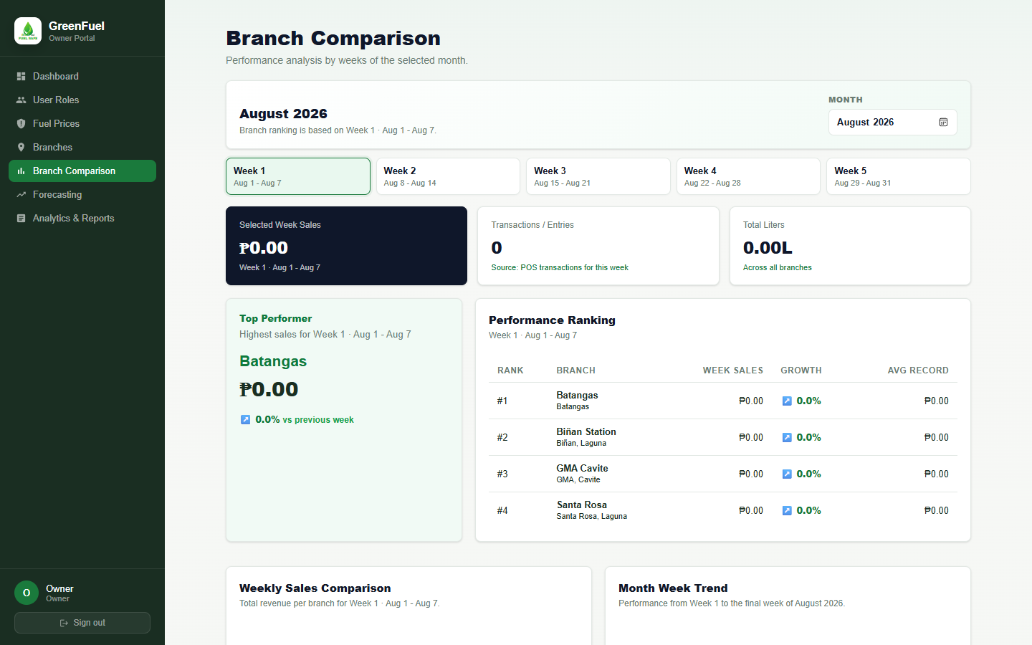
Notes:
This screenshot shows the Branch Comparison module where branch performance is compared by weeks of the selected month. Specific objectives supported: Objective 2.3 and Objective 2.6.
[Sources]
Local screenshot: 07-owner-branch-comparison.png, captured from http://localhost/greenfuel-project/frontend/index.html on 2026-08-29.
Study objectives: supplied by the user in this Codex task.

Slide 8
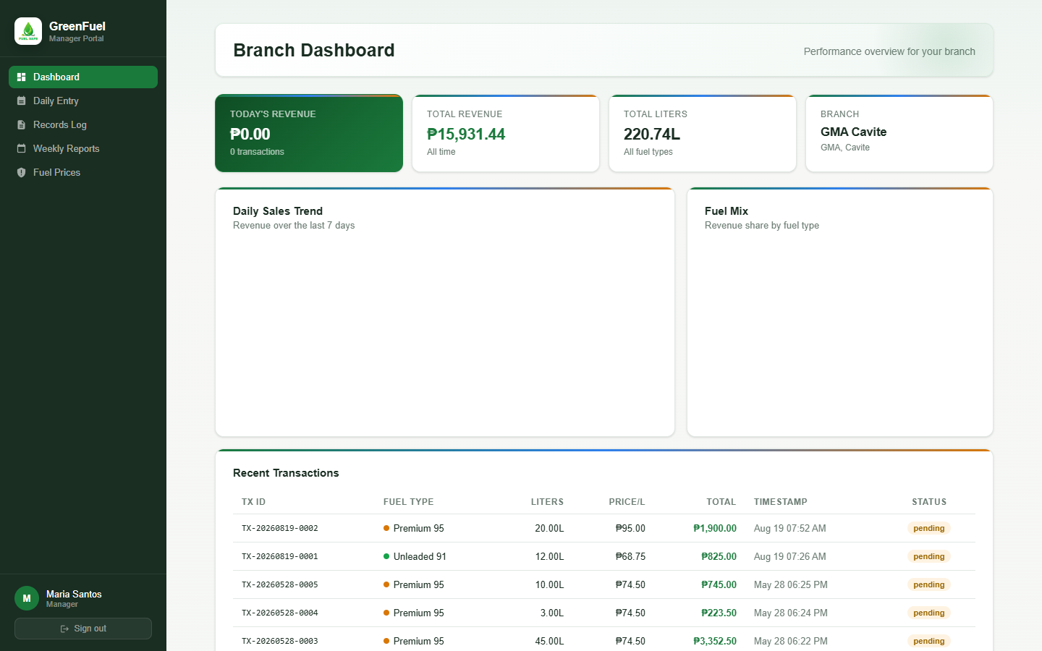
Notes:
This screenshot shows the Manager Dashboard for the assigned branch, giving the branch manager access to daily records, reports, and branch-specific operations. Specific objectives supported: Objective 2.1, Objective 2.3, and Objective 2.5.
[Sources]
Local screenshot: 08-manager-dashboard.png, captured from http://localhost/greenfuel-project/frontend/index.html on 2026-08-29.
Study objectives: supplied by the user in this Codex task.

Slide 9
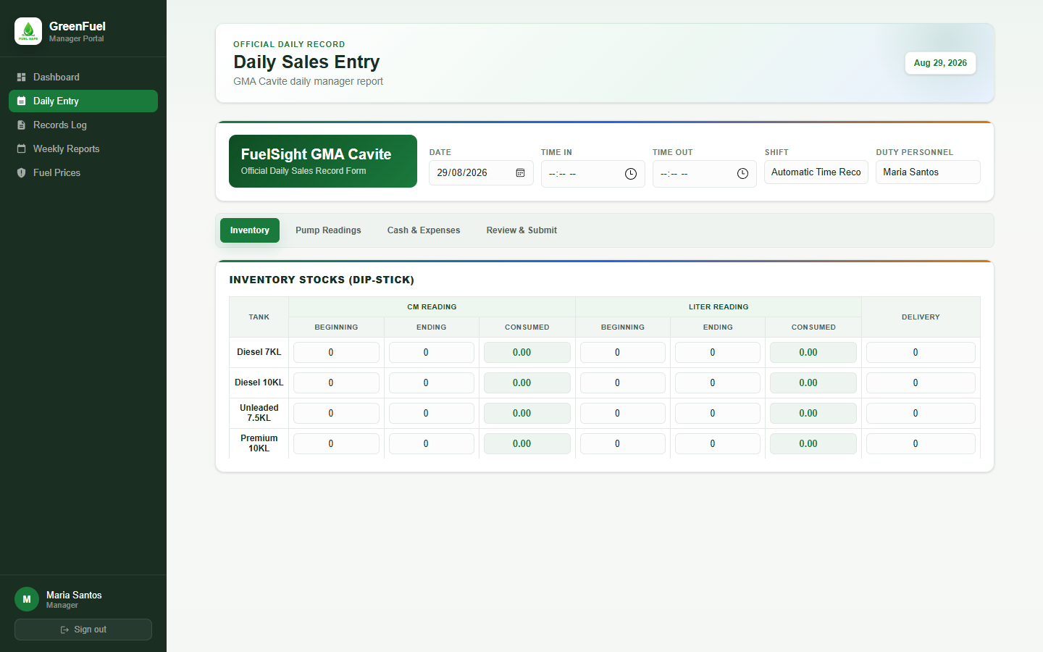
Notes:
This screenshot shows the tabbed Daily Sales Entry page used by managers for inventory, pump readings, cash and expenses, and final daily report submission. Specific objectives supported: Objective 1 and Objective 2.5.
[Sources]
Local screenshot: 09-manager-daily-entry.png, captured from http://localhost/greenfuel-project/frontend/index.html on 2026-08-29.
Study objectives: supplied by the user in this Codex task.

Slide 10
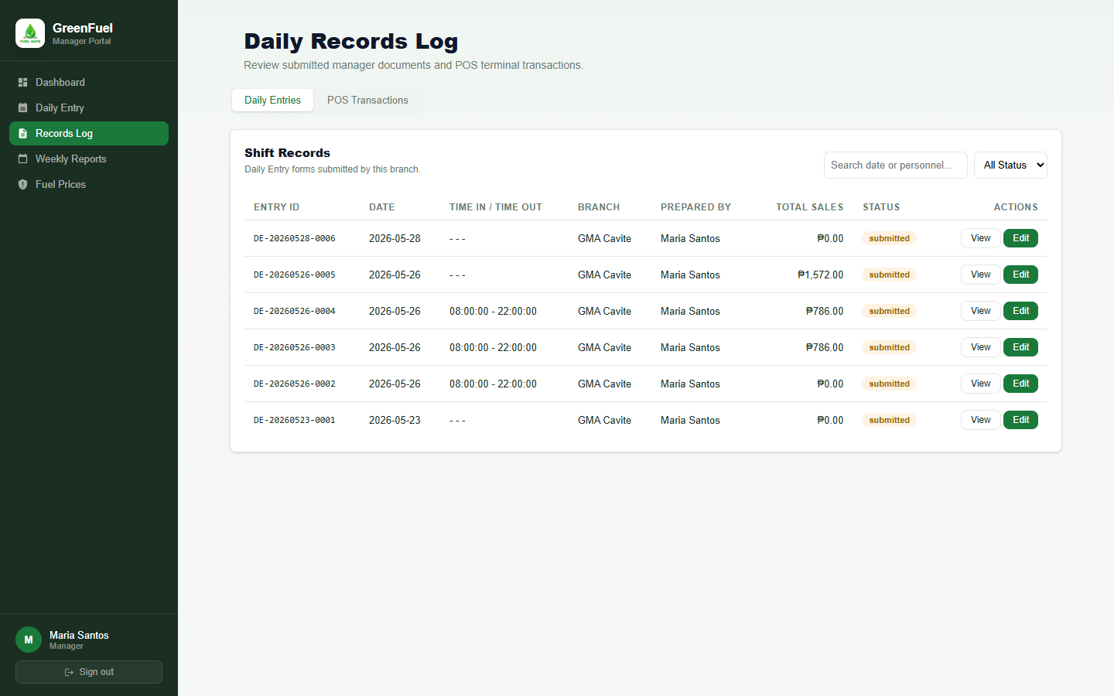
Notes:
This screenshot shows the Records Log for submitted daily entries, including organized daily entry IDs, dates, branch information, totals, and actions. Specific objectives supported: Objective 2.4 and Objective 2.5.
[Sources]
Local screenshot: 10-manager-records-log.png, captured from http://localhost/greenfuel-project/frontend/index.html on 2026-08-29.
Study objectives: supplied by the user in this Codex task.

Slide 11
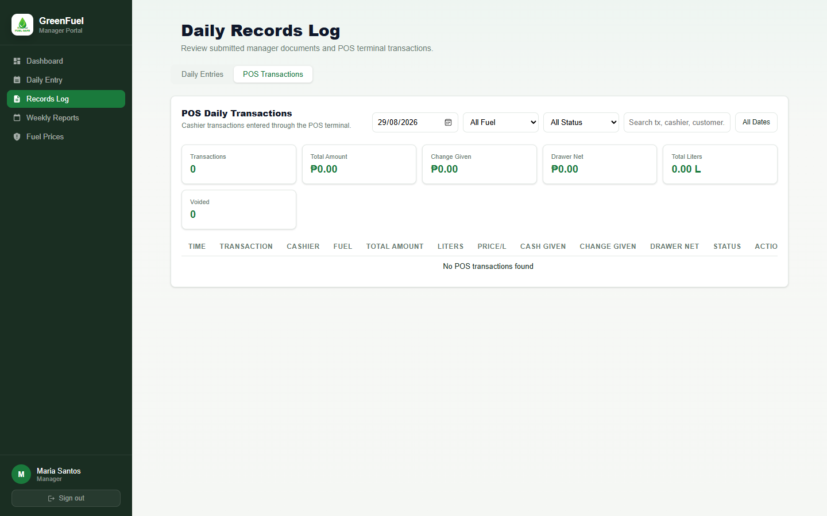
Notes:
This screenshot shows the POS Transactions tab where the manager can inspect cashier transactions, transaction IDs, cash data, and transaction status. Specific objective supported: Objective 2.4.
[Sources]
Local screenshot: 11-manager-pos-transactions.png, captured from http://localhost/greenfuel-project/frontend/index.html on 2026-08-29.
Study objectives: supplied by the user in this Codex task.

Slide 12
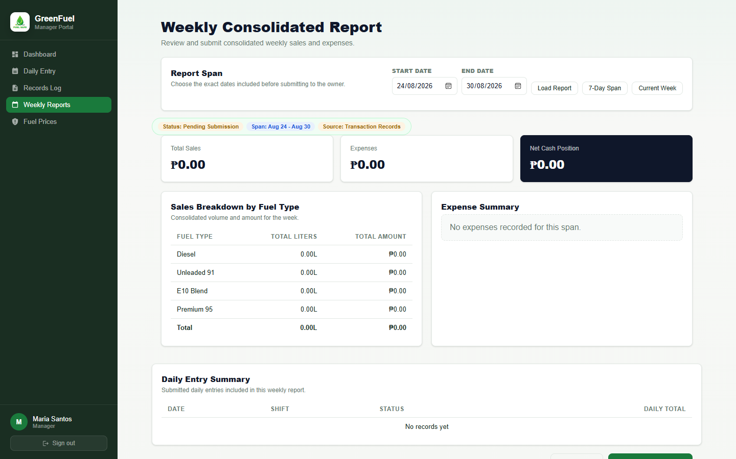
Notes:
This screenshot shows the Weekly Consolidated Report module where managers choose a report span, review daily entry summaries, and submit weekly reports to the owner. Specific objectives supported: Objective 2.5 and Objective 2.6.
[Sources]
Local screenshot: 12-manager-weekly-reports.png, captured from http://localhost/greenfuel-project/frontend/index.html on 2026-08-29.
Study objectives: supplied by the user in this Codex task.

Slide 13
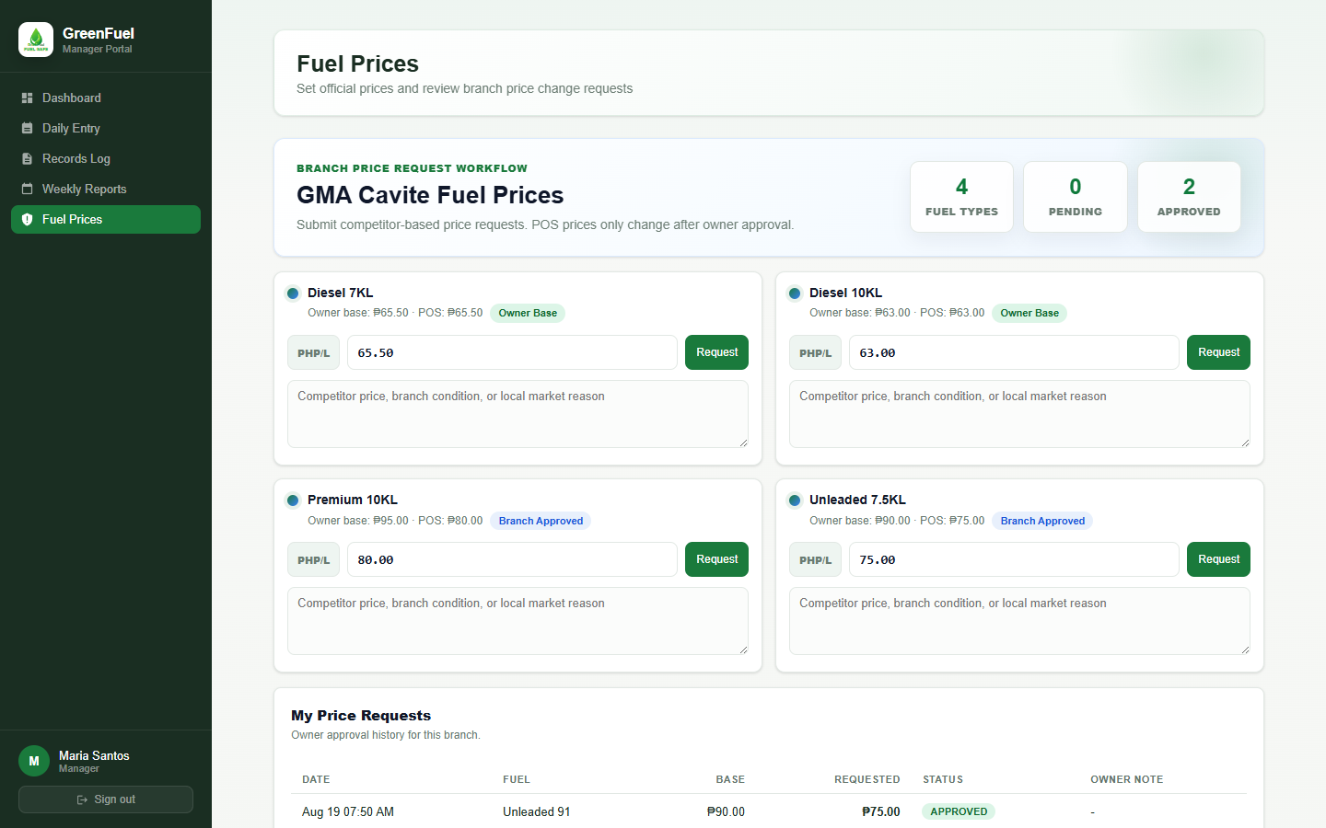
Notes:
This screenshot shows the manager fuel price request screen where branch managers can request branch-specific fuel price changes for owner approval. Specific objectives supported: Objective 2.1, Objective 2.4, and Objective 4.
[Sources]
Local screenshot: 13-manager-price-request.png, captured from http://localhost/greenfuel-project/frontend/index.html on 2026-08-29.
Study objectives: supplied by the user in this Codex task.

Slide 14
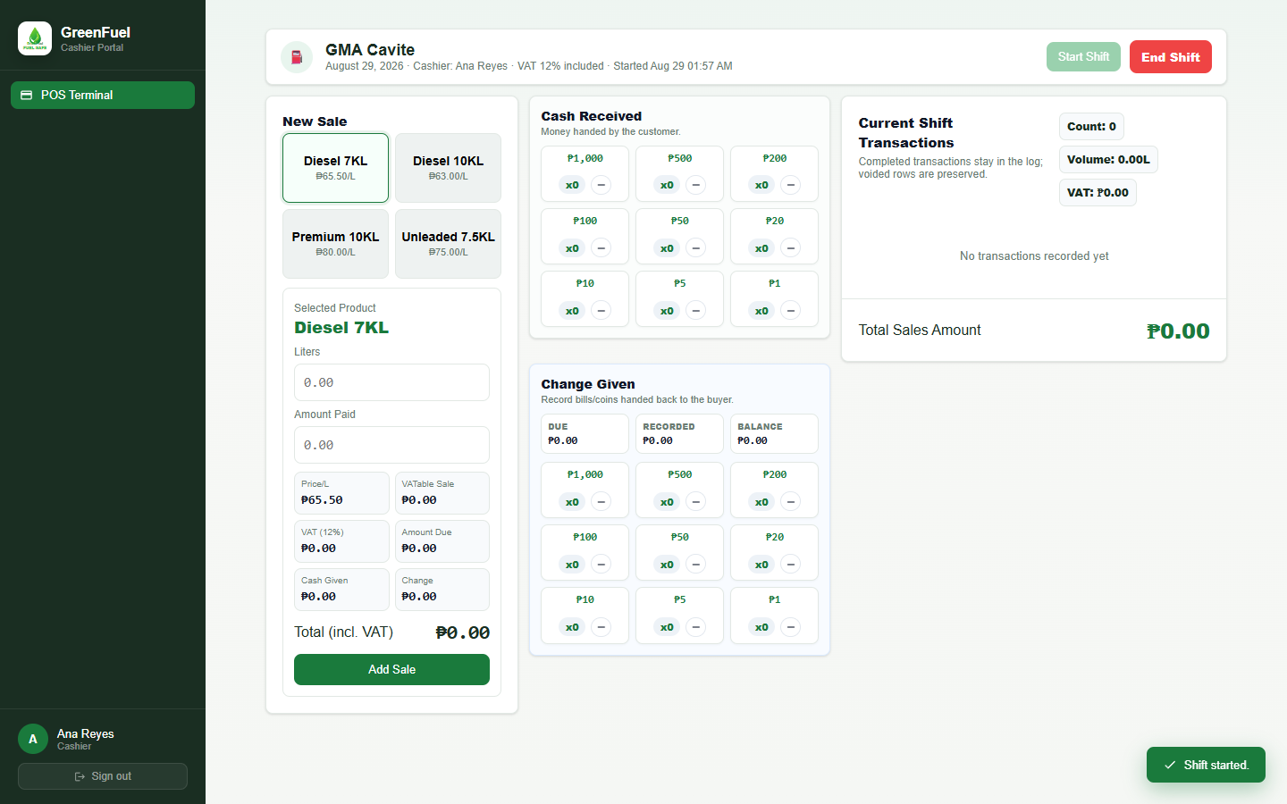
Notes:
This screenshot shows the Cashier POS Terminal for processing fuel sales, VAT calculations, cash denominations, change given, receipt printing, transaction logging, and shift controls. Specific objectives supported: Objective 2.2, Objective 2.4, and Objective 2.5.
[Sources]
Local screenshot: 14-cashier-pos-terminal.png, captured from http://localhost/greenfuel-project/frontend/index.html on 2026-08-29.
Study objectives: supplied by the user in this Codex task.

