Slide 1
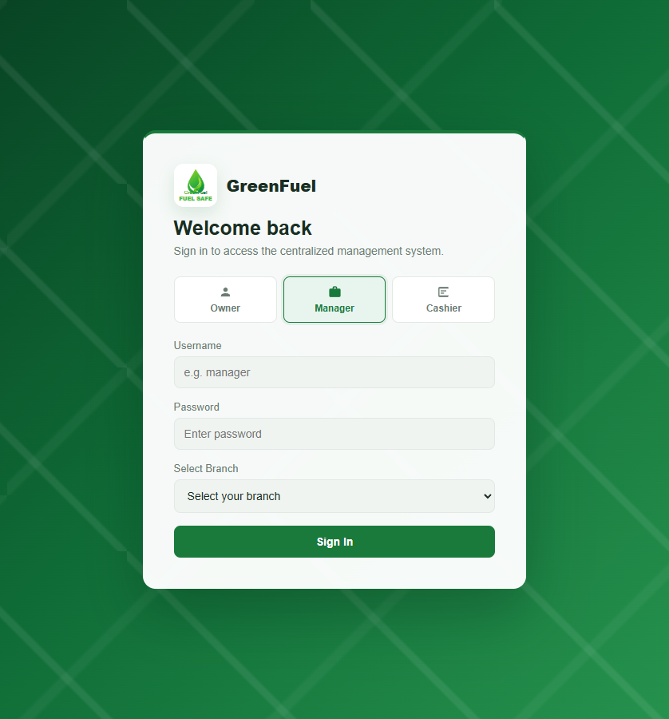

FuelSight
Centralized invoicing and sales reporting system for GreenFuel Gas Station
Actual developed system screenshots with objective-aligned notes
GreenFuel Fuel Safe
Notes:
What the screenshot shows: the FuelSight login screen and role-based entry point for Owner, Manager, and Cashier portals.
Specific objective supported: Objective 2, which introduces the centralized web-based invoicing and sales reporting application, and Objective 3, because it is implemented as a web-based system.
[Sources]
Local screenshot(s): 01-login, captured from http://localhost/greenfuel-project/frontend/index.html on 2026-08-29.
Study objectives: supplied by the user in this Codex task.

Slide 2
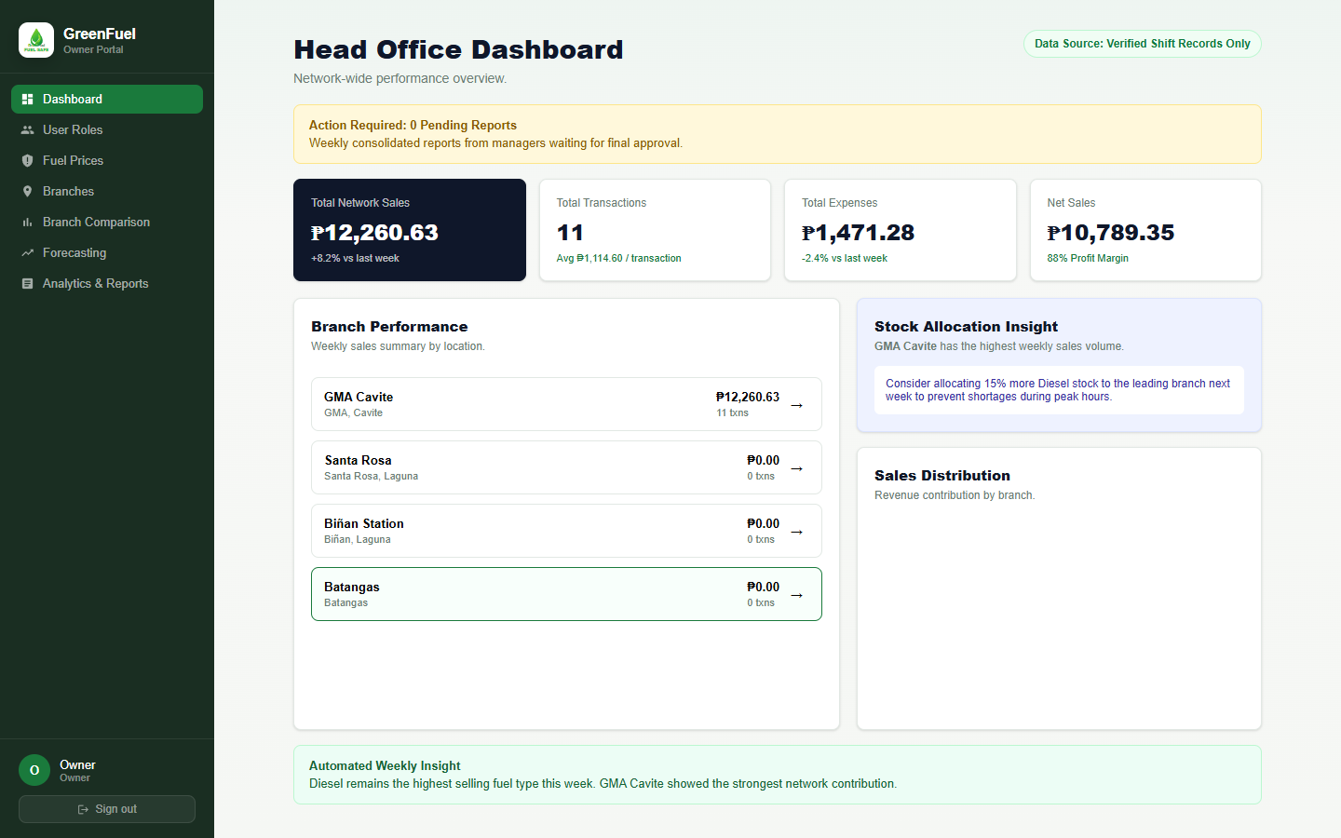
OWNER PORTAL
Centralized Monitoring Dashboard
A single owner view for branch sales, revenue, and operating signals.
Network visibility
Owner can monitor multiple branch records from one portal.
Dashboard cards and charts support fast operational review.
Centralized view supports real-time branch sales synchronization.
Objective link
Objectives 2.1, 2.3, 2.6
Notes:
What the screenshot shows: the Owner Dashboard that summarizes branch-level sales and graphical performance indicators.
Specific objective supported: Objectives 2.1, 2.3, 2.6.
[Sources]
Local screenshot(s): 02-owner-dashboard, captured from http://localhost/greenfuel-project/frontend/index.html on 2026-08-29.
Study objectives: supplied by the user in this Codex task.

Slide 3
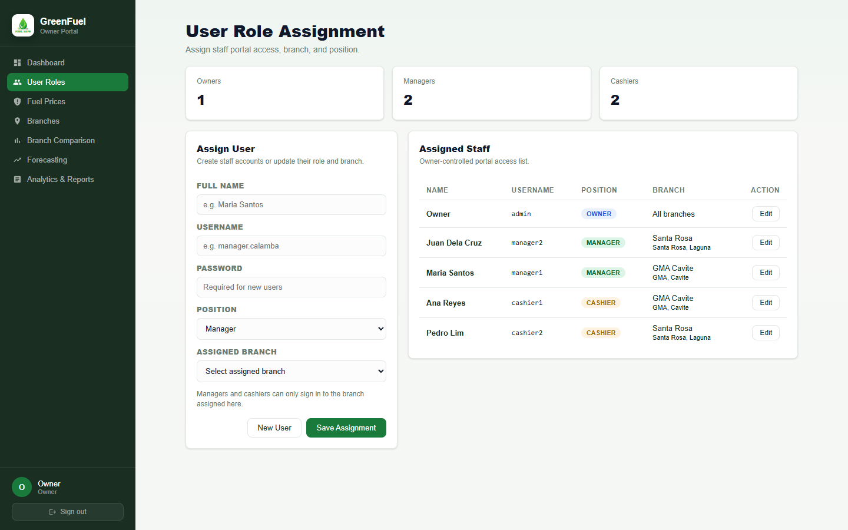
SECURITY AND ADMINISTRATION
User Role Assignment
Owner assigns each user to a role and branch before portal access.
Controlled access
Owner can assign users as owner, manager, or cashier.
Manager and cashier accounts are tied to a specific branch.
This supports accountability and separation of responsibilities.
Objective link
Objectives 2.4, 4
Notes:
What the screenshot shows: the User Roles screen where the owner manages branch and position assignments for system users.
Specific objective supported: Objectives 2.4, 4.
[Sources]
Local screenshot(s): 03-owner-user-roles, captured from http://localhost/greenfuel-project/frontend/index.html on 2026-08-29.
Study objectives: supplied by the user in this Codex task.

Slide 4
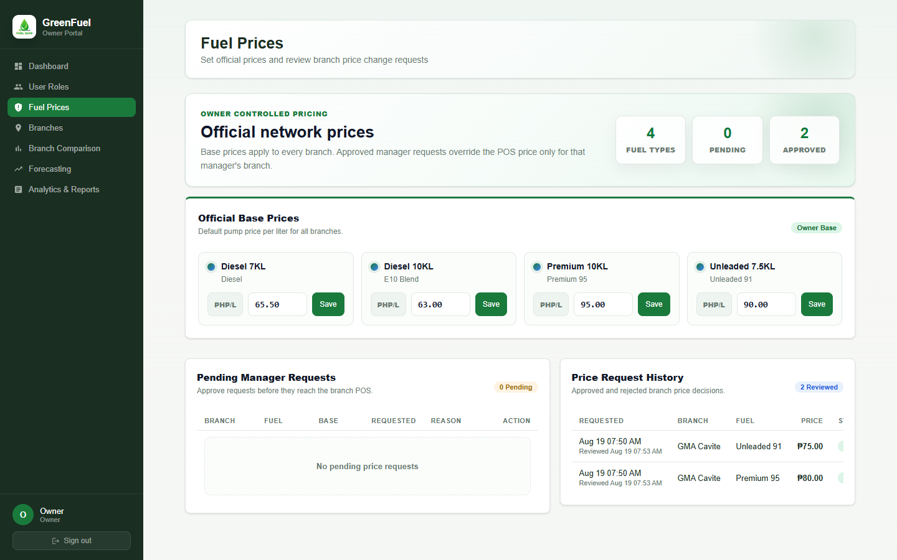
PRICE GOVERNANCE
Owner-Controlled Fuel Prices
Base prices are set by the owner, with branch requests reviewed before applying to POS.
Approval workflow
Owner sets official base pump prices for all branches.
Managers can request branch-specific changes when local competitors shift.
Approved prices become the branch price used by cashier POS terminals.
Objective link
Objectives 2.1, 2.4, 4
Notes:
What the screenshot shows: the owner Fuel Prices module showing network base prices, pending manager requests, and price request history.
Specific objective supported: Objectives 2.1, 2.4, 4.
[Sources]
Local screenshot(s): 04-owner-fuel-prices, captured from http://localhost/greenfuel-project/frontend/index.html on 2026-08-29.
Study objectives: supplied by the user in this Codex task.

Slide 5
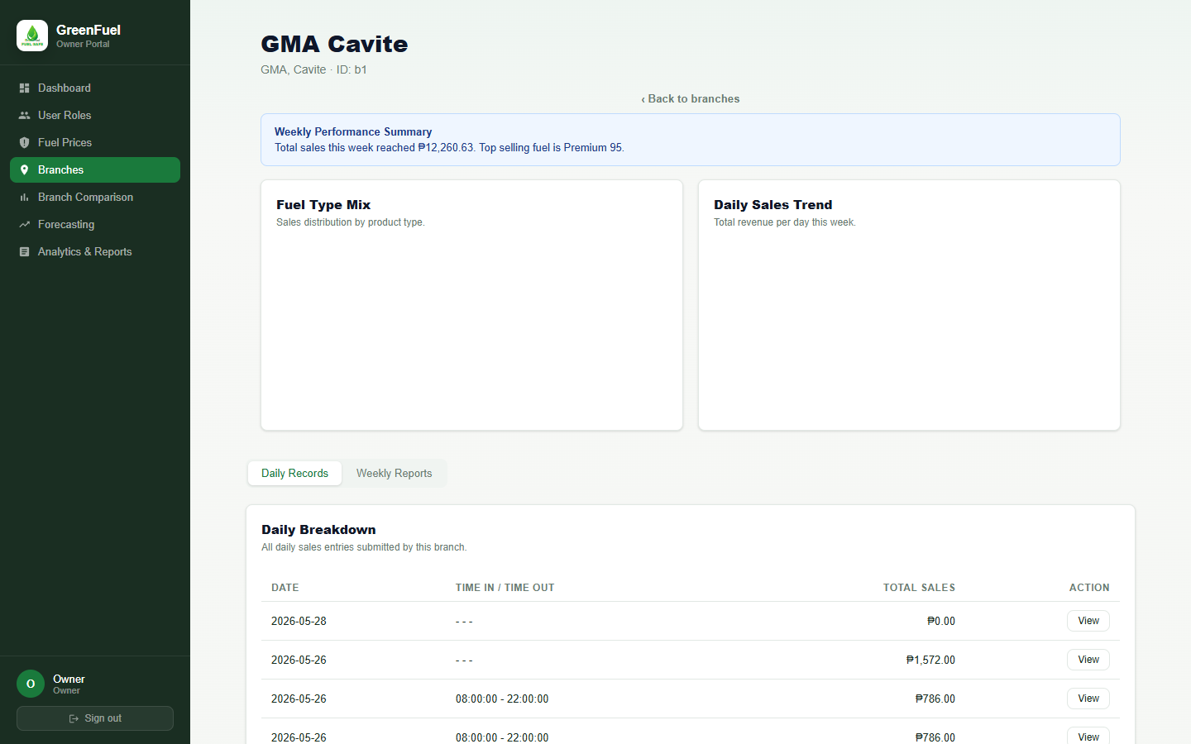
BRANCH RECORDS
Branch Daily Records View
Owner can open a branch and review submitted daily records in a familiar table view.
Branch drill-down
Branch detail view separates daily records and submitted weekly reports.
Daily records are visible after manager submission.
The branch dashboard connects operational data to owner review.
Objective link
Objectives 2.1, 2.5, 2.6
Notes:
What the screenshot shows: the Branches module after opening a specific branch, including its daily records tab and branch performance context.
Specific objective supported: Objectives 2.1, 2.5, 2.6.
[Sources]
Local screenshot(s): 06-owner-branch-detail, captured from http://localhost/greenfuel-project/frontend/index.html on 2026-08-29.
Study objectives: supplied by the user in this Codex task.

Slide 6
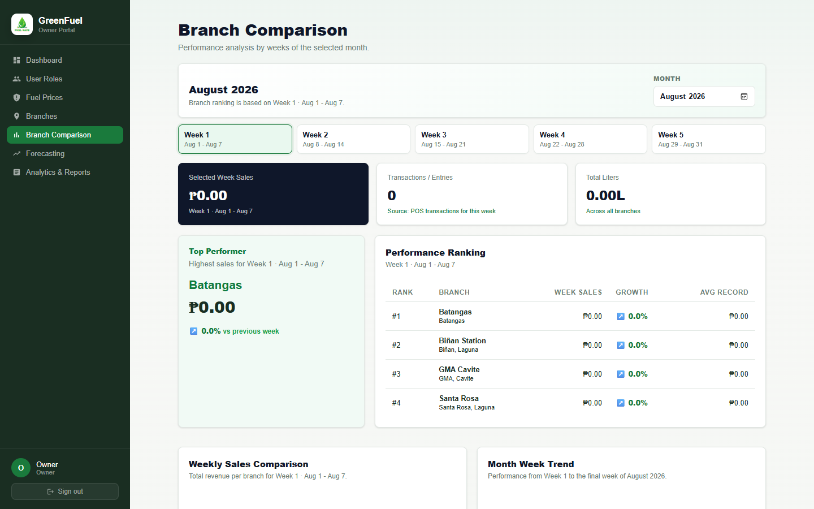
PERFORMANCE ANALYTICS
Branch Comparison by Week
Branch performance is grouped by weeks of the selected month.
Month-week view
Owner selects a month and compares Week 1 through Week 5.
Branch totals, liters, and transactions are presented side by side.
Ranking and trend indicators support branch performance decisions.
Objective link
Objectives 2.3, 2.6
Notes:
What the screenshot shows: the Branch Comparison screen with month and week controls, branch ranking, and performance metrics.
Specific objective supported: Objectives 2.3, 2.6.
[Sources]
Local screenshot(s): 07-owner-branch-comparison, captured from http://localhost/greenfuel-project/frontend/index.html on 2026-08-29.
Study objectives: supplied by the user in this Codex task.

Slide 7
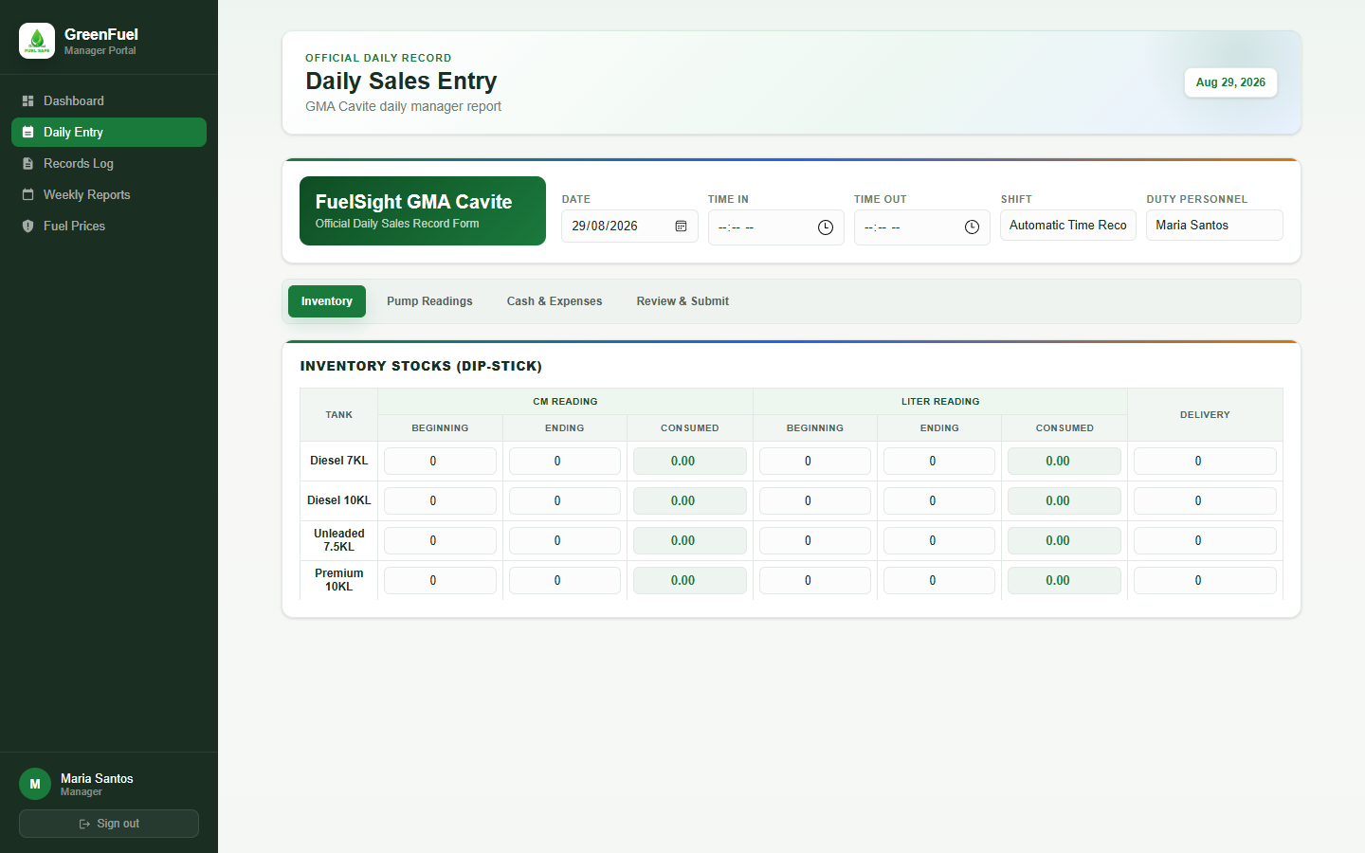
MANAGER PORTAL
Tabbed Daily Sales Entry
Daily entry sections are organized into tabs to reduce scrolling for managers.
Daily report form
Shift information remains visible above the tabs.
Inventory, pump readings, cash and expenses, and submission are separated.
Submitted daily entries feed the weekly report workflow.
Objective link
Objectives 1, 2.5
Notes:
What the screenshot shows: the Manager Daily Entry screen with inventory fields arranged in a tabbed layout as requested after adviser feedback.
Specific objective supported: Objectives 1, 2.5.
[Sources]
Local screenshot(s): 09-manager-daily-entry, captured from http://localhost/greenfuel-project/frontend/index.html on 2026-08-29.
Study objectives: supplied by the user in this Codex task.

Slide 8
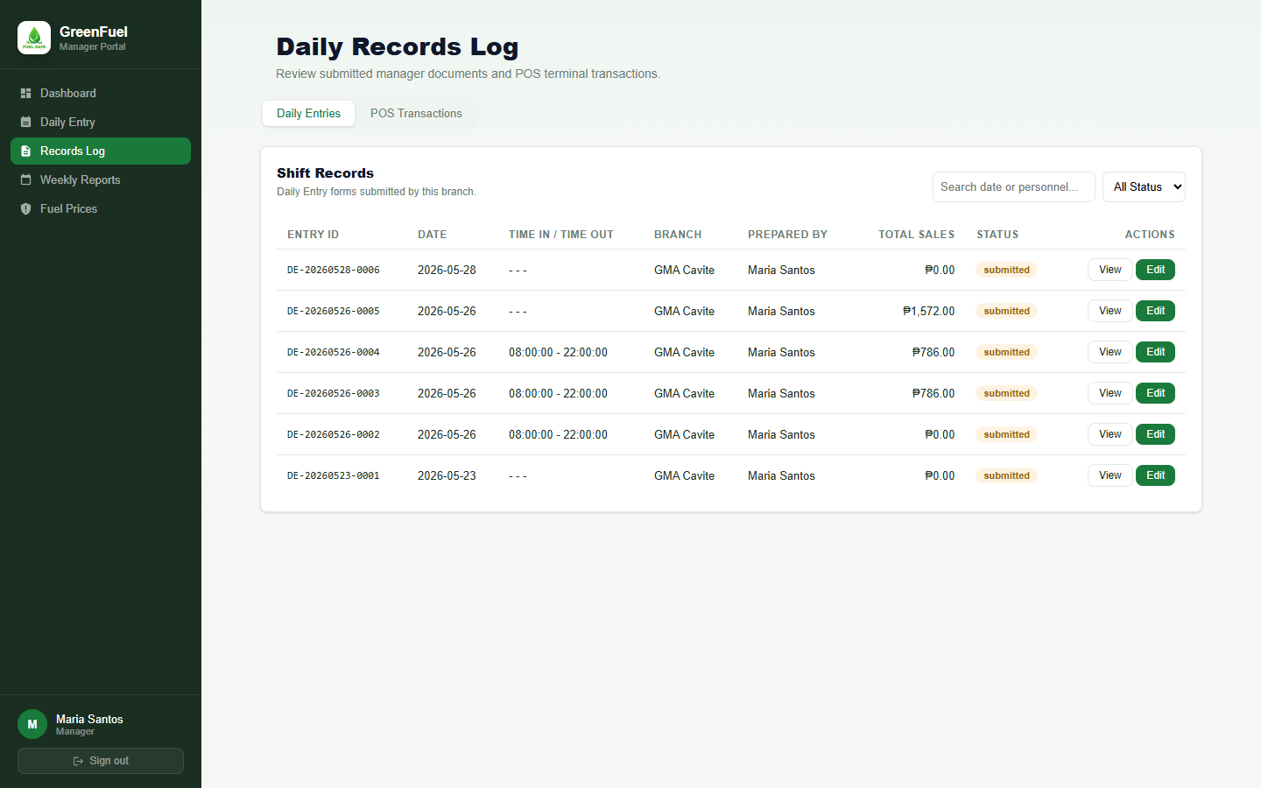
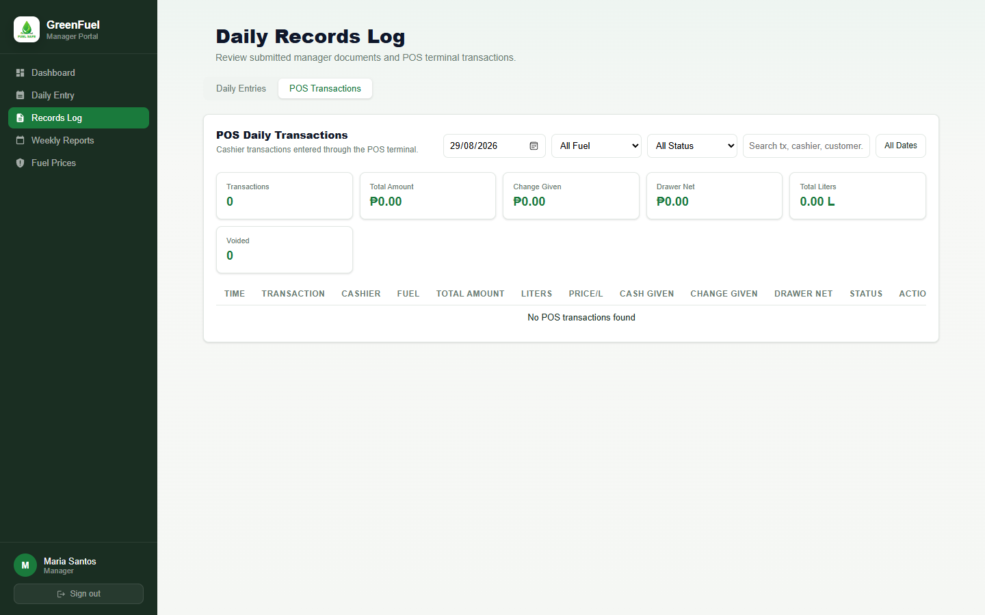
AUDIT TRAIL
Records Log and POS Transactions
Managers can inspect submitted daily entries and cashier transaction activity.
Daily Entry Records
POS Transaction Log
Objective 2.4
Screenshots demonstrate role visibility, transaction traceability, and report continuity across portals.
Notes:
What the screenshots show: the manager Records Log with daily entry IDs and the POS Transactions tab for monitoring cashier sales and voided records.
Specific objective supported: Objective 2.4.
[Sources]
Local screenshot(s): 10-manager-records-log, 11-manager-pos-transactions, captured from http://localhost/greenfuel-project/frontend/index.html on 2026-08-29.
Study objectives: supplied by the user in this Codex task.

Slide 9
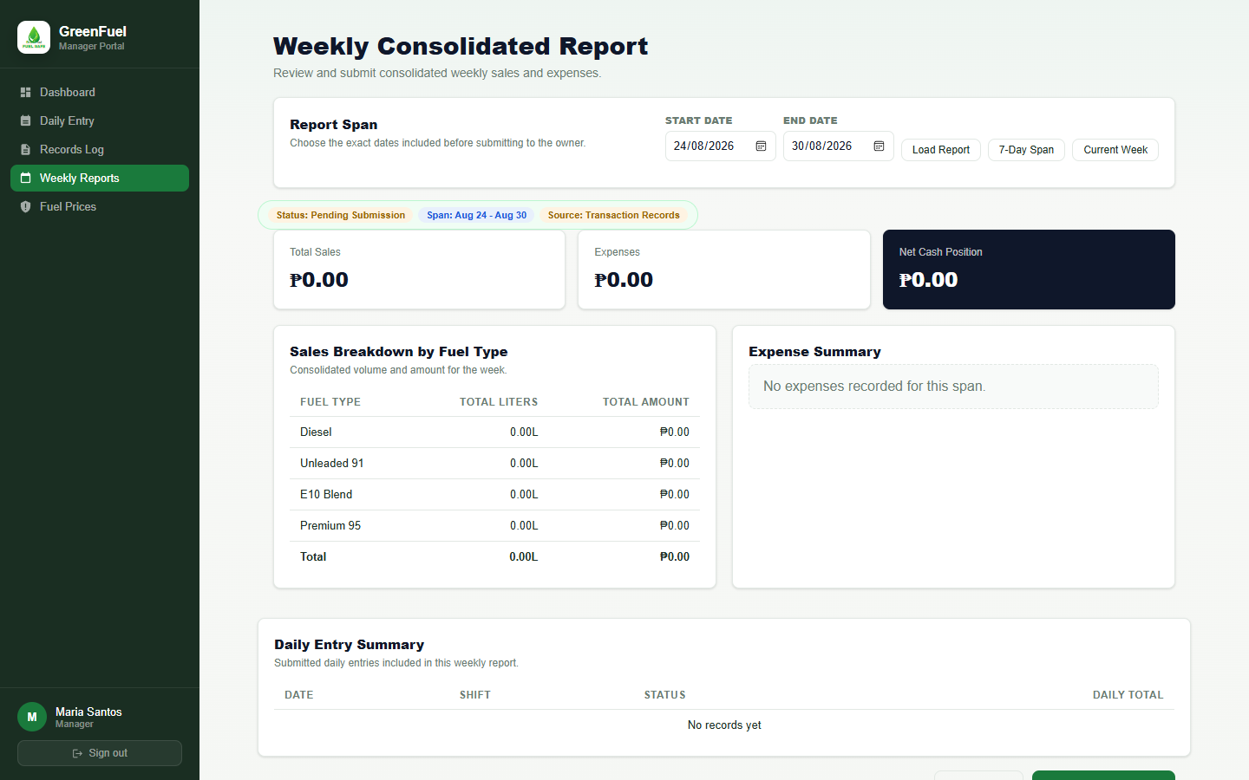
WEEKLY REPORTING
Weekly Consolidated Report
Managers choose the exact date span before submitting weekly reports to the owner.
Report handoff
Weekly report span can be set using start and end dates.
Fuel breakdown and daily entry summary come from submitted daily entries.
Owner portal only sees reports after manager submission.
Objective link
Objectives 2.5, 2.6
Notes:
What the screenshot shows: the manager Weekly Reports module with configurable report span, daily entry summary, fuel breakdown, and submit/print controls.
Specific objective supported: Objectives 2.5, 2.6.
[Sources]
Local screenshot(s): 12-manager-weekly-reports, captured from http://localhost/greenfuel-project/frontend/index.html on 2026-08-29.
Study objectives: supplied by the user in this Codex task.

Slide 10
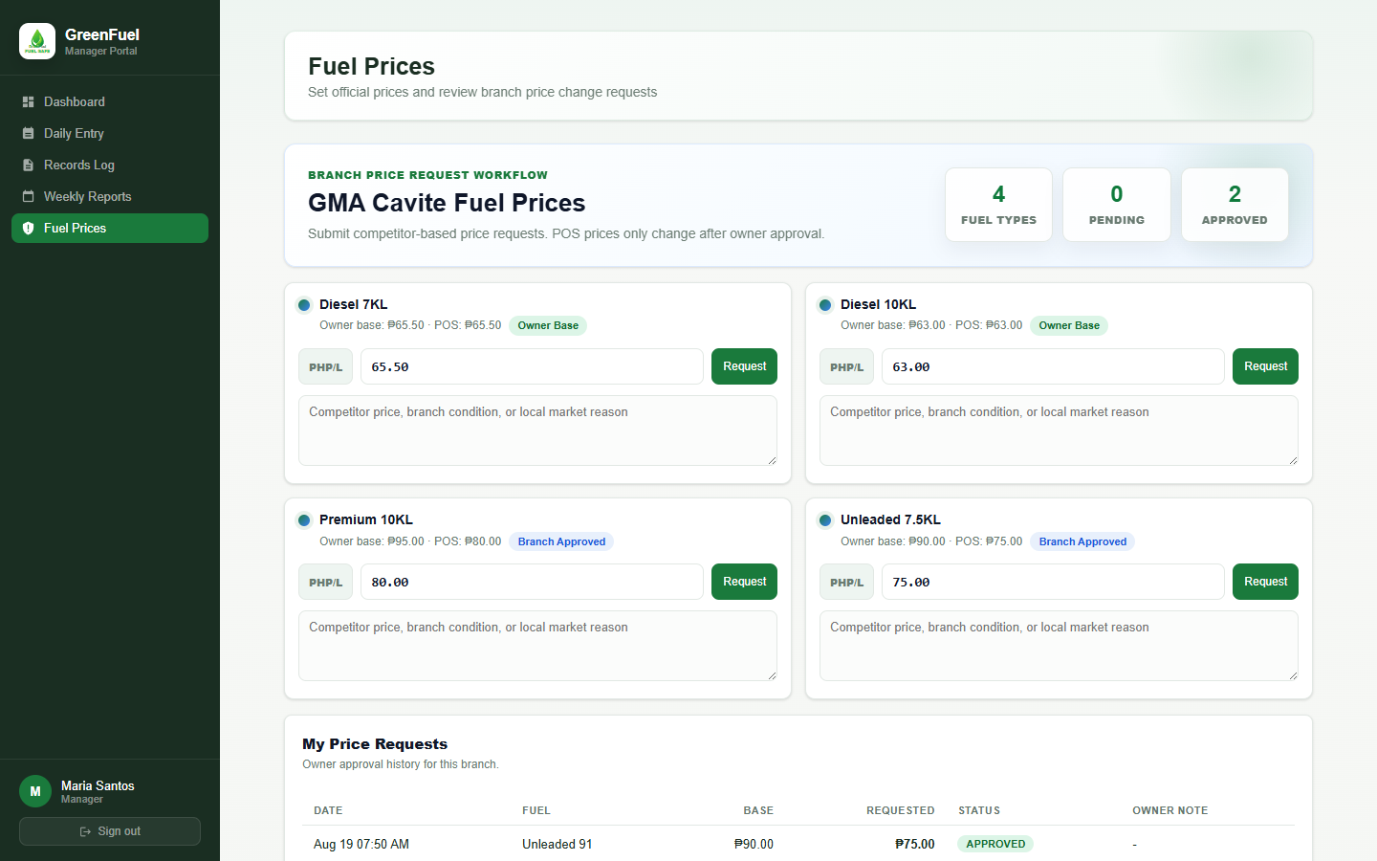
BRANCH PRICE REQUEST
Manager Price Change Request
Managers propose branch-specific prices for owner review instead of directly changing network prices.
Local competitor response
Manager sees current branch prices and official base prices.
Manager submits a requested price and reason.
Changes remain pending until the owner approves or rejects them.
Objective link
Objectives 2.1, 2.4, 4
Notes:
What the screenshot shows: the manager Fuel Prices module used to request local fuel price changes for the assigned branch.
Specific objective supported: Objectives 2.1, 2.4, 4.
[Sources]
Local screenshot(s): 13-manager-price-request, captured from http://localhost/greenfuel-project/frontend/index.html on 2026-08-29.
Study objectives: supplied by the user in this Codex task.

Slide 11
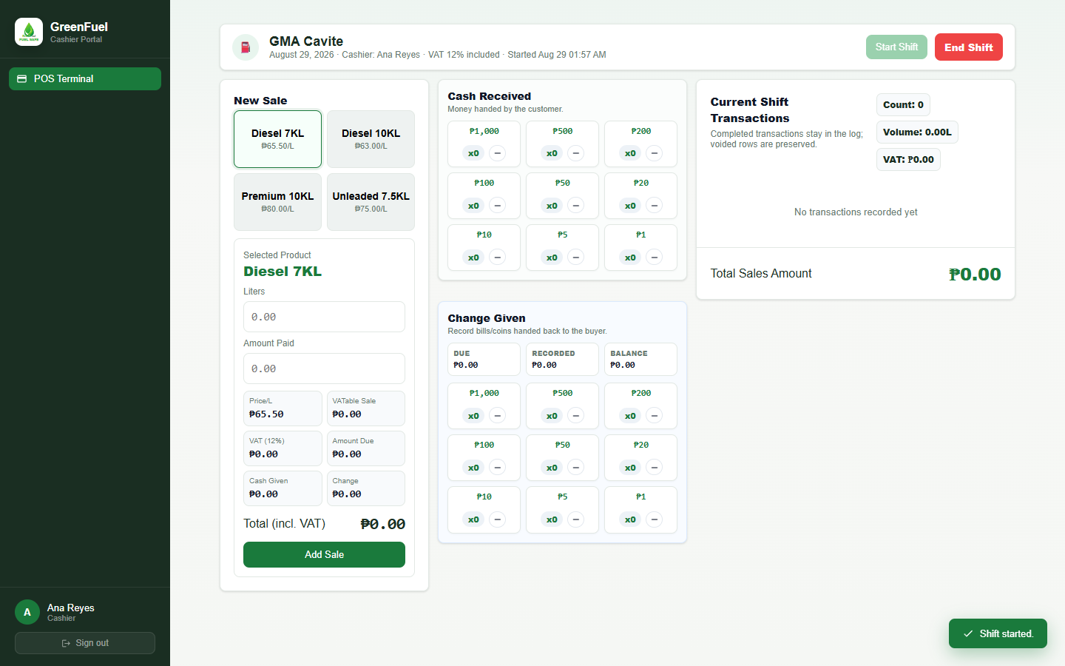
CASHIER PORTAL
POS Terminal with VAT and Cash Tracking
Cashiers process fuel transactions, cash denominations, change, voids, receipts, and shifts.
Transaction workflow
Fuel type, liters, VAT, and total are computed during each sale.
Cash received and change given are recorded by denomination.
Shift totals and receipt printing support end-of-day reporting.
Objective link
Objectives 2.2, 2.4, 2.5
Notes:
What the screenshot shows: the Cashier POS Terminal showing product selection, VAT included calculations, cash received denomination buttons, change given recording, and current shift totals.
Specific objective supported: Objectives 2.2, 2.4, 2.5.
[Sources]
Local screenshot(s): 14-cashier-pos-terminal, captured from http://localhost/greenfuel-project/frontend/index.html on 2026-08-29.
Study objectives: supplied by the user in this Codex task.

Slide 12
STUDY OBJECTIVES
Objective Coverage Summary
Screenshots show how each objective is represented in the developed system.
Owner dashboard
Daily entry
Weekly reports
Cashier POS
Objectives 1 and 3
Daily entry, records log, MySQL/PHP backend, and HTML/CSS/JavaScript frontend show the analyzed workflow as a working web system.
Objectives 2.1 and 2.3
Owner dashboard and branch comparison show synchronized branch data and graphical sales analysis.
Process and build method
Centralized monitoring
Objectives 2.2 and 2.4
Cashier POS, receipts, transaction logs, void status, and user roles support invoicing and traceable operations.
Objectives 2.5, 2.6, and 4
Daily/weekly reports, branch performance views, and role controls support usability, functionality, reliability, performance, and security review.
POS and audit trail
Reports and evaluation
Notes:
What the screenshots show: a compact overview of the developed modules used as evidence for the study objectives.
Specific objective supported: Objectives 1, 2.1 through 2.6, 3, and 4.
[Sources]
Local screenshot(s): 02-owner-dashboard, 09-manager-daily-entry, 12-manager-weekly-reports, 14-cashier-pos-terminal, captured from http://localhost/greenfuel-project/frontend/index.html on 2026-08-29.
Study objectives: supplied by the user in this Codex task.

