Slide 1
Graph Based Analytics in Azure Security
Yogesh Roy

Slide 2


Cloud Defenders Mindset
Server
Domain
Domain Admin
Pass the Hash
Private IPs
RDP/SSH
Services
Subscriptions
Subscription Admin
Credential Pivot
Public IPs
Management APIs
Source: Johnson, Andrew (@limeyjohnson)

Slide 3
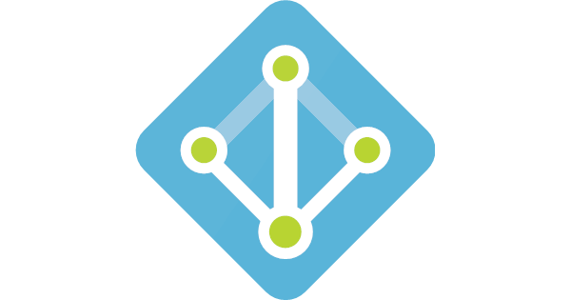





Azure Active Directory
Key Vault
Azure Resource Manager
Azure Information Protection
Azure Database
Virtual Machine

Slide 4
Graphs for Cloud Security
Detections that are focused on individual services can miss many attacks.
Advanced adversaries often engineer complicated multi stage attacks
Goal: Build cross service detections that are capable of identifying multi-stage attacks through various stages of the kill chain
Leverage adaptive graph-based machine-learning solutions, that can incorporate rules as well as traditional supervised learning for detecting multi-stage attacks

Slide 5

Kill-chain based graphs can stop an attack in its track
Identity Detection
(Installation)
Service Principal creation in MSODS
(Persistence 1)
Add principal to ARM subscription
(Persistence 2)
?
Identity Detection
(Installation)
Enable Remote Access
(Lateral Movement)
?
Identity Detection
(Installation)
Key/Secret Enumeration
(Credential Access)
?

Slide 6
Microsoft’s cloud security scale - Daily numbers
18 Billion
Microsoft Account authentications
500 million
Number of active Microsoft account users
30 Million
Geo Login Anomaly Attacks deflected
1.5 Million
Number of compromise attempts deflected
77 million
Threats detected on devices

Slide 7
Overview of approach Graph based cross service detections
Service layer detections and behaviors
Convert to Graph. Apply probabilistic
kill-chain model
Score each subgraph
2.4 | 1.5 | 2.3 | 1.1
….
Detection
Platform
Identity detections
(27 million)
Publish to Customers
Identity detections
INSTALL
New service principal created
SP added as admin
PERSIST
AAD admin actions
(41 million)
Dozens subgraphs
Hundreds possible subgraphs
Azure admin actions
(4 million)

Slide 8
Building a Cross Service Graph of Detections and Behaviors
Nodes consist of:
Detections
High impact activities
Linking elements
Edges indicates relationship
AAD Admin
Behaviors
Service Principal Added
RDP BF Success, TI_Outbound
AAD Target
ASC
Detect
AAD Actor
AAD User
Sub
VM Entity
ASC
Detect
Type
Geo Login Anomaly Detection (GLAD),
Familiar Location, Suspicious IP, AIP Exfiltration etc
AADIP-AIP
Detect
AADIP-AIP
Detect
Type
AAD
Identity
Azure User
Azure
Behaviors Actor
IP
Address
Azure
Behaviors
Azure
Behavior Target
Azure Permission Modification,
RDP Enable, RDP Download, etc

Slide 9
Probabilistic Kill Chain Connectivity between nodes in the graph
Detections / Behaviors | Kill Chain Phase
Port Scanning Infected Devices | Recon
RDP BF Suspicious Ip, Familiar Location | Delivery
RDP BF Success GLAD, Suspicious Ip, Familiar Location | Installation
AAD User Created, Azure Permission Modification | Privilege Escalation
RDP Download, RDP Enable Others Implicit from Paths (e.g. Azure Permission, AAD account Creation, IP BGA) | Lateral Movement
AIP Exfiltration | Exfiltration
Scanner, Abnormal Process, Scuba PS, TI Outbound, etc. | Actions
AAD User Deleted [Azure Permission Removed, VM Deleted] | Concealment
Map detections & behaviors to a stage in the kill-chain
Use kill-chain as basic probability model to constrain edges, build out connections using a stochastic process
Similar to how epidemics/outbreaks are modeled, or how false information spreads in social networks
Calculate the kill-chain connectivity metric which then used for scoring

Slide 10
Kill Chain Walkthrough
Model
joe
AADIP
GLAD
09/15
52.16.89.18
joe
GLAD – 09/15
Azure 09/20
alice
FL – 09/18
Azure
HIA
09/20
AAD HIA
09/01
AADIP
Unfamiliar Location
09/18
alice
AIP
Exfiltration
09/01
Azure 09/27
Azure
HIA
09/27
AAD HIA
09/16

Slide 11
Graphs for detecting cloud pivoting attacks
Build graph of privileged behaviors and detections across multiple services
Hundreds of millions nodes, edges, and security attributes
Use knowledge of all known attack patterns and match their occurrence in the graph
Apply the knowledge of kill chains and calculate probabilities of attack paths – kill chain connectivity
Score every match using machine learning algorithms and flag the malicious ones
Unsupervised algorithms
Supervised algorithms

Slide 12
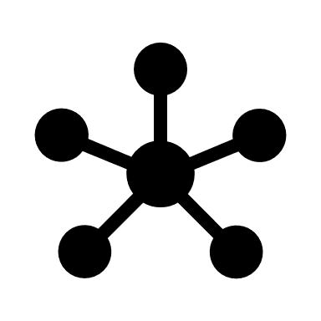

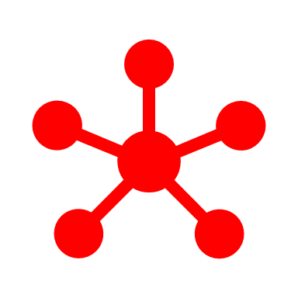
Bunch of graphs as an input
Flag them

Slide 13
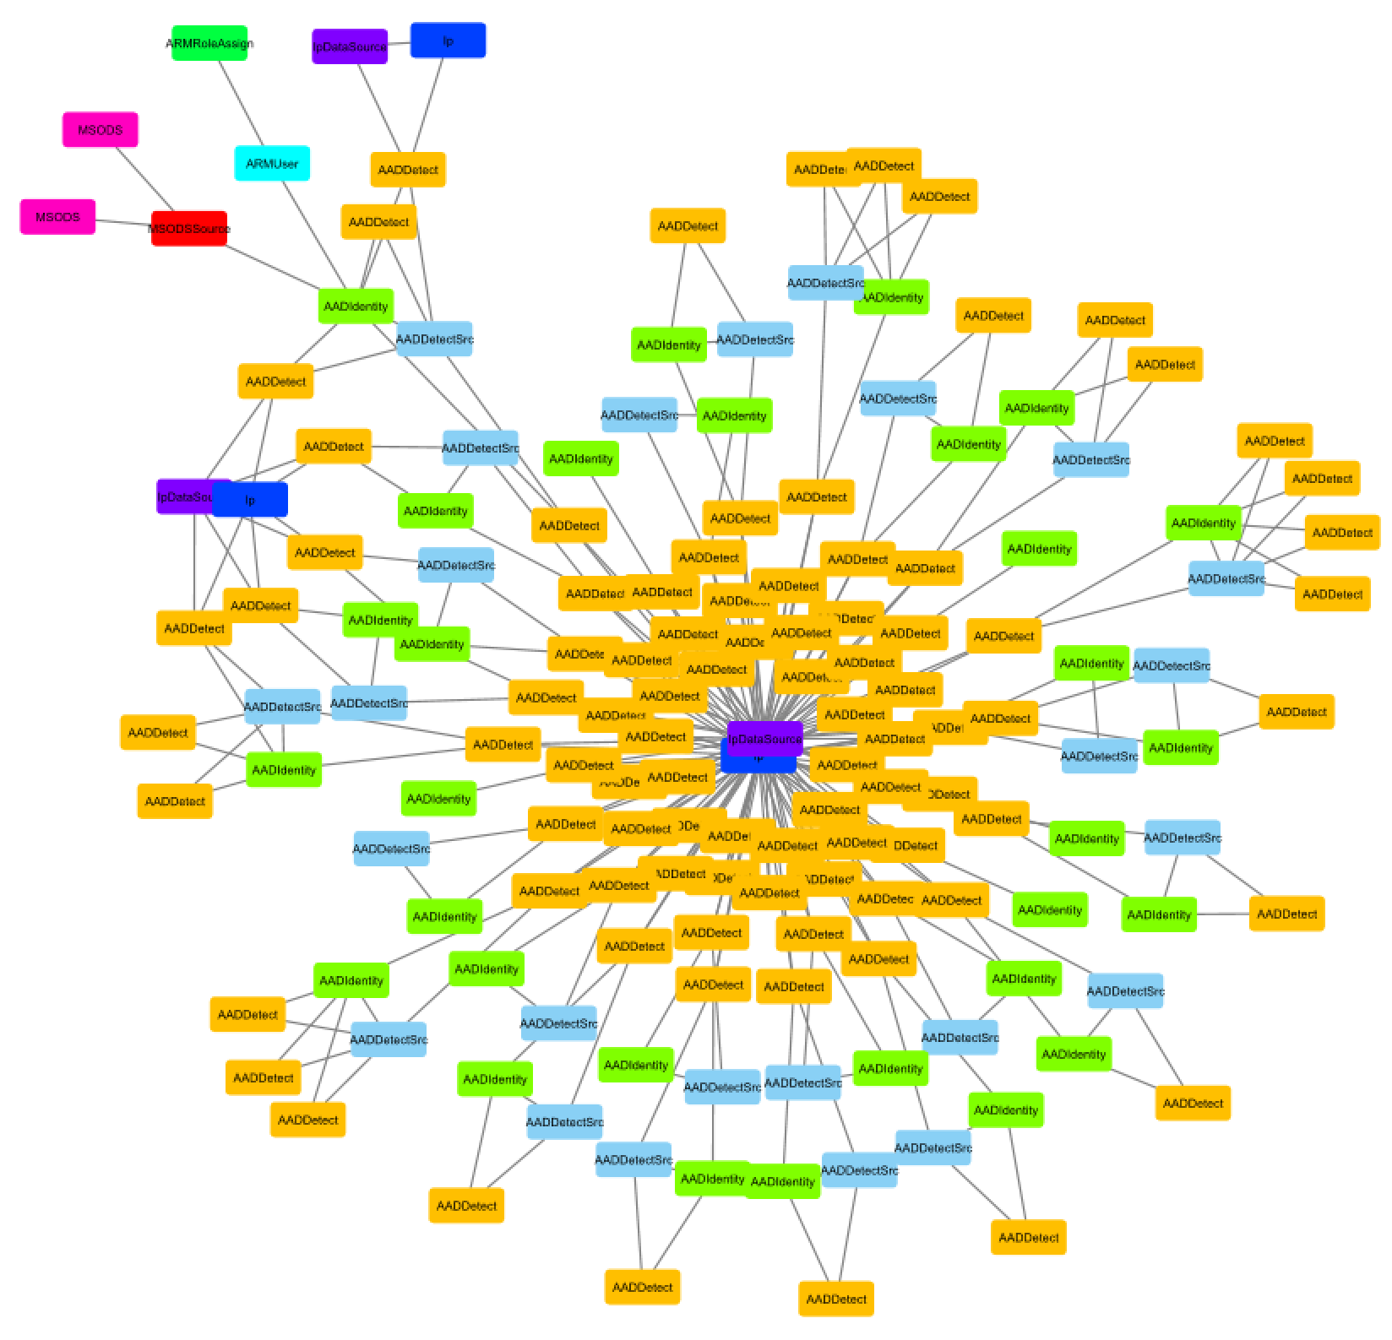
Snippet of our graph

Slide 14
Unsupervised graph scoring
Compute connectivity score (local density) of sub-graph by the pair-wised nodes reachability from Random Walk/Kill Chain Connectivity
Smoothen connectivity score of subgraph with the scores of k-nearest similar sub-graphs
Gave us good Precision/Recall on internal data
Caught 19 of 24 red team attacks
One false-positive

Slide 15
Features for supervised scoring: Frequent Subgraph Mining
Support = 2
This approach gives high accuracy, however frequent subgraph mining belongs is np-complete class (not scalable).
We would like to find trade off between scalability and accuracy.

Slide 16
Optimized approach for featurization:
AAD Add Service Principal
AAD Add Service Principal
AAD Detection
Azure
AAD Detection
AAD target
AAD target
Add to Subscription
Azure
Azure
Add to Subscription
AAD Detection
AAD target
Building only subtrees with maximum count of nodes equal 3
Azure

Slide 17

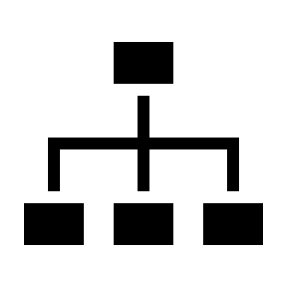

Supervised Learning Model
Decision tree
Does it have any detection?
Random Forest
Yes
No
Does it have segment X?
Not Compromised
Yes
No
Compromised
$$αx_{1}+βx_{2}>0 ?$$
Yes
No
Compromised
Not Compromised

Slide 18
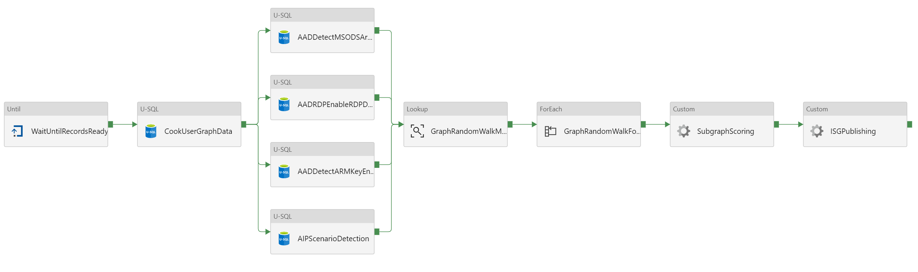
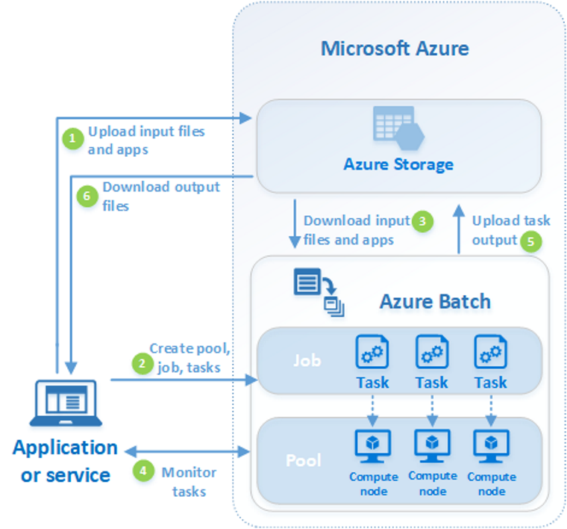
Azure Data Factory
Infrastructure
Azure Batch

Slide 19
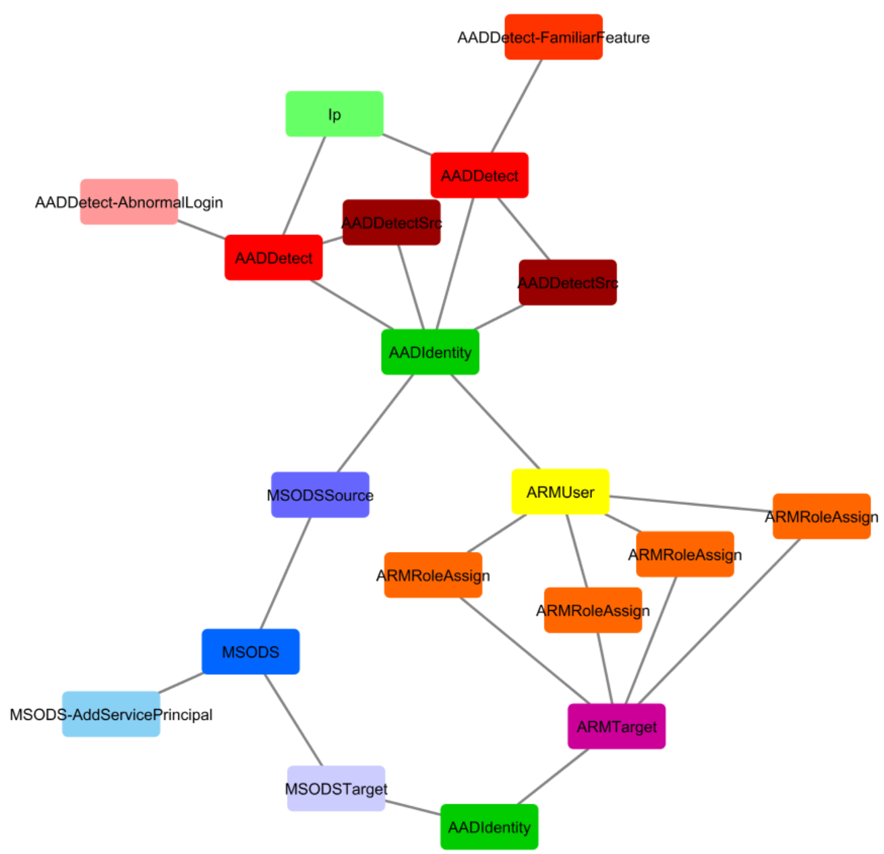
1 hour travel from New Zeland to Sydney,
Within 30 seconds: new service principal and
Azure permissions changed

Slide 20
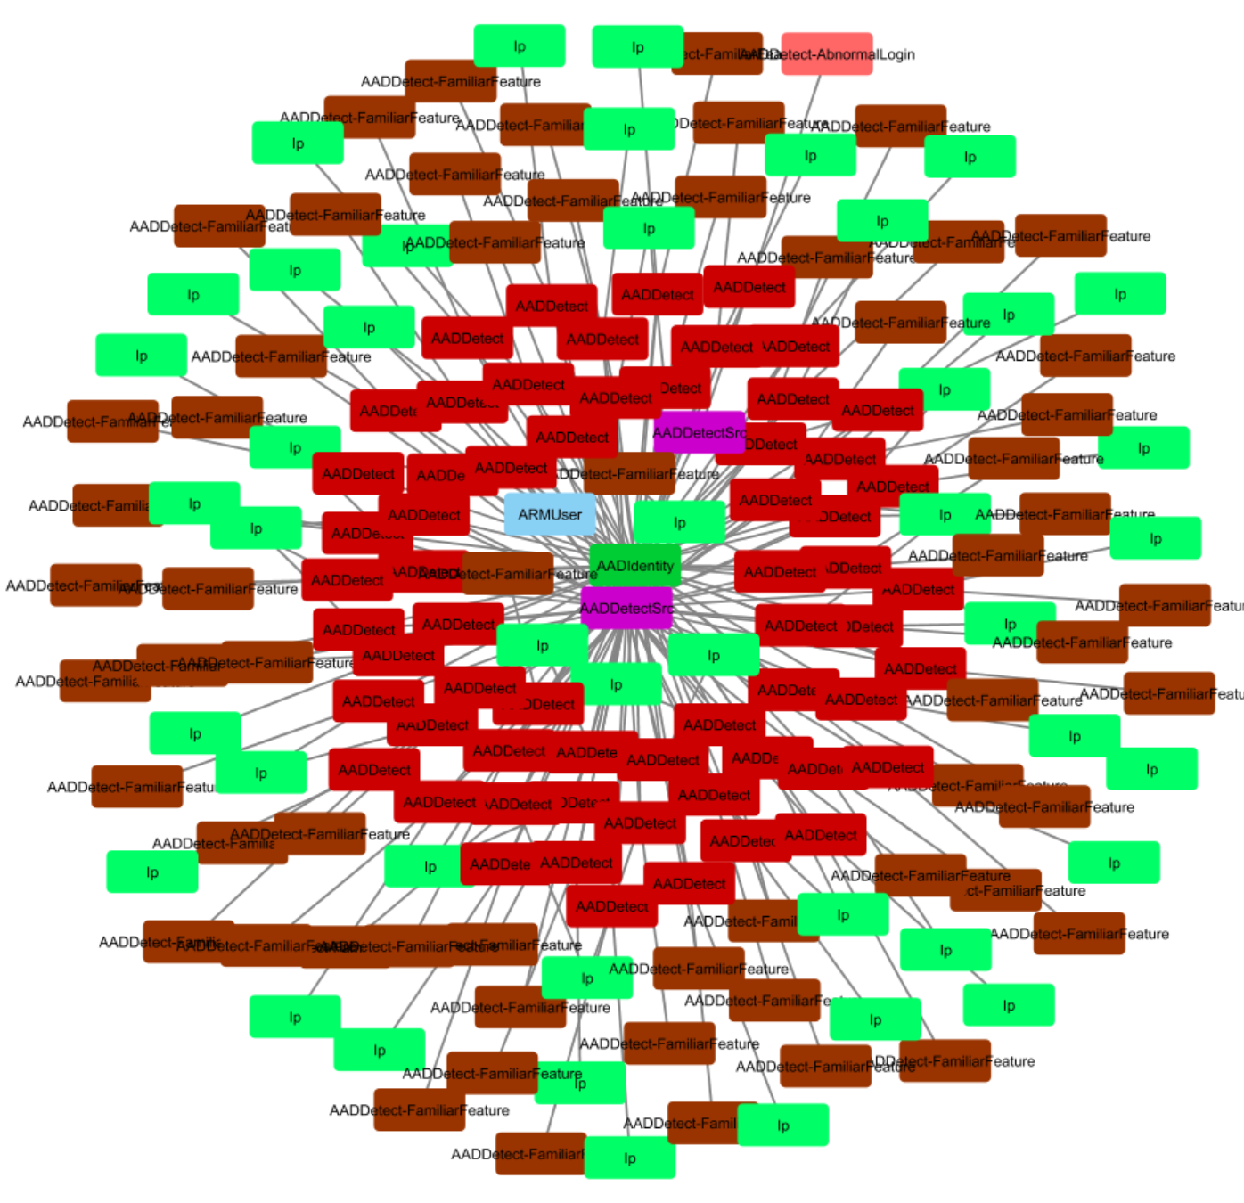
All different Ips – very suspicious

Slide 21
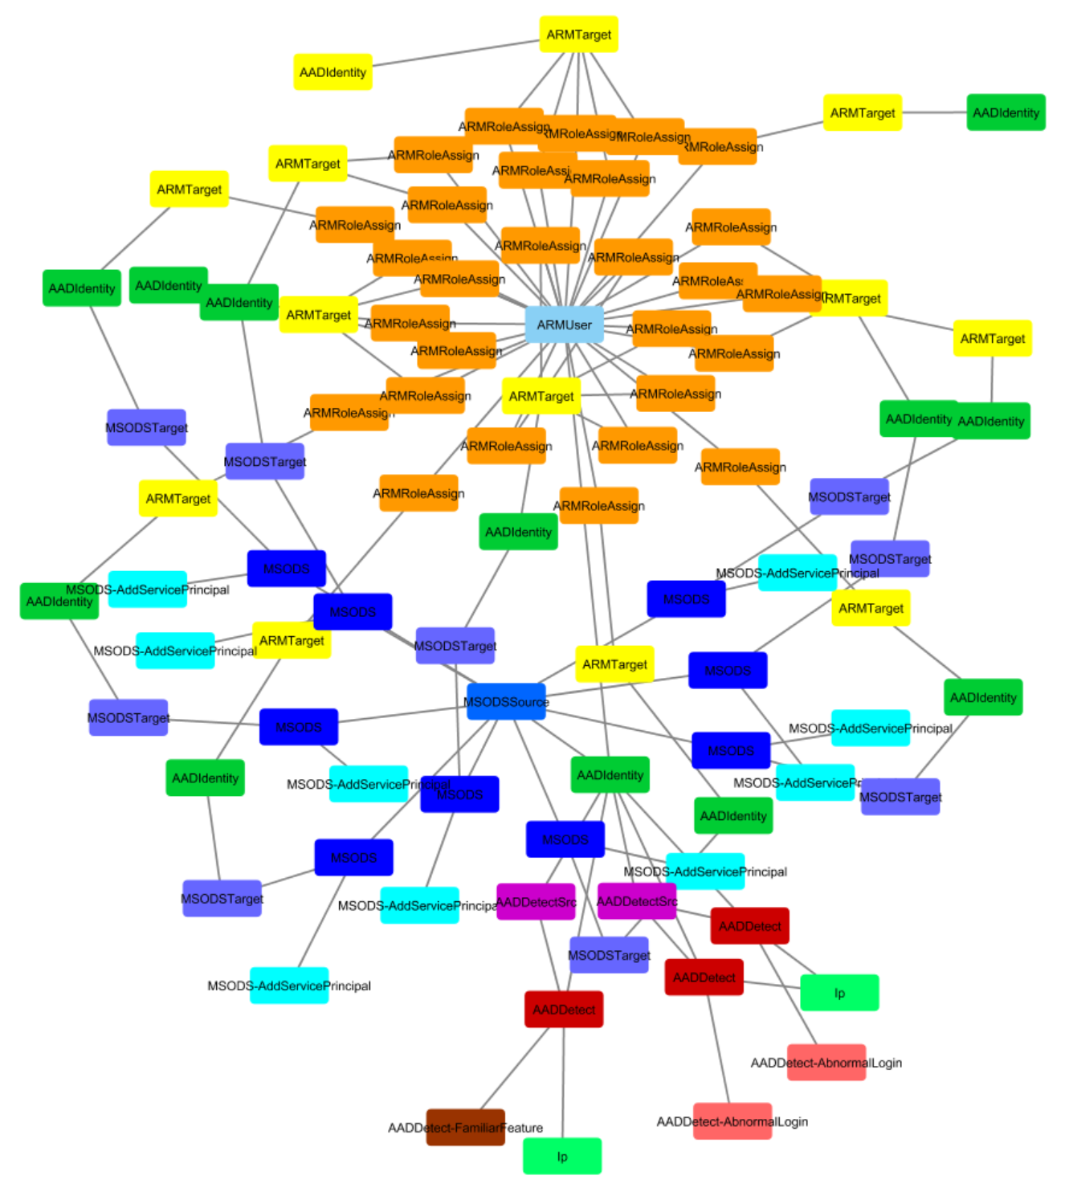

Slide 22
Questions? yroy@microsoft.com

