Slide 1

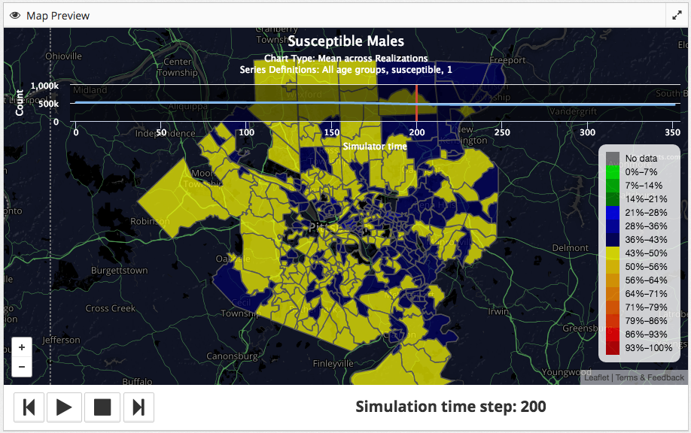
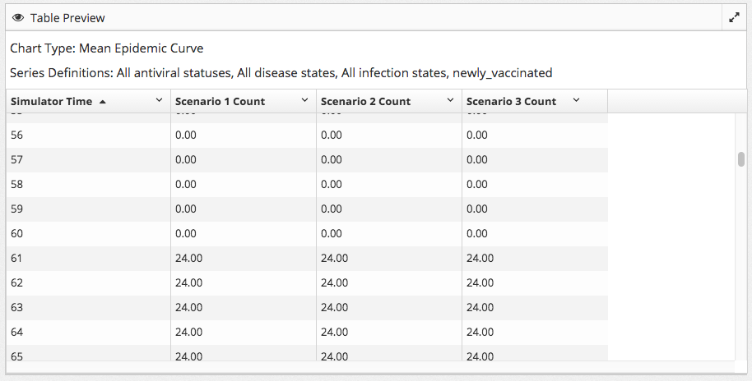
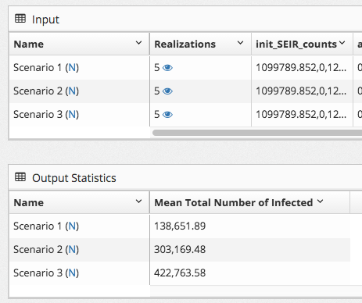
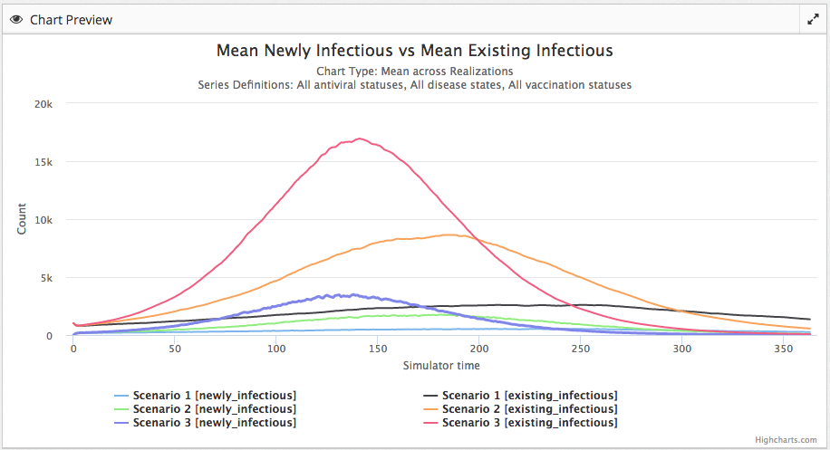
MIDAS ISG Informatics Services Group
Software Development Service
Galapagos v2.0: A Web-based visualization tool for
Comparing and exploring the results of epidemic simulators.
Adam Darr, John Levander, Nicholas Millett
Informatics Services Group, University of Pittsburgh, Pittsburgh PA
What is Galapagos?
Galapagos is a web-based visualization tool for comparing and exploring the results of epidemic simulators.
Use Galapagos to quickly upload and review the results from multiple epidemic simulations and explore a detailed spatiotemporal visualization of a single simulation. The visualizations in Galapagos are rendered on-demand, allowing the user to customize the visualizations in real-time.
With Galapagos, you create views (i.e. charts, tables, and maps) displaying any combination of variables (e.g. age, gender, location) of your simulator output data. The views are saved between sessions so you can always return and continue your analysis without having to recreate any views.
Galapagos supports multiple analysis modes:
Statistics view - This view is used to analyze input parameters as well as build custom statistics based on the results of a specific simulation.
Chart view - This view is used to create a time series graph which compares population counts across simulations.
Table view - This view is used to look at the data associated with a simulation or group of simulations.
Map view - This view is used to create custom choropleth animations from the results of a specific simulation.
Animated Map View
This figure shows a choropleth of the results of a simulator run on an infectious disease scenario. The average of the mean values of each realization in the scenario were used to calculate each count.
The choropleth can be played like a movie using the buttons in the bottom left corner of the image. The movie would start from simulator time zero, and show the value of the chosen variable at each point in time at each location.
In this image we show the percentage of susceptible males in different parts of Allegheny County at time step 200.
What’s new in Galapagos v2.0?
Support for user uploaded data
View both realization and scenario data in various analysis modes
Workspaces for users to differentiate between simulator datasets
Plot moving averages and error bars on charts and view their values in tables
Statistics builder for users to create and view their own statistics
Table View
This view allows users to see the data underlying their simulations. In this table, the user is comparing the mean counts of “newly_vaccinated” for three different scenarios.
Time-series chart comparing scenarios
This figure shows a time-series chart that compares three scenarios. The average of the mean values of each realization in the scenario were used to calculate each count. Galapagos can be configured to display any output variable in any “view.” Here, we compare the value of “newly infectious” and “existing infectious” across scenarios.
Statistics View
Galapagos allows users to view input statistics and create output statistics. Input statistics are the parameters to the simulators that users run. Output statistics are custom statistics based on a simulator’s outputs and can be built by the user. In this example, the user built a statistic displaying the “Mean Total Number of Infected” for each scenario.
Scenarios vs. Realizations
The development of Galapagos was born out of the desire to analyze infectious disease simulator output across multiple scenarios and realizations (or replications), in a user-friendly way.
In Galapagos, we use the term “scenario” to reference the set of parameters that are supplied to the simulator. For example, a researcher running an Influenza simulator might create a scenario named: “Influenza Activity in the State of Texas in 2009.” The parameters supplied to the simulator would configure the run for the state of Texas, set the pathogen to Influenza, set the transmission probably to 0.08, etc.
Researchers that run stochastic (non-deterministic) simulators will usually run many “realizations” (or “replications”) of a single scenario. Each realization is run using the exact same set of configuration parameters, but with a new random seed. The purpose of these additional runs is to control for the uncertainty caused by using a stochastic simulator.
MIDAS Informatics Services Group
University of Pittsburgh, Pittsburgh Supercomputing Center, Carnegie Mellon University, University of Florida, Johns Hopkins
Notes:
1

