Slide 1

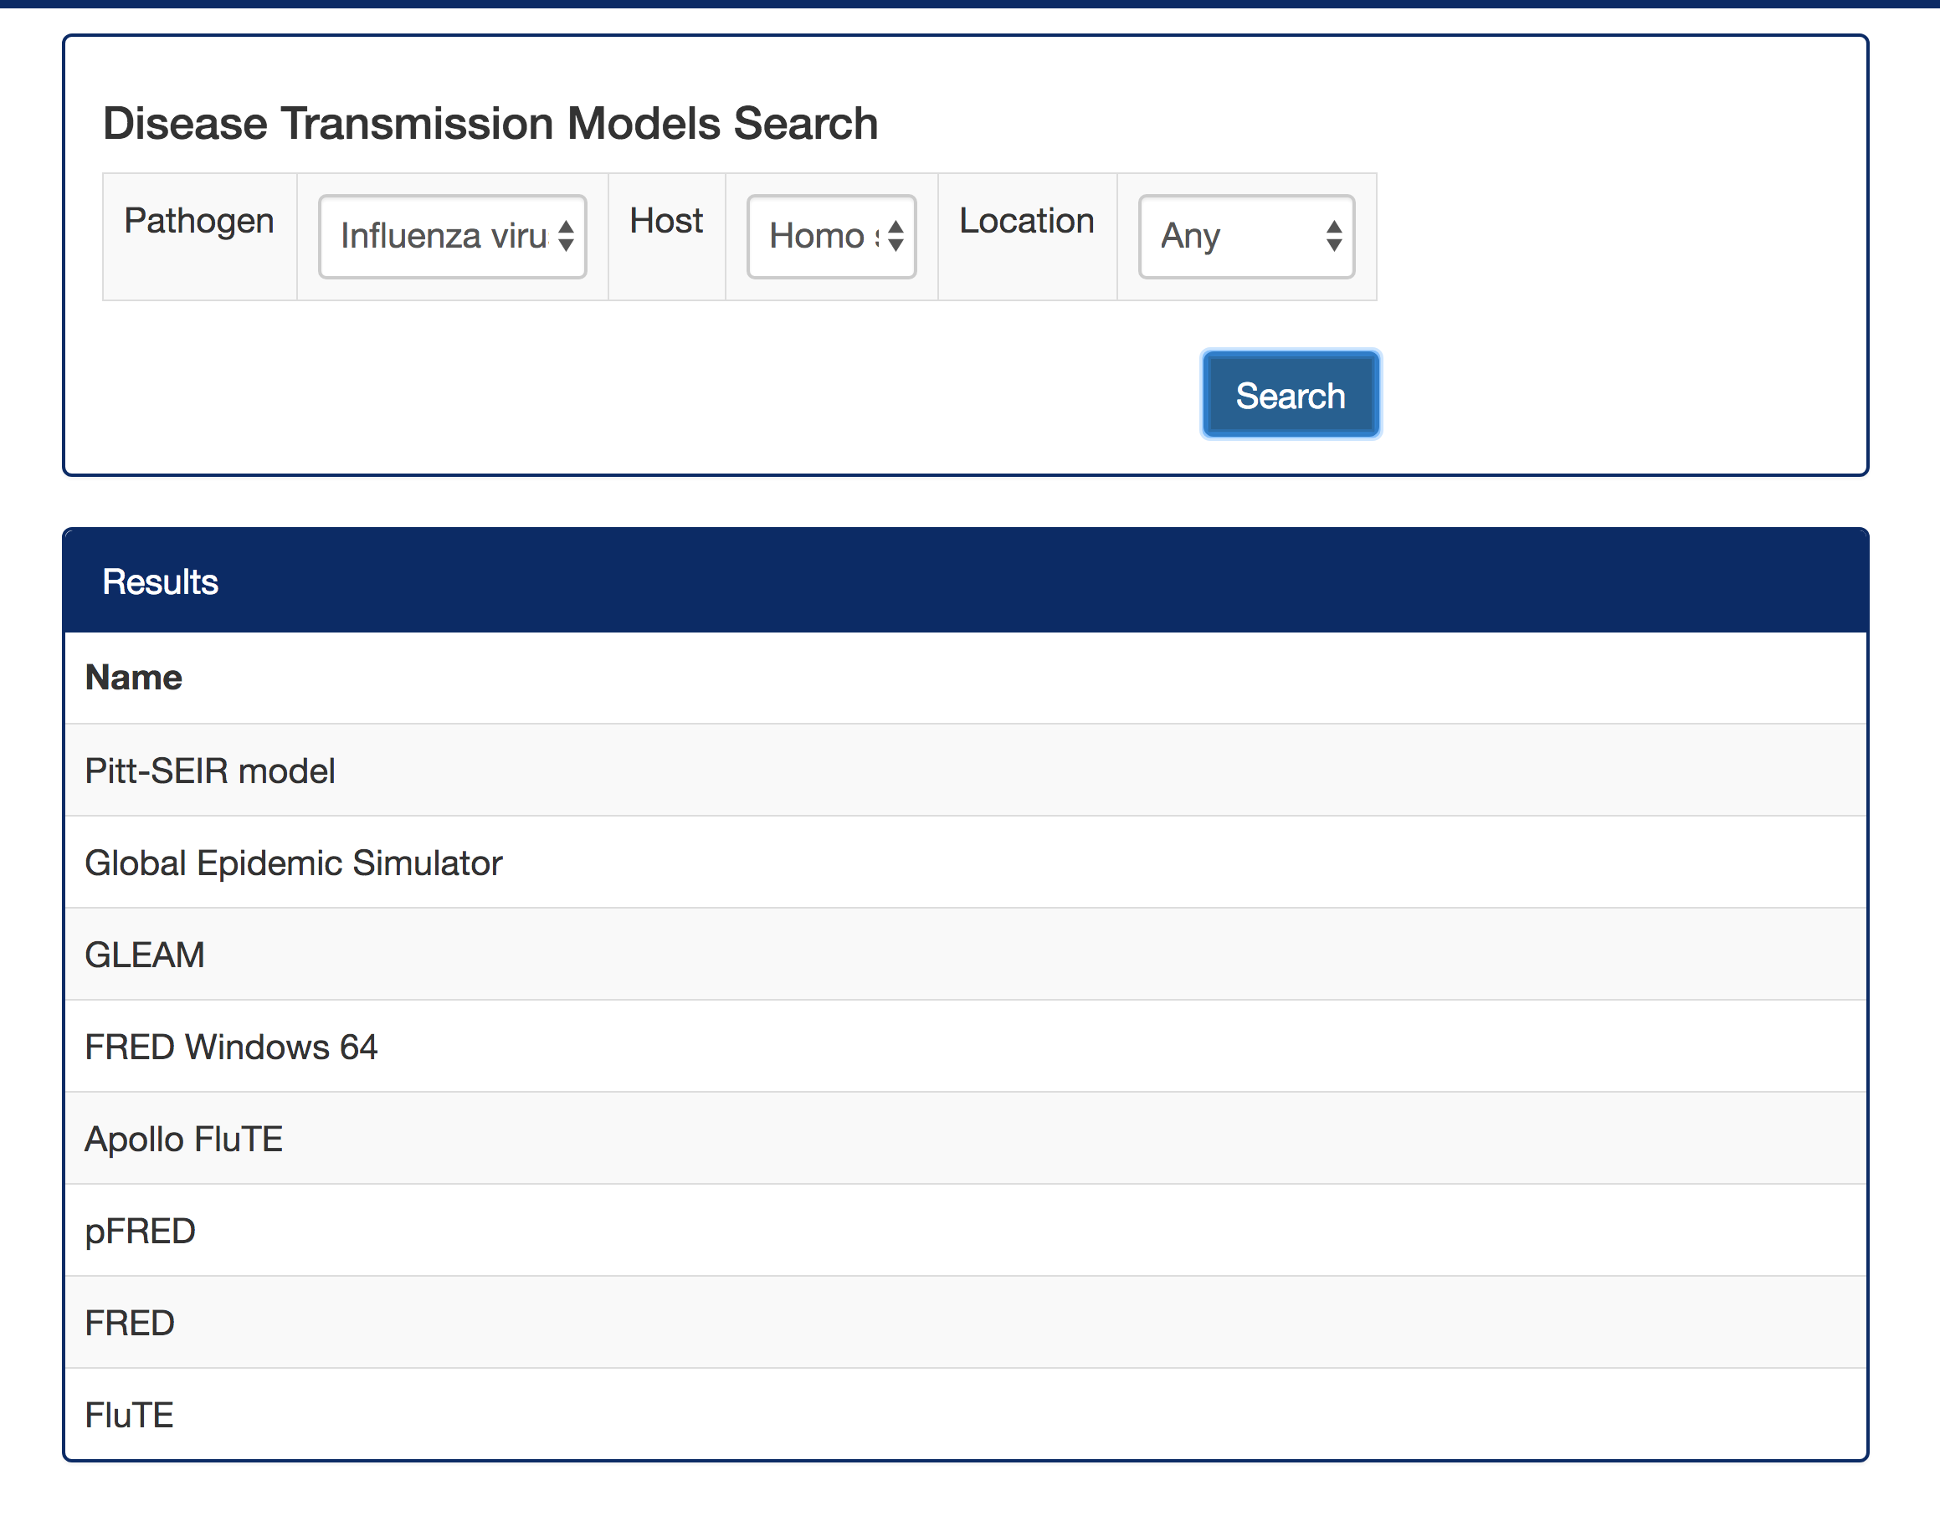
The MIDAS Digital Commons
Michael Wagner¹, MD, PhD, William Hogan² MD, MS, Wilbert van Panhuis⁴ MD PhD, Jeremy Espino¹ MD MS,
Shawn Brown³ PhD, Jay DePasse³, John Levander¹, Adam Darr¹, Max Sibilla¹, Sahawut Wesaratchakit¹ , Matthew Diller² and Jeffery Stazer¹
Informatics Services Group (¹University of Pittsburgh, Pittsburgh PA; ²University of Florida, Gainesville, FL; and ³Pittsburgh
Supercomputing Center, Pittsburgh, PA) and ⁴Graduate School of Public Health, University of Pittsburgh, Pittsburgh, PA.
MIDAS ISG Informatics Services Group
Objective
We created the MIDAS Digital Commons (MDC) to support epidemiologists who are developing computational models of biological phenomena such as epidemics, endemics and pathogen evolution. The MDC comprises (1) a set of digital objects compliant with FAIR (Findable, Accessible, Interoperable, and Re-usable) guidelines, (2) the Olympus compute platform, and (3) search pages for finding digital objects.
Methods and Results
We collected over 1,000 digital objects consisting of software, datasets and data formats. We created metadata representations of each object using DATS v2.2 JSON schemas for datasets and data formats and our own metadata schema for software. DATS is the metadata schema used by DataMed. We further represented the digital objects using an OWL-2 logical representation. The OWL-2 representations are stored in a Stardog triple store that supports logical queries for datasets and software.
We make the digital objects findable by displaying them on a browsable content page, and via multiple search functions.
The AOC labels on the content page indicate software and datasets that are available on the Olympus cluster. The Compute Platform tab contains a complete list of the programming languages, compilers, development tools, and disease transmission models that are available on Olympus.
Significance
The MDC’s potential is to facilitate scientific discovery. A now prevailing view in data-intensive science is that FAIR principles will assist humans and machines in their discovery of, access to, integration and analysis of, task-appropriate scientific data and their associated algorithms and workflows.
Objects
Representation Process
Data, Software & Data Format Discovery Index
Software
(61 objects)
Software represented per MDC Software Metadata v1.0 schema
OBC.ide¹
(Stardog
triple store)
(planned)
Software, dataset, and data format represented in
OWL-2 logical formalism
Data format represented per
DATS v2.2
DataStandard schema
SPARQL query
Data formats
(24 objects)
Visit the
MIDAS Digital Commons
Dataset represented per DATS v2.2 Dataset schema
(Data Discovery Only)
Datasets
(~940 objects)
(planned)
www.epimodels.org/apps/mdc
¹OBC.ide - Ontology-based Catalog of Infectious Disease Epidemiology
MIDAS Informatics Services Group
University of Pittsburgh, Pittsburgh Supercomputing Center, Carnegie Mellon University, University of Florida, Johns Hopkins
Notes:
1

