Slide 1
EtherCAT x86 主站應用討論

Slide 2
Agenda
Overview
OPC UA Server
OpenPLC

Slide 3
Overview (1/2)
Windows
Application
iFace SCADA
SoftPLC
NEXTW SDK
ADLink SDK
Windows 10/11
Acontis RT Linux
NEXTW
EtherCAT Master
EtherNet Network Card

Slide 4
Overview (2/2)
SCADA(iFix, Citect, WonderWare…)
OPC UA Client
OPC UA Server
NEXTW SDK
ADLink SDK
Windows 10/11
Acontis RT Linux
NEXTW
EtherCAT Master
EtherNet Network Card

Slide 5
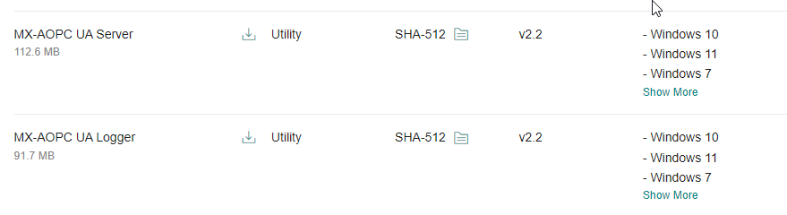
OPC UA Server (1/2)
https://ppt.cc/fm6W1x

Slide 6
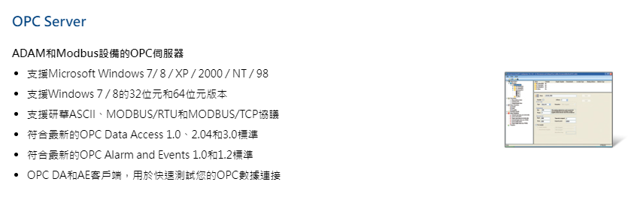
OPC UA Server (2/2)
https://ppt.cc/fdZB4x

Slide 7
OpenPLC (1/2)
OpenPLC Editor
  Generate .st (IEC 61131-1 Structure Text)
OpenPLC Runtime
  .st -> C/C++ -> mingw -> .exe
  Scan time
    Default: 20ms
    Mitsubishi FX3U: < 1ms

Slide 8
OpenPLC (2/2)
updateBuffersIn()
ST Program
updateBuffersOut()

