Slide 1
MONGODB

Slide 2
MySQL | MongoDB
Database | Database
Table | Collection
Row | Document
Column | Field
SQL | MongoDB Query Language
Fixed schema | Flexible schema

Slide 3
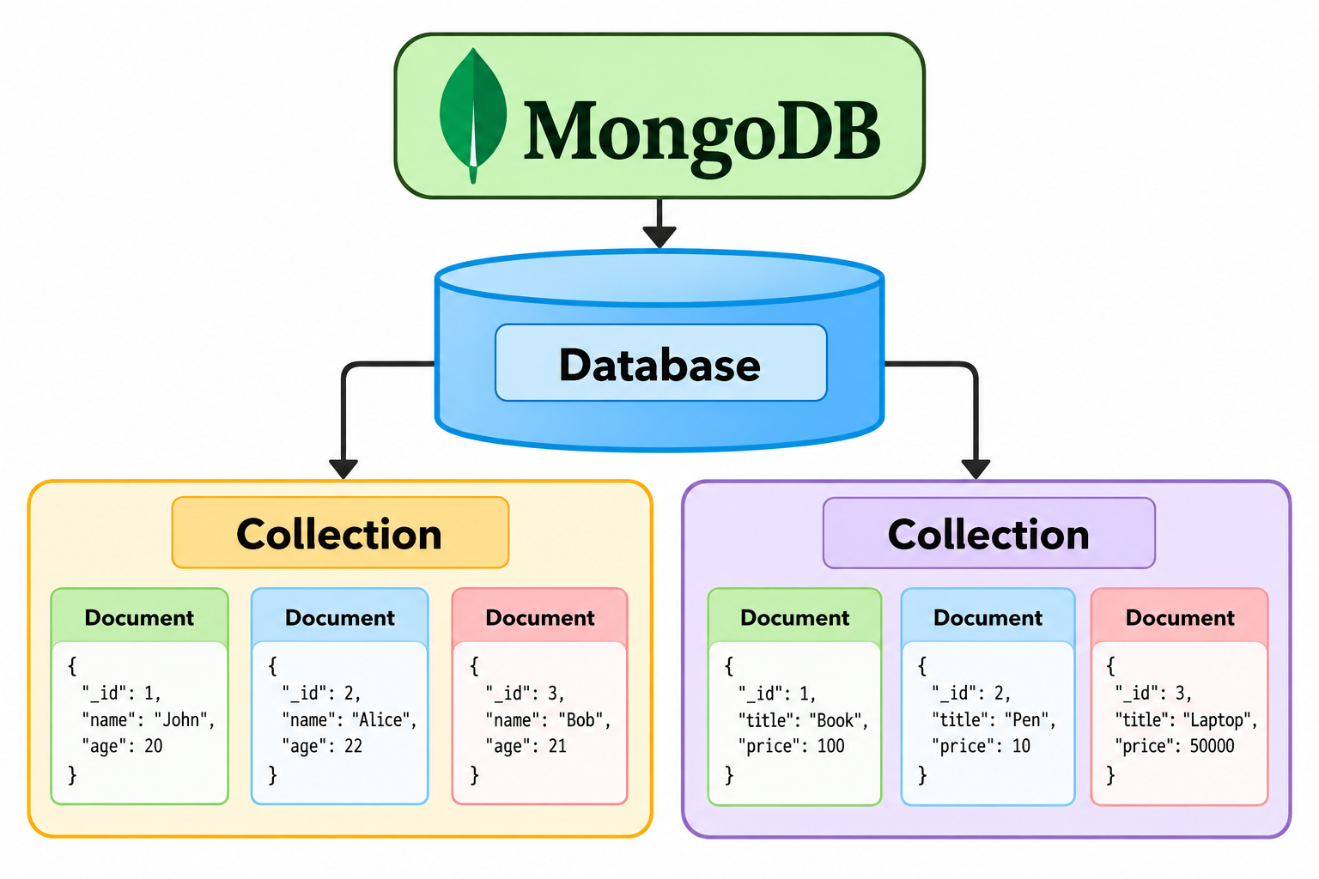
MongoDB Structure

Slide 4
Show all databases
show dbs

Slide 5
Change or Create a Database
ou can change or create a new database by typing use then the name of the database.
use Database_name
In MongoDB, a database is not actually created until it gets content!

Slide 6
Create Collection
Method 1
→You can create a collection using the createCollection() database method.
db.createCollection(“Collection_name")
db.createCollection("students")

Slide 7
Method 2
→You can also create a collection during the insert process.
db.posts.insertOne(object)
This will create the "posts" collection if it does not already exist.

Slide 8
Insert a Document
db.students.insertOne({
rollno: 101,
name: "Anu",
course: "BCA",
mark: 85
})

Slide 9
Insert Multiple Documents
db.students.insertMany([
{
rollno: 101,
name: "Anu",
course: "BCA",
mark: 85
},
{
rollno: 102,
name: "Rahul",
course: "BCA",
mark: 78
}
])

Slide 10
Display Documents
db.students.find()
db.students.find().pretty()
db.students.find({rollno: 101})
db.students.find({course: "BCA"})

Slide 11
Find Students with Mark Greater Than 80
→ db.students.find({mark: {$gt: 80}})
MongoDB | Meaning
$gt | Greater than
$gte | Greater than or equal
$lt | Less than
$lte | Less than or equal
$eq | Equal
$ne | Not equal
$in | Matches any value in an array
$nin | Does not match values

Slide 12
AND Condition
db.students.find({
course: "BCA",
mark: {$gt: 80}
})

Slide 13
OR Condition
db.students.find({
$or: [
{course: "BCA"},
{course: "MCA"}
]
})

Slide 14
Update a Document
db.students.updateOne(
{rollno: 101},
{$set: {mark: 90}}
)

Slide 15
Update Multiple Documents
db.students.updateMany(
{course: "BCA"},
{$inc: {mark: 5}}
)
$inc = increment

Slide 16
Delete a Document
db.students.deleteOne({rollno: 104})

Slide 17
Delete Multiple Documents
db.students.deleteMany({
course: "MCA"
})
This permanently removes matching documents, so should be careful.

Slide 18
Sorting
Sort by mark in ascending order
→db.students.find().sort({mark: 1})
Descending order
→db.students.find().sort({mark: -1})

Slide 19
Limit
Display only the first two students:
db.students.find().limit(2)

Slide 20
Count Documents
db.students.countDocuments()
→ db.students.countDocuments({
course: "BCA"
})

Slide 21
Aggregation
db.students.aggregate([
{
$group: {
_id: null,
averageMark: {$avg: "$mark"}
}
}
])

Slide 22
Projection
db.students.find(
{},
{name: 1, mark: 1}
)
1 means include the field.
0 means Exclude the field.

