Slide 1
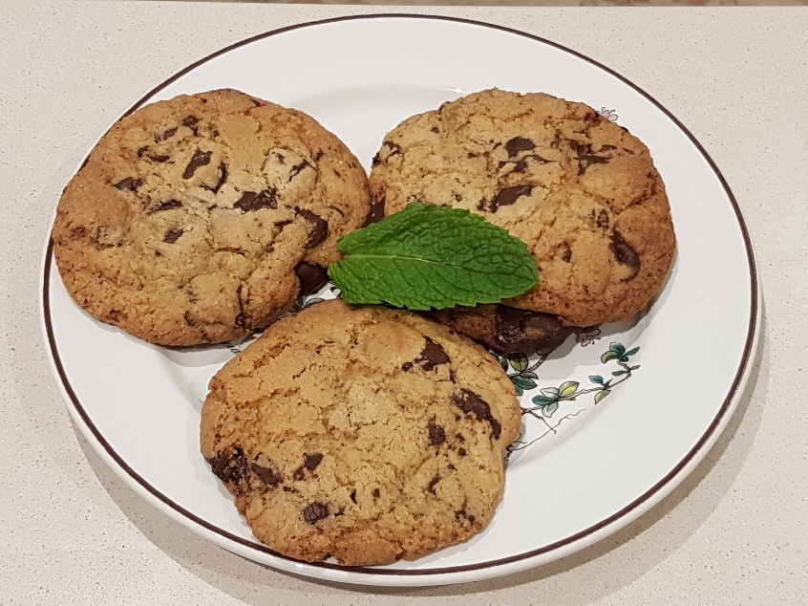
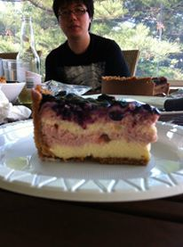
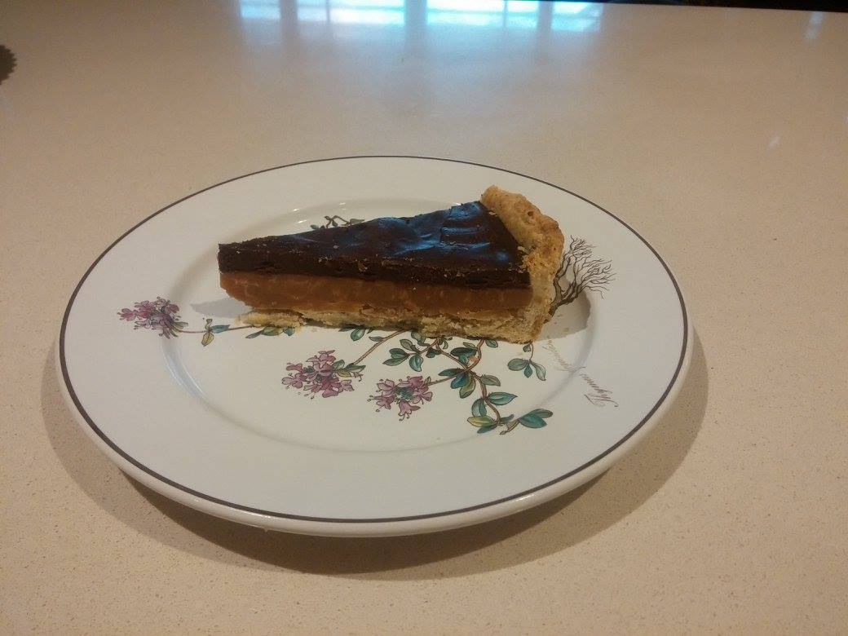
Recipe Database
By John Massy-Greene

Slide 2
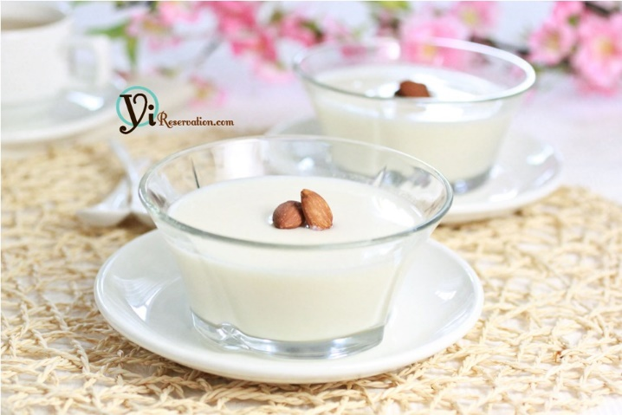
Inspiration/Requirements for Database
I required a storage method for recipes that I used or came up with that would be lightweight, wouldn’t degrade with time and wouldn’t be easily lost.
Lost many recipes by storing the adjustments in just my head.
So what entities and information are required for a recipe database?
Recipes – instructions, who created them, time to create them
Ingredients - name, units of measurement, allergy information
How much of the ingredient is used in the recipe?
Can recipe’s use other recipes in their creation?
Can you substitute ingredients in a recipe? Can you use these substitutions in any recipe?
What sort of people are going to connect to and use my database ?
Almond Jelly (杏仁豆腐） Recipe
Milk – 400 ml
Sugar – 4 tablespoons
Almond essense – 1 Teaspoon
Agar Agar Powder – 5-10 grams
Cream(optional) 50 ml
Instructions:
Dissolve gelatin in cold water.
Heat milk gently, making sure it doesn’t boil
Add sugar and stir till dissolved
Turn off heat, add cream, agar agar and essense
Stir well and allow to cool
Source: http://sumokitchen.com/JapaneseRecipes/japanese-annindofu/

Slide 3
UserTypes
type
role
description
Component
mainID *
compID *
step
Recipe
recID
title
Instruction
time
Notes
Source
UID *
hasComponents
gfLevel
vegLevel
nutFree
dairyFree
Pictures
link
recID *
descriptor
Users
UID
name
password
type *
Contains
recID *
iname *
amount
units
cups
Ingredient
iname
metricToCup
gfLevel
vegLevel
nuts
dairy
Substitution
mainIngred *
subIngred *
recipe *
notes

Slide 4
A One to Many Relationship
UserTypes
type | role | description
1 | Super Admin | This role has access to all privileges
2 | Admin | User can read all tables, write their own recipes and add or delete users, except admins
3 | Regular | Can read all tables(except users and userTypes) and write their own recipes and upload pictures
4 | Guest | Can only read all tables(except users and userTypes)
UserTypes
type
role
description
Users
UID
name
password
type *
Users
ID | Name | password | Type
1 | John Massy-Greene | sexbomb | 1
2 | Kat Goh | ameizing | 2
3 | Jax Arnold | gremlin | 2
4 | Andrew Lem | bananas | 3
5 | Joshua Ching | iheartpi | 3

Slide 5
Recipe Database – A Many-to-Many Relationship
Recipe
recID
uID *
title
Instructions
time
Notes
Source
hasComponents
gfLevel
vegLevel
nutFree
dairyFree
Contains
recID *
iname *
amount
units
cups
Ingredient
iname | metricToCup | gfLevel | vegLevel | nutFree | dairyFree
Peanut butter | 250 | 1 | 1 | False | True
White sugar | 225 | 1 | 1 | True | True
Egg | NULL | 1 | 2 | True | True
Ingredient
iname
metricToCup
gfLevel
vegLevel
nutFree
dairyFree

Slide 6
Recipe
recID | UID | Title | instructions | Time | Notes | source | gfLevel | vegLevel | nutFree | dairyFree
5 | 1 | 3-Ingrediant Peanutt Butter Cookies | Preheat oven to 350. Mix All Ingrediants together. Bake | 20 | Adding cranberries makes these even better | www.epicurious.com | 1 | 2 | False | True
Contains
recID | Iname | amount | Unit | cups
5 | Peanut butter | 1 | NULL | TRUE
5 | White sugar | 1 | NULL | TRUE
5 | Egg | 1 | unit(s) | FALSE

Slide 7
Querying The Dabatabase A simple Query
Output
The Query
select *
from substitution
where recipe = 0;
Explanation
Find all the general purpose substitutions. That is substitutions that can usually be used in any baking recipe.
mainingred | subingred | recipe | notes
baking powder | baking soda | 0 | 1 tspn to 1/4 tspn of baking soda + 1/2 teaspoon of cream of tar tar
baking powder | cream of tartar | 0 | 1 tspn to 1/4 tspn of baking soda + 1/2 teaspoon of cream of tar tar
cream of tartar | lemon | 0 | 1:1 substitution
cream | whole milk | 0 | substitute 1 cup of cream for 210ml mls of whole milk + 25g of melted butter
cream | unsalted butter | 0 | substitute 1 cup of cream for 210ml mls of whole milk + 25g of melted butter
vanilla pod | vanilla extract | 0 | 1/2 a vanilla pod = 1 teaspoon of vanilla extract
corn starch | AP flour | 0 | 1 tablespoon of cornstarch = 2 tablespoons of all purpose flour

Slide 8
Querying The Dabatabase Natural Join Query and Cross Product Notation
The Query
select uid, name, recID, title
from users natural join recipe
where source is NULL AND and recID <> 0;
OR
select a.uid, a.name, b.recID, b.title
from users as a, recipe as b
Where a.uid = b.UID AND
b.source is NULL AND b.recID <> 0;
Explanation
Find the names of users and the recipe that they’ve done where they came up with the recipe themselves. That is did not take the recipe from a source.
Output
uid | name | recid | title
5 | Joshua Ching | 1 | Easy Watermelon Treat
2 | Kat Goh | 4 | Onde Onde
5 | Joshua Ching | 9 | Hazlenut Crust
5 | Joshua Ching | 10 | Simple Salted Caramel
5 | Joshua Ching | 11 | Chocolate Ganache
5 | Joshua Ching | 12 | Salted Caramel Chocolate Tart
4 | Andrew Lem | 13 | Rhubarb Strawberry Pie Filling

Slide 9
Querying The Dabatabase A group by query
The Query
select title, count(*) as ingredientNum
from recipe natural join contains
group by title
order by count(*);
Explanation
Find all the recipes with ingredients and count how many ingredients there are in each recipe. Then order the table in descending order by the number of ingredients
Output
title | ingrediantNum
Chocolate Ganache | 2
Easy Watermelon Treat | 2
3-Ingediant Peanut Butter Cookies | 3
Double Pie Crust | 4
Easy apple cake | 4
Hazelnut Crust | 5
Simple Salted Caramel | 5
Alice's House Truffles 4.0 | 5
Onde Onde | 5
Rhubarb Strawberry Pie Filling | 6
Baileys Cookies | 8
Choc Chunk Cookies GF | 12

Slide 10
Querying The Dabatabase Using subqueries
The Query
select title, count(*)
from recipe natural join contains
where recID not in
(select compID from component)
group by title
having count(*) <= 4
order by count(*);
Explanation
A user may wish to find recipes that a simple to make(requiring 4 ingredients or less). But in order to make sure those recipes are truly simple they can’t be apart of a larger recipe.
Output
title | count
Easy Watermelon Treat | 2
3-Ingediant Peanut Butter Cookies | 3
Easy apple cake | 4

Slide 11
Querying The Dabatabase Non-Natural Join Cross Products
The Query
select title, step
from recipe as a, component as b
where a.recID = b.compID and b.mainID = 12
order by b.step;
Explanation
Find all the names of recipe components that are required to make the salted caramel chocolate tart. Order them by the order in which they are made in main recipe.
Output
title | step
Hazelnut Crust | 1
Simple Salted Caramel | 2
Chocolate Ganache | 3

Slide 12
Domain Integrity The use of check statements
Contains
recID *
iname *
amount
units
cups
Examples of constraints in the Contains table
CONSTRAINT contain_unit1 CHECK ((cups is TRUE AND unit IS NULL)
OR (cups is FALSE and unit IS NOT NULL))
Either the ingredient can have a unit of measurement assigned to it or it will use cups. The reasoning behind this is that users may wish to switch or convert between cups and units of measurement which are mutually exclusive methods of measurement.

Slide 13
Domain Integrity The use of check statements
Examples of constraints in the Contains table
CONSTRAINT contain_unit2 CHECK(unit IN ('ml', 'l', 'mg', 'g', 'kg', 'unit(s)','tspn', 'tbspn', 'lb', 'oz'))
Precise units of measurement are required in some recipes(especially desserts) in order for the recipe to be successful. A “pinch” of salt is usually ok but being imprecise when specifying the ingredients in a recipe will result in yourself and others not being able to replicate the results and could potentially end up in disaster.

Slide 14
Domain Integrity The use of check statements
Ingredient
iname
metricToCup
gfLevel
vegLevel
nuts
dairy
Example of a constraint in the Ingrediant table
CONSTRAINT ingred_vegLevel CHECK(vegLevel >= 1 AND vegLevel <= 3)
vegLevel is part of the allergen attributes that is present in both the recipe and ingrediant table. It is a number that is one of three values:
1 = vegan friendly. 2 = vegetarian friendly.
3 = only suitable for those who eat meat (bacon icecream is actually pretty good)

Slide 15
Use of Action Statements
Recipe
recID
title
Instruction
time
Notes
Source
UID *
hasComponents
gfLevel
vegLevel
nutFree
dairyFree
Contains
recID *
iname *
amount
units
cups
CONSTRAINT rec_FK FOREIGN KEY(uID) REFERENCES users(uID) ON DELETE CASCADE
A recipe is dependent on the user that creates them. So if a user leaves the database or is deleted then their recipes are no longer relevant or needed.
CONSTRAINT contain_FK2 FOREIGN KEY(iname) REFERENCES ingrediant(iname) ON DELETE RESTRICT
Ingredients are used by many recipes and are essentially the body of a recipe so we want to make absolutely sure that an ingredient needs to be deleted otherwise it can affect many tables.

Slide 16
Use of Views
With any recipe a person, company or party can claim any number of health benefits. However if a person knows what ingredients are used they can judged for themselves if these claims are legitimate.
Within the database this can be solved via the use of triggers.
create view jointAllergens AS
select recID, iname, gfLevel, vegLevel, nutfree, dairyfree
from contains natural join ingredient;
create view recipeGF AS
select recID, max(gfLevel) as gfLevel
from jointAllergens
group by recID;
create view recipeVLevel AS
select recID, max(vegLevel) as vegLevel
from jointAllergens
group by recID;
create view recipeNuts AS
select recID, bool_and(nutfree) as nutFree
from jointAllergens
group by recID;
create view recipeDairy AS
select recID, bool_and(dairyfree) as dairyfree
from jointAllergens
group by recID;
create view recipeAllergyMatrix AS
SELECT a.recID, a.title, b.gfLevel,
c.vegLevel, d.nutFree, e.dairyfree
FROM recipe as a, recipeGF as b,
recipeVLevel as c, recipeNuts as d, recipeDairy as e
WHERE a.recID = b.recID
AND a.recID = c.recID
AND a.recID = d.recID
AND a.recID = e.recID;

Slide 17
Use of Views
recid | title | gflevel | veglevel | nutfree | dairyfree
14 | Easy apple cake | 3 | 2 | t | t
13 | Rhubarb Strawberry Pie Filling | 1 | 2 | t | f
11 | Chocolate Ganache | 2 | 2 | f | f
10 | Simple Salted Caramel | 1 | 2 | t | f
9 | Hazlenut Crust | 3 | 2 | f | f
8 | Double Pie Crust | 3 | 2 | t | f
6 | Alice's House Truffles 4.0 | 2 | 2 | f | f
5 | 3-Ingediant Peanut Butter Cookies | 1 | 2 | f | t
4 | Onde Onde | 1 | 1 | t | t
3 | Choc Chunk Cookies GF | 2 | 2 | f | f
2 | Baileys Cookies | 3 | 2 | f | f
1 | Easy Watermelon Treat | 1 | 1 | t | t

