Slide 1
CGS 1060C · OPERATING SYSTEMS
Win
+
V
Windows 11: the parts worth knowing
Win
+
Z
Win
+
.
The essentials from the chapter, the features that changed since it was written, and the shortcuts almost nobody finds on their own.
Notes:
Framing: students already use Windows, so skip "click Start to open Start." Tonight focuses on three things: what the textbook has out of date, the security and file habits that actually prevent lost work, and shortcuts that save time every week. Timing: about 35 to 45 minutes with demos. Have a Windows 11 PC on screen share throughout; almost every slide ends in a live demo.

Slide 2
READ THIS FIRST
What's changed since the textbook
The chapter says | Windows 11 today
Create documents in WordPad | WordPad was removed in version 24H2. Use Notepad for plain text and Word for formatted documents.
Win + A opens the Action Center | Win + A opens Quick Settings. Win + N opens notifications and the calendar.
Ease of Access Center | Settings › Accessibility
Settings › Apps › Apps & features | Settings › Apps › Installed apps
Alt + F4 turns the device off | Alt + F4 closes the current app. On an empty desktop, it opens a Shut Down dialog.
Notes:
The McGraw-Hill slides predate several Windows 11 updates. SimNet simulations may still show older screens, so tell students both names are the same feature. Extra changes to mention if asked: pinned apps on Start are icons, not tiles (tiles were Windows 10); Focus Assist became Do not disturb plus Focus sessions; slide 22 in the textbook deck is titled Windows 10 by mistake. In current builds, All apps is shown by scrolling down the Start menu rather than a button in the top right. DEMO: search Start for WordPad to show it is gone, then open Notepad.

Slide 3
Home or Pro: what your PC runs
Windows 11 Home
Windows 11 Pro
For personal devices. Includes Windows Hello sign-in, Microsoft Defender, and device encryption on most modern hardware.
For business and school. Adds BitLocker management, Remote Desktop hosting, Group Policy, and joining an organization's network.
Check yours: Settings › System › About, under Windows specifications.
Notes:
Keep this short. The practical point is that most students have Home, and Home still encrypts the drive on most modern hardware if they sign in with a Microsoft account. Worth mentioning: Windows 10 reached end of support in October 2025, so students still on Windows 10 no longer get free security updates. DEMO: Settings › System › About, show edition, version (for example 24H2 or 25H2), and device name.

Slide 4
SURPRISING BUT TRUE
A PIN is safer than a password
PIN
Password
A PIN only works on this one device. Someone who learns it still needs your physical PC.
Chosen at setup. Stored on the device.
Your Microsoft account password.
A stolen password works from any computer in the world, and often unlocks your email too.
Face
Fingerprint
Needs a compatible webcam.
Built-in or USB reader.
Set up or change them: Settings › Accounts › Sign-in options
Notes:
Students assume a 4-digit PIN is weaker than a long password. Microsoft designed Windows Hello PINs to be tied to the device hardware, so the PIN is never sent to a server and is useless elsewhere. Face, fingerprint, and PIN together are called Windows Hello. DEMO: Settings › Accounts › Sign-in options; show PIN (Windows Hello) and the option to require sign-in after sleep.

Slide 5
Walking away: lock, sign out, sleep, or shut down
Action | How | Your open work | Use it when
Lock | Win + L | Stays open | Stepping away for a minute
Sign out | Start › your name › Sign out | Apps close | Someone else will use this PC
Sleep | Start › Power › Sleep | Kept in memory on low power | Coming back later today
Shut down | Start › Power › Shut down | Everything closes | Done for the day or installing updates
On a shared or campus computer, sign out. Locking still leaves your accounts open.
Notes:
The chapter covers each separately; the confusing part is choosing. Emphasize Win + L as the habit to build. Mention that Restart, not Shut down, is what finishes most updates, and that closing a laptop lid usually means Sleep. DEMO: Win + L, sign back in with PIN; then show Start › Power menu options.

Slide 6
Nine shortcuts from the chapter
Win
+
L
Win
+
E
Win
+
I
Lock the PC
Open File Explorer
Open Settings
Win
+
S
Win
+
A
Win
+
N
Search apps, files, and the web
Quick Settings
Notifications and calendar
Win
+
W
Win
+
D
Alt
+
Tab
Widgets board
Show or hide the desktop
Switch between open apps
Notes:
Hold the first key, tap the second. Win means the Windows logo key. Point out the pattern: Win plus a letter opens a place in Windows. Correction to the chapter: Win + A is Quick Settings, and notifications moved to Win + N. DEMO: go around the grid quickly; ask students to try each one along with you.

Slide 7
HIDDEN GEMS
Six shortcuts the chapter skips
Win
+
V
Win
+
Shift
+
S
Win
+
.
Clipboard history: paste anything you copied recently
Screenshot any part of the screen
Emoji, symbols like ©, and accented letters
Ctrl
+
Shift
+
Esc
Win
+
Z
Win
+
Tab
Task Manager, for an app that stops responding
Snap layouts for the current window
Task View and virtual desktops
Notes:
These get the biggest reaction. Win + V: the first time, Windows asks to turn clipboard history on; pinned items survive restarts. Win + Shift + S: the screenshot goes to the clipboard, and a notification opens it in Snipping Tool for saving or marking up; great for sending an error message to the instructor. Win + period: accented letters are under the Symbols tab, useful for Spanish names. Ctrl + Shift + Esc: select the frozen app, End task. DEMO each one live.

Slide 8
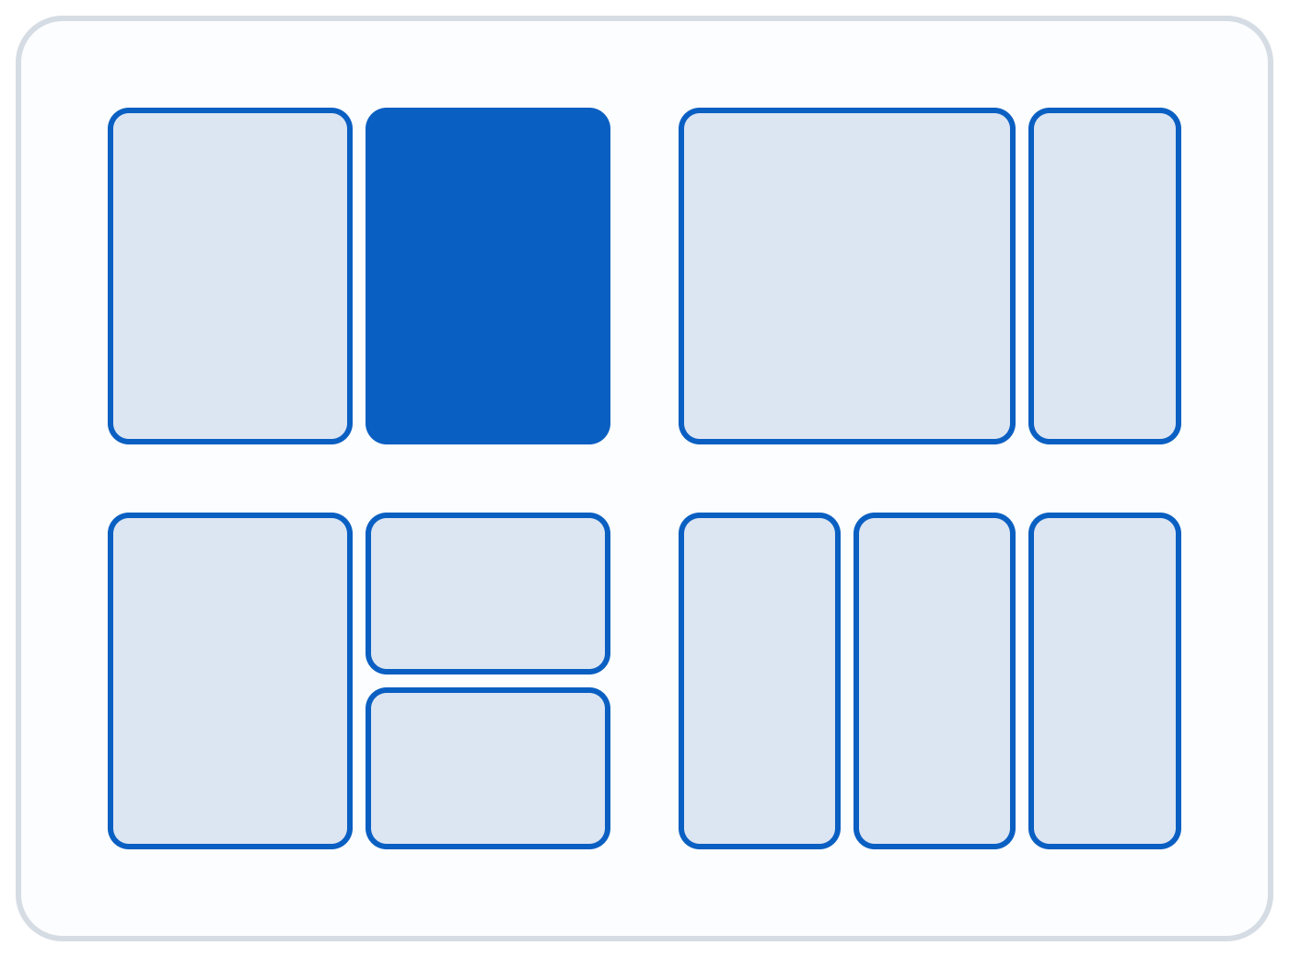
Snap two windows side by side
Hover the Maximize button
A layout picker appears. Click the zone where this window should go.
Or drag a window to the top
Layouts drop down from the top edge of the screen.
Then fill the rest
Snap Assist offers your other open windows for the empty zones.
Notes:
Snap is the feature students most often use accidentally and then cannot undo. Keyboard version: Win + left or right arrow snaps to half the screen; Win + Z opens the layout picker. To un-snap, drag the title bar away from the edge. Practical use for this class: SimNet or the textbook on one side, the app on the other. DEMO: hover Maximize on Edge, pick the left half, choose File Explorer for the right half.

Slide 9
HIDDEN GEM
Separate desktops for class, work, and home
Class
Work
Personal
Shortcut | What it does
Win + Tab | Open Task View: every window and desktop
Ctrl + Win + D | Create a new desktop
Ctrl + Win + ← / → | Switch desktops
Notes:
The chapter mentions the New desktop button in Task View; the payoff is organization. Apps stay on the desktop where they were opened, so the Class desktop can hold Teams, Canvas, and Word while Personal holds everything else. Closing a desktop (Ctrl + Win + F4) moves its windows to the neighboring desktop rather than closing them. You can rename a desktop by clicking its name in Task View. DEMO: Win + Tab, New desktop, rename it Class, open apps, then switch with Ctrl + Win + arrows.

Slide 10
Two panels in the corner of the taskbar
Win
+
A
Win
+
N
Quick Settings
Notifications
Wi-Fi, Bluetooth, volume, brightness, airplane mode, and Night light.
Alerts, the calendar, and Do not disturb to silence alerts during class or tests.
Click the pencil icon to add or remove buttons.
Focus sessions start a timer that also silences alerts.
Too many pop-ups? Settings › System › Notifications turns them off app by app.
Notes:
The textbook still calls this the Action Center, which was the Windows 10 name. In Windows 11, clicking the network, volume, or battery icons opens Quick Settings; clicking the date and time opens notifications. At the bottom of Settings › System › Notifications, under Additional settings, turn off Windows tips and suggestions, which the chapter recommends. DEMO: Win + A, edit with the pencil, add Accessibility; Win + N, turn on Do not disturb.

Slide 11
File Explorer: know where you are
Home
This PC
Recent files and favorites. Replaced Quick Access, and it is where Explorer opens.
Your drives and USB devices. Older versions called it My Computer.
The address bar
Tabs
Click the empty space beside the folder names to reveal the full path.
Press Ctrl + T for a new tab, just like a web browser.
Notes:
Open with Win + E. The address bar tip is the most useful for troubleshooting: clicking the blank area turns the breadcrumb into a typed path such as C:\Users\name\OneDrive\Documents, which explains where a file really is. Tabs arrived in a 2022 update, so older screenshots will not show them. DEMO: Win + E, open Documents, click the address bar to show the path, Ctrl + T for a second tab, drag a file between tabs.

Slide 12
SECURITY HABIT
Turn on file extensions
Extension | Opens in
.docx | Word
.xlsx | Excel
.pptx | PowerPoint
.pdf | PDF reader or browser
.txt | Notepad
.jpg .png | Photos
.zip | Compressed folder
.exe | Runs a program
What you see with extensions hidden
Syllabus.pdf
What the file really is
Syllabus.pdf.exe
A program disguised as a document.
File Explorer › View › Show › File name extensions
Notes:
The chapter defines extensions but Windows hides them by default, which is exactly how disguised attachments trick people. Once extensions are visible, a file ending in .exe that claims to be a PDF is obvious. Also mention: renaming a file changes only the name, not the format; changing .docx to .pdf does not convert it. DEMO: in File Explorer, View › Show › File name extensions, then rename a copy of a .txt to .pdf and show it will not open correctly.

Slide 13



HIDDEN GEM
Is my file on this PC or in the cloud?
Documents, Desktop, and Pictures may already be backed up to OneDrive. The Status column in File Explorer tells you where each file lives.
Online only
On this device
Always keep
Saved in OneDrive, not on this PC. Needs internet to open.
Downloaded when you opened it. Windows may free up the space later.
Stays on this PC even offline. Right-click › Always keep on this device.
Notes:
This explains the classic student complaints: a file vanished from the laptop (it is online only), or a file will not open on the bus (no internet). If the address bar path includes OneDrive, the folder is being synced. Before a trip or test, right-click a folder and choose Always keep on this device. Recycle Bin note: files deleted from OneDrive folders can also be recovered from the OneDrive website. DEMO: open Documents in File Explorer, point to the Status column, and set a file to Always keep on this device.

Slide 14
Right-click the taskbar before you search
Jump Lists
Pin a file
Pin an app
Right-click an app on the taskbar to see its recent files. On a touchscreen, drag the icon upward.
Hover a file in the Jump List and click the pin. It stays at the top until you unpin it.
Right-click it in Start and choose Pin to taskbar or Pin to Start. Right-click again to unpin.
Pin the files you open every week: this syllabus, your notes, the SimNet link.
Notes:
Jump Lists are the chapter item students find most useful once they see it, and most never discover it on their own. File Explorer's Jump List shows pinned and frequent folders. DEMO: right-click Word on the taskbar, pin a recent document; right-click File Explorer and pin a class folder; then pin Calculator to the taskbar from Start.

Slide 15
Install and remove apps safely
Install
Remove
Microsoft Store: search, then select Get. Store apps are checked by Microsoft and update themselves.
Settings › Apps › Installed apps, then the ··· menu › Uninstall.
Other programs: download only from the maker's official website, never from pop-up ads or "free download" sites.
Or right-click the app in Start › Uninstall.
Older desktop programs may use Control Panel › Programs and Features.
Notes:
Many Store apps are free, but some charge; Store purchases go through the Microsoft account, so no card details are typed into a website. Third-party download sites often bundle adware; that is the practical warning. Note the chapter lists Apps & features, which is now Installed apps. DEMO: open Microsoft Store, search for an app, show the price and ratings without installing; then Settings › Apps › Installed apps, sort by size.

Slide 16
Settings worth a visit
Win
+
I
Where | Why
Windows Update | Set Active hours so restarts wait until you are done. Pause only for short periods.
System › Power & battery | Choose Best power efficiency or Best performance.
Apps › Default apps | Make Chrome or Firefox your default browser instead of Edge.
System › Display › Advanced display | Pick a higher refresh rate for smoother scrolling.
Personalization › Taskbar | Move Start back to the left under Taskbar behaviors.
Time & language › Language & region | Change the Windows display language.
Notes:
These are the chapter's settings, ordered by how often students need them. Windows Update: Advanced options › Active hours is the fix for surprise restarts during an online test. Pausing updates skips security fixes, so resume soon. Refresh rate options depend on the monitor (60 Hz, 120 Hz, 144 Hz...). Taskbar alignment Left is the most requested change from Windows 10 users. DEMO: open Settings with Win + I and use the search box at top left to jump to each one, which is faster than browsing.

Slide 17
HIDDEN GEMS
Accessibility tools anyone can use
Win
+
+
Win
+
Ctrl
+
L
Win
+
H
Magnifier: zoom into part of the screen
Live captions for any audio, including recordings
Voice typing into any text box
Win
+
Ctrl
+
Enter
Win
+
Ctrl
+
O
Shift ×5
Narrator reads the screen aloud
On-Screen Keyboard, no touchscreen needed
Sticky Keys: press shortcut keys one at a time
All of them live in Settings › Accessibility, which the chapter calls Ease of Access.
Notes:
Frame these as productivity tools, not only disability features. Live captions work on this class's recorded lectures and on any video without captions; the first use downloads a language pack. Voice typing needs an internet connection and a microphone. Press Win + Esc to close Magnifier. If Sticky Keys turns on by accident (five Shift presses), press Shift five times again or turn it off in Settings. DEMO: Win + Ctrl + L while playing a short video, then Win + H in Notepad.

Slide 18
Try these five before next week
Win + V
Turn on clipboard history
Win + Shift + S
Take a screenshot
Win + Z
Snap two windows
View › Show
Turn on file extensions
File Explorer
Check your OneDrive status icons
Notes:
Close by having students actually do the five items while you are still on the call, then take questions. Encourage them to screenshot an error with Win + Shift + S when they ask for help instead of describing it.

