Slide 1

Agent Zero
Stop Reading Email and Teams Messages. Start Acting.
more impact
THE PROBLEM
BUSINESS VALUE
28%
~30 min
Missed
⏱ ~30 min saved daily
Eliminates manual email/Teams scanning per knowledge worker
of a knowledge worker’s day spent reading email
daily wasted scanning for action items
deadlines, lost context, dropped threads
🎯 Zero missed action items
AI identifies tasks humans might overlook in busy inboxes
Outlook and Teams deliver messages. They never act on them. No agent watches your M365 for commitments, deadlines, or follow-ups — until now.
🔄 Automatic thread monitoring
Continuous update checks — stay current without effort
💰 Zero storage cost
THE SOLUTION — 4 SPECIALIZED AI AGENTS
Runs 100% locally — no cloud deployment, no new licenses
1
Discovery Agent
~60s
🔗 Works with existing M365
Scans email & Teams subjects. Identifies actionable messages. Creates task cards with title, source, sender, and direct link.
No migration needed — leverages current email and Teams
RESPONSIBLE AI BY DESIGN
2
Enrichment Agent
~60–300s
Extracts full conversation content. Generates summaries with temporal awareness. Detects ambiguities and asks clarifying questions.
🛡️ Hallucination Prevention
Agents report failure honestly — never fabricate information
Update Check Agent
~30–90s
⚠️ Ambiguity Detection
3
Uncertain results flagged as needs-review with clarifying questions
Detects new replies since last check. Updates summaries with only new information. Runs on every scan cycle.
🕰 Temporal Awareness
Distinguishes current vs. historical information using timestamps
4
Search Agent
~30–120s
🔒 Data Privacy & Retention
Goal-oriented search with 3-attempt strategy, self-assessment, confidence levels, and bilingual keyword support.
All data local — auto-deleted after configurable period (default 3 days)
👤 Human in the Loop
Built with GitHub Copilot SDK · Work IQ MCP · Node.js + Express
AI provides summaries and recommendations — never acts autonomously
github.com/JohnMavic/Work_IQ

Slide 2
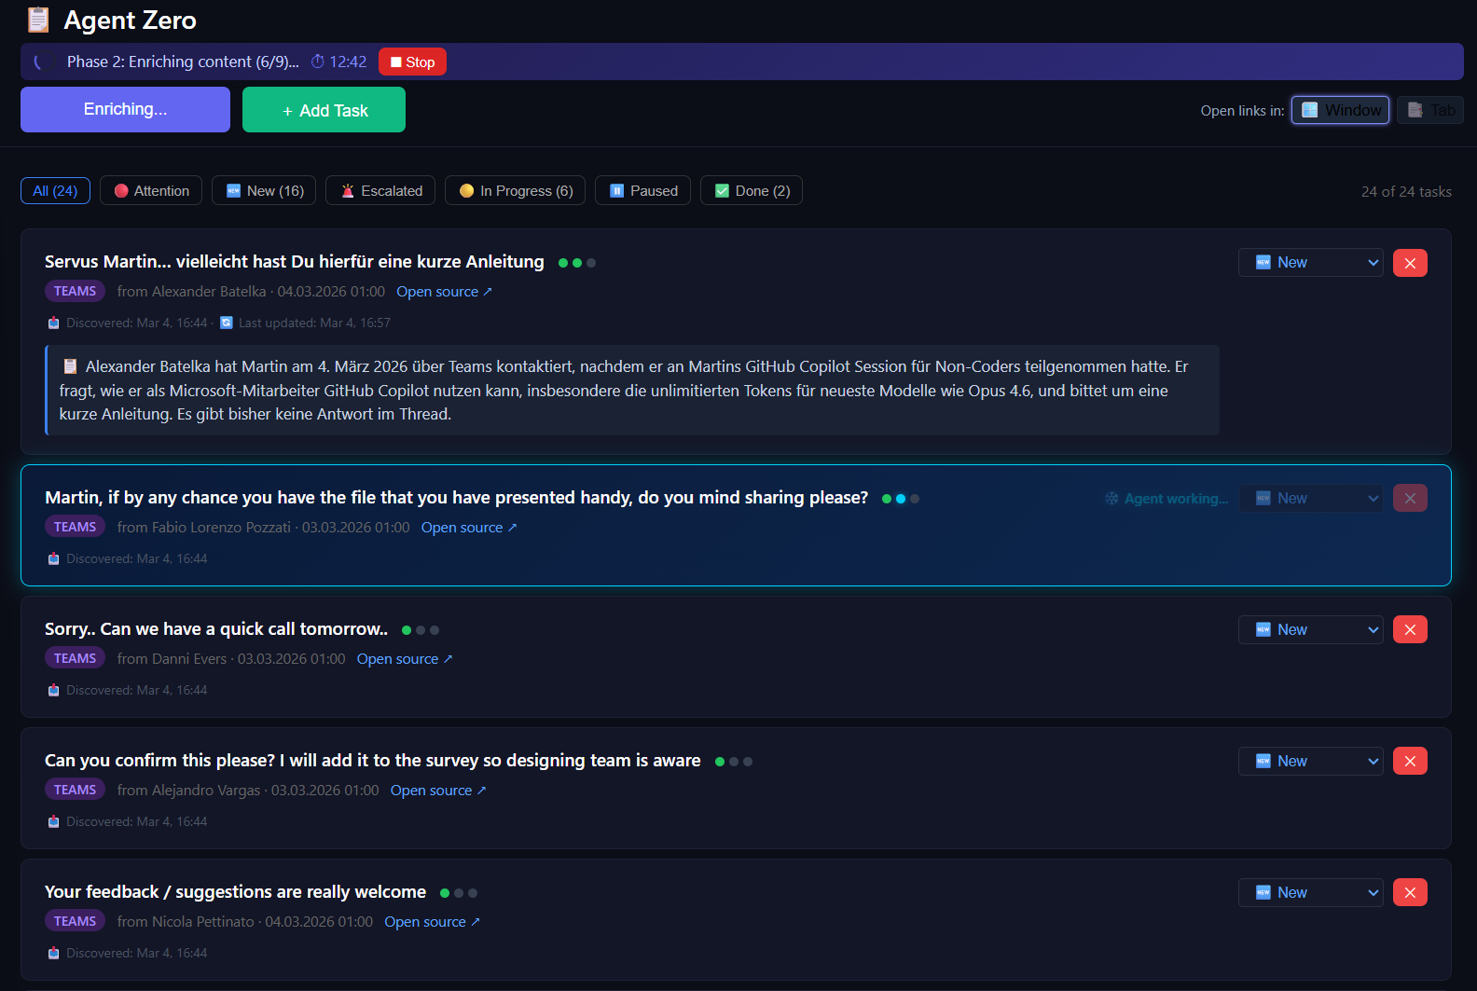
Agent Zero — Architecture
End-to-end data flow from Microsoft 365 to actionable task cards
more impact
TECH STACK
🌐 Browser (index.html)
Dark-themed SPA · Filter bar · Task cards · Agent interaction panels · Step indicators
Runtime
Node.js v22.15.0
Framework
Express 5.2.1
▼ HTTP :3000
AI Engine
@github/copilot-sdk 0.1.25
⚡ Express Server (server.js)
M365 Access
@microsoft/workiq 0.2.8
REST API · Scan orchestration · 6 Skill files (docs/) · Write queue · Error handling
Frontend
Single-file HTML/CSS/JS
▼ Copilot SDK (stdio)
▼ fs read/write
Storage
Local JSON — no cloud
🤖 GitHub Copilot SDK
📋 tasks.json
AGENT ZERO IN ACTION
@github/copilot-sdk v0.1.25 Session manager · AI orchestration
Local JSON store · No cloud Auto-cleanup after 3 days
▼ MCP (stdio)
🔌 Work IQ MCP Server
@microsoft/workiq v0.2.8 Microsoft Search API
▼ Microsoft Search API
☁️ Microsoft 365
Email · Teams · Calendar · SharePoint
GitHub Copilot SDK Enterprise Challenge · March 2026
github.com/JohnMavic/Work_IQ

