Slide 1
Agent Zero
Stop Reading Email. Start Acting.
THE PROBLEM
BUSINESS VALUE
28%
30–60 min
Missed
⏱ 30–60 min saved daily
Eliminates manual email/Teams scanning per knowledge worker
of a knowledge worker’s day spent reading email
daily wasted scanning for action items
deadlines, lost context, dropped threads
🎯 Zero missed action items
AI identifies tasks humans might overlook in busy inboxes
Outlook lets you read messages — not act on them. No agent exists that turns M365 conversations into tracked action items over time.
🔄 Automatic thread monitoring
Continuous update checks — stay current without effort
THE SOLUTION — 4 SPECIALIZED AI AGENTS
💰 Zero infrastructure cost
Runs 100% locally — no cloud deployment, no new licenses
1
Discovery Agent
~60s
🔗 Works with existing M365
Scans email & Teams subjects. Identifies actionable messages. Creates task cards with title, source, sender, and direct link.
No migration needed — leverages current email and Teams
RESPONSIBLE AI BY DESIGN
2
Enrichment Agent
~60–300s
Extracts full conversation content. Generates summaries with temporal awareness. Detects ambiguities and asks clarifying questions.
🛡️ Hallucination Prevention
Agents report failure honestly — never fabricate information
Update Check Agent
~30–90s
⚠️ Ambiguity Detection
3
Uncertain results flagged as needs-review with clarifying questions
Detects new replies since last check. Updates summaries with only new information. Runs on every scan cycle.
🕰 Temporal Awareness
Distinguishes current vs. historical information using timestamps
4
Search Agent
~30–120s
🔒 Data Privacy & Retention
Goal-oriented search with 3-attempt strategy, self-assessment, confidence levels, and bilingual keyword support.
All data local — auto-deleted after configurable period (default 3 days)
👤 Human in the Loop
Built with GitHub Copilot SDK · Work IQ MCP · Node.js + Express
AI provides summaries and recommendations — never acts autonomously
github.com/JohnMavic/Work_IQ

Slide 2
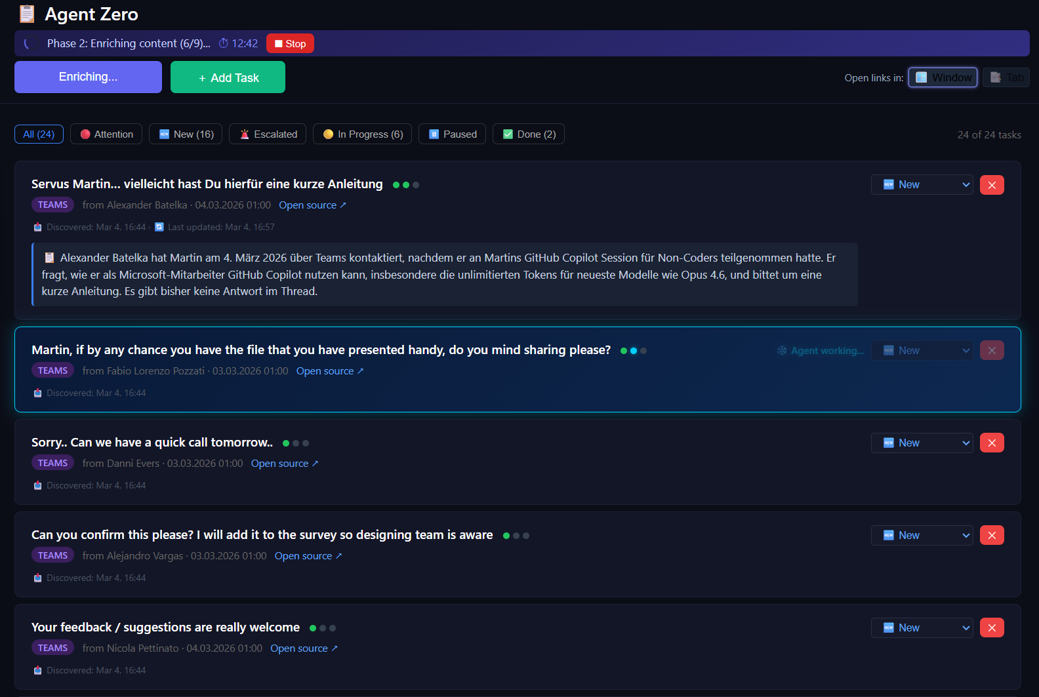
Agent Zero — Architecture
End-to-end data flow from Microsoft 365 to actionable task cards
🌐 Browser (index.html)
TECH STACK
Dark-themed SPA · Filter bar · Task cards · Agent interaction panels · Step indicators
Runtime
Node.js v22.15.0
▼ HTTP :3000
Framework
Express 5.2.1
⚡ Express Server (server.js)
AI Engine
@github/copilot-sdk 0.1.25
REST API · Scan orchestration · 6 Skill files (docs/) · Write queue · Error handling
M365 Access
@microsoft/workiq 0.2.8
▼ Copilot SDK (stdio)
▼ fs read/write
Frontend
Single-file HTML/CSS/JS
Storage
Local JSON — no cloud
🤖 GitHub Copilot SDK
📋 tasks.json
@github/copilot-sdk v0.1.25 Session manager · AI orchestration
Local JSON store · No cloud Auto-cleanup after 3 days
AGENT ZERO IN ACTION
▼ MCP (stdio)
🔌 Work IQ MCP Server
@microsoft/workiq v0.2.8 Microsoft Search API
▼ Microsoft Search API
☁️ Microsoft 365
Email · Teams · Calendar · SharePoint
GitHub Copilot SDK Enterprise Challenge · March 2026
github.com/JohnMavic/Work_IQ

