Slide 1
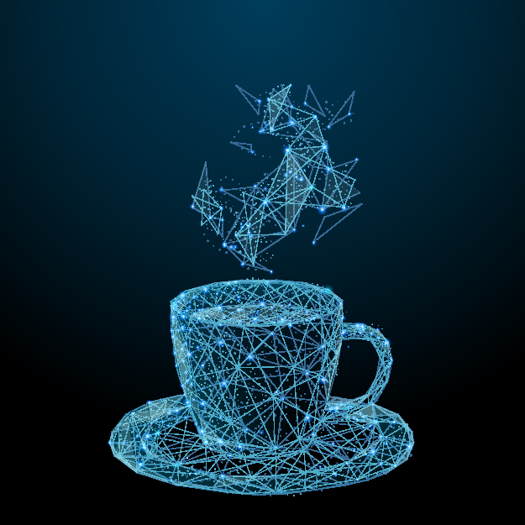
Data Science for Sensory and Consumer Scientists

