Slide 1
Building a Side Modal Portal with ChatGPT
First Name, Last Name

Slide 2
Introduction
Side modal portals offer dynamic content presentation while ChatGPT enhances interactivity.
This presentation delves into the innovative integration of ChatGPT within side modal portals, marking a significant advancement in web interactivity and functionality
Notes:
In today's web development landscape, creating immersive user experiences is paramount. This presentation delves into the innovative integration of ChatGPT within side modal portals, marking a significant advancement in web interactivity and functionality. As the digital realm evolves, there's a growing emphasis on captivating user engagement and seamless content delivery. This research explores how leveraging ChatGPT enhances the development of side modal portals, paving the way for dynamic and personalized user interactions. Join us as we embark on a journey to redefine user engagement in web development.

Slide 3
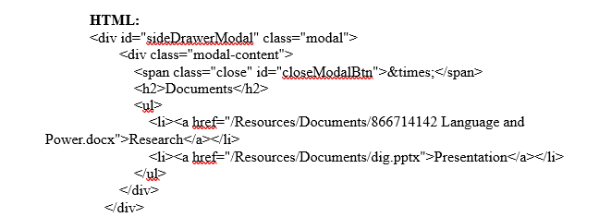
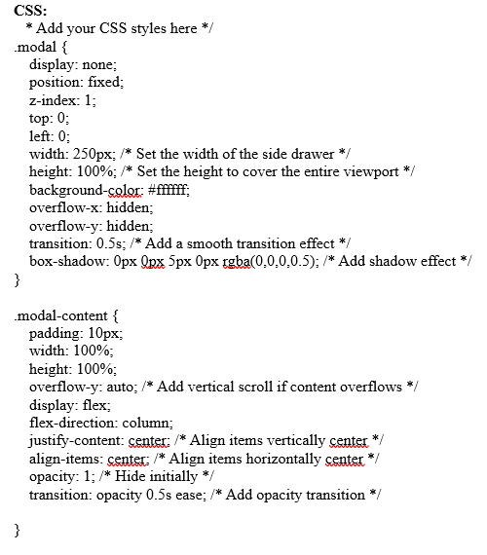
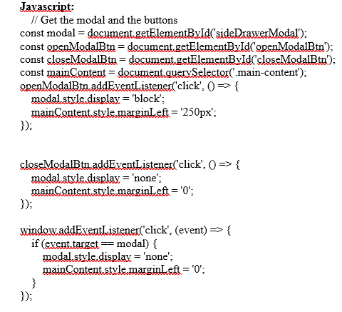
Querying ChatGPT
Objective: Constructing a side modal portal for a school project site redesign.
Requesting guidance from ChatGPT on building the portal using HTML, CSS, and JavaScript.
ChatGPT's Response: Sample code snippets provided demonstrating modals, CSS styles, and JavaScript functions.
Notes:
Requesting guidance from ChatGPT on building the portal using HTML, CSS, and JavaScript.
Sample code snippets provided by ChatGPT for implementation.

Slide 4
Implementation
Modifications made to the provided code to suit the site's layout and functionality.
Customization with Bootstrap framework classes and JavaScript events.
Demonstrating the efficiency of ChatGPT in addressing complex coding tasks and expediting development workflows.
Modifications made to the provided code to suit the site's layout and functionality.
Adjustments to the provided code to align with the site's layout and functionality requirements.
Demonstrating the efficiency of ChatGPT in addressing complex coding tasks and expediting development workflows. One immediate benefit of a model like ChatGPT is speeding up the coding process(Wahyu Rahmaniar, 2023).
Notes:
Efficiency of ChatGPT
ChatGPT's role in streamlining complex coding tasks, facilitating rapid prototyping, and reducing development time.
Demonstration of ChatGPT's ability to provide actionable insights and code snippets tailored to specific project requirements.

Slide 5
Results and Conclusion
Successful Development:
The side modal portal was successfully developed with the invaluable assistance of ChatGPT.
ChatGPT's guidance streamlined the development process, resulting in a functional and user-friendly portal.
The project underscores the significance of AI tools in expediting web development workflows.
AI, exemplified by ChatGPT, has proven instrumental in accelerating prototyping and reducing development time.
Notes:
ChatGPT played a pivotal role in providing foundational code snippets and facilitating customization.
Its contribution significantly contributed to the project's success and efficiency in implementation.

Slide 6
Reference
Wahyu Rahmaniar. (2023). ChatGPT for Software Development: Opportunities and Challenges. https://doi.org/10.36227/techrxiv.23993583.v1

