Slide 1

Transition your T-SQL skills to Spark
John Miner Data Architect
john.miner@insight.com

Slide 2
Purpose
Many companies are moving their work loads from on-premise operational data stores to in-cloud data lakes. The spark processing platform is a key player in this transition.
As a developer, how can you leverage your existing SQL skills to take advantage of this growing segment of work?
Today, we are going introduce you to concepts and code that will help you during this transition.

Slide 3
Topics
General overview of Spark
What is a data lake?
Working with files and folders
Reading and writing data
Posting to the hive catalog
Review SQL constructs
Review Spark SQL functions
Some known differences

Slide 4
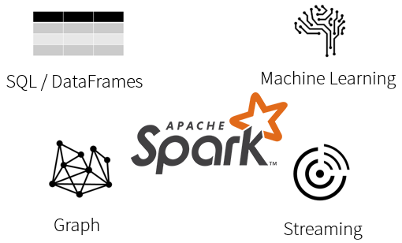
What is Spark?
Spark is a unified processing engine that can analyze big data using SQL, machine learning, graph processing or real-time stream analysis.

Slide 5
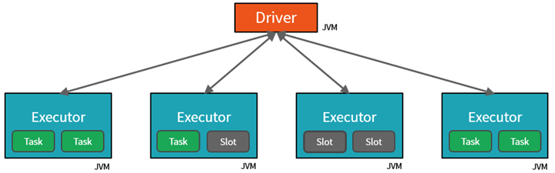
Databricks Cluster
By creating Tasks, the Driver can assign units of work to Slots for parallel execution.
The Driver must also decide how to partition the data so that it can be distributed for parallel processing.

Slide 6
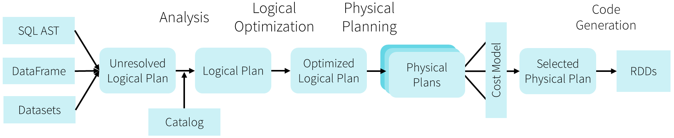
Databricks Optimizer
The Catalyst Optimizer converts the notebook code into an execution model that uses Resilient Distributed Datasets for in memory processing. The resulting code is Java Byte code that can execute on the cluster.
The optimizer is one key difference between open-source Spark and Databricks environment.

Slide 7
Review Databricks Service
Workspaces
Clusters
Importing Files
Hive database
Notebooks
Jobs
Demo 1 – Read and write files.

Slide 8
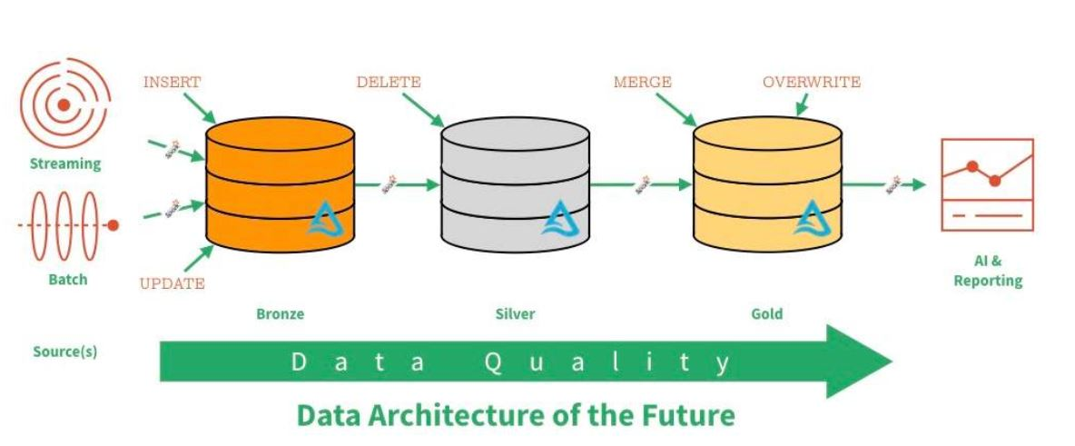
Data Lake – Zones & Data Quality

Slide 9
Data Dictionary
Some companies use a data dictionary to enhance the information stored in the data lake.
It is very important to use naming convention standards on directories, sub-folders and files so that the information in the lake be easily found and understood.

Slide 10
Various File Types
Weakly typed file formats can lead to data quality and ETL pipeline issues. For instance, a delimited file type as Comma Separated Values (CSV) can be easily broken. This file type does not allow for compression.
Strongly typed file formats can lead to better data quality and the least amount of ETL pipeline issues. For instance, an Apache Parquet file format is stored as binary data, contains columns names/types and allows for compression of the data.

Slide 11
Load Patterns
The full load design pattern involves replacing the target dataset with a completely new version. Use this pattern with small sized data.
An incremental load design pattern involves merging the target dataset with a small dataset the represents changes over a given time period. For instance, a daily update file. This pattern can be used with small to medium sized data.
For the largest datasets, the use of a partitioning allows the full or incremental patterns to work with a subset of the data.

Slide 12
Delta File Format – Uses parquet files +
ACID transactions make sure complete writes are committed.
Schema enforcement allows only clean data inserted into the lake.
Time travel allows for versioning the delta lake table. Thus, we can view data at any given point.
Snapshot isolation allows for multiple readers and writers.
Open-source format that is built for distributed systems such as Spark.

Slide 13
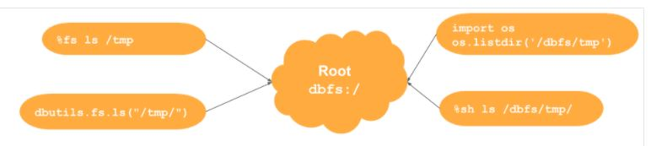
Databricks File System
Out of the box, the Azure Databricks system has a local file system. Remote storage can be mounted or attached to at run time.
There are many ways to work with files and folders.

Slide 14
PySpark – Read and write files
PySpark is a Python API for Apache Spark to process larger datasets in a distributed cluster.
Spark.Read() – allows the Python program to read one or more files into a dataframe.
Spark.Write() – allows the Python program write the dataframe to given format using one or more files.
Example 1 – Read and write files.

Slide 15
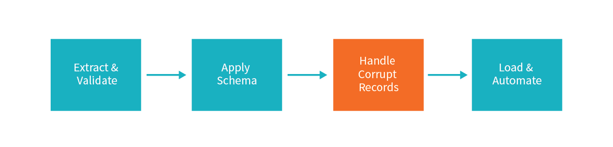
Processing files
Weakly typed files take more time to process if you are inferring the schema. Consider passing a DDL string for faster processing.
Some files have corrupt records, you must determine what to do with them.

Slide 16
PySpark – Working with SQL
Create and drop statements for databases, tables and views are supported by the hive catalog.
Spark.Sql() – allows the Python program execute dynamic Spark SQL. For select statements, this action returns a data frame.
The magic command (%sql) allows for the static execution of commands.
df.createOrReplaceTempView() converts a data frame to a session level view.
Please refer to documentation.
Example 2 – Manage NYC cab data

Slide 17
PySpark – Working with Data Frames
There are a-lot of functions that can be called with spark DataFrames.
df.select() is used to reduce the number of columns.
df.withColumn() is called to reformat or create new columns.
df.where() is used to reduce the number of rows.
Please refer to documentation.
Example 3 – Refining lending club data

Slide 18
Exploring a dataset with SQL
This section of the presentation is designed to reinforce the fact that SQL skills are applicable to PySpark.
We will be looking at both simple and advance constructs that are available with Spark SQL.
Example 4 – Exploring lending club data

Slide 19
Summary
The modern data platform design for Microsoft Azure allows companies to place a variety of data into a data lake.
Essentially, this data lake follows the spoke and hub design pattern. Source data from producers can be either pushed or pulled into the data lake. Processing can be done on a sub-set of data to allow for investigational queries. Data Science models can be used to predict future events. The final curated data can be available to consumers for analytic reports.
The most important part about deploying objects, creating data lake entries or coding data factory pipelines is the use of naming standards. These standards allow the end user to easily understand the nature and purpose of the item in question.
Both Azure Databricks and Azure Synapse support the Apache Spark architecture. Skills that you learn with Python and Spark will be transferable between the products. The future is bright for those who can adapt.

Slide 20
References
Databricks Documentation
https://docs.databricks.com/index.html
Spark SQL functions
https://spark.apache.org/docs/latest/api/sql/index.html
Spark Data Frames
https://spark.apache.org/docs/latest/api/python/pyspark.sql.html#pyspark.sql.DataFrame
ADB – Local File System
https://www.mssqltips.com/sqlservertip/6700/azure-databricks-local-file-system-management/

Slide 21
Questions / Thank You

