Slide 1



SQL Server 2014 New Backup Features
Blog: www.craftydba.com
Tweet: JohnMiner3
John Miner
RI SSUG – DEC 2015

Slide 2


Two important features
Using Azure Storage for backup files (full, diff, log).
Encrypting backups using a database certificate.

Slide 3
Managing Azure Storage
PowerShell command lets can do everything.
Azure portal website has some limitations.
CloudBerry Explorer is a great storage tool.
Azure Storage explorer from Code Plex

Slide 4

Azure Storage Hierarchy
Azure Subscription
MSDN comes with 150 hours to play.
Storage Account
Can be used to store blobs, tables, queues and files.
Container
Multiple objects can fit into a container.
Blob Object
This is the smallest unit. Either blob or page.

Slide 5

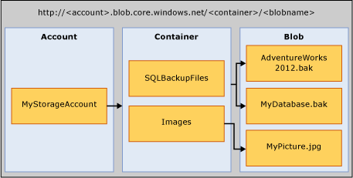
Russian Doll Hierarchy

Slide 6

Examples
Power Shell to create objects.
Playing with Cloud Berry explorer.
Looking at Azure Storage explorer.
Backing and restoring up using the new URL command.
Failed backups may cause locked partial files.

Slide 7

Backup Encryption
Create master key
Create certificate using master
Always backup keys & certificates
Use certificate when backing up
Need certificate installed to server to restore

Slide 8

Example
Create key and certificate.
Encrypt backup using certificate.
Delete certificate. Show failed restore.
Restore certificate. Show successful restore.

Slide 9
Thank you for attending!
John Miner
RI SSUG - DEC 2015

