Slide 1


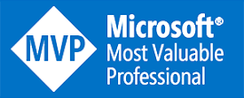

Centralizing Business Intelligence with Azure Analysis Services
John Miner Data Architect
john.miner@insight.com
Blogs: www.craftydba.com www.mssqltips.com
Tweet: JohnMiner3

Slide 2
Target Audience
Business Intelligence Developers
Typical development environment for a tabular semantic data model. Creating, enhancing and testing the model. Deploying the model to the production server (SSRS or AAS).
Business Intelligence Administrators
How to use the Portal or PowerShell to deploy and manage Analysis Services in Azure.

Slide 3
Centralized Data Problem
Most companies today are faced with silos of data that might be located in legacy on premise systems, modern software as a service providers and/or born in the cloud applications.
Given the location of the systems, how can we mash up and model data to define metrics that are important to the business users? Of course, the Azure cloud is a centralized place to do this work.
Azure Analysis Services is a platform as a service offering that eliminates the need for managing more hardware and software.
The trusted tabular model can be used to compress large amounts of data into a small memory space and the DAX language can enhance the model with the metrics that are users are looking for.

Slide 4
Presentation Overview
Architectural diagram
Build development environment
Create and load data into model
Defining model properties
Performance and security
Deploy and process model
Testing the tabular model
Azure Analysis Services considerations

Slide 5
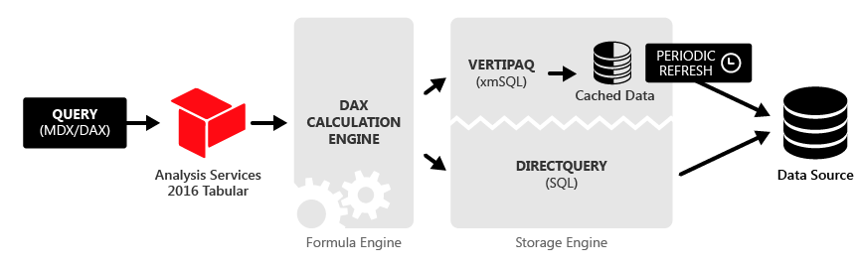
Architectural Diagram

Slide 6
Build Development Environment
Visual Studio 2017 (SSDT)
SQL Server Management Studio
SQL Server Analysis Services
SQL Server Database
DAX Studio
Example 1 – Log into Azure VM

Slide 7
Create Tabular Project
There are three ways to create a tabular project.
Brand new empty project
Import from Power Pivot
Import from existing server.
There are two ways to setup a project workspace.
Integrated workspace
Workspace server
Example 2 – Create new project

Slide 8
Importing Data vs Direct Query
Import Data
Copy of the source data is stored in Vertipaq (tabular) format
Use of memory results in quick query responses
Larger data set equals larger processing time
For extremely large data, remove unwanted columns, filter unwanted rows
Direct Query
Native query is executed by source system
Source system can implement security
Can have larger data sets
While overall memory footprint is smaller, query responses maybe slower

Slide 9
Understanding Data Sources
There are five different type of data sources that we can import into our tabular model.
Relational database
Multi-dimensional
Data feeds
Text files
Other sources
Stay away from data sources that are not well typed, consistent, time predictable and verified. The relational database is the best source of data for corporate reporting.

Slide 10
Impersonation vs Security
Impersonation
Comes to play when processing the model (tables).
Three common choices are specific windows account, service account or current user.
Security
Restricts who can access the model (tables).
Define roles with model.
Assign members to roles.

Slide 11
Database Design Suggestions
Decouple schema
When a model is processed, the source system data has to be queried
Source system changes result in tabular model changes
Use TSQL views to decouple the schema from the semantic model
Filtered datasets is an additional development benefit
Data modeling
De-normalized single table results in longer processing time, lack of granularity and complex DAX code.
Over normalized snow flake design results in slow query execution and inability to create hierarchies.
A star schema design is in the middle of the spectrum and is a good choice.
Example 3 – Import star schema tables

Slide 12
Managing table relationships
The import table wizard will guess at the relationships between the tables.
There are two types of relationships: 1-to-1 and 1-to-many.
The DAX query language uses the defined relationships when determining the evaluation context.
Before 2016, bi-directional filtering was not allowed between tables.
Only one relationship, between two tables, can be active at a given time.
However, a special DAX formula can use an inactive relationship.

Slide 13
Business Metrics Using DAX
Calculated Column
Associated with table
Stored with model
Row context
Measures
Independent of tables
Evaluated with queried
Filter Context
KPI
Uses a measure
Compared against target
Example 4 – Adding Business Metrics

Slide 14
Model Viewpoints and Pathways
Perspective
Defines a viewable subset of a model that provides focused, business-specific, or application-specific viewpoints.
Reduces the visibility model objects to the end user (tables, columns, measures, hierarchies, and KPIs).
Hierarchy
Hierarchies are groups of columns arranged in levels.
Limits the data returned by a query.
Natural hierarchies are considered pathways to the data.
Example 5 – Reducing query results

Slide 15
Performance and Security
Partitions
Applied at the table level.
Define a subset of the data.
Reduces overall processing time.
Roles
Typical concept of access control lists (groups)
Roles can have none, read, process or admin rights.
DAX filter can be applied to table for row level security.
Filter can be static or dynamic.
Members are Active Directory users.
Example 6 – Partitions and roles

Slide 16
Deploy and Process Model
Deploy
Can be simple as pressing a button in VS2017.
Meta data is transferred to target service.
Process
Connect to data sources.
Import data into cache.
Create calculated columns and tables.
Tools
SQL Server Management Studio
Code (C#, PowerShell, etc.)
Azure DevOps
Example 7 – Deploy locally or in Azure

Slide 17
Test Tabular Model – Desktop Tools
MS Excel
Pivot Tables
Slicers
Uses MDX code
Power BI
Custom Visuals
Slicers
Uses DAX code
Example 8 – Testing the model

Slide 18
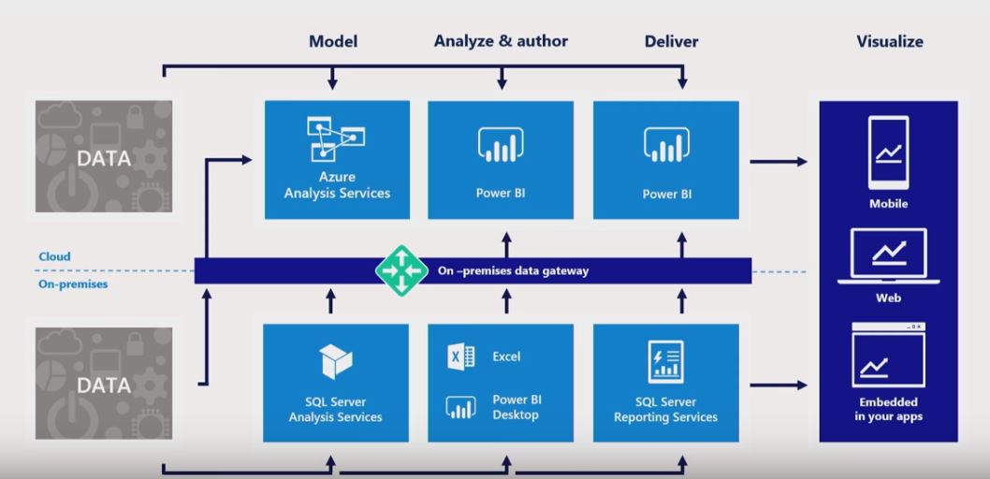
Data Gateway

Slide 19
Azure Analysis Services
Backup/Restore
Uses Azure Blob
Manual execution via Portal or SSMS
Programmatic execution (REST API)
Process Model
Manual execution via SSMS
Programmatic execution (REST API)
Security
Azure Active Directory
Can use on premise Group if federated AD
Connectivity
Native access to Azure Data Services
Use Gateway for on premise connectivity
Example 9 – Exploring the portal

Slide 20
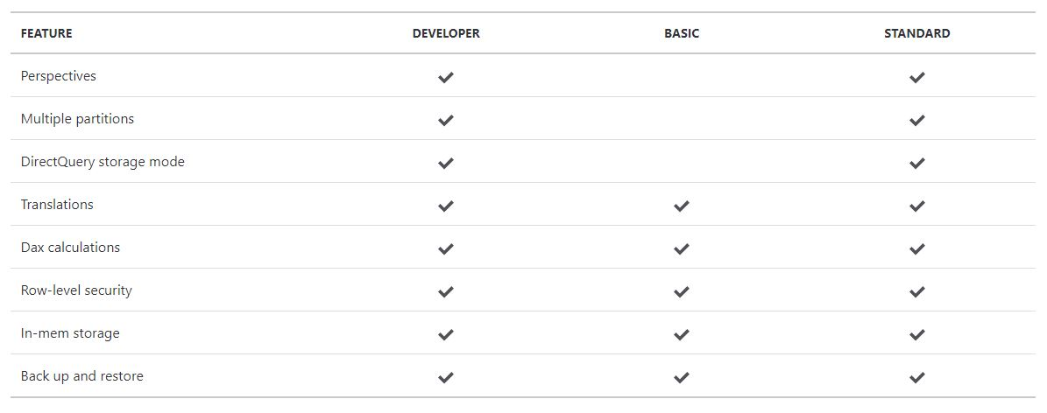
Features By Tier

Slide 21
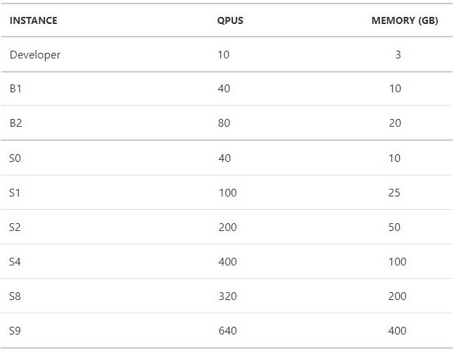
Increasing Performance – Scale Up
Blended performance based on QPUs
Different memory levels at each instance (tier)
Different features for given tier

Slide 22
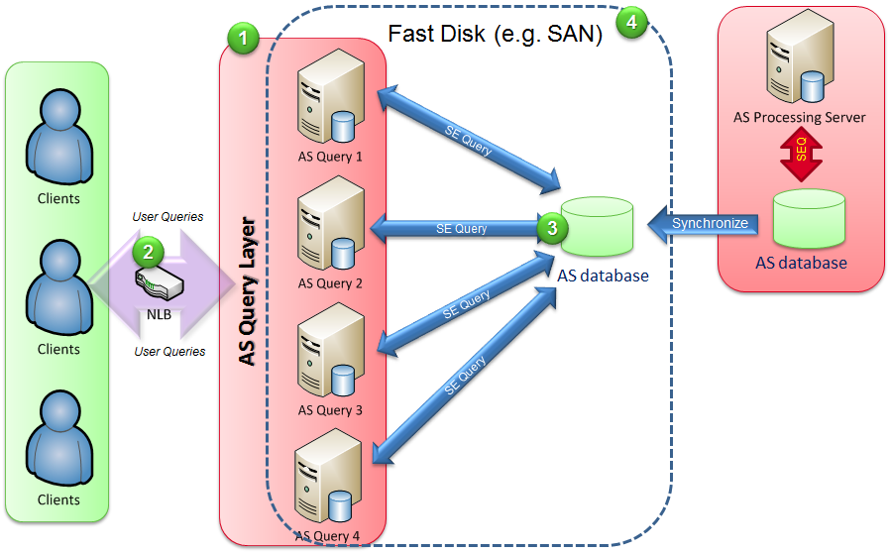
Increasing Performance – Scale Out
Diagram is based on in-house scale out architecture.
One master database that is read/write.
Up to seven read only replicas to increase query performance.

Slide 23

!! Warning Label !!
This is not a complete coverage of all the techniques involved.
I suggest you get familiar with how I solved this one simple problem.
Researching these topics will increase your knowledge and will allow you to solve more complex problems.

Slide 24
Summary
The invention of the tabular model has become popular with products such as Power Pivot and Power BI. Unfortunately, secure sharing, memory size, and validity of the data & measures do not come with self service bi.
Consider using Centralized Business Intelligence with Analysis Services to over come these obstacles.
All new development should be done with the tabular model for its ease of use and quick life cycle.
Today, there are many choices in where to house your computing power. If you do not want to manage hardware, consider Azure Analysis Services.

Slide 25
References
Azure AS talk at Build 2017
https://www.youtube.com/watch?v=44I48ufKhOs
Developers guide to Azure AS
https://channel9.msdn.com/Events/Build/2016/P402
Microsoft Documentation for Azure AS
https://docs.microsoft.com/en-us/azure/analysis-services/
Deploy Azure AS using PowerShell
https://www.mssqltips.com/sqlservertip/5320/deploying-azure-analysis-services-using-powershell-cmdlets/

Slide 26
References (cont.)
Deploying models using Azure DevOps
https://azure.microsoft.com/en-us/resources/videos/azure-analysis-services-automation/
Tutorial on tabular modeling
https://docs.microsoft.com/en-us/azure/analysis-services/tutorials/aas-adventure-works-tutorial
Sample databases on GitHub
https://github.com/Microsoft/sql-server-samples/releases/tag/adventureworks
Azure Virtual Machine w/SQL Server *
https://docs.microsoft.com/en-us/azure/virtual-machines/windows/sql/virtual-machines-windows-sql-server-iaas-faq
* - must copy over msmdsvr.ini

Slide 27
References (cont.)
Visual Studio (SSDT) Download
https://docs.microsoft.com/en-us/sql/ssdt/download-sql-server-data-tools-ssdt?view=sql-server-2017
SQL Server Management Studio (SSMS) Download
https://docs.microsoft.com/en-us/sql/ssms/download-sql-server-management-studio-ssms?view=sql-server-2017
DAX Studio 2.8.1 Download
https://www.sqlbi.com/tools/dax-studio/
Tabular Modeling in Microsoft SQL Server Analysis Services
https://www.amazon.com/Modeling-Microsoft-Analysis-Developer-Reference/dp/1509302778

Slide 28
Biography
John Miner is a Data Architect for Insight Digital Innovations and helps corporations solve their business needs with various data platform solutions. He has thirty years of data processing experience, and his architecture expertise encompasses all phases of the software project life cycle, including design, development, implementation, and maintenance of systems. His credentials include undergraduate and graduate degrees in Computer Science from the University of Rhode Island. He has also earned certificates from Microsoft for Database Administration (MCDBA), System Administration (MCSA) and Data Management & Analytics (MCSE). Before joining Insight, John won the Data Platform MVP award in 2014, 2015 and 2018 for his outstanding contributions to the SQL Server community. When he is not busy talking to local user groups or writing blog entries on new technology, he spends time with his wife and daughter enjoying outdoor activities. Some of John’s hobbies include wood working projects, crafting a good beer and playing a game of chess.

Slide 29
Questions / Thank You

