Slide 1

Don’t lose your integrity
SNESSUG - DEC 2012
By John Miner
www.craftydba.com
Blog: www.craftydba.com
Tweet: JohnMiner3

Slide 2
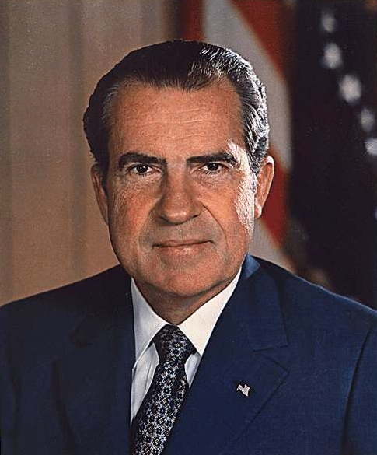
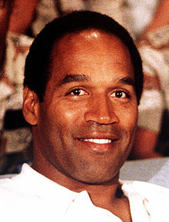
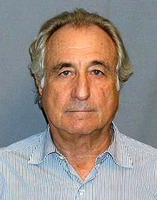
Famous People (integrity issues)
Politics
Murder
Money
Nixon
Simpson
Madoff
2 |

Slide 3
Technical Problem & Solution
Databases are like people, they can have integrity issues.
Please use TSQL to enforce integrity into your database design.
3 |

Slide 4
Integrity constraints (types)
Domain integrity
User defined integrity
Entity integrity
Referential integrity
4 |

Slide 5
Domain integrity
Domain integrity states that every column must respect restrictions of its corresponding data type.
Typical restrictions are the range of storable values, the default value if none is provided, the length of the data and/or the acceptance of NULL values.
5 |

Slide 6
User defined integrity
User defined integrity enforces a business rule within the bounds of the data type.
For instance, the year of the car must be from 1903 to Year() + 1. This is a subset of all integers which is the data type.
6 |

Slide 7
Entity integrity
Entity integrity states that every record must be uniquely identified by one or more columns that are not null.
7 |

Slide 8
Referential integrity
Referential integrity states that every child record must have a corresponding record in the parent. This enforces a relationship between two tables.
8 |

Slide 9
Autos Database
This simple database contains a make and a model table.
First version demonstrates integrity issues when inserting, adding or deleting data.
Second version is an example of good design to prevent integrity issues.
9 |

Slide 10
TSQL constructs for integrity
Primary Keys (entity integrity)
Foreign Keys (referential integrity)
Check constraint (user defined integrity)
Data type (domain integrity)
Default constraints (domain integrity)
Null constraints (domain integrity)
DML Trigger (user defined integrity)
10 |

Slide 11
Summary
Please use constraints to enforce entity, referential and user integrity.
Use triggers as a last resort since all data changes have to be rolled back.
Good luck with keeping your integrity!
11 |

