Slide 1




Full Text Indexing (basics)
SQL Saturday #741
Albany, NY
John Miner
Data Architect
Blue Metal
Blogs: www.mssqltips.com
www.craftydba.com
Tweet: JohnMiner3
Email: john@craftydba.com

Slide 2
Today’s Data Explosion
Each one of us creates data every day
Use VISA card to buy gas at store
Pass and pay toll both with E-Z Pass
Check into Marriot Hotel
Companies are saving data longer
Increased data retention periods
Lack of purge routines
Disk space is cheaper

Slide 3
Historical Data Types
Common data types used by 3rd Generation languages. This is what we used when learning how to program (C / Pascal).
Integer
Numeric
Character
String
Date/Time

Slide 4
Modern Data Types
Today's large object data types (LOB) are able to store up to 2GB of information.
These large data fields (LDF) are full of unstructured information stored in the following formats.
Varchar, Varbinary, XML
Text *, Ntext *, Image *
* = removed in future releases.

Slide 5

Fairy Tales
The Brothers Grimm, Jacob (1785-1863) and Wilhelm (1786-1859), were born in Hanau, Germany.
Published two volumes of 'Nursery and Household Tales' in 1812 and 1814.
Edgar Taylor, made the first English translation in 1823 which contained 50 tales.
Project Gutenberg Literary Archive Foundation

Slide 6
Sample Database
The Grimm sample database contains the text of over 62 fairy tales. This type of unstructured data is perfect for FULL TEXT INDEXING.
Create local database named [GRIMM].
Create table called [TBL_FAIRY_TALES].
Load the table with 62 titles.
Save fairy tale text as 62 files.
BULK IMPORT files into [text] field.

Slide 7
Table Structure
CREATE TABLE [DBO].[TBL_FAIRY_TALES]
(
[MY_ID] [SMALLINT] IDENTITY(1, 1) NOT NULL,
[MY_TITLE] [VARCHAR] (75) NOT NULL,
[MY_TALE] [TEXT] NULL
)
[MY_ID] – surrogate key for table.
[MY_TITLE] – the title of the fairy tale.
[MY_TALE] – full text of the fairy tale.

Slide 8
Searching For Patterns 1
There are two traditional ways to search for a pattern.
Use the LIKE operator with a search pattern.
Use the PATINDEX operator specifying the field name and a search pattern.

Slide 9
Judging Query Performance
Turn on statistics gathering.
SET STATISTICS TIME ON
SET STATISTICS IO ON
Clean buffers and clear plan cache
DBCC DROPCLEANBUFFERS
DBCC FREEPROCCACHE
Execute the select query.
Capture statistics (reads & writes).
Capture estimated / actual query plan.
Turn off statistics gathering.
SET STATISTICS TIME OFF
SET STATISTICS IO OFF

Slide 10
Performance Results 1
Table does not have a primary key.
full table scan
Table does have a primary key.
full index scan
Unable to add index.
Composite index limits are 16 fields and less than 901 bytes.
Does not support LOB data types.

Slide 11
Full Text Search – Concepts
User tables - contain the data to be full-text indexed.
Full-text catalog - logical concept that refers to a group of full-text indexes.
Full-text index (FTI) - stores information about significant words and their location within one or more columns of a database table.
Full-text gatherer - responsible for scheduling and driving the population of full-text indexes.

Slide 12
Full Text Search - Concepts
Thesaurus files - contains synonyms of search terms.
Stop list objects - list of common words that are not useful for the search.
Full-Text filter – varbinary, image, or xml data types require extra processing (filter) which extracts the textual information.

Slide 13
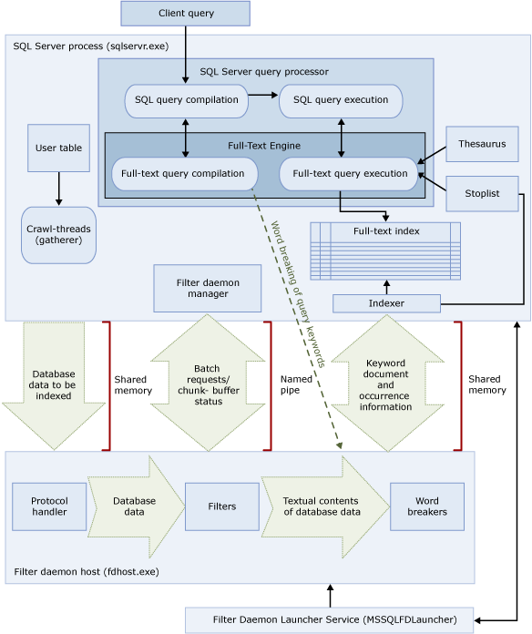
Full Text Search - System

Slide 14
FTI Wizard (step-by-step)
Right click [tbl_fairy_tales] table, select FTI wizard.
Select index name as [pk_fairy_tales_id].
Select column name as [my_tale].
Select change tracking as manual.
Create new catalog named [ftc_fairy_tales].
Create new schedule called [sch_fairy_tales].

Slide 15
Searching For Patterns 2
There are four ways to search for a pattern using a full text index.
Use the CONTAINS operator for exact matches.
Use the FREETEXT operator for fuzzy matches.
Use the CONTAINSTABLE operator for exact matches with ranking *.
Use the FREETEXTTABLE operator for fuzzy matches with ranking *.
* = join to user table on key

Slide 16
Performance Results 2
All plans now use a full text match operator with a clustered index seek.
For our toy database, timings are small. For large databases, significant query time reduction can be shown.
Index maintenance should be scheduled at night after the daily ETL load. This can take significant time.

Slide 17
Where FTI can go wrong?
Full text indexing does a great job for matching exact words or pre-fix words.
Full text indexing gets lost when looking for post-fix words.
Results for post-fix word searches can be missing rows.
Consider using a trigger and a flag for post-fix searching.

Slide 18
Applying the technology!
Search help desk tickets.
Commercial off the shelf (COTS) system.
Data is from an offsite database.
Loads data into a SQL Server table with a full text index.
Search xml application logs.
Custom web application.
XML messaging logs from a middleware layer.
Loads data into a SQL Server table with a full text index.

Slide 19
Biography
Has twenty five years of data processing and proven project management experience, specializing in the banking, health care, and government areas.
His credentials include a Masters degree in Computer Science from the University of Rhode Island; and Microsoft Certificates (MCSE Data & Analytics).
John is currently a Data Architect at Blue Metal. He was award the MVP (2014/2015/2018) honor for his contributions to the community.
When he is not busy talking to local user groups or writing blog entries on new technology, he spends time with his wife and daughter enjoying outdoor activities. Some of John’s hobbies include wood working projects, crafting a good beer and playing a game of chess.

Slide 20
References
Azure SQL DB (FTI) – My article
https://www.mssqltips.com/sqlservertip/5086/full-text-indexing-with-azure-sql-database/
Free e-book of tales
http://www.gutenberg.org/
TV show based on books
http://en.wikipedia.org/wiki/Grimm_(TV_series)
MSDN – like operator
http://msdn.microsoft.com/en-us/library/ms179859.aspx
MSDN – patindex function
http://msdn.microsoft.com/en-us/library/ms188395(v=sql.90).aspx
MSDN – create index
http://msdn.microsoft.com/en-us/library/ms188783.aspx
MSDN – full text search
http://msdn.microsoft.com/en-us/library/ms142571.aspx#sqlprocess

Slide 21
Questions & Answers
Please visit SQL Server Books Online for more info.
Please ask about the presentation or visit my blogs
(CRAFTY DBA or MS SQL TIPS AUTHOR) for articles
on various subject.
If you have any questions, you can contact me at john@craftydba.com.

