Slide 1




Effective Data Warehouse Storage Patterns
SQL Saturday #741
Albany, NY
John Miner
Data Architect
Blue Metal
Blogs: www.mssqltips.com
www.craftydba.com
Tweet: JohnMiner3
Email: john@craftydba.com

Slide 2
Goals for Target Audience
SQL Server Developers
Know the difference between the four storage patterns presented today.
Learn how to design, code and implement various storage patterns.
SQL Server Administrators
All the goals of the developers.
Preach these patterns to the wayward flocks.
2 |

Slide 3
Typical Business Problem
Many companies create a simple data mart for reporting. As the company grows, users become dependent on the data mart for making decisions on Key Performance Indicators (KPI).
Unexpected information growth may lead to a performance impacted system.
How do you reduce the size of your data mart and speed up data retrieval?
3 |

Slide 4
Presentation Overview
Review the following subjects
What is horizontal partitioning?
Implementing database sharding.
What are files and file groups.
Creating a partitioned view.
What is Row-level data compression?
What is Page-level data compression?
Designing a table partition.
Programming a sliding window.
Clustered column store index (1M row min)
SQL Server 2016 SP1 – Standard version has enterprise features.
4 |

Slide 5
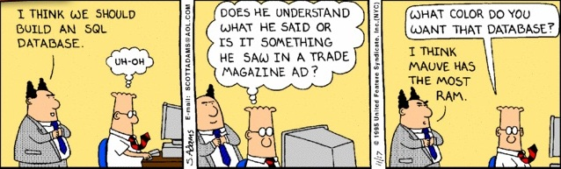
WARNING – TSQL Skills Required
All of the demonstrations are code based to give a real life example of how to apply a technique.
I will be not offended if you decide to leave now.
5 |

Slide 6
Big Jon’s BBQ – Data Mart
Who does not like a good barbeque?
This fictitious two year old company sells pig parts to the general public.
Each customer gets a monthly delivery of chosen pig parts (package) for 1 year.
Pig packages & dates are the dimensions in the star schema.
One million randomly created customers is the key fact table.
6 |

Slide 7
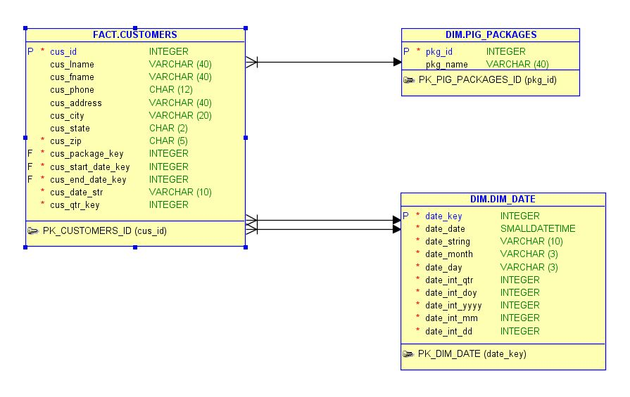
Big Jon’s BBQ – E.R. Diagram
7 |

Slide 8
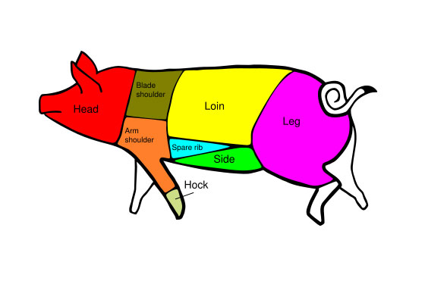
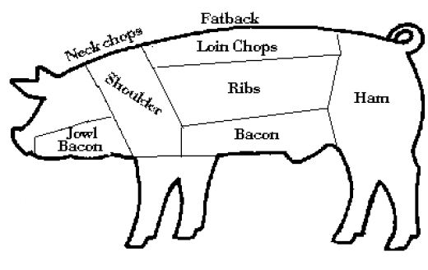
Big Jon’s BBQ – Yummy stuff!
8 |

Slide 9
Big Jon’s BBQ – TSQL Comments
Schemas are a great way to segregate and secure your database.
Bulk Insert is a quick and dirty import statement.
Sequences are new in SQL Server 2012.
Calculated columns can use a function to reference other tables.
Make sure to use primary and foreign keys to enforce relationships.
9 |

Slide 10
Partitioning Methods
Horizontal partitioning involves putting different rows into different databases, tables or files. This division is control by a hash column.
Vertical partitioning involves creating tables with fewer columns and using additional tables to store the remaining columns.
Database partitioning is normally done for manageability, performance or availability reasons..
10 |

Slide 11
Horizontal Partitioning Benefits
Objects such as databases or file groups can be set as read only after the data load.
Using separate databases or file groups can reduce or eliminate page splits.
Backups can now be done quicker since we only have to work with most recent data.
We can reduce or eliminate database contention when loading a new interval.
11 |

Slide 12
Database Sharding - Design
Dynamically create database based on the values of a specified column.
Best to use an SQL Instance to implement.
Define tables, indexes, and other objects in model database.
Optionally create objects via code if a dedicated instance is not available.
[Sharding Example]
12 |

Slide 13
Database Sharding - Diagram
201101
[Dates]
[Packages]
[Customers]
201102
[Dates]
[Packages]
[Customers]
201103
[Dates]
[Packages]
[Customers]
201104
[Dates]
[Packages]
[Customers]
201201
[Dates]
[Packages]
[Customers]
201202
[Dates]
[Packages]
[Customers]
201203
[Dates]
[Packages]
[Customers]
201204
[Dates]
[Packages]
[Customers]
13 |

Slide 14
Database Sharding – Debate
Pros
Do not need Enterprise version to implement.
Table and index size is reduced by N (hash column).
Deleting data from the system is a ‘DROP DATABASE’ command.
Limited to 32K of unique databases.
Cons
Must know the hash column value to select the correct database.
Aggregating data between databases is complex.
Must write code to add, load, and delete databases.

Slide 15
Files & File Groups - Defined
Every database has at least one primary data file (*.mdf) and one log file (*.ldf).
We can define additional secondary files (*.ndf) to increase performance.
Every database has a default primary file group.
We can define additional file groups as we see necessary.
There can be a one to many relationship between file groups and files. This allows us to spread I/O over multiple disks.
15 |

Slide 16
Partitioned View - Design
Dynamically create files, file groups, and tables based on the values in the hash column.
Must use CHECK constraint on hash column.
Primary key must include hash column. Can be last item in the list to improve selectivity.
View is created joining multiple tables with a UNION ALL with SCHEMA BINDING.
Tables can be local or distributed.
Insert, update and delete actions use the same rules as views.
[Partitioned View Example]
16 |

Slide 17
Partitioned View - Diagram
Customers
201101
Customers
201102
Customers
201103
Customers
201104
View Customers
Customers
201201
Customers
201202
Customers
201203
Customers
201204
Dim Date
Dim Packages
17 |

Slide 18
Partitioned View – Debate
Pros
Do not need to have Enterprise version to implement.
Table and index size is reduced by N (hash column).
Deleting data from the system is a ‘DROP TABLE’ command.
Query analyzer determines table automatically.
Cons
Must list every single column in each table in the view since we are using schema binding.
Must write code to add, load, and delete tables.
Limited to 4096 columns per SELECT statement or the number of tables in a query (memory).

Slide 19
SQL Data Compression
Row-level Data Compression is essentially turning fixed length data types into variable length data types. It also stores zero and null values in only 4 bits, saving additional space.
Page-level Data Compression starts with row-level data compression. In addition, two additional compression features, prefix and dictionary, are applied for possible additional savings.
[Compression Example]
19 |

Slide 20
Table Partitioning - Design
Create a file group and corresponding files that will hold the partitions specified by the partition scheme.
Create a partition function that maps the rows of a table or index into partitions based on the values of a specified column.
Create a partition scheme that maps the partitions of a partitioned table or index to the new file groups.
Create or modify a table or index and specify the partition scheme as the storage location.
[Table Partition Example]
20 |

Slide 21
Table Partitioning - Diagram
File Group 201101
Customers
Partition Scheme
Partition Function
…
Dim Packages
Dim Date
File Group 201204
21 |

Slide 22
Table Partitioning – Debate
Pros
Table or index is defined on the storage scheme over N file groups.
Deleting data from the system is complicated: Switch, Merge, Drop Table, Remove File Group, Remove File.
Query analyzer determines table automatically.
Cons
Must have Enterprise version to implement.
Must write code to add, load, and delete partitions.
Out of all the techniques, this is the most complicated.
Limited by number of partitions - 1K (32 bit) and 15K (64 bit)

Slide 23
Table Partitioning – Sliding window
Always use a hospital partition at the front and back of your data.
Add a new partition at the back of the queue.
Remove a old partition from the front of the queue.
We have added work when removing since we want to maintain the front hospital partition.
23 |

Slide 24
Compare Storage Techniques – Full Table Scan
24 |

Slide 25
Compare Storage Techniques – Add Non-Clustered Index
Database Name | Scan Count | Logical Reads | Physical Reads | Read Ahead | Cpu Time (ms) | Elapsed Time (ms)
[BIG_JONS_BBQ_DW] - Hint | 1 | 27984 | 55 | 12340 | 249 | 4946
[BBQ_SHARD_2011002] - No Hint | 1 | 1601 | 3 | 1581 | 94 | 329
[BBQ_PART_VIEW] - Hint | 1 | 32583 | 2 | 1677 | 78 | 342
[BBQ_TABLE_PART] - Hint | 1 | 24960 | 87 | 557 | 47 | 265
25 |

Slide 26
Biography
Has twenty five years of data processing and proven project management experience, specializing in the banking, health care, and government areas.
His credentials include a Masters degree in Computer Science from the University of Rhode Island; and Microsoft Certificates (MCSE Data & Analytics).
John is currently a Data Architect at Blue Metal. He was award the MVP (2014/2015) honor for his contributions to the community.
When he is not busy talking to local user groups or writing blog entries on new technology, he spends time with his wife and daughter enjoying outdoor activities. Some of John’s hobbies include wood working projects, crafting a good beer and playing a game of chess.
26 |

Slide 27
References
Wikipedia - Shards
http://en.wikipedia.org/wiki/Shard_(database_architecture)
Wikipedia - Horizontal Partitioning
http://en.wikipedia.org/wiki/Partition_(database)
MSDN - partitioned views
http://msdn.microsoft.com/en-us/library/ms187956.aspx
MSDN - partitioned tables
http://msdn.microsoft.com/en-us/library/ms188730.aspx
MSDN - files and file groups
http://msdn.microsoft.com/en-us/library/ms179316(v=sql.105).aspx
MSDN – implementing a sliding window
http://msdn.microsoft.com/en-us/library/aa964122(v=sql.90).aspx
27 |

Slide 28
Questions & Answers
Please visit SQL Server Books Online for more info.
Please ask about the presentation or visit my blogs (CRAFTY DBA or MS SQL TIPS AUTHOR) for articles on various subject.
If you have any questions, you can contact me at john@craftydba.com.
28 |

