Slide 1

Azure Data Factory – Design Patterns
John Miner Data Architect
john.miner@insight.com

Slide 2
Terminology
The movement of data can be defined with a series of steps categorized as Extracting data, Translating and Loading data. This is commonly referred to as ETL.
System designs can be either tightly or loosely coupled.
In a tightly coupled design, any change to the source producers or destination consumers impacts the whole system.
With a loosely coupled design, any changes do not effect the whole system. Only a small section of the system needs redesigning.

Slide 3
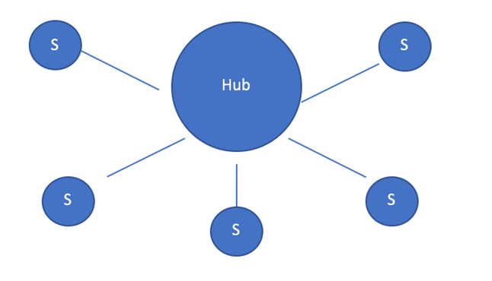
Data Hub (Hub & Spokes)
A loosely couple design pattern.
The producers write data to the hub.
The consumers read data from the hub.
Typical called an operational data store.
With big data, use of data lake storage.
Can be the single source of truth for a company.

Slide 4
Data Lake – Various File Types
Weakly typed file formats can lead to data quality and ETL pipeline issues. For instance, a delimited file type as Comma Separated Values (CSV) can be easily broken. This file type does not allow for compression.
Strongly typed file formats can lead to better data quality and the least amount of ETL pipeline issues. For instance, an Apache Parquet file format is stored as binary data, contains columns names/types and allows for compression of the data.

Slide 5
Delta File Format – Uses parquet files +
ACID transactions make sure complete writes are committed.
Schema enforcement allows only clean data inserted into the lake.
Time travel allows for versioning the delta lake table. Thus, we can view data at any given point.
Snapshot isolation allows for multiple readers and writers.
Open source format that is built for distributed systems such as Spark.

Slide 6
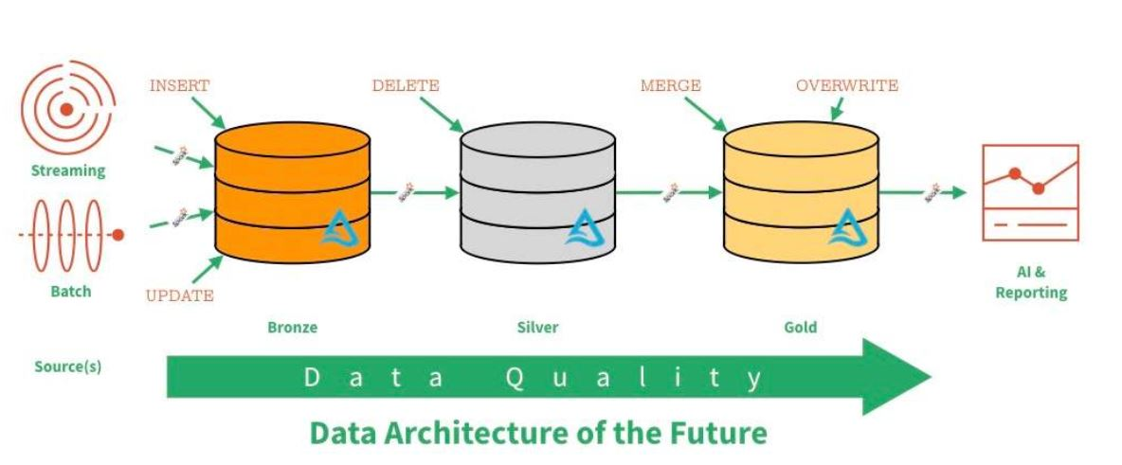
Data Lake – Zones & Data Quality

Slide 7
Load Patterns
The full load design pattern involves replacing the target dataset with a completely new version. Use this pattern with small sized data.
An incremental load design pattern involves merging the target dataset with a small dataset the represents changes over a given time period. For instance, a daily update file. This pattern can be used with small to medium sized data.
For the largest datasets, the use of a partitioning allows the full or incremental patterns to work with a subset of the data.

Slide 8
Historical Background
The first version of Azure Data Factory (ADF) was designed as an orchestration engine (ELT) and was release in the summer of 2015.
The second version of ADF was released in the summer of 2018. This version excels at connecting, orchestrating, delegating and managing, using a combination of legacy and modern environments.
Mapping Data Flows for ADF was release in the Fall of 2019. This new offering brought ELT transformations to ADF for cloud born services.
Wrangling Data Flows for ADF leverage the Power Query interface to simplify complex transformations into selections from a menu.

Slide 9
Business Problems
Why use object naming conventions and project folders?
What are the benefits of using the ELT design pattern.
What are the benefits of using the ETL design pattern.
What is the cost/benefit trade of for each pattern?

Slide 10
Naming Conventions
The use of a naming convention makes each pipeline, activity, dataset, linked service and/or data flow object look the same.
The prefix usually denotes the object type. Next, an action word or system location. Including the source and destination adds completeness to the naming.
PL = pipeline
COPY_DATA = action
ORADB = source system
ASQLDB = destination system
The combination of these parts creates the final name.
See references to a website that has a sample naming convention.

Slide 11
Organizing Projects
Folders can be used to group pipelines, datasets, and data flows by project.
Unfortunately, Azure Data Factory objects do not allow for annotations (comments). If it did, information such as designer, version and date are important items to keep track of. Also, complex designs can have a short algorithm enclosed in the header.
A consistent use of GIT branches should be used for version control.

Slide 12
Extract, Load & Translate – Overview
The copy activity is the center of attention using this design pattern.
Data is moved from a variety of sources to a variety of destinations.
An external computing resource is used for the translation. Both SQL Server and Databricks are popular computing endpoints.

Slide 13
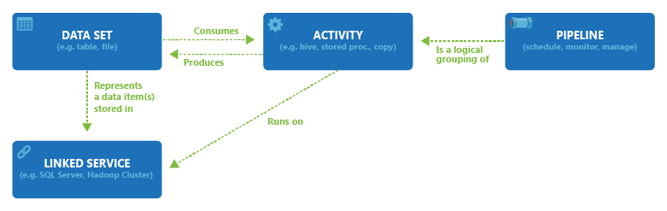
Extract, Load & Translate – Diagram
The above image shows the components that make up a pipeline.
Triggers are used to schedule pipeline executions.
Alerts can be defined in the portal for failed events.

Slide 14
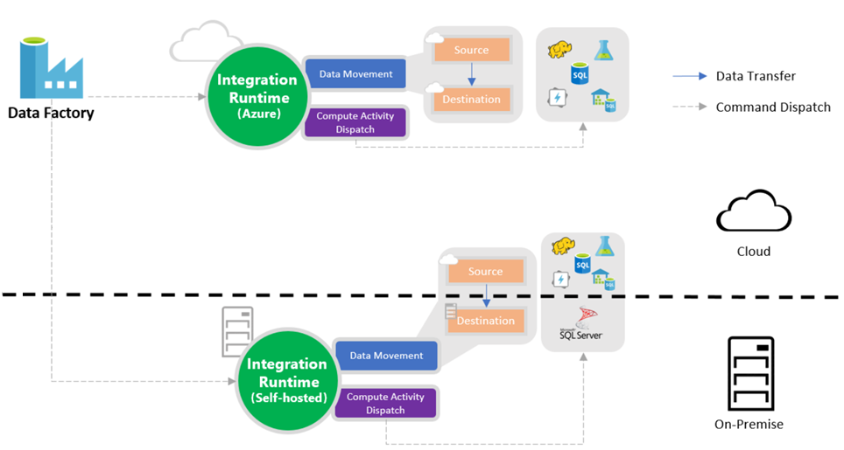
Extract, Load & Translate – Hybrid Data Movement

Slide 15
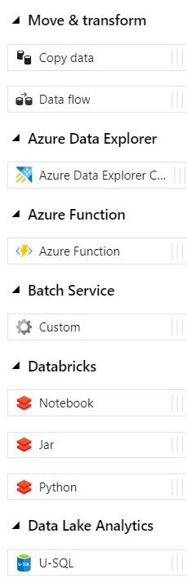
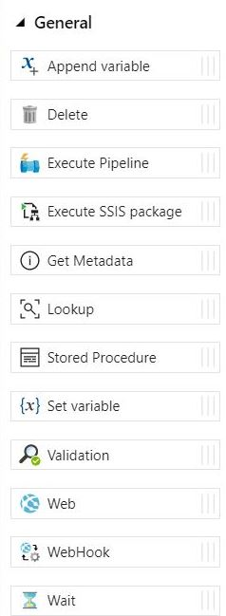
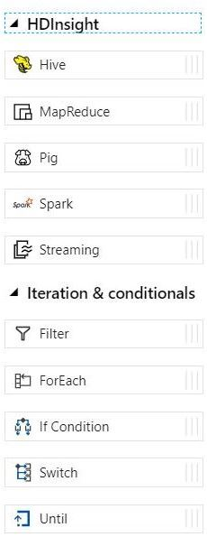
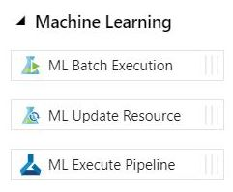
Extract, Load & Translate – Activities
Note
U-SQL has no future roadmap.
HD Insight is being replace with Databricks.

Slide 16
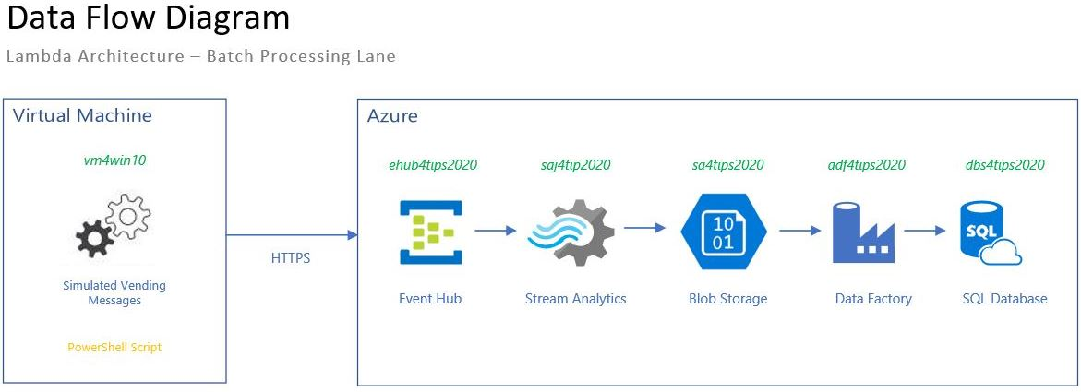
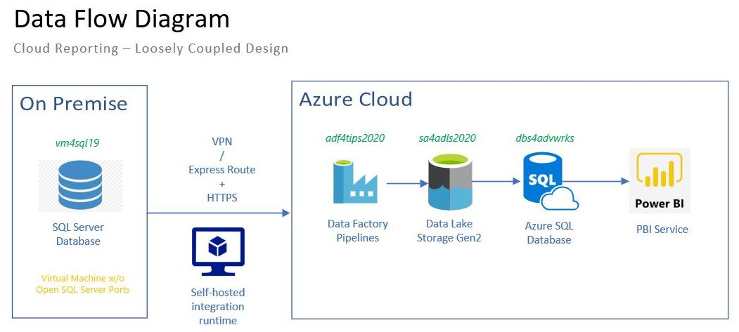
Pipeline Examples
IOT streaming data
Cloud reporting

Slide 17
Extract, Load & Translate – ELT - Pros vs Cons
Almost all components can be parameterized. This means that only master pipelines are used to call one generic pipeline.
Stored procedures in the database are used to do the heavy lifting: merging or transforming data. Must write on per each data set.
Complex queries involving multiple joins (lookups) can be save as views. These views can be used in the merge process if needed.
Executing multiple pipelines in parallel on a sub-set of data can be used to decrease the overall transfer time.
Changing the batch size can alter execution performance and overall timings.

Slide 18
Extract, Translate & Load – ETL - Overview
The source and destination for a data flow must be one of the four supported Azure systems (STORAGE, DB, DW, NOSQL).
Mapping Data Flows use the Data Bricks (Spark) Engine as a computing platform.
While parameters are supported for data flows, the engine can not handle dynamic destination datasets.
The 16 additional transformations turn a pipeline into an ETL process.
Wrangling Data Flows are still a preview feature. It is based on the Power Query interface and the M Language. Not all source data types are accepted at this time.

Slide 19
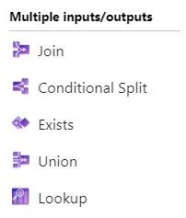
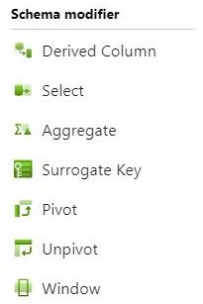
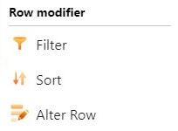
Extract, Translate & Load – Components
Not Listed
Source
Sink
New Branch

Slide 20
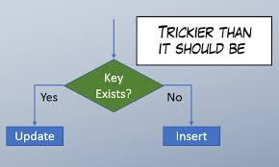

Data Flow Examples
UPSERT data pattern
AGGREGATE data pattern

Slide 21
Extract, Translate & Load – Pros vs Cons
The data flow activity is called from a standard pipeline. It uses both a source and destination data set that can not be parameterized. These data connections have to be one of the supported azure services.
Options such as partitioning, batch size and isolation level effect the overall performance.
Make sure the time to live (TTL) is set to acceptable value. The spin up of a data bricks cluster takes around 5 minutes.
There is an overhead to parallelism a data stream. A copy activity might perform better than a data flow for small data sets. However, dataflows might scale better for big data.
Advanced lookup and transformation steps can be performed with data flows.

Slide 22
Monthly Costs
A quick estimate of how much Azure Data Factory costs with and without Data Flows. This estimated did not include the cost of a Virtual Machine for the Integration Runtime Engine.
On average, a regular ADF costs about $262 per month.
Since data flows use a Spark cluster, an additional $1500-$2000 per month will be added for this service.

Slide 23
Summary
Azure Data Factory supports both ELT and ETL designs.
Pipelines, Activities, Datasets and Linked Services are at the heart of the orchestration engine. The copy activity supports a multitude of sources and destinations. This activity fulfills the extract and load processing (EL). Usually additional computing such as a RDBMS stored procedure is used to transform (T) the data.
Recently, Microsoft worked with Data Bricks to create Mapping Data Flows. This technology truly supports Extract, Translate and Load processing (ETL). The flow starts with a source, includes zero or more translations, and ends with a destination.

Slide 24
Summary (Continued)
There is no right or wrong way to create an ELT or ETL process; However, Business Line Managers might ask the following questions.
“Does the process accurately perform the movement and translation of the data?”
“Does the process execute in the given time frame using a reasonable amount of resources?”
“Does the process scale when the data increases?”
“Does the cost meet the monthly operating budget?”
In summary, Azure Data Factory offers the data processing developer many ways to move and transform data.

Slide 25
References
Sample Naming Conventions – ADF (Pipelines, Activities, Datasets, etc.)
https://dnavin.wordpress.com/2019/12/23/adf-naming-convention/
Azure Data Factory (Pipelines & Activities)
https://docs.microsoft.com/en-us/azure/data-factory/concepts-pipelines-activities
Azure Data Factory (Mapping Data Flows)
https://docs.microsoft.com/en-us/azure/data-factory/concepts-data-flow-overview
Azure Data Factory (Wrangling Data Flows)
https://docs.microsoft.com/en-us/azure/data-factory/wrangling-data-flow-overview
Azure Data Factory (Integration Runtime)
https://docs.microsoft.com/en-us/azure/data-factory/concepts-integration-runtime

Slide 26
Questions / Thank You

