Slide 1






Cleaning and preparing data with Pandas Presented by John Miner

Slide 2
The function of good software is to make the complex appear to be simple.”
Grady Booch,
Software Engineer
Known for UML

Slide 3
Presentation overview
Introduction to Python
Numerical Arrays with NumPy
Data Frames with Pandas
Data Science (clean & prepare)
Load data frame from file
Eliminating outliers
Encoding categorical
Handling missing data
Scaling features
Feature elimination
Save data frame to file

Slide 4

1. Python Language
One of the two popular open source data science languages.

Slide 5
About Python
Python is a general-purpose programming language created by Guido van Rossum in 1991.
It was designed for readability and easy syntax by using significant whitespace.
The main goal was to allow programmers to solve problems using fewer lines of code.

Slide 6
Anaconda Distribution
Python Interpreter
Package Management System (PIP)
Spyder IDE
Jupyter Notebooks
Example #100 – Hello World

Slide 7
Language versions
There are two main releases of the Python language. Python is an open source project.
Version 2.7.17 was release 19 October 2019.
Version 3.8.0 was release 14 October 2019.
All new projects should use version 3.X if possible.

Slide 8
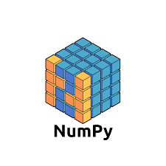
2. Numerical arrays
NumPy is a package that support multi-dimensional arrays and functions.

Slide 9
History
Numeric Python is the full name of the library.
In 2005, Travis Oliphant created NumPy by incorporating features of competing packages with heavy modifications into a brand-new library.
Alternative to python lists.
Calculations over the entire array.
Easy. Fast. Just one data type.

Slide 10
Creating numerical arrays
Various methods can be used to construct a Numpy array.
Method | Description
array() | Convert collection to an array.
asfarray() | Convert collection to floating point array.
asarray() | Convert collection specified dtype array.
zeros(), ones() | Create array of zeros or ones.
empty(), full() | Create an empty or full array.
range() | Create array given a range and step.
linespace() | Create array by dividing line.
random().normal() | Create array from a normal random sample.
Example #200 – Creating numerical arrays

Slide 11
Array Arithmetic
The following arithmetic operators can be used on same sized arrays.
Operator | Name
+ | Addition
- | Subtraction
* | Multiplication
/ | Division
% | Modulus
** | Exponentiation
// | Floor Division
Example #201 – Array Arithmetic

Slide 12
Indexing, Slicing and Subsetting
Indexing is used to access one item within the array.
Slicing is used to access several items in the array.
Sub-setting is the act of using a Boolean conditional array to return a subset of the original array.
Broadcasting is used when an operation is performed on arrays of different sizes.
Example #202 – Slicing arrays

Slide 13
Statistics
Understanding the data is the first step the analysis process.
Operator | Name
amin | Minimum array value.
amax | Maximum array value
percentile | Percentile
mean | Average value in array.
median | Median value in array
std | Standard deviation of array.
var | Variance of array
corrcoef | Correlation coefficient between vectors.
Example #203 – Load, change & save text files

Slide 14

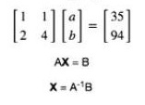
Linear equations
A "system" of equations is a set or collection of equations that you deal with all together at once.
Numpy supports matrix algebra.
How do we solve the following problem?

Slide 15

3. Creating data frames
A data frame is a two-dimensional object that has columns and rows.

Slide 16
History
Developer Wes McKinney started working on pandas in 2008 while at AQR Capital Management out of the need for a high performance, flexible tool to perform quantitative analysis on financial data.
He was able to convince management at the company to open source the project.
The Pandas library relies heavily on the NumPy array for the implementation of Pandas data objects and shares many of its features.

Slide 17
Creating data frames
The Series function takes a list as a parameter and turns it into a data frame.
More complex data can be passed to the DataFrame method to create the object.
Most important, pandas supports functions that can read from or write to popular formats such as CSV.
The index can be an auto increment number or part of the data.

Slide 18
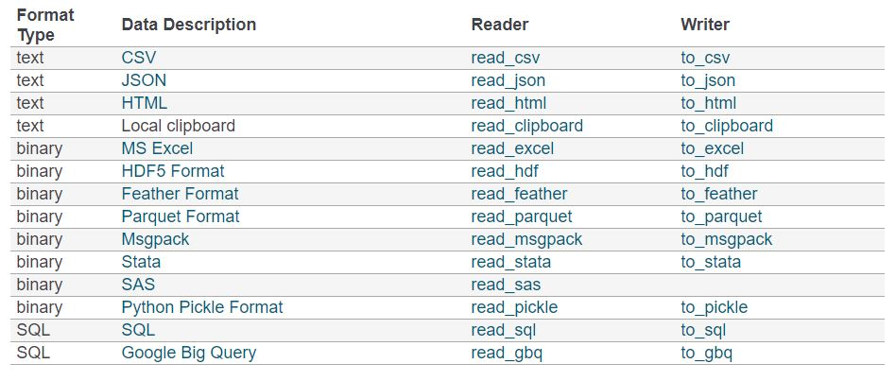
Reading and Writing data (4A & 4G)
The table below shows the formats that are supported by the Pandas library.

Slide 19
Select, Add and Delete Data
Data can be sorted by column for ranking. Also data can be selected by the column, row or element.
Prebuilt methods like index, column and values return corresponding series.
Row or column data can be removed by using the drop method.
A column can be added by setting a new column name to a value. Rows can be added by appending two data frames.

Slide 20
Working with data
The head and tail methods can be used to peek at the topmost or bottommost five records.
The describe method produces statistical information on each column.
Save the results of a comparison, true/false array, in a Panda series.
Subset the data frame using the save comparison, series.
Combine conditions using bit operations: & - and, | - or and ~ not.
Example #300 - Load, change & save text files

Slide 21
4. Data Science
Data scientists spend around 80% of their time on preparing and managing data for analysis..

Slide 22
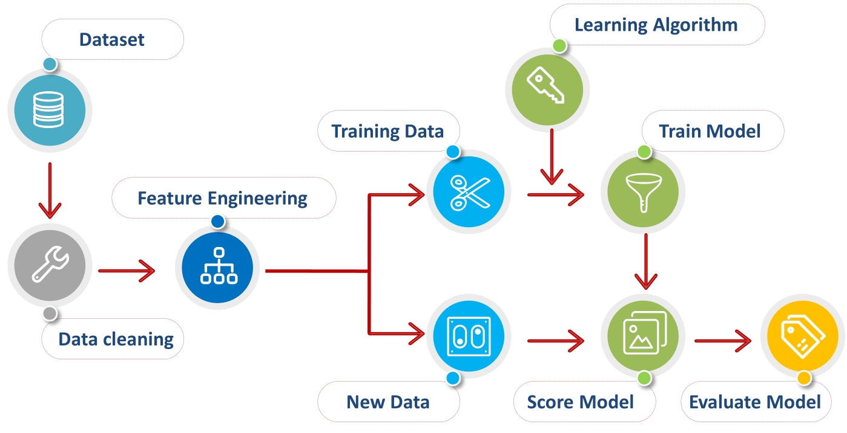
Model Life Cycle

Slide 23
Plotting Data
The matplotlib library has been directly integrated with pandas library to make plotting of data easier. For ultimate control, use the base library.
Method | Name
df.plot.line | Draw a line chart.
df.plot.scatter | Show a scatter plot.
df.plot.hist | Create a histogram.
df.plot.bar | Display a bar chart.
df.plot.boxplot | Draft a box plot.

Slide 24
Eliminating Outliers
Use the describe, group by and aggregate functions to figure out the distribution of the data.
A picture is worth a thousand words. Use plotting to document this chosen pre-processing step for the data.
Use sub-setting to drop the rows containing the outliers from the original data set.
Optionally save the cleaned data to a file.
Example #400 – Detect & Eliminate Outliers

Slide 25
Classic Encoders
Ordinal - convert string labels to integer values.
OneHot - one column for each value in feature.
Binary - convert integer to binary digits (columns). Some info loss but fewer dimensions.
BaseN - Higher order encoding. Doesn’t add much functionality.
Hashing - Fewer dimensions, some info loss due to collisions.
Example #401 – Encode categorical features

Slide 26
Handling Missing Data
Drop record from data set.
Set feature to know value such as zero.
Estimate feature value using a statistic.
Guess at feature value?
Example #402 – Handling missing data

Slide 27
Why Scale or Normalize Data?
Many machine learning algorithms perform better or converge faster when features are on a relatively similar scale and/or close to normally distributed.
linear and logistic regression
nearest neighbors
neural networks
support vector machines with radial bias kernel functions
principal components analysis
linear discriminant analysis

Slide 28
Scaling Data
MinMaxScaler() – for each data point, subtract the minimum value of the feature and then divide by the range.
StandardScaler() – for each data point, subtracting the mean and then scaling to unit variance ~ divide by the standard deviation.
MinAbsScaler() – similar in nature to the min/max scaler except for the fact that absolute values are used.
RubostScaler() - Unlike the previous scalers, the centering and scaling statistics of this scaler are based on percentiles and are therefore not influenced by a few number of very large marginal outliers.
Example #403 – Scaling numerical features

Slide 29
Feature Elmination
Filter method relies on the general uniqueness of the data to be evaluated and pick feature subset.
The wrapper method needs one machine learning algorithm and uses its performance as evaluation criteria.
Principal Component Analysis (PCA) is a linear dimensionality reduction technique that can be utilized for extracting information from a high-dimensional space by projecting it into a lower-dimensional sub-space.

Slide 30
Where to go next?
The python manual is the first place to go for core language questions. https://tinyurl.com/lvmapwf
Data Camp has great courses on specific areas such as Python or spark. https://tinyurl.com/hucco8m
Kaggle is where data scientist compete. There is actual money here that can be earned. Be careful of the entries (good, bad, & ugly). https://tinyurl.com/mwcfava

Slide 31
End of session!
Any questions?
You can find me at:
@JohnMiner3 or
john@craftydba.com

Slide 32
References
Python manual - https://tinyurl.com/lvmapwf
Numpy manual - https://tinyurl.com/y4sk2tao
Pandas manual - https://tinyurl.com/yyovugcf
Matplotlib & Pandas - https://tinyurl.com/tvreyfy
Encoding article - https://tinyurl.com/slcuuo5
Missing data article - https://tinyurl.com/vqdbjoq
Scaling article - https://tinyurl.com/ujyf7ug
Feature selection article - https://tinyurl.com/yahzsluv
Dimensional reduction article - https://tinyurl.com/vfw964l

