Slide 1

How isolated are your sessions?
SSUG – Hartford, CT
By John Miner ~ www.craftydba.com
Blog: www.craftydba.com
Tweet: JohnMiner3

Slide 2
Presentation Overview
Review the following subjects.
What is a transaction?
Maintaining the ACID quality of transactions.
How SQL Server implements transaction durability?
System versus User transactions.
Transaction basics.
Exploring the various transaction modes.
Exclusive versus Shared locks.
Blocking versus Deadlocks.
How to detect them with my free code.
How Isolation levels affect transaction behavior.
What is a dirty read versus a phantom read?
2 |

Slide 3
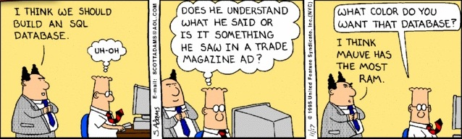
WARNING – TSQL Skills Required
All of the demonstrations are code based to give a real life example of how to apply a technique.
I will be not offended if you decide to leave now.
3 |

Slide 4
What is a transaction?
“A transaction is a logical unit of work. Either all the work completes as a whole unit, or none of it does.” *
* = Querying Microsoft SQL Server 2012
(70-461 Training Kit)
Itzik Ben-Gan, Dejan Sarka, & Ron Talmage.
4 |

Slide 5
Wire Transfer Example 1
What if a wire transfer did not rollback after a step fails?
The order of the transactions determines who is in the red $.
Customer (Red)
Debit Customer Account (Pass)
Credit Vendor Account (Fail)
Bank (Red)
Credit Vendor Account (Pass)
Debit Customer Account (Fail)
[show bolts/nuts video]
5 |

Slide 6
ACID properties of transactions
Atomicity - A transaction is an atomic unit of work. All changes succeed or none of them succeed.
Consistency – A transaction leaves the database in a consistent state.
Isolation – A transaction looks as though it occurs in isolation from other transactions.
Durability – A transaction endures a service interruption. Therefore, committed transactions are rolled forward and all uncommitted transactions are rolled back.
6 |

Slide 7
Write ahead logging
Microsoft SQL Server uses write ahead logging (WAL) to provide the atomic and durable properties to user databases.
Transaction log keeps track of DML and DDL statement changes.
Lazy writer, eager writer or checkpoint applies changes to data file(s).
Recovery from a service interruption involves the following.
Analysis – What transactions were not completed?
Redo – Roll committed changes forward to the data file.
Undo – Roll back changes since they were not committed.
7 |

Slide 8
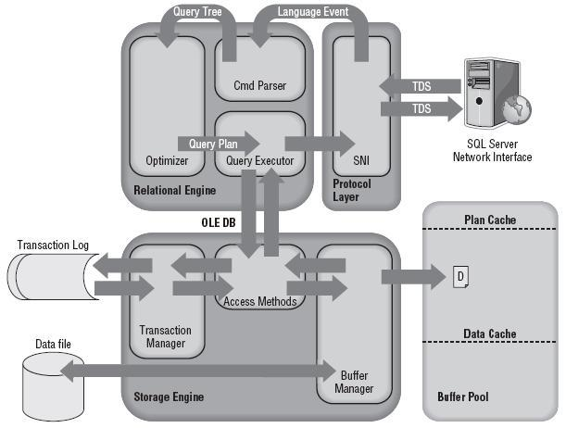
Database Engine Diagram
8 |

Slide 9
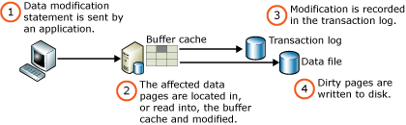
WAL Diagram
9 |

Slide 10
System versus User Transactions
System transactions are defined as any process that has a SPID < 50. Some processes run all the time. Others run on a timer. See below for a small sample.
LOG WRITER
LAZY WRITER
RECOVERY WRITER
CHECKPOINT
GHOST CLEANUP
LOCK MONITOR
All other transactions are considered user transactions.
[examples 1-3]
10 |

Slide 11
Transaction Basics
TSQL Commands
BEGIN TRAN – Start a new transaction.
COMMIT [TRAN] – Save the current transaction.
ROLLBACK [TRAN] – Undo the transaction(s).
@@TRANCOUNT – How nested are we?
XACT_STATE() – Are there any user transactions?
SET IMPLICIT_TRANSACTIONS – ON or OFF.
DBCC OPENTRAN(‘DB NAME’) – Show the open transactions.
11 |

Slide 12
Wire Transfer Example 2
The following pseudo code is used to demonstrate how transactions can maintain the ACID quality of the database.
-- Must have to/from account plus amount.
Declare @Amt = 250, @CustAcct = 1, @VendAcct = 2;
-- Explicit transaction
Begin Tran
-- Debit customer account
Update [Checking] Set [Bal] -= @Amt Where [AcctNo] = @CustAcct;
If (@@error <> 0) RollBack;
-- Credit vendor account
Update [Checking] Set [Bal] += @Amt Where [AcctNo] = @VendAcct;
If (@@error <> 0) RollBack;
-- No errors were detected
Commit;
12 |

Slide 13
Transaction Modes
Auto-commit – Any single DDL or DML statements automatically commit. This is the default behavior.
Implicit transaction – This mode has to be turned on. Any DDL or DML starts a transaction. You have to explicitly commit or rollback the transaction.
Explicit transaction – All transactions start with a ‘begin trans’ and end with a ‘commit’ or ‘rollback’.
[examples 4-6]
13 |

Slide 14
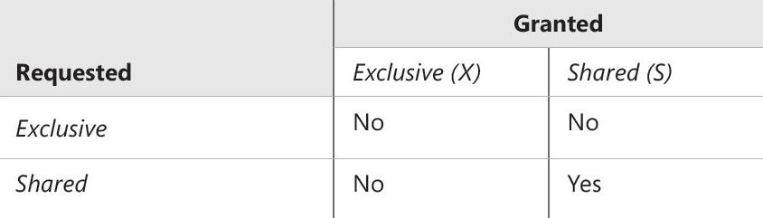
Exclusive & Shared Locks
Only a shared lock request can be granted to a shared resource. All other combinations are blocked until the resource is released.
[examples 7-8]

Slide 15
Blocking Defined
If two sessions request an exclusive lock on the same resource, and one is granted the request, then the other session must wait until the first releases its exclusive lock.
In a transaction, exclusive locks are held to the end of the transaction. *
* = 70-461 Training Kit

Slide 16

Real-life blocking example
Waiting for concert tickets

Slide 17
Blocking Example – A.W. database
Process 1
-- Start a transaction
BEGIN TRAN
-- Update (needs X lock)
UPDATE P SET Title = 'Ms.'
FROM
[AdventureWorks2012].[Person].[Person] AS P
WHERE P.BusinessEntityID = 21;
-- Wait for 2 minutes
WAITFOR DELAY '00:02:00';
-- Never commit
IF (1 = 0) COMMIT TRAN;
-- Roll back the transaction
ROLLBACK TRAN;
Process 2
-- Start a transaction
BEGIN TRAN
-- SELECT (uses S lock)
SELECT *
FROM
[AdventureWorks2012].[Person].[Person] AS P
WHERE P.BusinessEntityID = 21;
-- Commit the transaction
COMMIT TRAN;

Slide 18
Deadlocking Defined
A deadlock results from mutual blocking between two or more sessions. Sometimes locking sequences between sessions cannot be resolved simply by waiting for one transaction to finish.
This occurs due to a cyclical relationship between two or more commands. *
* = 70-461 Training Kit

Slide 19

Real-life deadlock example
Grid lock in a city

Slide 20
Deadlock Example – A.W. database
Process 1
-- Start a transaction
BEGIN TRAN
-- First resource
UPDATE
[AdventureWorks2012].[Person].[EmailAddress]
SET EmailAddress = 'dylan-007@adventure-works.com'
WHERE BusinessEntityID = 7;
-- Wait for 2 minutes
WAITFOR DELAY '00:02:00';
-- Second resource
UPDATE [AdventureWorks2012].[Person].[Person]
SET Title = 'Mr.'
WHERE BusinessEntityID = 7;
-- Never commit
IF (1 = 0) COMMIT TRAN;
-- Roll back the transaction
ROLLBACK TRAN;
Process 2
-- Start a transaction
BEGIN TRAN
-- Second resource
UPDATE [AdventureWorks2012].[Person].[Person]
SET Title = 'Mr.'
WHERE BusinessEntityID = 7;
-- Wait for 2 minutes
WAITFOR DELAY '00:02:00';
-- First resource
UPDATE
[AdventureWorks2012].[Person].[EmailAddress]
SET EmailAddress = 'dylan-007@adventure-works.com'
WHERE BusinessEntityID = 7;
-- Never commit
IF (1 = 0) COMMIT TRAN;
-- Roll back the transaction
ROLLBACK TRAN;

Slide 21
Detecting Blocking & Deadlocks (B&D)
Use the lock monitor thread since it constantly looks for blocking and deadlocks.
Enable service broker for all databases that need monitoring.
Enable blocked process threshold. How often to create the blocked report.
Create WMI alerts for both Deadlock and Blocking graphs.
Pass XML data to the jobs via tokens.
Write code to interpret XML, save results, and notify administrators.
21 |

Slide 22
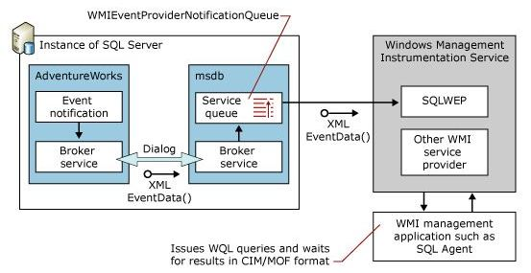
Why we need service broker?
22 |

Slide 23
Custom B&D Monitoring (c1)
ALERTS:
Alerts for blocking
Alerts for deadlocks
JOBS:
Alerts: Blocking Report
Alerts: Deadlock Report
TABLES:
tbl_Monitor_Blocking
tbl_Monitor_Deadlocks
tbl_Wmi_Xml_Reports
23 |

Slide 24
Custom B&D Monitoring (c2)
TABLE VALUE FUNCTIONS:
ufn_Parse_Blocking_Report
ufn_Parse_Deadlock_Report
STORED PROCEDURES:
usp_monitor_blocking
usp_monitor_deadlocks
[examples 9-10] + [batch files]
24 |

Slide 25
Various Isolation Levels (weak)
READ COMMITTED –
This is the default isolation level in which readers only read data committed data. All read (select) statements will attempt to acquire shared locks and any data resources being changed (insert, update, delete) obtain exclusive locks. In short, writers block readers.
READ UNCOMMMITED –
This isolation level allows readers to read uncommitted data. In short, the shared locks are not used so that readers are no longer are blocked by writers.
However, a process may read uncommitted data that was changed during a transaction and then later was rolled back to its initial state. This is called a dirty read.
25 |

Slide 26
Various Isolation Levels (weak)
READ COMMITTED SNAPSHOT (RCSI) –
This is the default isolation level for SQL Azure. Just a different way to implement read committed This isolation level also uses row versioning in [tempdb] to keep track of the original data during a transaction.
It is enabled as a persistent database property. Shared locks are not longer needed.
26 |

Slide 27
Various Isolation Levels (strong)
REPEATABLE READ –
This isolation level guarantees that data read in a transaction can be re-read later. Updates and deletes of rows already selected are prevented since shared locks are kept until the end of a transaction. However, the transaction may see new rows added after its first read; this is called a phantom read.
SNAPSHOT –
This isolation level also uses row versioning in [tempdb]. It is enabled as a persistent database property and then set per transaction. The data is a copy in time. Thus, no shared locks are acquired on the underlying data.
SERIALIZABLE - This isolation level is the strongest set per session. All reads are repeatable and new rows are not allowed in the underlying tables that would satisfy the conditions of the SELECT statements in the transaction.
27 |

Slide 28
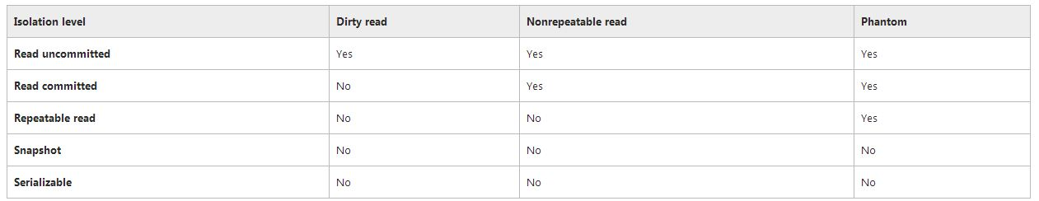
Side Effect Matrix
28 |

Slide 29
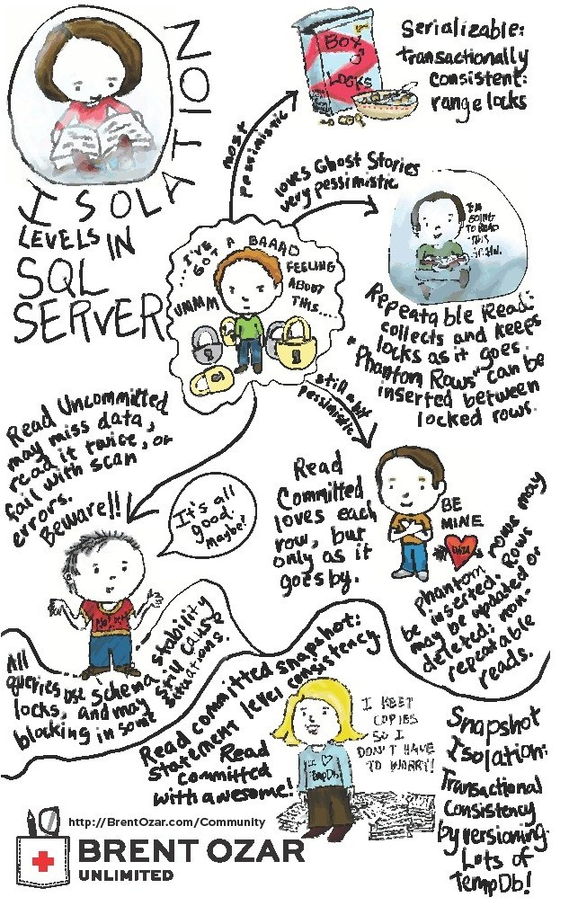
29 |

Slide 30
Demonstrations
EX 11 –
Read uncommitted isolation with a dirty read.
EX 12 –
Repeatable read isolation with moved row.
EX 13 –
Repeatable read isolation with a phantom read.
EX 14 –
Read committed snapshot isolation with version store.
EX 15 –
Snapshot isolation with version store.
EX 16 –
Serializable isolation, no dirty reads, no phantom records.
EX 17 –
Why the (nolock) table hint is bad. Can cause counting issues.
30 |

Slide 31
References
MSDN - Transaction Types & ACID
http://technet.microsoft.com/en-us/library/ms190612(v=sql.105).aspx
MSDN – Writing Pages (WAL)
http://technet.microsoft.com/en-us/library/aa337560(v=sql.105).aspx
WIKIPEDIA - Recovery & isolation levels using WAL
http://en.wikipedia.org/wiki/Algorithms_for_Recovery_and_Isolation_Exploiting_Semantics
MSDN - WMI Provider for server events
http://technet.microsoft.com/en-us/library/ms181893.aspx
MSDN – Job Tokens
http://technet.microsoft.com/en-us/library/ms175575.aspx
MSDN - Isolation levels (detailed)
http://technet.microsoft.com/en-us/library/ms189122(v=sql.105).aspx
MSDN – Understand row versioning based isolation
http://msdn.microsoft.com/en-us/library/ms189050(v=sql.105).aspx
MSDN – Monitoring the version store
http://msdn.microsoft.com/en-us/library/ms175492(v=sql.105).aspx
31 |

Slide 32
Biography
Has twenty years of data processing and proven project management experience, specializing in the banking, health care, and government areas.
His credentials include a Masters degree in Computer Science from the University of Rhode Island; and Microsoft Certificates (MCDBA & MCSA).
John is currently a Developing DBA at SENSATA working with SQL Server 2008 + silo of products.
When he is not busy working, he spends time with his wife, daughter and dog enjoying outdoor activities
32 |

Slide 33
Questions & Answers
Please visit SQL Server Books Online for more info.
Please ask about the presentation or visit my blog (www.craftydba.com) for articles on this and many other subjects.
If you have any questions, you can contact me at j.miner@cox.net
33 |

