Slide 1


Best Practices Azure SQL Server VM
Rhode Island
Business Intelligence
User Group
April 2016
Name: John Miner
Blog: www.craftydba.com
Tweet: JohnMiner3

Slide 2
Wikipedia
Cloud computing companies offer services in three typical flavors. They are listed from high to low complexity in terms of management.
Infrastructure as a service (IAAS) basically supplies the consumer with a virtual machine.
Platform as a service (PAAS) supplies the consumer with application development environment.
Software as a service (SAAS) supplies the consumer with access to an application and data.

Slide 3
Azure Services
Here are three typical cloud services in Azure.
Power BI dashboard is a software as a service offering.
Azure SQL Server database is a software as a service offering.
Azure virtual machines is a infrastructure as a service offering. *
* = possible lift & shift workload to the cloud.

Slide 4
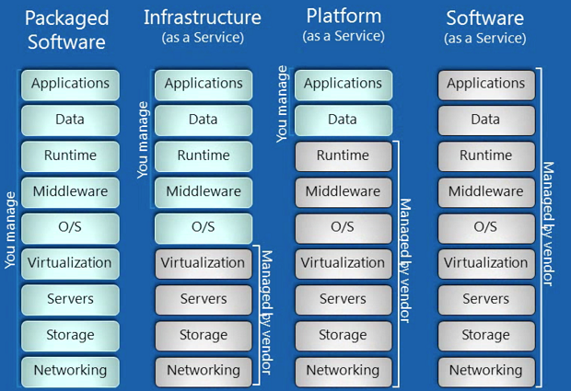
Cloud services vs Packaged Software

Slide 5

Presentation Overview
Design virtual machine
Access virtual machine
Configure windows settings
Setup database engine
Install database mail
Enable basic alerting
Provide maintenance plans
Take system baseline

Slide 6




Compute Considerations
Are you going to use a public internet connection or dedicated pipe (express route)?
Where is the information located? There are currently 22 data centers in the world.
How much processing power does the solution need?
How is security going to play a role?

Slide 7

Design Virtual Machine
Unique machine name
Admin credentials
Pick a machine size
Storage account
Availability set for failover
Enable public access
Optional standard security
Select automatic patching
Choose automatic backups
Example - Task 1

Slide 8

Virtual Machine Sizes
Five different sizes.
A-series can be deployed on a variety of hardware types and processors.
D-series VMs are designed to run applications that demand higher compute power and temporary disk performance.
G-series VMs offer the most memory and run on hosts that have Intel Xeon E5 V3 family processors.
GS/DS – series VM’s follow their parent series with the hard disk being solid state drives.

Slide 9
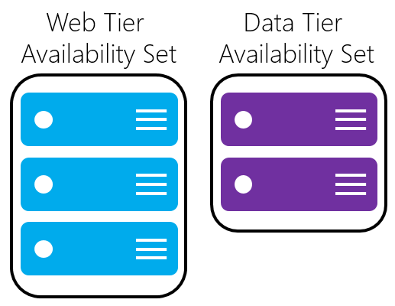
Fault & Update Domains
Fault Domains define the group of virtual machines that share a common power source and network switch.
Update Domains indicate groups of virtual machines and underlying physical hardware that can be rebooted at the same time
By default, there are 3 fault domains and 5 update domains. Group similar machines into different availability groups.

Slide 10
Performance Best Practices (pg. 1)
Machine Size
DS3 or higher for SQL Enterprise edition.
DS2 or higher for SQL Standard and Web editions.
* = the size of the virtual machine can be changed when it is stopped
Storage Account
Use Premium Storage. Standard storage is only for dev/test.
Keep the storage account and SQL Server VM in the same region.
Disable Azure geo-redundant storage on the storage account.

Slide 11
Performance Best Practices (pg. 2)
Add Hard Disks
Use a minimum of 2 x Premium 30 Disks (disk 1=log files; disk 2=data files & tempdb). Avoid using operating system or temporary disks for database storage or logging. Enable read caching on the disk(s) hosting the data files and [tempdb]. Do not enable caching on disk(s) hosting the log file.
Stripe multiple Azure data disks to get increased IO throughput. Format with documented allocation sizes (OLTP = 64KB, OLAP=256KB)

Slide 12

Disk Partition Alignment
Command Line Utility
Diskpart.exe
list disk
select disk <DiskNumber>
create partition primary align=<Offset_in_KB>
assign letter=<DriveLetter>
format fs=ntfs unit=64K label=“label” nowait

Slide 13
Performance Best Practices (pg. 3)
Local Security Policy
Enable instant file initialization.
Enable locked pages.
Database File Changes
Enable database page compression. Limit or disable autogrow on the database. Disable autoshrink on the database.
Use Fast Disks Move all databases to data disks, including system databases. Move SQL Server error log and trace file directories to data disks. Setup default backup and database file locations. Apply SQL Server performance fixes.

Slide 14

Configure Windows Settings
Add data disk(s) in Azure
Enable read caching for data disks
Add log disk in Azure
Align and format disks in Windows
Set power setting to high
Configure local account for services
Add account to volume maintenance
Add account to lock pages in memory
Configure firewall rule
Example - Task 3

Slide 15

Setup database engine
Configure [tempdb] files
Enable [tempdb] trace flags
Resize system databases
Set min/max memory value
Set default data/log/backup directories
Always compress backups
Optimize for ad-hoc queries
Set MAXDOP value
Enable DAC for emergencies
Example - Task 4

Slide 16

Install database mail
Create & Activate Send Grid Account
Enabling the DB mail service
Creating a mail account
Making a mail profile
Associating profiles with accounts
Assign the profile a principle
Update SMTP credentials
Sending that first email message
Example - Task 5

Slide 17

Enable basic alerting
Add a database operator
Define a fail-safe operator
Enable SQL Agent mail
Enable fail-safe operator
Create basic alerts (11-24)
Test basic alerts
Add blocking alert
Add deadlock alert
Example - Task 6

Slide 18

Provide Maintenance Plans
Data file backups
Log file backups
Index defragmentation
Update table statistics
Clean up msdb logs
Monitor file size
Monitor vlf size
You can use ola hallengren’s scripts, custom jobs and/or maintenance plans.
Example - Task 7

Slide 19

Baseline Current System
The modern DBA should use the DMAIC process to manage a dynamic system.
Crystal Disk Mark
SQL IO
Performance Analysis of Logs (PAL)
Pssdiag / Sqldiag Manager
Sqlnexus
Capture DMV information

Slide 20
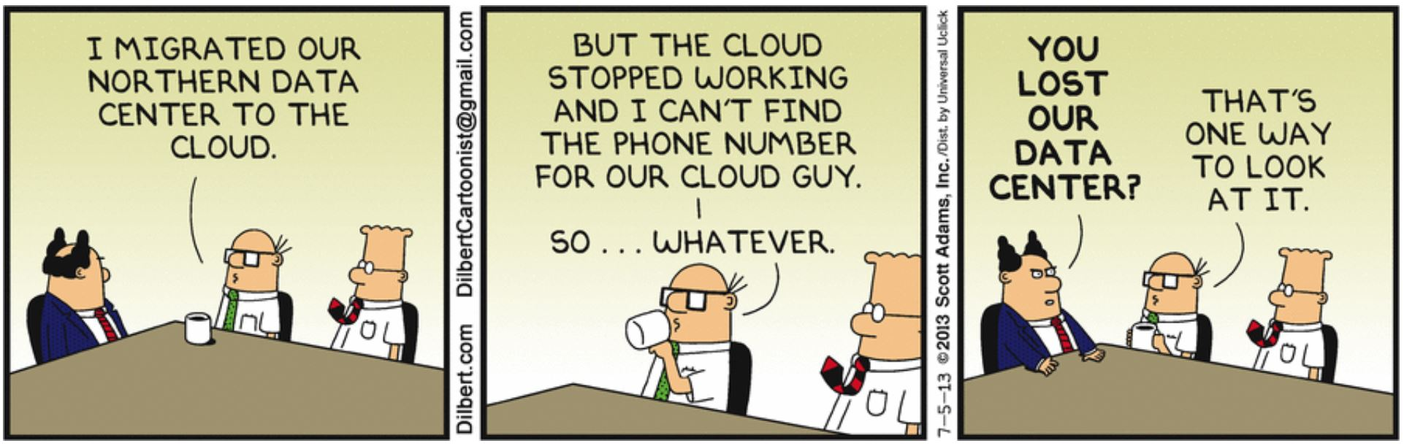
Migrating Workloads to Azure
Azure is more resilient than this comic strip!

Slide 21
To Summarize The Talk
To be successful with infrastructure as a service, you need to know a little about virtual machine, windows system and SQL database administration.
The benefit of controlling your own VM is that you have 100% on premise to in cloud compatibility.
After setting up you system, make sure you take a baseline. You never know when a noisy neighbor might be the cause of your woes.

Slide 22
References (pg. 1)
Virtual Machine Sizes
https://azure.microsoft.com/en-us/documentation/articles/virtual-machines-linux-sizes/
Performance Best Practices (Azure SQL VM)
https://azure.microsoft.com/en-us/documentation/articles/virtual-machines-windows-sql-performance/
Premium Storage
https://azure.microsoft.com/en-us/documentation/articles/storage-premium-storage
Disk Partition Alignment Best Practices for SQL Server
https://technet.microsoft.com/en-us/library/dd758814(v=sql.100).aspx

Slide 23
References (pg. 2)
Manage Availability
https://azure.microsoft.com/en-us/documentation/articles/virtual-machines-windows-manage-availability/
Send Grid Service
https://azure.microsoft.com/en-us/documentation/articles/sendgrid-dotnet-how-to-send-email/
System Alerts
http://craftydba.com/?p=1099
Database Mail
http://craftydba.com/?p=1025

Slide 24
References (pg. 3)
Operators
http://craftydba.com/?p=1085
Alerts
http://craftydba.com/?p=1099
Effects of min and max server memory
https://technet.microsoft.com/en-us/library/ms180797(v=sql.105).aspx
Optimize For Ad-hoc Workloads
https://msdn.microsoft.com/en-us/library/cc645587(v=sql.110).aspx

Slide 25
References (pg. 4)
Optimizing tempdb configuration
https://www.simple-talk.com/sql/database-administration/optimizing-tempdb-configuration-with-sql-server-2012-extended-events/
Tempdb trace flags
https://www.brentozar.com/archive/2014/06/trace-flags-1117-1118-tempdb-configuration/
Dedicated Administrator Connections
https://technet.microsoft.com/en-us/library/ms178068(v=sql.105).aspx
Storage Spaces
https://technet.microsoft.com/library/hh831739.aspx

Slide 26
References (pg. 5)
High Performance Power Setting
https://www.brentozar.com/archive/2010/10/sql-server-on-powersaving-cpus-not-so-fast/
Maintenance Scripts
https://ola.hallengren.com/sql-server-backup.html
Monitoring Database VLF’s
http://craftydba.com/?p=3374
Monitoring Database File Size
http://craftydba.com/?p=3423
Maintenance & History Cleanup Tasks
http://craftydba.com/?p=3258

Slide 27
References (pg. 6)
Management Data Warehouse
https://msdn.microsoft.com/en-us/library/bb677179.aspx
Performance Analysis Of Logs
http://pal.codeplex.com/
Crystal Disk Mark
http://download.cnet.com/CrystalDiskMark/3000-2094_4-75330576.html
SQL IO
https://www.mssqltips.com/sqlservertip/2127/benchmarking-sql-server-io-with-sqlio/
SQL Nexus
http://sqlnexus.codeplex.com/
DMV Scripts
http://www.sqlskills.com/blogs/glenn/category/dmv-queries/

Slide 28
Thank you for attending!
John Miner
RI BIUG - SMITHFIELD RI - APR 2016

