Slide 1
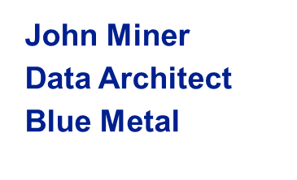



How to audit and prevent unwanted user actions
SQL Saturday #723
Rochester, NY
Blogs: www.mssqltips.com
www.craftydba.com
Tweet: JohnMiner3
Email: john@craftydba.com

Slide 2
Target Audience
SQL Server Developers
How to use table, database and server triggers to prevent and audit various actions.
Exploring other constructs to control the chaos.
SQL Server Administrators
All the coding tricks of the developers.
Granting correct privileges for principles on objects.
Change data capture as another alternative method.
2 |

Slide 3
Typical Corporations
Composed of small divisions located in different countries and time zones.
Other people have keys to the kingdom.
Change control process is usually weak.
SDLC might not be well structured.
How do you prevent and audit unwanted user actions to key data?
3 |

Slide 4
Presentation Overview
Review techniques on the following subjects.
Granting correct user access is vital.
DML triggers to keep a DATA audit trail.
DDL triggers to keep a SCHEMA audit trail.
Preventing unwanted DATA modifications.
Preventing unwanted SCHEMA changes.
Preventing table TRUNCATIONS.
LOGIN triggers to control who, what, and when.
Change data capture (CDC) an alternative to triggers.
4 |

Slide 5
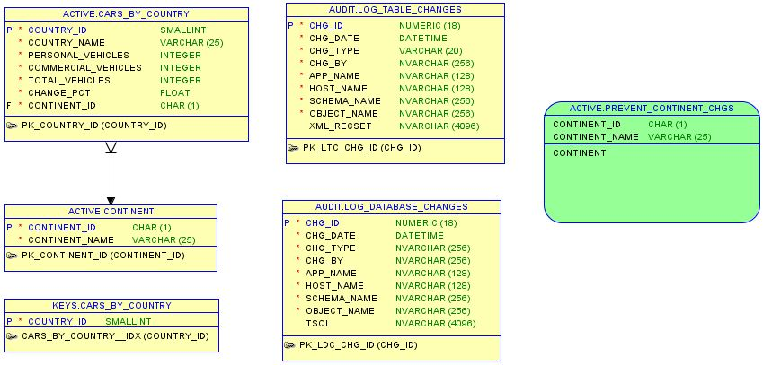
Autos Sample Database
5 |

Slide 6
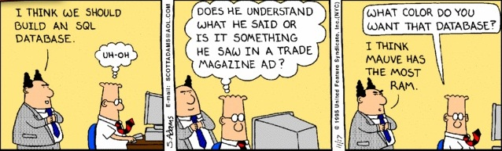
WARNING – TSQL Skills Required
All of the demonstrations are code based to give a real life example of how to apply a technique.
I will be not offended if you decide to leave now.
6 |

Slide 7
Starting from ground zero
Create the [autos] database.
Make the [active] & [audit] schemas.
Create the [continent] & [cars_by_country] tables.
Design two stored procedures to populate above tables with data.
Load the two above tables with data by execution for mentioned code.
[Steps 1-5]
7 |

Slide 8
Granting User Access
Principle of least security. Never give out more than needed.
Principles are objects that have access to resources (logins, groups, roles)
Securable are any object that can be secured (table, view, store procedure).
Granting, revoking, and denying access privileges to meet our needs.
When ever possible, use standard database and server roles.
[Step 6]
8 |

Slide 9
Audit Data Changes
Table triggers can be used to audit inserts, updates or deletes
A user defined table is used to keep track of the following: change type, change date, user name, host name, schema, object, and raw row data.
One table can be used for the whole database. Just add a trigger for each table.
[Steps 7-9]
9 |

Slide 10
Audit Schema Changes
Database triggers can be used to audit the following events on typical objects: triggers, functions, procedures, tables, views and security.
A similar user defined table is used to keep track information including the TSQL statement.
One table can be used for the whole database.
[Steps 10-12]
10 |

Slide 11
Prevent Data Changes
Table triggers can be used to prevent unwanted inserts, updates or deletes.
The Check Option of a view is the poor mans version of range integrity, data prevention.
Both techniques allow truncation of tables.
Again, correct security is key.
db_datareader
db_datawriter
[Steps 15-16]
11 |

Slide 12
Prevent Table Truncation
Maintain table K that has the same key as the mission critical table T.
Create a foreign key relationship between table T and table K.
Referential integrity protects the data.
Again, correct security is key.
[Steps 17]
12 |

Slide 13
Prevent Schema Changes
Database triggers can be used to prevent unwanted schema changes.
Schema and object names can be used to selectively apply this prevention.
Optional logging before rolling back the operation.
Again, correct security is key.
db_ddladmin
db_owner
[Steps 18]
13 |

Slide 14
Audit Server Logins
Login triggers can be used to audit successful attempts.
Just like table and database triggers, a table can used to track this information.
I suggest you use the [msdb] database since it will always exist and is not mission critical like [master].
[Step 19]
14 |

Slide 15
Prevent Server Logins
Login triggers can be used prevent users from obtaining a valid connection (session).
Triggers can be used to keep out new logins during maintenance windows.
Triggers can be used to prevent certain applications like MS Access or Excel from using the database via ODBC.
[Steps 20-21]
15 |

Slide 16
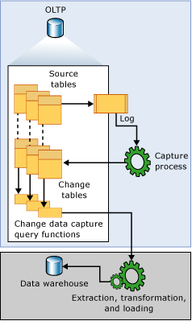
Change Data Tracking (Overview)
New feature in SQL Server 2008.
Asynchronous from transaction log.
Uses SQL jobs to capture data.
Views & Functions to pull data.
16 |

Slide 17
Change Data Tracking (Details 1)
Enable at database which creates a set of cdc.* system tables. The following SQL Agent jobs are made to scoop data.
cdc.[Database Name]_capture
cdc.[Database Name]_cleanup
Enable at table level which creates a
cdc.[Table Name]_CT table to track data.
Tracks DML changes on table.
Tracks DDL changes on table.
[Steps 23]
17 |

Slide 18
Change Data Tracking (Details 2)
cdc.captured_columns – This table returns result for list of captured column.
cdc.change_tables – This table returns list of all the tables which are enabled for capture.
cdc.ddl_history – This table contains history of all the DDL changes since capture data enabled.
cdc.index_columns – This table contains indexes associated with change table.
cdc.lsn_time_mapping – This table maps LSN number (for which we will learn later) and time.
18 |

Slide 19
My Comments On CDC
Nice first try at Change Data Capture.
Missing user and host name which are key items.
Alter table does not add new column to capture list.
Did not find a stored procedure to allow additions to capture list.
Disabling CDC removes the table.
Need to research the cleanup job timing.
19 |

Slide 20
Biography
Has twenty five years of data processing and proven project management experience, specializing in the banking, health care, and government areas.
His credentials include a Masters degree in Computer Science from the University of Rhode Island; and Microsoft Certificates (MCSE Data & Analytics).
John is currently a Data Architect at Blue Metal. He was award the MVP (2014/2015) honor for his contributions to the community.
When he is not busy talking to local user groups or writing blog entries on new technology, he spends time with his wife and daughter enjoying outdoor activities. Some of John’s hobbies include wood working projects, crafting a good beer and playing a game of chess.
20 |

Slide 21
Questions & Answers
Please visit SQL Server Books Online for more info.
Please ask about the presentation or visit my blog (www.craftydba.com) for articles on this subject.
If you have any questions, you can contact me at j.miner@cox.net
21 |

