Slide 1
SQL Server on Linux
Various DBA Topics
DATA
John Miner
jominer@microsoft.com
Data Platform TSP
September 2017

Slide 2
Topics covered
Different SQL Server on Linux builds.
Migrating a database from Windows to Linux.
Monitoring your environment for issues.
Providing high availability to your application.

Slide 3

SQL Server on the platform of your choice
Linux
Linux/Windows container
Linux distributions including Red Hat Enterprise Linux (RHEL), Ubuntu, and SUSE Linux Enterprise (SLES)
Linux containers for Docker engine on Mac OS, Windows and Linux; Windows and Hyper-V container for SQL Server on Windows
Package-based installation, yum install, apt-get, zypper and more options
Windows
Windows Server

Slide 4

How to deploy on Linux?
In-cloud install (Azure)
  Deploy complete image from gallery (OS & DB).
  Deploy a Linux kernel (OS). Manually install and configure components (DB).
On-premise install (VM or Physical)
  Deploy a Linux kernel (OS). Manually install and configure components (DB).
* - RHL is the only pre-installed image. No HA images available.

Slide 5
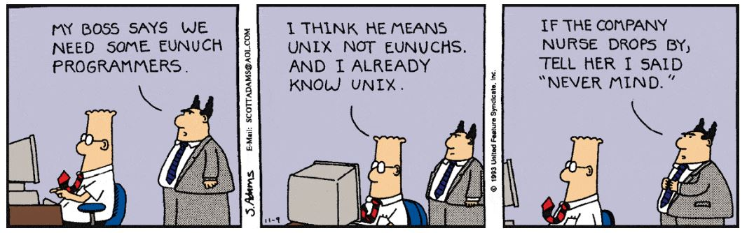
Unix Skills Required
Many of the actions that could be easily done in SSMS are now command line actions.
Advanced configurations for Business Continuity require manual setup.

Slide 6

Required freeware tools
Who does not like free software?
Putty.exe is used to connect securely to Linux.
Puttygen.exe is used to generate SSH keys.
Winscp.exe is used to securely copy files between environments.

Slide 7

Separate download and install
SQL Database
SQL Tools
SQL Agent
Full Text Search
Integration Services
https://docs.microsoft.com/en-us/sql/linux/sql-server-linux-setup

Slide 8

Server Configuration
Unix command - firewall-cmd
Unix command - mssql-conf
Unix command – ssis-conf
Azure Portal - network security group
https://docs.microsoft.com/en-us/sql/linux/sql-server-linux-configure-mssql-conf

Slide 9

More about mssql-conf
Use setup to set SA password.
Can set various directories (data, log, backup).
Used to set default email profile for alerts.
Can change TCP/IP port for the engine.
Configure TLS keys for SSL.
Change dump profile.
Can add trace flags to startup.
Enable HADR.
* Most actions require restart of service.
https://docs.microsoft.com/en-us/sql/linux/sql-server-linux-configure-mssql-conf

Slide 10

Other things to consider
The [tempdb] is just one file.
Might want to adjust [model] database settings.
Add dedicated admin console connection.
Set optimize for ad-hoc queries.
Set MAXDOP value.
Some new trace flags set by default.

Slide 11

Database Migration Paths
Backup and restore.
Consider warm standby for larger dbs. *
Export and Import BACPAC.
Data Migration Assistant
BCP Utility
Integration Services
* - https://technet.microsoft.com/en-us/library/ms175548(v=sql.105).aspx
https://docs.microsoft.com/en-us/sql/linux/sql-server-linux-migrate-bcp

Slide 12

Simple monitoring
Install SQL Server Agent
Configure database mail.
Create a database operator.
Create standard alerts.

Slide 13
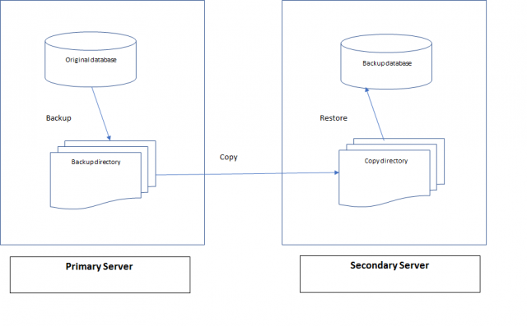
Business Continuity – Option 1
Log shipping
  Uses CIFS + Samba to setup a network share.
  Must use system stored procedures to create backup/restore jobs.
https://docs.microsoft.com/en-us/sql/linux/sql-server-linux-use-log-shipping

Slide 14
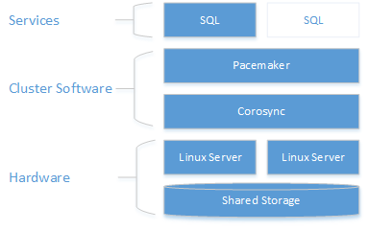
Business Continuity – Option 2
Fail Over Clustering
  Only supports Active/Passive configuration.
  Requires a server for the network file share.
  Pacemaker & corosync coordinate communication and resources.
https://docs.microsoft.com/en-us/sql/linux/sql-server-linux-shared-disk-cluster-configure

Slide 15
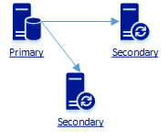
Business Continuity – Option 3
Availability Groups
  Linux does not support a file share witness.
  Requires at least three servers for automatic HA.
  Uses pacemaker for resource coordination.
https://docs.microsoft.com/en-us/sql/linux/sql-server-linux-availability-group-overview

Slide 16

Securing your database
Granting access with least privileges.
Guard data with masking and/or row level security with filter/block predicates.
Enable TDE for databases & backups.
Configure TLS for encrypted connections.
Supports Active directory authentication.
  Join SQL Server host to AD domain - Kerberos
  Create AD user for SQL Server and set SPN
  Configure SQL Server service key tab
  Create AD based logins using T-SQL
https://docs.microsoft.com/en-us/sql/linux/sql-server-linux-security-overview

Slide 17
Summary
The core database engine works almost flawlessly at this time.
There are still many features missing from the SSMS tool.
Please keep on posting suggestions for features that you miss.
Keep an on the updated release notes.
https://docs.microsoft.com/en-us/sql/linux/sql-server-linux-release-notes

Slide 18
Thank you for your time.

