Slide 1

Azure Synapse – Serverless Pools
John Miner Data Architect
john.miner@insight.com

Slide 2
Business Problem & Solution
Many organizations are consolidating all their informational assets into data lake. Both structured and unstructured data can be stored in the lake and many different types of users can access the data.
Most of the time, the Apache Spark cluster is used to transform and increase the quality of the data. The more powerful the cluster is, the more costly is the Azure monthly bill.
Azure Synapse Serverless SQL pools allow the architect to replace the interactive Apache Spark cluster with a lower cost service.

Slide 3
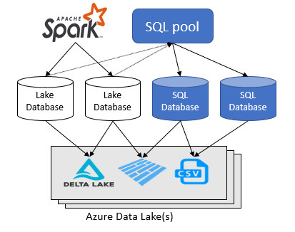
Two types of databases
Synapse SQL leverages a scale out architecture to distribute computational processing of data across multiple nodes.
Compute is separate from storage, which enables you to scale compute independently of the data in your system.
A serverless SQL pool scales automatically to accommodate query resource requirements and adapts to computation processing changes in the environment.

Slide 4
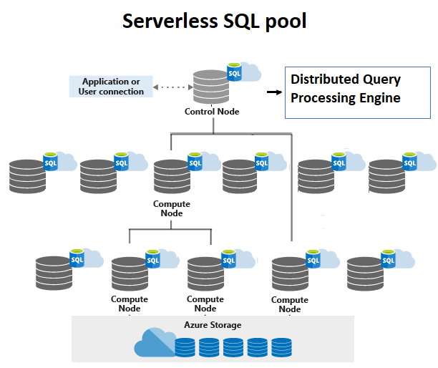
Serverless SQL Pool
At this time, serverless SQL pools are read only in nature. That means some process has already created the files in the lake.
To the end user, the SQL endpoint look like a typical database.
Both types of databases support external tables and views. The former defines the schema on read to use and the later allows the developer to aggregate data for end user consumption.

Slide 5
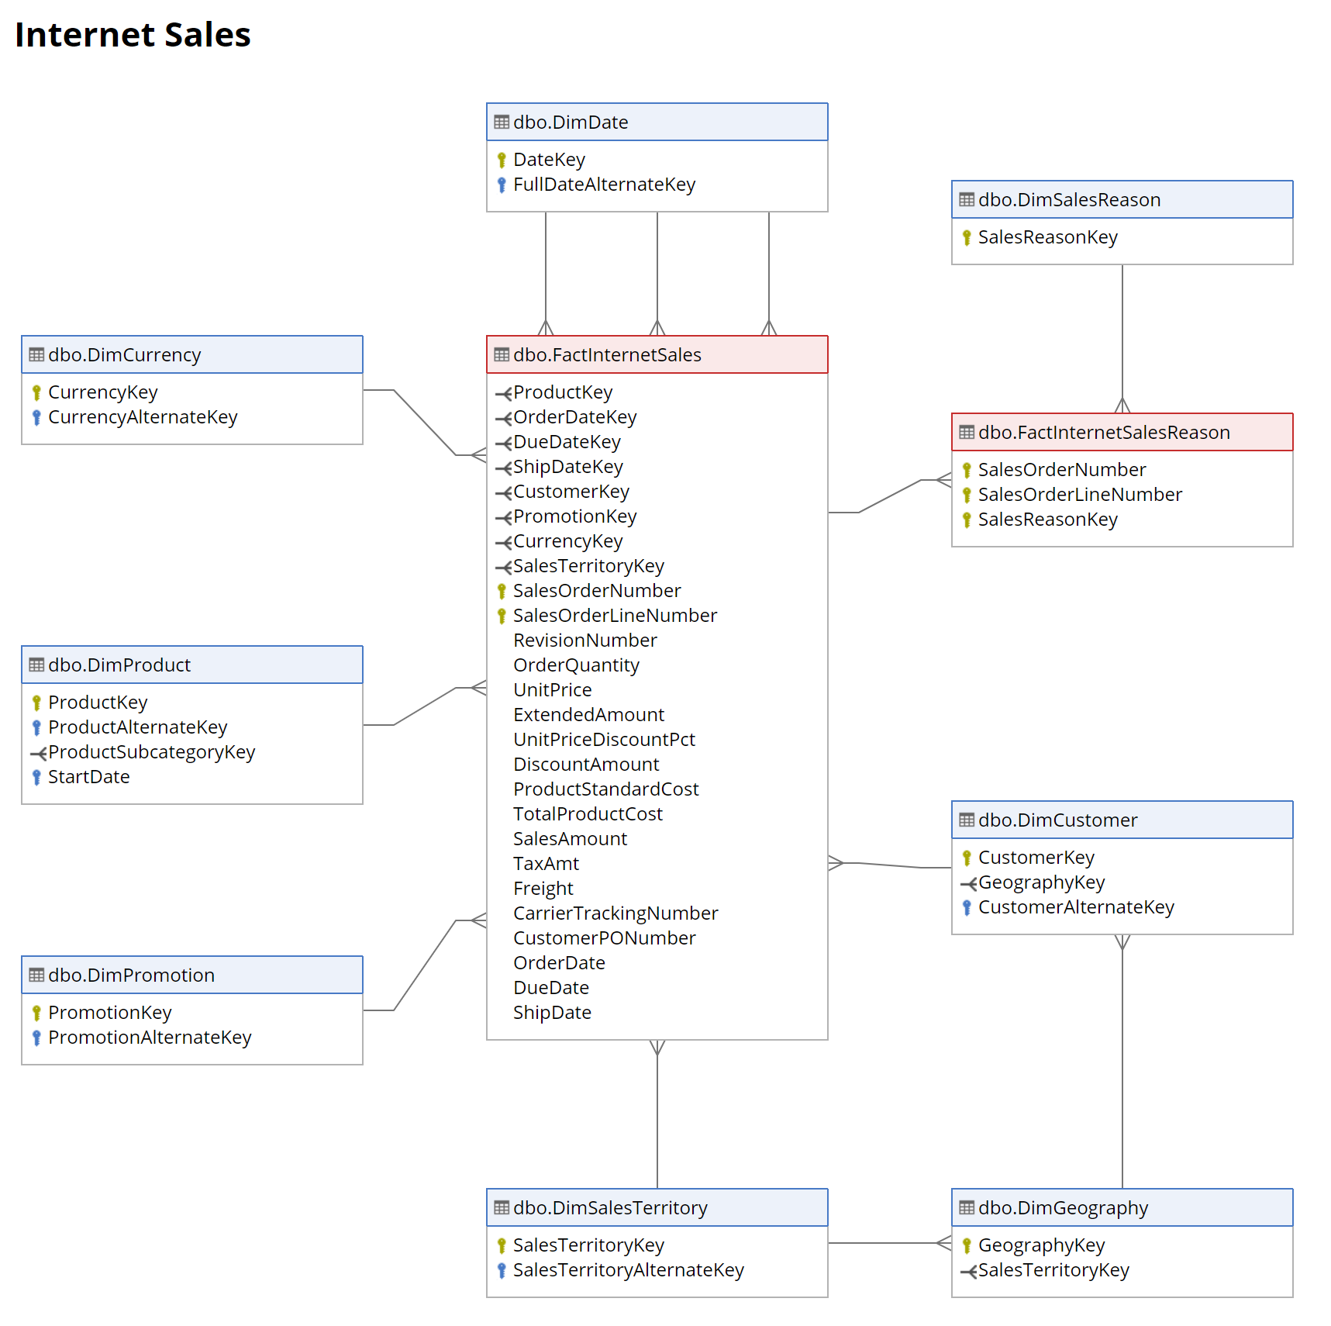
Sample Data Set
The Adventure Works has a complete data warehouse schema that can be used for teaching.
The deployment script has a bunch of CSV files that can be placed into data lake storage.
These CSV files can be converted into parquet files to save space.

Slide 6
Designing Pattern
Have existing files saved to Azure Data Lake Storage.
Create connection from Synapse to ADLS.
Create database and/or schema to house objects
Create any external file types or external data sources
Create external tables for schema on read
Create views to summarize data if necessary
Create users associated with the database
Give users rights to read database
Test user access

Slide 7
SQL Database – create objects
The developer can create the following objects: database, schema, external table, view, external file format, external data source.
Each database has a default schema [dbo]. I suggest user defined schemas to segregate data as needed.
External tables can be created using the POLYBASE syntax that the MPP supports.
Ad-hoc querying of the data can be achieved with the OPENROWSET function.
SQL Notebook 1 – ‘nb-first-exploration’

Slide 8
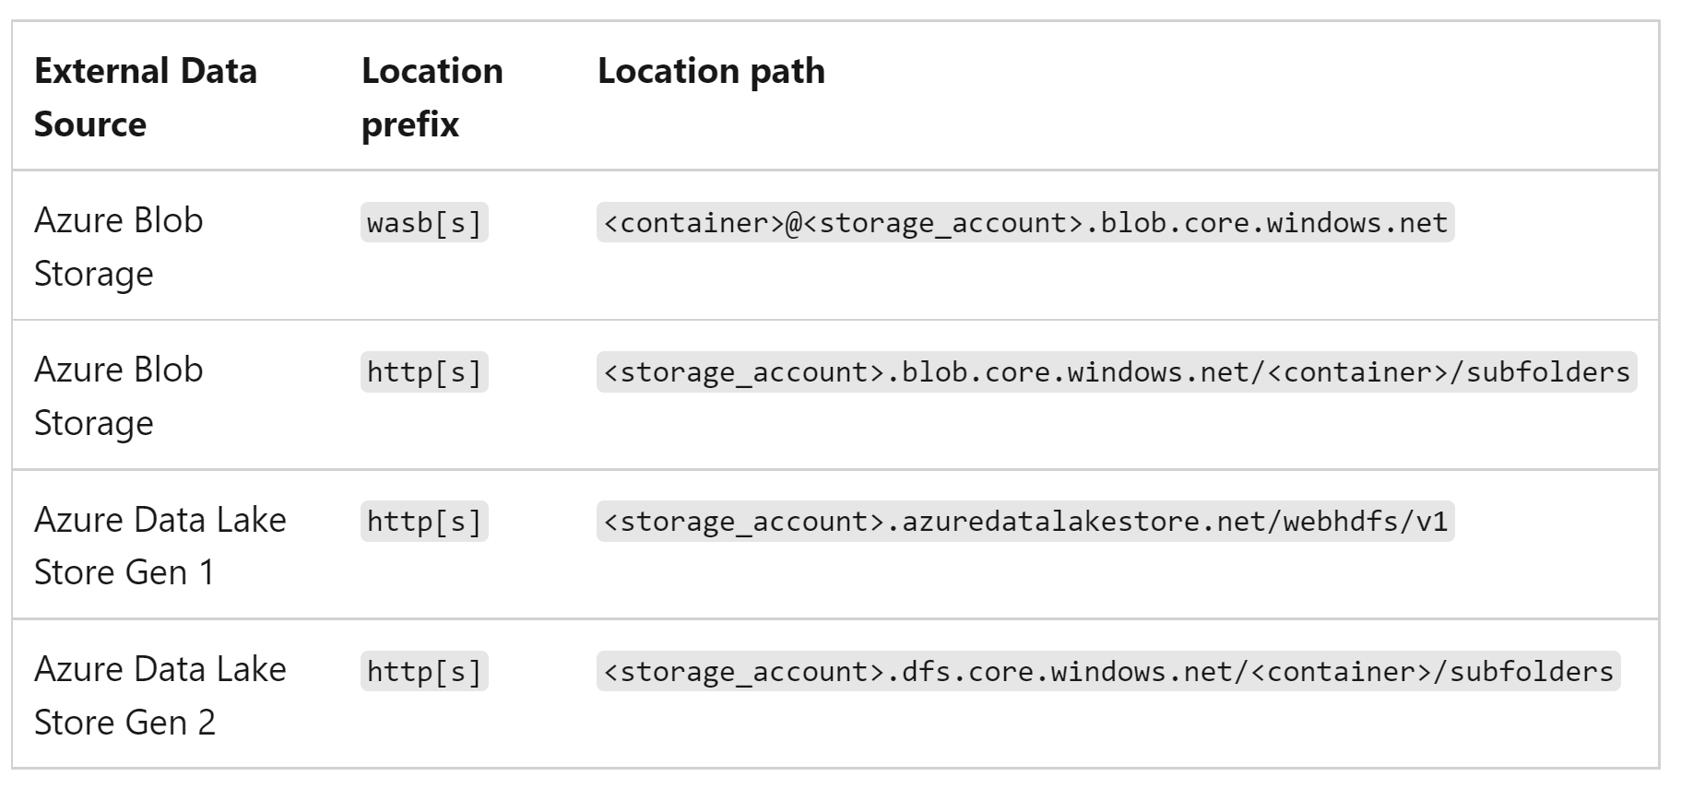
SQL Database – supported storage locations
There are four supported storage locations. However, ADLS Gen 2 is preferred for its RBAC and ACL controls.

Slide 9
SQL Database – creating storage connection
The following access patterns are supported for a data connection: account key, service principle and user/system managed identity.
The older way of creating a database credential with a shared access signature (SAS) is frowned up.
The preferred way is to create a linked service that uses the managed identity for Azure Synapse Workspace to connect to ADLS Gen 2.
This managed identity should be given both contributor and storage blob contributor rights at the role-based access control (RBAC) level.
The managed identity should be given “rwx” at the access control level (ACL).
Explore Storage Connection

Slide 10
SQL Database – supported file formats
Comma Separated Value
Apache Parquet File Format
Delta File Format *
* - just supported by openrowset()
SQL Notebook 2 – ‘nb-second-exploration’

Slide 11
SQL Database – how you are charged
Data read while reading data.
Data read while reading metadata
Amount of data in intermediate results.
Amount of data written to storage. *
This amount can be reduced by using compressed file formats.
* - purposely left off CTAS.
SQL Notebook 3 – ‘nb-third-exploration’

Slide 12
Lake Database – what is different?
There are only tables and views.
Suggest using Spark SQL to create tables.
The syntax for parquet is very compact.
The Spark Engine supports more file formats.
Spark Notebook 1 – ‘nb-spark-lake-database-code’

Slide 13
Serverless Pools – Security Layer
Create Server Login
Create Database User
Assign Rights
Test Access
SQL Notebook 4 – ‘nb-spark-lake-database-code’

Slide 14
Summary
The data lake follows the spoke and hub design pattern. Source data from producers can be either pushed or pulled into the data lake. Processing can be done on a sub-set of data to allow for investigational queries. Data Science models can be used to predict future events. The final curated data can be available to consumers for analytic reports.
In the past, a very expensive SPARK cluster had to be available to service read only queries against the data lake. Azure Synapse has release Serverless Pools. This technology allows you to either create a SQL database using POLYBASE syntax or a LAKE DATA using SPARK SQL. Both techniques allow you to expose the underlying files as tables. The consumer is only charged for the bytes that are read.
To recap, Azure Synapse has the Serverless Pools service that may be cheaper than leaving a SPARK cluster always up to service end user queries.

Slide 15
References
Serverless Pools – Overview
https://docs.microsoft.com/en-us/azure/synapse-analytics/metadata/database
SQL - External Tables
https://learn.microsoft.com/en-us/azure/synapse-analytics/sql/develop-tables-external-tables
SQL – OpenRowSet
https://docs.microsoft.com/en-us/azure/synapse-analytics/sql/develop-openrowset
SQL - Query Storage
https://learn.microsoft.com/en-us/azure/synapse-analytics/sql/query-data-storage
SPARK - Create table
https://spark.apache.org/docs/latest/sql-ref-syntax-ddl-create-table-datasource.html

Slide 16
References (cont)
SPARK - Data Types
https://www.iguazio.com/docs/latest-release/data-layer/reference/spark-apis/spark-datasets/spark-df-data-types/
SQL POOL - Create Users + Assign Rights
https://learn.microsoft.com/en-us/azure/synapse-analytics/metadata/database

Slide 17
Questions / Thank You

