Slide 1


Efficient file management
Rhode Island SSUG
John Miner
Microsoft
Data Platform & Analytics TSP
Blog: www.craftydba.com www.mssqltips.com
Tweet: JohnMiner3

Slide 2
Presentation Overview
Review the following topics:
Optimizing the temporary database
Fast file initialization
Virtual log file fragmentation
Using multiple data files for speed
2 |

Slide 3
Optimizing [tempdb] data files
“One of the most obvious bottlenecks in the performance of tempdb is caused by PAGELATCH, in-memory latch contention on the allocation bitmap of each data file used. We can use one of the rules-of-thumb to choose what should be roughly the best number of files, but how then do you check to see whether you've got it right for your data and workload?”
“The allocation bitmap pages are the page free space (PFS), global allocation map (GAM), and shared global allocation map (SGAM) pages in the database.”
Jonathan Kehayias
3 |

Slide 4
Rule of thumb
Four to eight files.
Each file has to be same size.
Restart engine for change to take place.
Set trace flags 1117 & 1118
Monitor contention and change if necessary.
Demo #1
4 |

Slide 5
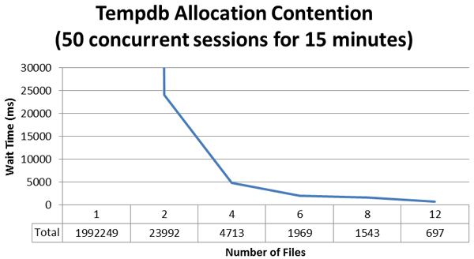
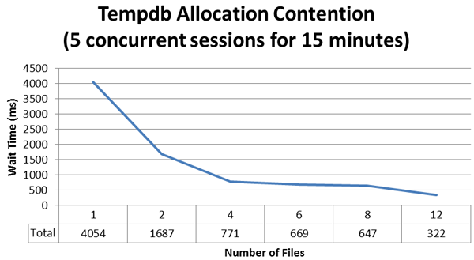
Results from testing
J. Kehayias
5 |

Slide 6
Fast File Initialization
What does this statement mean?
The SQL Server engine asks the operating system for disk space. Each byte of the allocated file is filled with zeros.
By giving the service account for the database engine a local policy right, this step is skipped.
Does not work for log files, sparse files (snapshots) or TDE databases.
6 |

Slide 7
How to enable?
Run database engine service under domain or local account.
Apply local policy setting.
Restart service to take effect.
Verify change via trace flags.
Demo #2
7 |

Slide 8
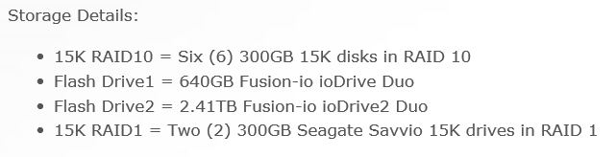
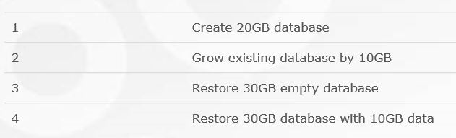
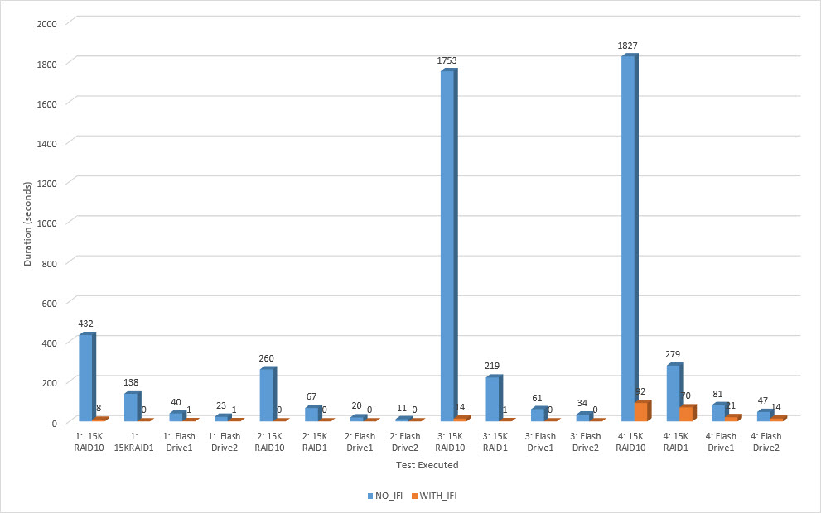
Results from testing
E. Stellato
8 |

Slide 9
Virtual Log File Fragmentation
What is log file fragmentation?
Each file is broken down into segments called virtual files.
Small growth factors on the database can cause 2 many VLF’s.
Hourly transaction log backups prevent excessive growth.
Operations like backups and restores can be effected by 2 many VLFs.
9 |

Slide 10
What to do?
Run a job to keep track of VLF’s.
Perform maintenance to reduce VLF’s.
Investigate process like ETL that might have large batches.
Demo #3
10 |

Slide 11
Multiple data files
Why use multiple data files?
If you are still using spinning disks, the bottle neck is the moving parts of the disk drive.
If you create a file group with between 4 and 8 equally sized files, you are now spreading the IO across many disk.
Hopefully, move paths to your RAID or SAN appliance speed upon performance.
11 |

Slide 12
How to enable?
Create a new file group.
Assign 4-6 equally size files to the group.
Set the default file group.
Create objects in file group.
Demo #4
12 |

Slide 13
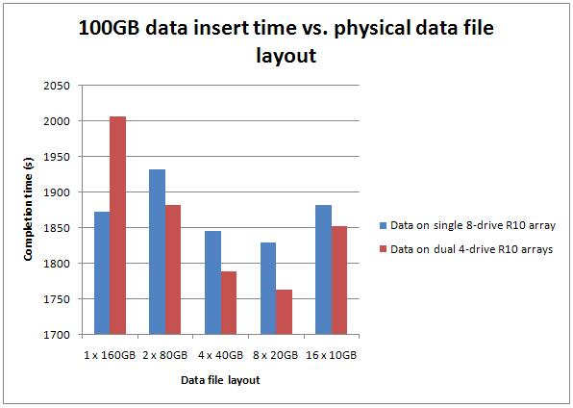
Results from testing
P. Randal
13 |

Slide 14
Biography – John Miner
Has twenty five years of data processing and proven project management experience, specializing in the banking, health care, and government areas.
His credentials include a Masters degree in Computer Science from the University of Rhode Island; and Microsoft Certificates (MCSE Data & Analytics).
John is currently a Data Platform TSP at Microsoft. He was award the MVP (2014/2015) honor for his contributions to the community.
When he is not busy working, he spends time with his wife, daughter and dog enjoying outdoor activities

Slide 15
References
Optimizing tempdb configuration with SQL Server 2012 Extended Events
Johnathan Keyahias
http://tinyurl.com/bn2j7bu
How and Why to Enable Instant File Initialization
SQL Server Premier Field Engineering
http://tinyurl.com/yabqbotg
8 Steps to better Transaction Log throughput
Kimberly Tripp
http://tinyurl.com/ybndhdjv
Benchmarking: do multiple data files make a difference?
Paul Randal
http://tinyurl.com/ycpa2b2y
15 |

Slide 16
References
Trace Flags 1117, 1118, and Tempdb Configuration
Kendra Little
http://tinyurl.com/yc9l8msr
Instant File Initialization: Easier to Enable in SQL Server 2016 (and some updated numbers)
Erin Stellato
http://tinyurl.com/y7twbmwq
16 |

Slide 17
Questions & Answers
Please visit Documentation Online for more info.
If you have any questions, you can contact me at john@craftydba.com.
17 |

